Slide 1


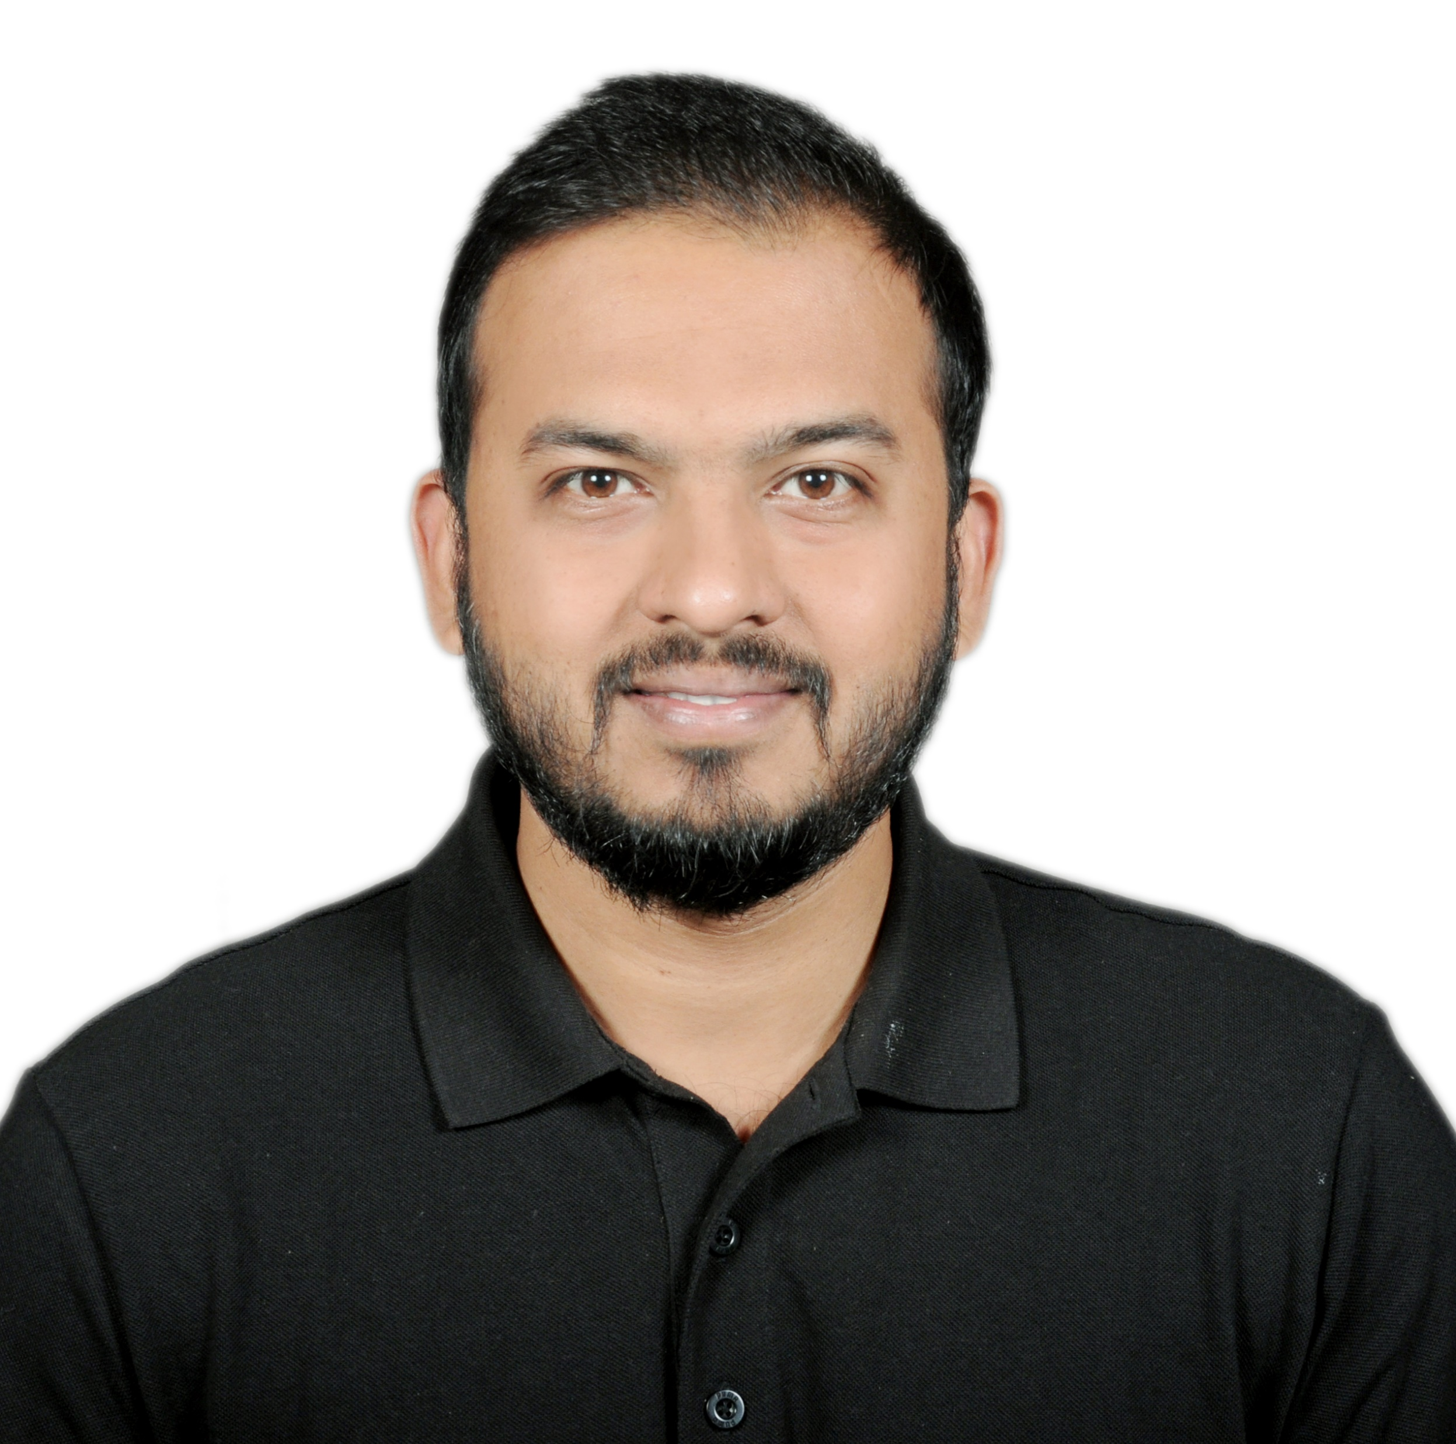
Navin Dhote
Team Lead (Cloud App)
Project experience
BMW Retail CRM Europe Accenture, Team Lead Cloud Apps
(Dec 2021 – Present)
BMW Retail CRM is used to manage all the Operations and Sales for BMW in Europe. Development of Applications in Mule, Java, Spring Boot, Microservices. Building the REST API Communication between Systems using MuleSoft.
Technologies: Mule 4, Anypoint Studio, Core Java, RAML, Oracle Cloud, REST API, Kibana, Postman, PostgreSQL,
Methodologies: Agile.
HSBC Holdings UK Globant, Senior Software Engineer
(Mar 2021 – Nov 2021)
Domestic Payment Operation in HSBC is a Solution to all HSBC Operations in UK. Creation of REST API Framework using MuleSoft to Operate as an Integration specialist between Multiple Banking Applications.
Technologies: Mule 4, Anypoint Studio, Core Java, Spring Boot, Microservices, RAML, SQL, PLSQL, Oracle11g, JIRA, Bit Bucket, Maven, Service Now, GIT, Team City, REST API.
Methodologies: Agile.
Galileo Payment System Hub Deutsche Bank, Senior Analyst
(Feb 2019 – Mar 2021)
Galileo Payment System is a Global Platform for Deutsche Bank to carry out the International and Domestic Payments all over the Globe using SWIFT, CHAPS, BACS. Creation and Deployment of Microservices Applications, REST API’s and looking into CICD. Technologies: Mule 4, Anypoint Studio, Core Java, Spring Boot, Microservices, RAML, SQL, PLSQL, Oracle11g, JIRA, Bit Bucket, Maven, Service Now, GIT, Team City, REST API.
Methodologies: Agile
State Street Liquidity Risk Management System
Oracle, Senior Software Engineer
(May 2017- Jan 2019) Liquidity Risk Management uses accounting techniques to assess the need for cash or collateral to meet financial obligations. Perform Java and Database Development.
Technologies: Core Java, Collections, Oracle 11G, SQL, PLSQL, JIRA, Tortoise SVN, ANT, Groovy, Gradle. Methodology: Agile
Vodafone Corporate Online Hewlett Packard, Software Engineer
(Dec 2014 – May 2017)
Vodafone E-Care is an application to manage all the customers of Vodafone UK and Vodafone Germany where Customer manages all the products and Services of Vodafone they have Subscribed. Implemented the functionalities for the Telecomm Product for the Corporate and Individual Customers. Creation of Automation Testing Framework in Selenium and Junit for Regression Testing.
Technologies: Core Java, Mule 4, Anypoint Studio, RAML, Spring MVC, Tortoise SVN, ANT, Junit, Selenium. Methodologies: Agile.
Trainings & Certifications
2022 : Currently pursuing for Mule 4 MCD Level 1 Certification
2022 : Mendix Certified Rapid Developer
2021 : Oracle Certified Foundations Associate in Oracle Cloud Infrastructure
2014 : Oracle Certified Associate in Oracle 11G Database – SQL and PLSQL
Functional/ technical skills
Expert
Java 8, Java 11
Mule 4
Rest API
Microservices
Oracle
Spring Boot
Oracle Cloud
Mendix
Intermediate
Anypoint Studio
Cloud
CICD Pipeline
Munit
Salesforce
Beginner
AWS
Language skills
English (Native)
Professional background
Overall 8 years of experience in Development of Web, Integration and Migration Platforms and Applications, Enterprise and Banking applications using MuleSoft Technology and JAVA Technologies, Database Development and Microservices, Spring Boot, Low Code and Rapid Development. Experience of working in various Domains such as Telecommunication, Investment Banking, Finance, Liquidity Risk, Payments and Automobile.
Bachelors in Engineering in Information Technology- University of Mumbai
Aug 2009 – Mar 2014

