Slide 1
ECON 4402 Seminar on Elections
Meeting #6: Information Aggregation

Slide 2
Today’s goals
(Non-strategic) Information aggregation
Bayes Rule applications

Slide 3
Information Aggregation
In some contexts, voting/elections are used even when there are no fundamental preference conflicts
Canonical example: juries or other committees
Grofman and Feld’s interpretation of Rousseau’s “Theory of General Will”:
There is some true common good
Individuals are not always accurate in their judgments about what will achieve the common good
Voting is a mechanism that allows society to aggregate well all individuals’ fallible opinions

Slide 4
Bayes Rule (1)
We are interested in probability of an event
how likely is it that it will snow tomorrow?
Often, interested in the probability of an event given that some other event has occurred
given that it is not snowing today, how likely is it that it will not snow tomorrow?
given that you got an A on the midterm, how likely is it that you will get an A for the course?
Bayes Rule is a mathematical formula that prescribes/describes how to perform such reasoning

Slide 5
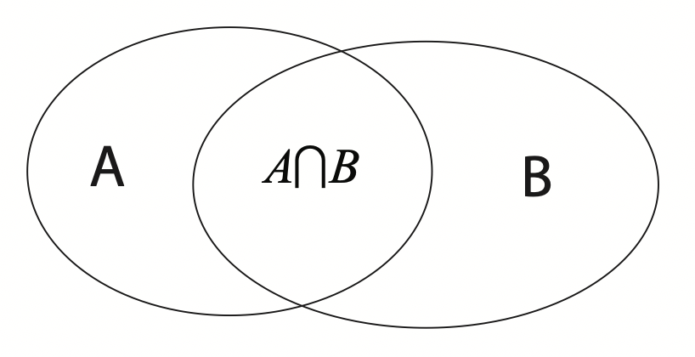
Bayes Rule (2)
Rectangle is sample space of all possible (random) outcomes
If outcomes are finite [which we will generally assume], a probability mass function describes the probability of each outcome
Two events: A and B
Suppose you know that B is true/has occurred; what is the conditional probability that A has occurred? We write this as Pr(A|B).

Slide 6
Bayes Rule (3)

Slide 7
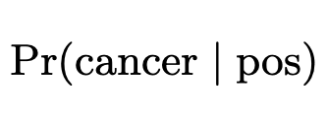
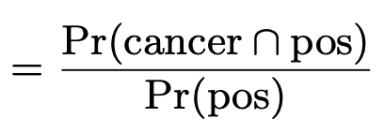
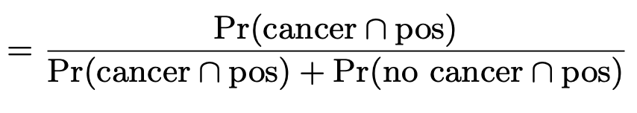
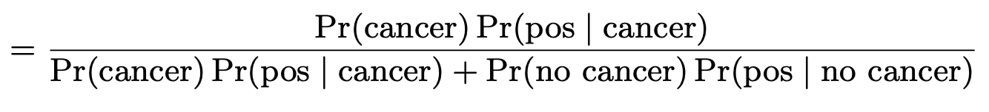
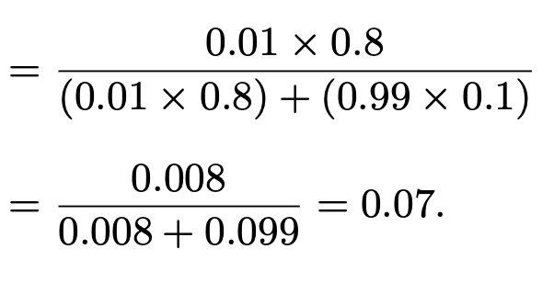
Bayes Rule Example (1)
1% of women at age forty in routine screening have breast cancer
80% of women with breast cancer will get positive mammographies
10% of women without breast cancer will also get pos. mammographies.
A woman in this age group had a positive mammography in a routine screening. What is the probability that she actually has breast cancer?

Slide 8
Bayes Rule Example (2)
Consider the following courtroom drama:
Expert: ““the probability of finding — by chance — the blood type at the crime scene which matches the one of the defendant is about one in 1,000.”
Prosecutor in closing argument: “as you can see, there is only a one in 1,000 chance that the defendant is innocent and therefore it is clear beyond any reasonable doubt that the defendant is guilty.”
What is the connection with Bayes Rule?
All depends on the prior: Pr(Innocent) vs. Pr(Guilty)
Compute with Pr(g|I)=1/1000, Pr(G)=1/10000, Pr(g|G)=1 to get Pr(G|g) ≈ 9%

Slide 9
Monty Hall Problem (1)
A valuable prize is randomly placed behind one of three doors
Only the game show host knows which door has prize
Contestant can select one of the three doors
Suppose (without loss) the contestant chose Door 1
Host opens an empty door that contestant did not pick
If prize is behind Door 2, then Door 3 is opened
If prize is behind Door 3, then Door 2 is opened
If prize is behind Door 1, then Door 2 and Door 3 are each equally liked to be opened
Contestant is then offered choice to switch doors or stay
Win the prize if and only if chosen door contains prize
Should one stay or switch?

Slide 10
Monty Hall Problem (2)
Let D1 be the event that prize is behind door 1; similarly D2, D3
Let O1 be the event that door is opened; similarly O2, O3
Suppose (without loss) that after first choosing Door 1, the host opens Door 2 revealing it to be empty
Hence, Pr(D1|O2)=1/3. Conclusion: SWITCH!

Slide 11
Epistemic Group Decisions
Assume a group of n individuals (n odd) needs to choose between two alternatives, A and B, by simple majority rule
One of the two is best; all individuals want to choose the best option, but no-one knows which one
The prior is that they are equally likely to be best
Each individual gets her own signal, a or b
Pr(a|A)=Pr(b|B)=q, where ½<q<1
How should an individual vote based solely on her own information?

Slide 12
Individual Behavior
Use Bayes’ Rule:
Similarly, Pr(B|b)=q
So, each individual should vote A if she receives signal a and vote B if she receives signal b

Slide 13
Group Wisdom (1)
Each individual has a probability q of voting “correctly” or making the right decision on her own
What about the group, collectively?
Make the right decision if majority of signals are correct
Let n=3. Pr(2 or 3 correct signals)=
So the group is more likely to make the right decision than any individual

Slide 14
Group Wisdom (2)
Let P(n,q) be the probability that a group of n>1 (n odd) individuals makes the right decision by majority rule when each individual has an independent probability ½<q<1 of voting for the right option.
Condorcet Jury Theorems:
P(n,q)>p.
P(n+2,q)>P(n,q).
As n->∞, P(n,q)->1.
Note: For any n, P(n,q) is increasing in q.
"The many, when taken individually, may be quite ordinary fellows, but when they meet together, they may well be found collectively better than the few". --Aristotle

Slide 15
Illustrating the CJTs
q=.51, .55, .6, and .65

Slide 16
Caveat on Group Wisdom
If ½>q>0 then opposite conclusions hold:
P(n,q)<p.
P(n+2,q)<P(n,q).
As n->∞, P(n,q)->0.

