Slide 1
The Case for AI Based Web3 Reputation Systems
Navin V. Keizer, Fan Yang, Ioannis Psaras, George Pavlou
June 2021
DI2F: Decentralising the Internet with IPFS and Filecoin

Slide 2


Towards a Decentralized Web3
Building blocks of a decentralized Web
Blockchains and DLTs
Decentralized Storage Networks
Network Resource Sharing Services

Slide 3








Network Resource Sharing Services
Leverage Blockchain to provide incentive
Storage
Computation
Bandwidth

Slide 4
Need for Reputation Systems
In decentralised open networks any party may offer a service
No prior guarantee of performance
Blockchain allows for establishment of trust only for monetary transactions on-chain
Resource sharing services happen off-chain, hence another trust mechanism is required
Reputation system (currently only centralized solutions)

Slide 5
Need for Reputation Systems
Allow nodes to discern between honest and malicious parties
Use reputation metrics, which indicate the trust in a likely positive experience from transacting with another node

Slide 6
Web3 Reputation System Requirements
Properties
Data sources
Decentralized
Accurate
Quickly converging
Secure
Lightweight
Personalized
Blockchain data
Off-chain data

Slide 7
AI for Reputation Calculation
Allows for highly personalized reputation scoring
Reinforcement learning algorithm takes in inputs to assign optimal weights to the reputation function for a specific node
Based on preference profile of the node
Using on-chain transaction data
The weights are returned to the node who uses them to calculate reputation scores directly from the blockchain

Slide 8
Part 1: Training
Blockchain
Transaction data
Reinforcement Learning
Inputs
Client
Preference profile

Slide 9
Part 2: Score Calculation
Blockchain
Reinforcement Learning
2. Retrieve data for peer
Client
1. Return weights of
reputation function
3. Calculate Reputation Score

Slide 10
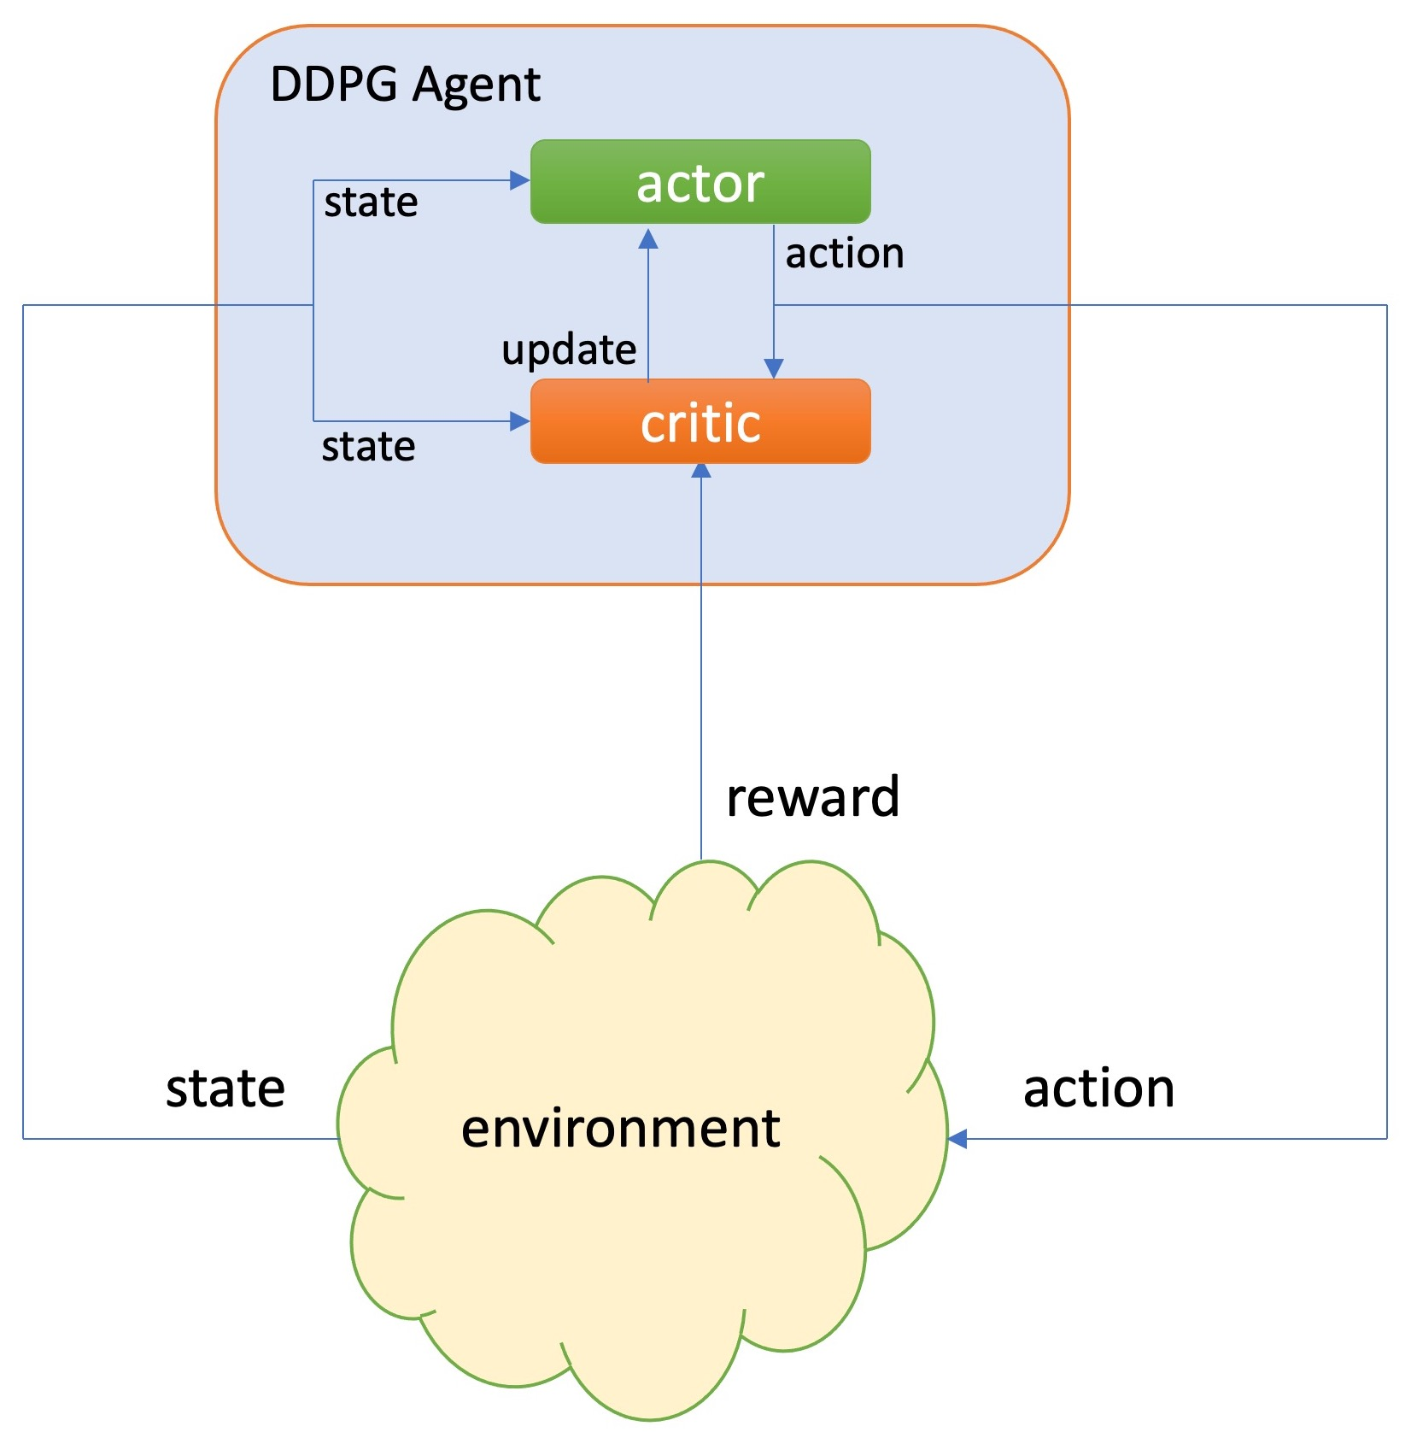
Overview of DDPG
Actor: generates actions by inputting states according to policy
Critic: updates policy by receiving the reward of last action
DDPG(Deep Deterministic Policy Gradients): outputs continues actions

Slide 11
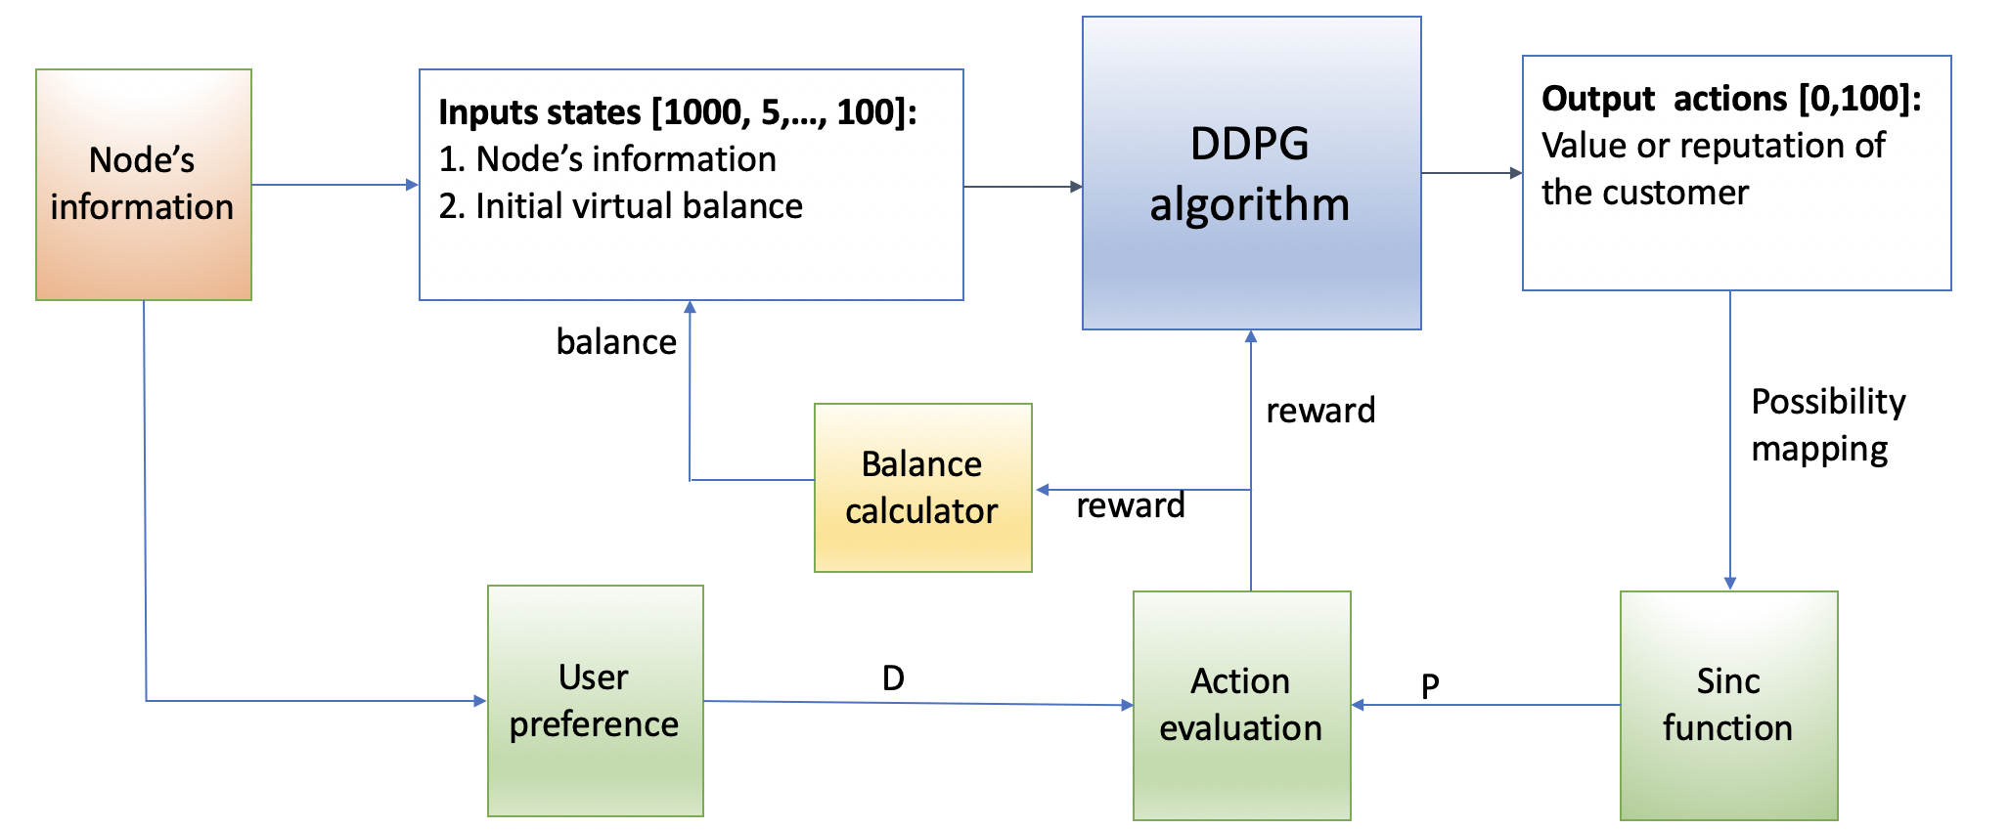
Filecoin Example
Node’s information: average deal time, storage size available, failed deals, and time since joining the network, etc.
Virtual balance: optimization goal for AI algorithm

Slide 12
Future Work
Develop lightweight solutions for AI computation
Training locally on all nodes is inefficient and computationally intensive
We can outsource training for weights to a dedicated node / network
Keep actual score calculations locally for security
Compare performance of an AI based reputation system to centralised systems in terms of accuracy, personalisation, and performance
Explore possible novel security vulnerabilities and attack vectors
Add off-chain data support in training and calculation

Slide 13
Thank You!
The Case for AI Based Web3 Reputation Systems
navin.keizer.15@ucl.ac.uk
fan.yang.15@ucl.ac.uk
June 2021
DI2F: Decentralising the Internet with IPFS and Filecoin

