Slide 1
Scalable Allocation for Decentralised Services on Blockchain
Navin V. Keizer, Onur Ascigil, Ioannis Psaras, George Pavlou
July 2021
Coseners ’21

Slide 2


Towards a Decentralised Future
Building blocks of a decentralised Web
Blockchains and Smart
Contracts
Decentralised Storage Networks
Network Resource Sharing Services

Slide 3





Network Resource Sharing Services
Sell spare network resources off-chain, in return for cryptocurrency rewards
B
A
Storage sharing example

Slide 4





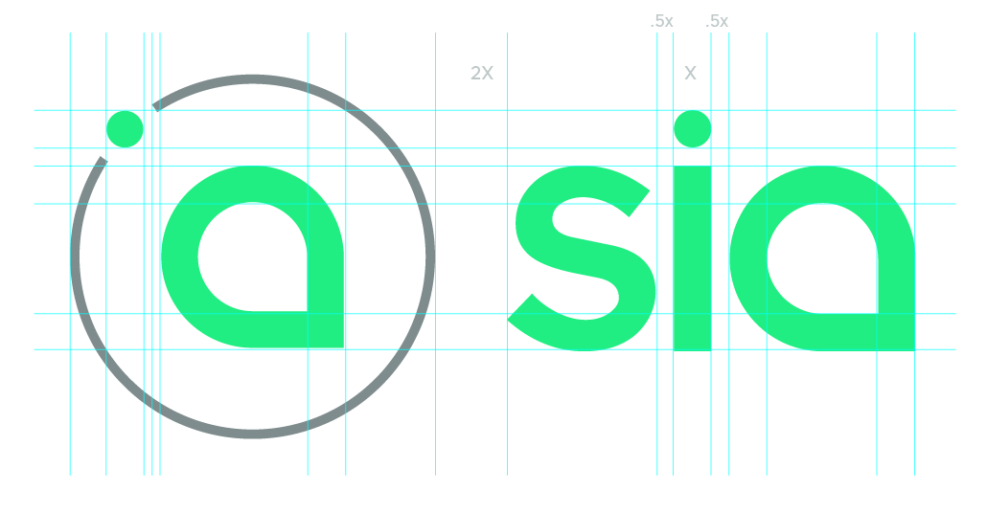


Decentralised Service Examples
Leverage Blockchain to provide incentive
Storage
Computation
Bandwidth

Slide 5
How will a node find and be allocated to a service node?

Slide 6
Decentralised Allocation Triangle
Scalability
Preference
based
Price
Derivation

Slide 7
Option 1: Orderbook on Blockchain
Buyers post a price they are willing to pay on-chain
Sellers post a price they are willing to accept for payment on-chain
They are then matched to each other based on prices
The final step may include an off-chain negotiation

Slide 8
Option 1: Orderbook on Blockchain
Scalability
Orderbook
Preference
based
Price
Derivation

Slide 9
Option 2: Blockchain Auctions
Decentralised auctions are possible using smart contracts
Single-item auctions (e.g. Vickrey)
Multi-item auctions (e.g. VCG)
Sellers set a hidden minimum price for a service on-chain
Buyers submit (sealed) bids for an item to the blockchain
After a collection time, the contract decides the who the auction is

Slide 10
Option 2: Blockchain Auctions
Scalability
Preference
based
Price
Derivation
Auctions

Slide 11


FLOCK [1]
Decoupled price derivation from allocation computation
Billboard and Oracle
Smart Contracts
Stable Matching
Algorithms
Trusted Execution
Environment
[1] Navin Keizer, Onur Ascigil, Ioannis Psaras, and George Pavlou, “FLOCK: Fast, Lightweight, and Scalable Allocation for Decentralised Services on Blockchain”, IEEE International Conference on Blockchain and Cryptocurrency (IEEE ICBC), 2021.

Slide 12
Overview of FLOCK
Stable matching allows for allocation without monetary bids, solely on preference
Preference lists can be incomplete (SMI)
Multiple allocated to single clients within a budget (HR)
Decoupled price derivation from computation
Use billboard smart contracts to orchestrate allocation process
Outsource heavy computation off-chain to TEE
Use oracle contract to separately set a global price for a service

Slide 13
Option 3: FLOCK
Scalability
FLOCK
Preference
based
Price
Derivation

Slide 14
Performance Comparison
Run time multi-item
Throughput multi-item

Slide 15
Smart Contracts Cost Comparison
 | FLOCK | PASTRAMI | Trustee
Client | 143827 | 391046 | 1847178
Seller | 92673 | 95934 | 143720
Execution Node | * | 7108 | *
Gas costs compared to auctions
Function | Gas Cost
Deploy Contract | 213008
Setup Oracle | 71360
Update Oracle | 56931
Gas costs per function

Slide 16
Thank You!
Scalable Allocation for Decentralised Services on Blockchain
Navin.Keizer.15@ucl.ac.uk
July 2021
Coseners ’21

