Slide 1
SECURE CUSTOM PROTOCOL
Navin Kumar L
Intel Unnati Industrial Training Program 2024
Vellore Institute of Technology, Chennai

Slide 2
PROBLEM STATEMENT
Cryptography Simulation with mbedTLS/OpenSSL Library Usage and User Interaction
Implement Various Cryptographic Algorithms using C and mbedTLS/OpenSSL Library to Secure a Custom Client-Server Protocol
Key Cryptographic Algorithms Implemented are Symmetric Encryption (AES-GCM-256), HMAC (SHA-256), HKDF (SHA-256), Digital Signature (RSA-384), Diffie Hellman Key Exchange, and Certificate Checking
To Develop a Interactive Website to Showcase the Cryptographic Algorithms through the Secure Custom Protocol

Slide 3
UNIQUE IDEA / SOLUTION
Created a Secure Custom Client-Server Protocol
Implemented Crypto Wrapper Class with the Help of OpenSSL Library
Created Self-Signed Root Certificates and RSA Key Pairs for Client (Bob) and Server (Alice)
Secured Traffic with the Help of SIGMA Key Exchange
Enhanced Security with Symmetric Encryption, HMAC, and Digital Signatures

Slide 4
FEATURES OFFERED
Self-Signed Root Certificate Generation
RSA Key Pair Generation
SIGMA Key Exchange Implementation
Symmetric Encryption for Secure Communication
HMAC for Message Integrity
Digital Signatures for Authentication
Secured Communication between Client and Server for the Custom Protocol

Slide 5

PROCESS FLOW

Slide 6
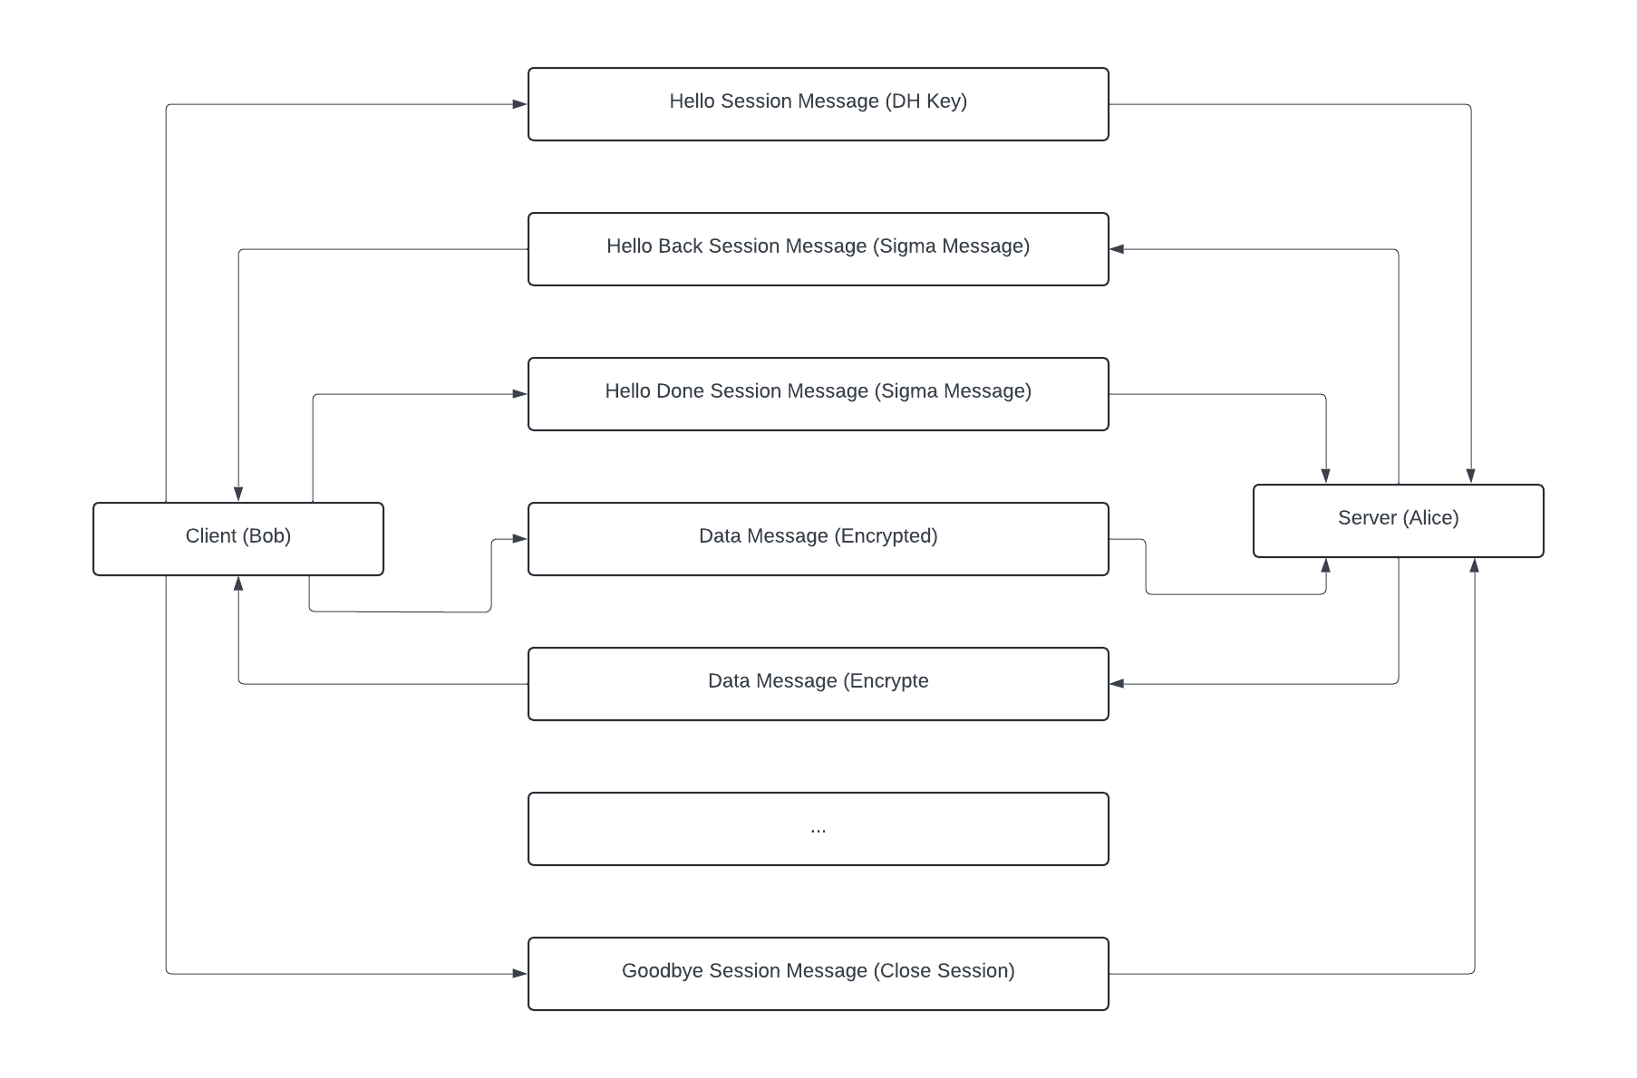
PROCESS FLOW

Slide 7
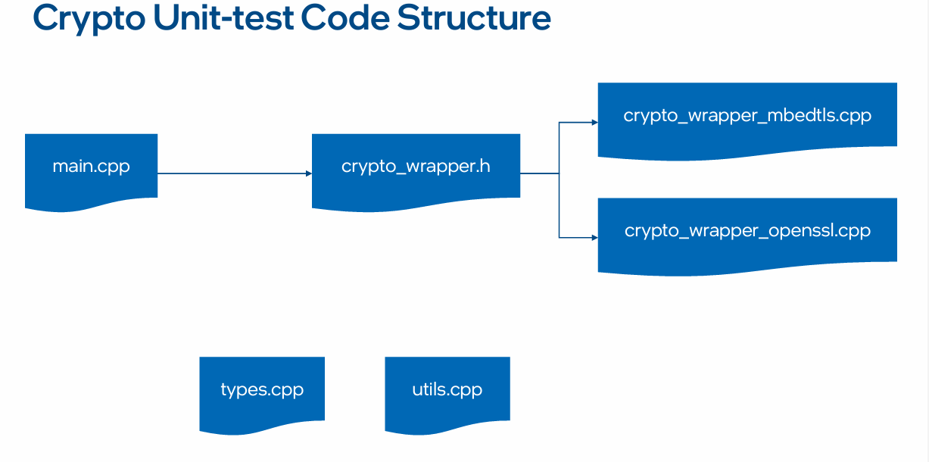
ARCHITECTURE DIAGRAM

Slide 8
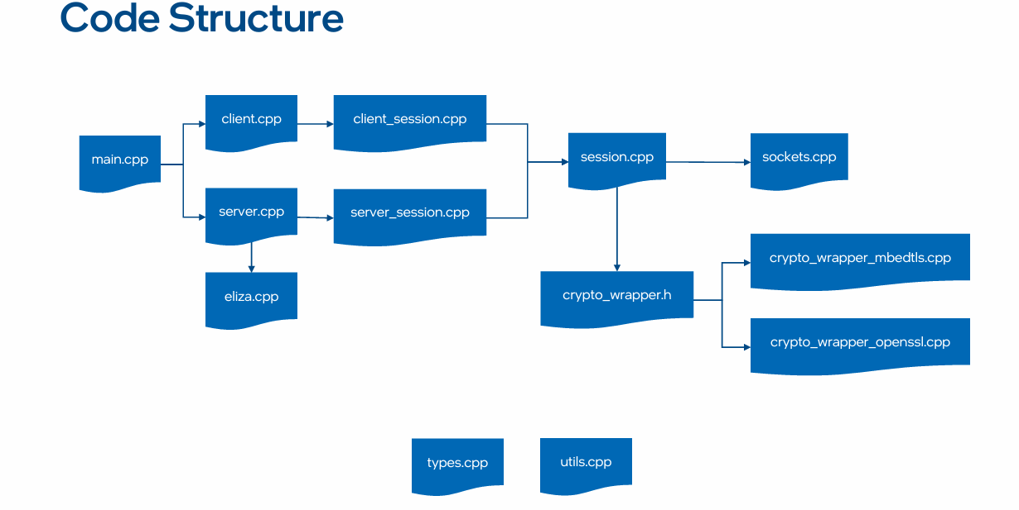
ARCHITECTURE DIAGRAM

Slide 9
TECHNOLOGIES USED
C / C++ - Core Implementation Language
OpenSSL Library - Cryptographic Functions
Visual Studio 2022 – Development Environment
Wireshark – Monitor Network Traffic
TreeFrog – Web Framework for Future Development

Slide 10
TEAM MEMBERS AND CONTRIBUTION
Solo Project
Implemented All Components Individually
Completed All Tasks Individually

Slide 11
CONCLUSION
Successfully Demonstrated Practical Application of Cryptographic Concepts
Generated Self-Signed Root Certificates and RSA Key Pairs for Secure Client-Server Communication
Implemented Crypto Wrapper Class Functions using OpenSSL Library
Integrated Crypto Wrapper Class to Establish Secure Communication Channel
Employed SIGMA Key Exchange, Symmetric Encryption, and Message Integrity Checks.
Future Work – To Develop an Interactive Website to Showcase the Implemented Cryptographic Techniques through the Custom Protocol

