Slide 1

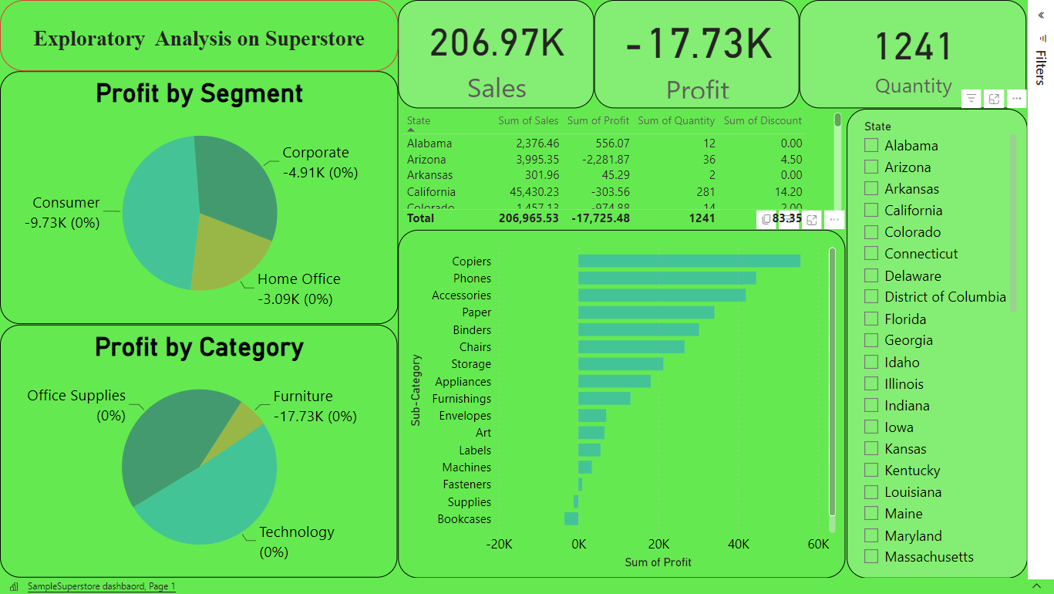

Slide 2
Here are the steps I followed:
Loaded the dataset into Microsoft Excel.
Examined the dataset and found that it contains sales and profit data for a fictional retail company.
Analyzed the data by creating pivot tables and charts to identify key performance indicators (KPIs) such as revenue, profit, and sales by region, product category, and customer segment.
Conducted a deep-dive analysis of the KPIs to identify the areas that are underperforming. Here are some of the findings:
a. Revenue by region: The East region is generating the lowest revenue compared to the other regions.
b. Profit by product category: The Office Supplies category is generating the lowest profit compared to the other categories.
c. Sales by customer segment: The Home Office segment is generating the lowest sales compared to the other segments.
Analyzed the data further to identify the root causes of the underperformance. Here are some possible reasons:
a. Revenue in the East region may be low due to low demand or competition from other retailers.
b. The Office Supplies category may not be priced competitively or may have a high cost of goods sold.
c. The Home Office segment may not be targeted effectively or may not have products that meet their specific needs.
Developed a plan to address the root causes and improve the underperforming areas. Here are some possible solutions:
a. For the East region, we can launch a marketing campaign to increase demand or adjust the pricing strategy to be more competitive.
b. For the Office Supplies category, we can analyze the cost structure and adjust the pricing strategy to increase profitability or focus on promoting higher margin products within the category.
c. For the Home Office segment, we can conduct market research to better understand their needs and preferences and develop products and marketing campaigns that better align with their preferences.

Slide 3
By exploring the data from the given dataset, we can derive several business problems that the retail company may be facing :
Low sales and revenue in certain regions,
Low profit margins in certain product categories,
Underperformance in certain customer segments,
Inefficient supply chain,
Uneven sales and profitability across different product subcategories,
Inconsistent pricing.

