Slide 1






Cloudflare Tunnel
Application & Policies
Domain Registered & SSL Configured
cloudflare
<subdomain>.example.com
Internet
Users
Cloudflared Service
Immich
Service(s)
Authentik
Service(s)
Portainer
Service(s)
Pair Drop
Service(s)
Local IP address
Home
Users
Home Network
Critical Storage Data (Encrypted and Protected)
Duplicate / Backup System

Slide 2
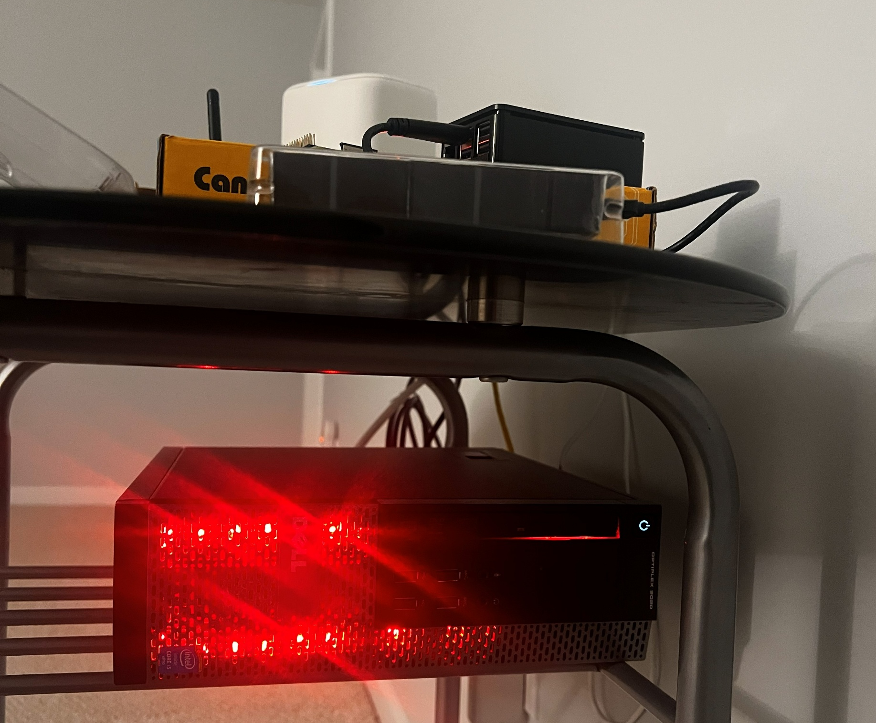
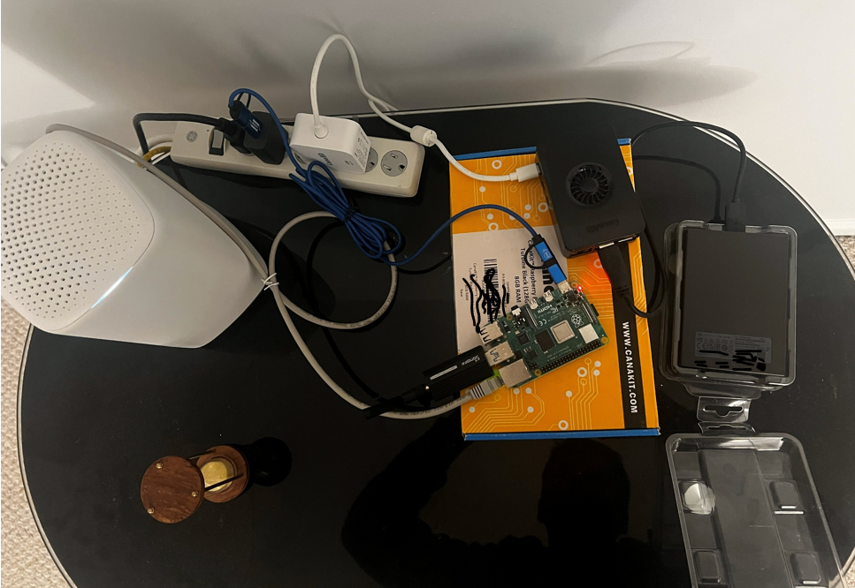
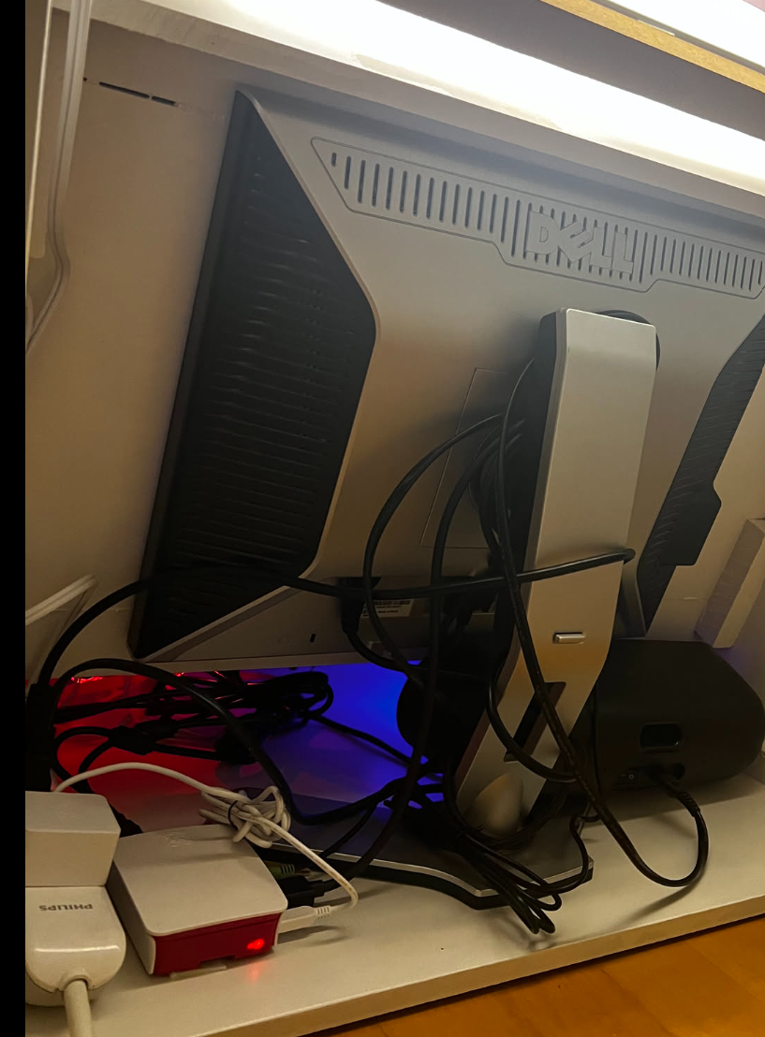





Slide 3






Cloudflare Tunnel
Application & Policies
Domain Registered & SSL Configured
cloudflare
<subdomain>.example.com
Internet
Users
Cloudflared Service
Home Assistant
Home Network
Local IP address
Home
Users
Zigbee Hub
Wi-Fi Hub
Temperature Control
Entertainment System
Sensors / Actuators
Camera / Security System

