Slide 1
Working with npcore repository

Slide 2
System requirements
Cloning the remote repository to your local machine
Additional steps to go through before working with NPCore repo
Creating container and setting up the connection to the container in VS Code
Downloading symbols
Creating a branch to sync to
Synchronizing changes to remote repository

Slide 3
System requirements
VS Code
Git for Windows (https://git-scm.com/download/win)
VS Code AL Language Extension (https://marketplace.visualstudio.com/items?itemName=ms-dynamics-smb.al)
VS Code Azure Repos Extension (https://marketplace.visualstudio.com/items?itemName=ms-vsts.team)

Slide 4
Cloning the repository
Go to the repository web location (https://dev.azure.com/navipartner/_git/NpCore)
Ensure master branch is selected (masters/NPR_BC16_W1)
Click “Clone” → “Clone in VS Code”

Slide 5
Additional steps to go through before working with npcore repo
Install .NET Core 3.1 SDK (https://dotnet.microsoft.com/download/dotnet-core/thank-you/sdk-3.1.401-windows-x64-installer)
Configure Azure Artifacts Credential Provider (https://github.com/microsoft/artifacts-credprovider#setup)
Run powershell script “download_compile_dependencies.ps1” in the root folder of the repo

Slide 6
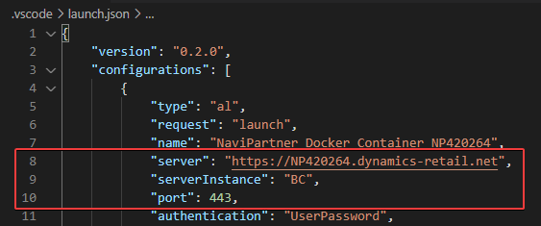
Creating container and setting up the connection to the container in VS Code
Use container template “CORE-AL-BC16-EMPTY” to create a new container
Use the following parameters from container’s landing page to update the “launch.json” file:
Development Server
Development Server Port
Development Server Instance

Slide 7
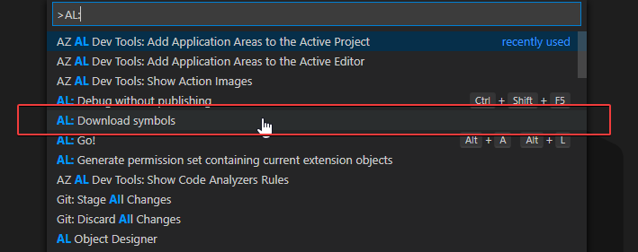
Downloading symbols
In VS Code select “View” → “Command Palette...” (Ctrl+Shift+P)

Slide 8
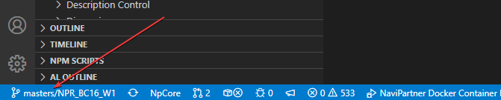
Creating a branch to sync to
VS Code status bar bottom left corner: click to access branch menu
Select “Create new branch from...”, provide a name for a new branch in format “topic/your_branch_name”
Select a branch (usually the master branch) to create your new branch from

Slide 9
Synchronizing changes to remote repo
Stage your local changes with a commit
Synchronize changes
Optionally create a pull request to move your changes into the master branch

