Slide 1


Slide 2
Issues with existing tools
The following issues are encountered when using the existing tools and making them difficult to fine-tune.
Human Error
Time Consuming
Versioning and deprecation
Health Status

Slide 3
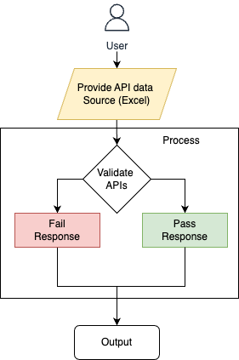
Flow Diagram

Slide 4
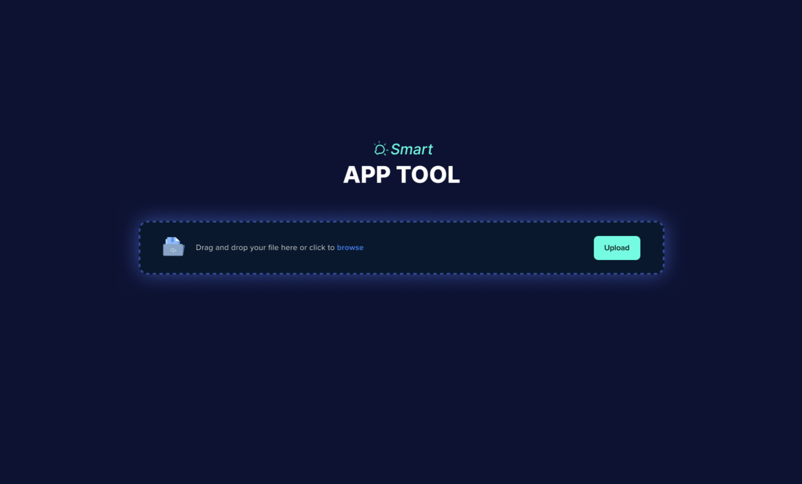
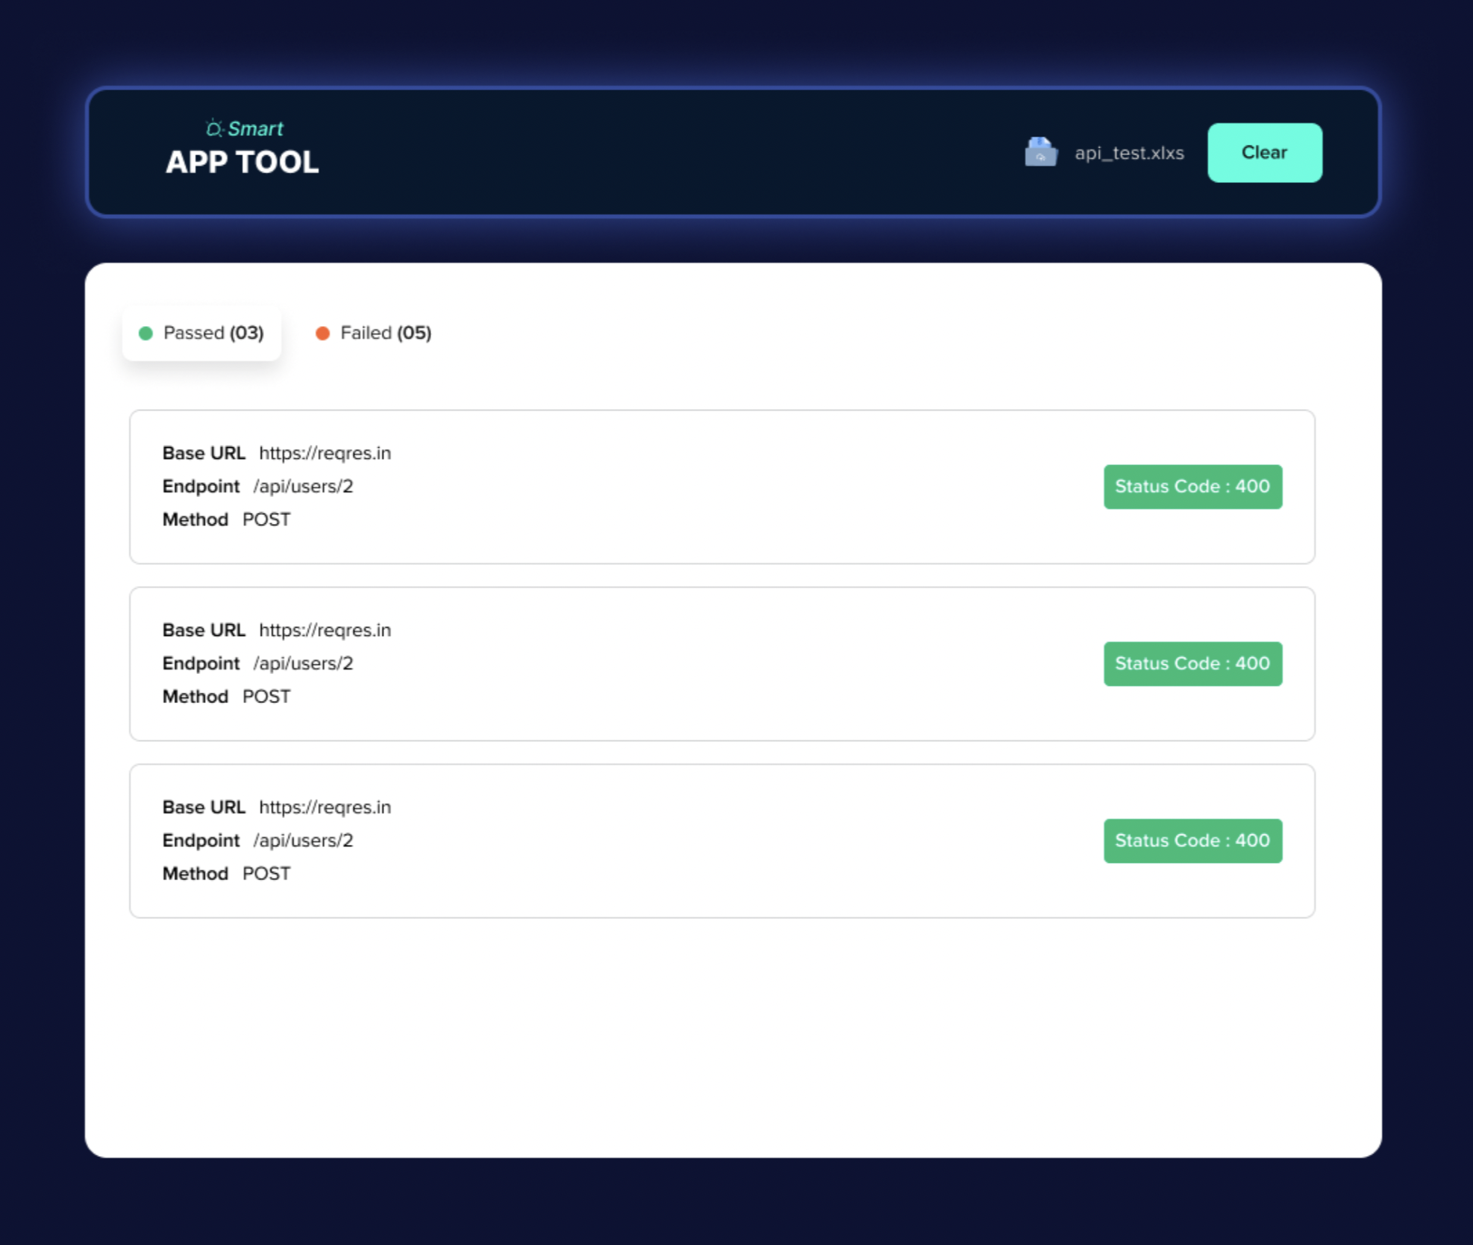
Design & Demo

Slide 5
Smart API Tool – Work & Advantage
The User should provide a source file containing API details.
The Smart API tool reads the file, and send API request and compares the responses
The Results are generated indication which APIs passed or failed based on the responses
This will help to implement in the Status page, How many alerts are passed or failed.
The one of vision of the tool is to integrate with Mass Comm Alert Status Page to monitor the health of all alert statuses.

Slide 6
Future Road Map
Smart API Tool will integrate with any Application in Tekion.
Smart API Tool will be able to support configurations based on different environments (development, staging, production).
Smart API Tool to manage dependencies between APIs for comprehensive end-to-end testing.
Smart API Tool will check the whole application health status and send mail

