Slide 1

INTERNSHIP PRESENTATION
Internship
&
Project-Based Learning Program
Navishtha Tiwari
B.Tech • Computer Science & Engineering • IILM University

Slide 2
Candidate & Internship Details
Candidate Details
Internship / Program Details
Student Name: Navishtha Tiwari Roll Number: 25SCS1003001186 Degree: B.Tech (Computer Science & Engineering) University: IILM University, Greater Noida, U.P. Academic Session: 2025–29 Semester: 3rd Semester
Program: Internship & Project-Based Learning Program Initiative: Job Bridge Certification: Unlox Edge Certification Focus: First Contact in Cyber Security
Joining Date: 1 June 2026 Completion Date: 26 August 2026 Certificate ID: UNXCS-INT-8681
Internship & Project-Based Learning Program • Navishtha Tiwari
2

Slide 3
Program Overview
Job Bridge
Unlox Edge
Cyber Security Focus
The Job Bridge initiative provides students with an opportunity to gain practical exposure through internship and project-based learning. It helps bridge the gap between academic concepts and professional learning by encouraging students to learn through practical activities and structured project work.
Successful completion of the internship and project-based learning program resulted in the Unlox Edge Certification. The certification recognizes the completion of the program and provides formal evidence of the learning and internship experience gained during the program.
The program was completed in collaboration with First Contact in Cyber Security, giving the internship a clear cybersecurity-oriented focus. It provided an opportunity to develop awareness of cybersecurity as a professional domain and understand the importance of security in today's digital environment.
Internship & Project-Based Learning Program • Navishtha Tiwari
3

Slide 4
Internship & Project-Based Learning
• The program combined internship exposure with project-based learning.
• The learning experience was conducted under the Job Bridge initiative.
• The program culminated in an Unlox Edge Certification.
• The certification was awarded in collaboration with First Contact in Cyber Security.
• The internship completion was formally recorded on 26 August 2026.
Key outcome: Completion of the internship and award of the Unlox Edge Cyber Security certification.
Internship & Project-Based Learning Program • Navishtha Tiwari
4

Slide 5
Cyber Security Focus
Cyber Security Orientation
Practical Learning
The certificate identifies the certification as being in collaboration with “First Contact in Cyber Security.”
The program is described as an internship and project-based learning program, indicating a combination of structured learning and project exposure.
Certification Outcome
Completion Record
Successful completion was recognized through the Unlox Edge Certification issued to Navishtha Tiwari.
Certificate reference: UNXCS-INT-8681 Completion date: 26-08-2026
Internship & Project-Based Learning Program • Navishtha Tiwari
5

Slide 6
Learning & Professional Development
• Exposure to a structured internship and project-based learning environment.
• Opportunity to connect academic learning with cybersecurity-oriented professional development.
• Development of a project-oriented approach to learning.
• Experience of completing a formal industry-linked learning program.
• Achievement of a recognized certification as evidence of program completion.
Internship & Project-Based Learning Program • Navishtha Tiwari
6

Slide 7
Internship Completion & Certification
Program
Focus
Outcome
Date
Job Bridge Internship & Project-Based Learning
First Contact in Cyber Security
Unlox Edge Certification
26 August 2026
Internship & Project-Based Learning Program • Navishtha Tiwari
7

Slide 8
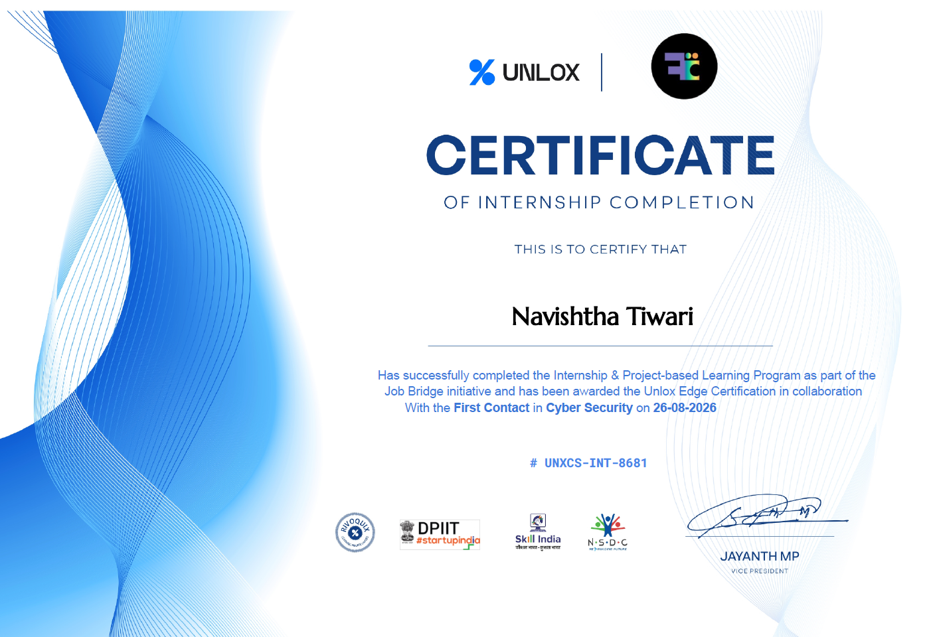
Certificate & Official Verification
Internship & Project-Based Learning Program • Navishtha Tiwari
8

Slide 9
Key Takeaways
Cybersecurity Exposure
Project-Based Learning
Professional Credential
The internship provided exposure to the cyber security domain through the program's association with First Contact in Cyber Security. It helped develop a basic understanding of cyber security concepts, practices, and their importance in protecting digital systems and information.
The program followed a project-based learning approach, allowing the concepts covered during the internship to be connected with practical learning. The certificate confirms the successful completion of the internship and project-based learning program under the Job Bridge initiative.
Successful completion of the program resulted in an Unlox Edge Certification, providing formal recognition of the internship and learning experience. The certificate serves as a professional credential documenting the successful completion of the program.
Internship & Project-Based Learning Program • Navishtha Tiwari
9

Slide 10
Conclusion
The internship and project-based learning program provided a structured opportunity to develop professional exposure in a cybersecurity-oriented environment. Completion under the Job Bridge initiative and the award of the Unlox Edge Certification mark the successful completion of the program.
Certificate ID: UNXCS-INT-8681 • Completion Date: 26-08-2026
Internship & Project-Based Learning Program • Navishtha Tiwari
10

Slide 11
THANK YOU
Navishtha Tiwari
25SCS1003001186
B.Tech • Computer Science & Engineering
IILM University, Greater Noida, U.P.

