Slide 1
Stackoverflow Survey
Languages & Salary

Slide 2

Stackoverflow Survey – May 2021
80+ Thousand Global Responses
Our model focused on United States salary information.
ETL Process was performed in Jupyter notebook using python and pandas.
Stepwise Regression was performed in Jupyter using statswise.api to eliminate data that was not impactful
Final data set included 44 languages.

Slide 3
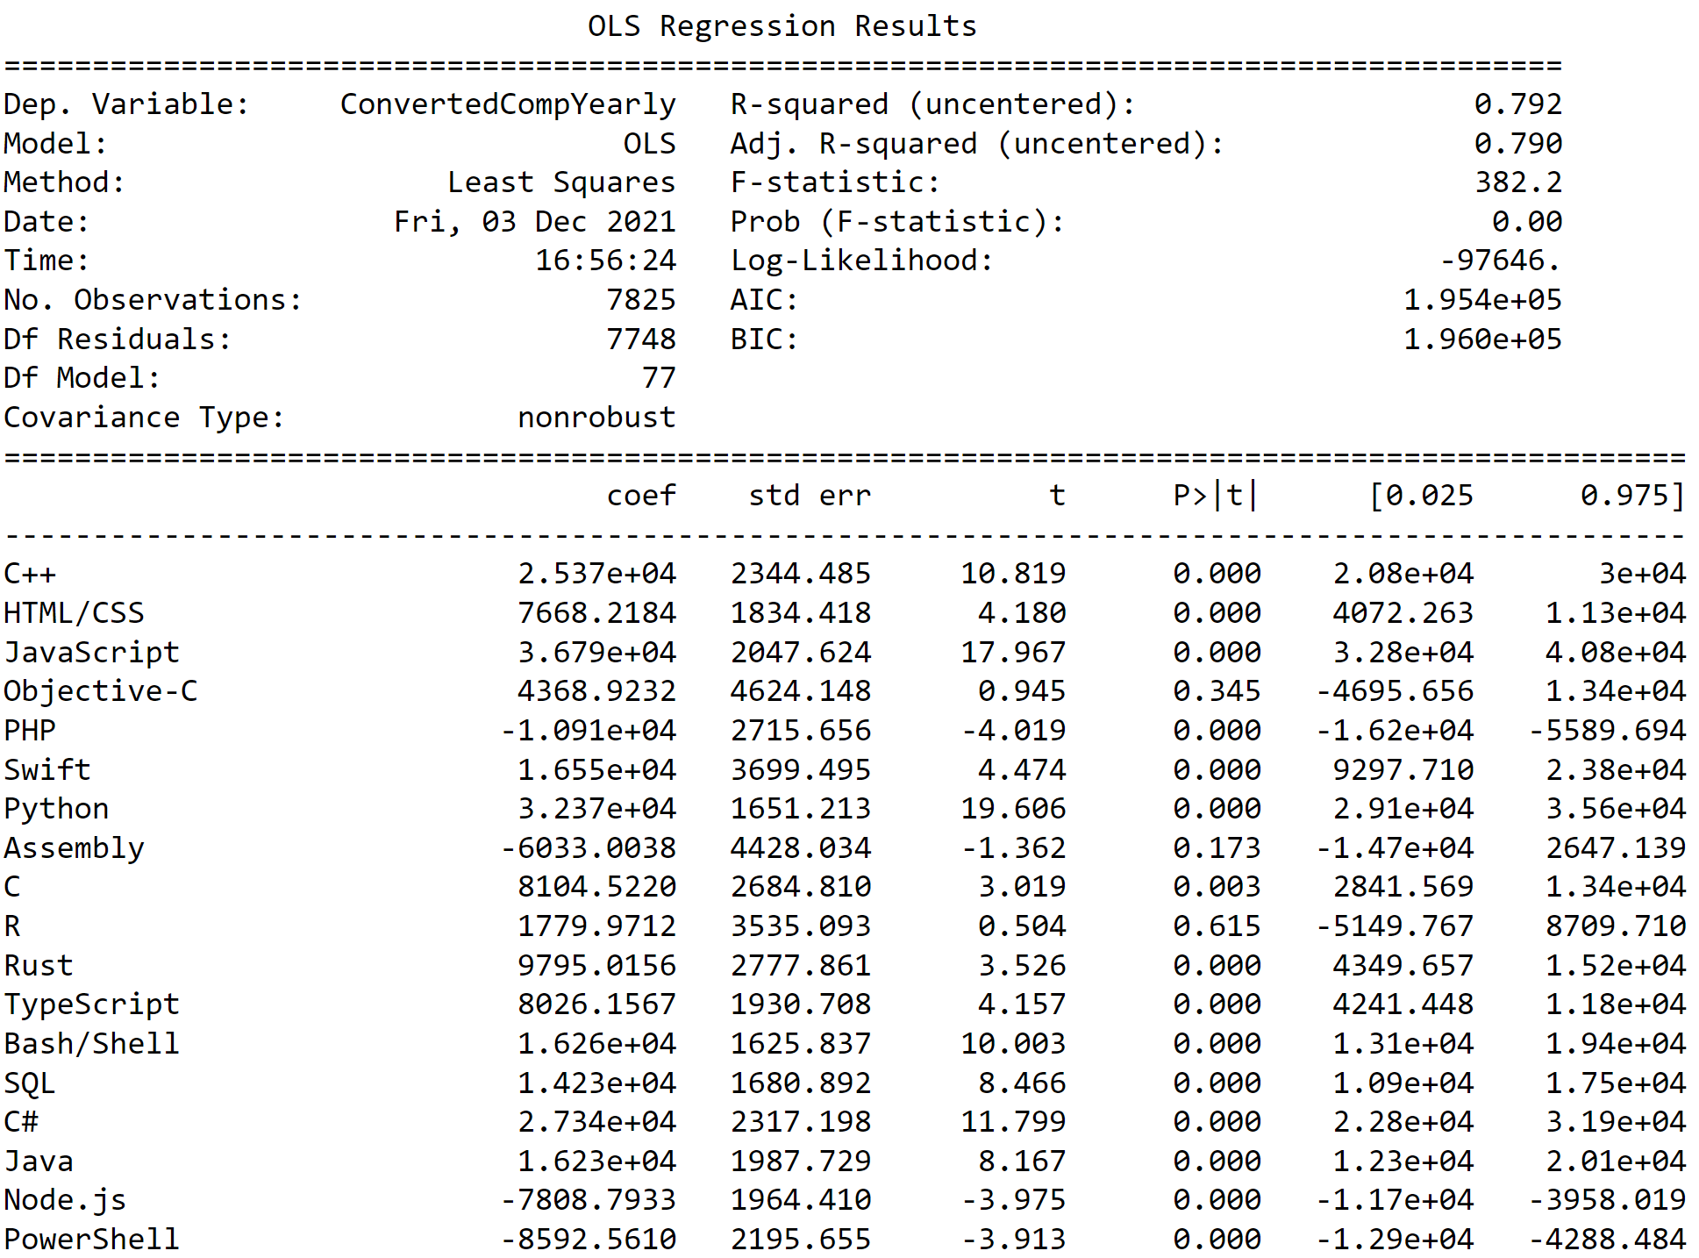
Stepwise Regression Analysis
1
2
3

Slide 4
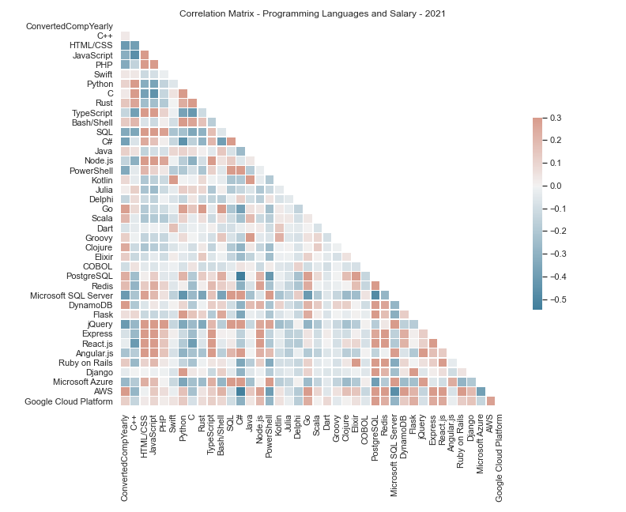
Correlation Matrix

Slide 5

AWS SageMaker Canvas
New Product
Simple Machine Learning Models
“Tableau” for ML
Required AWS S3

Slide 6
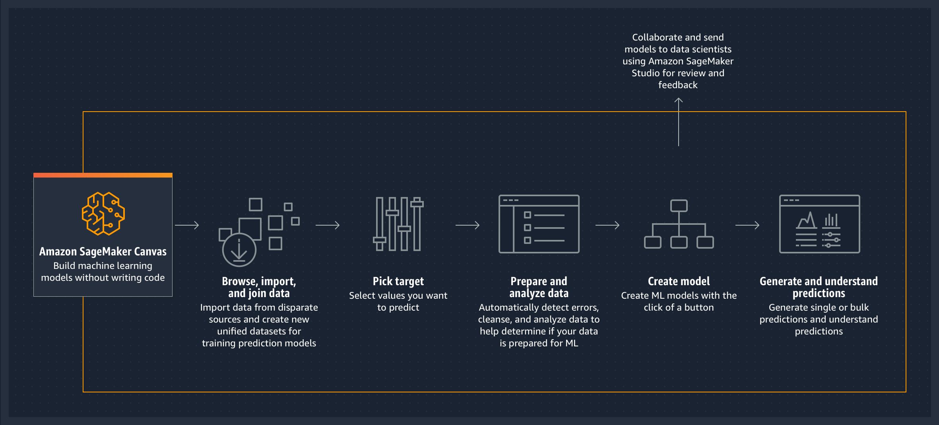
How it works:

Slide 7

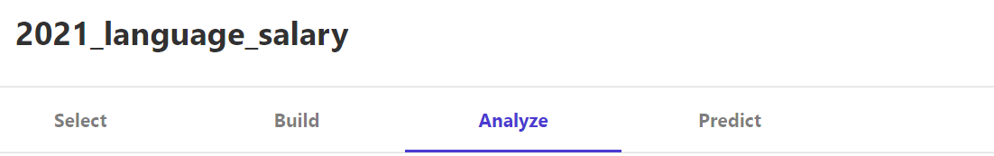

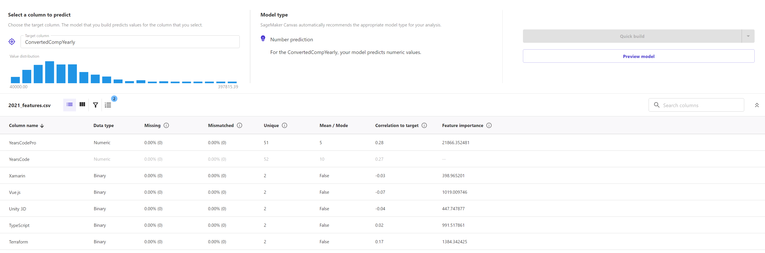



Slide 8
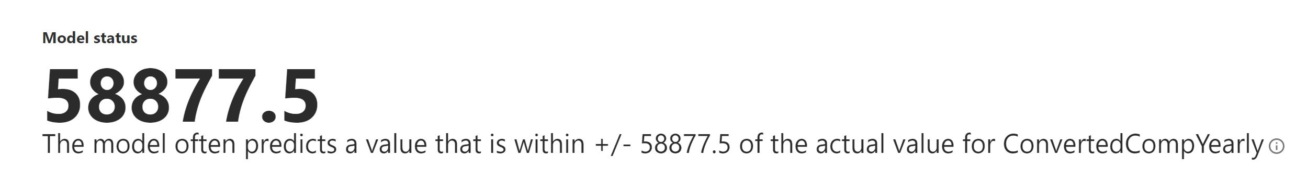

Slide 9
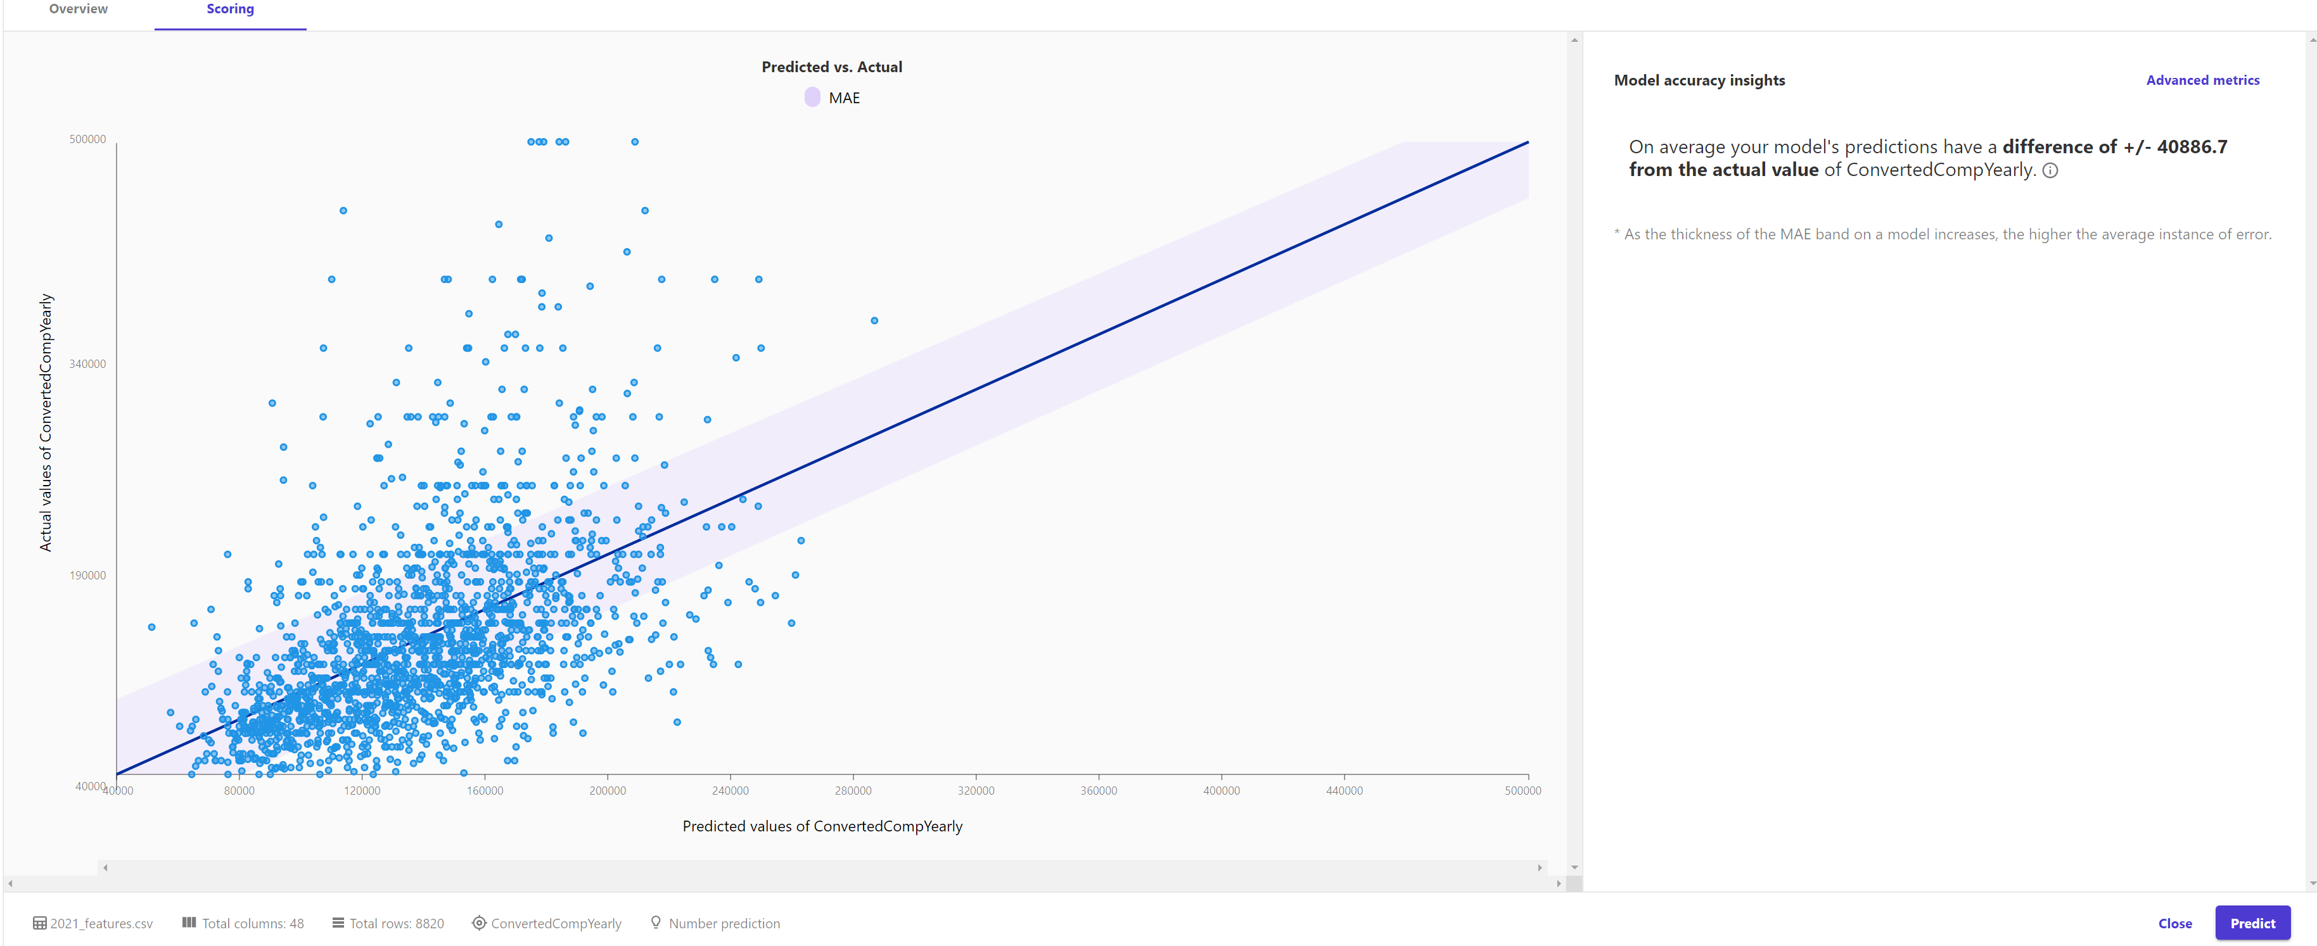
Predicted vs. Actual - MAE

Slide 10
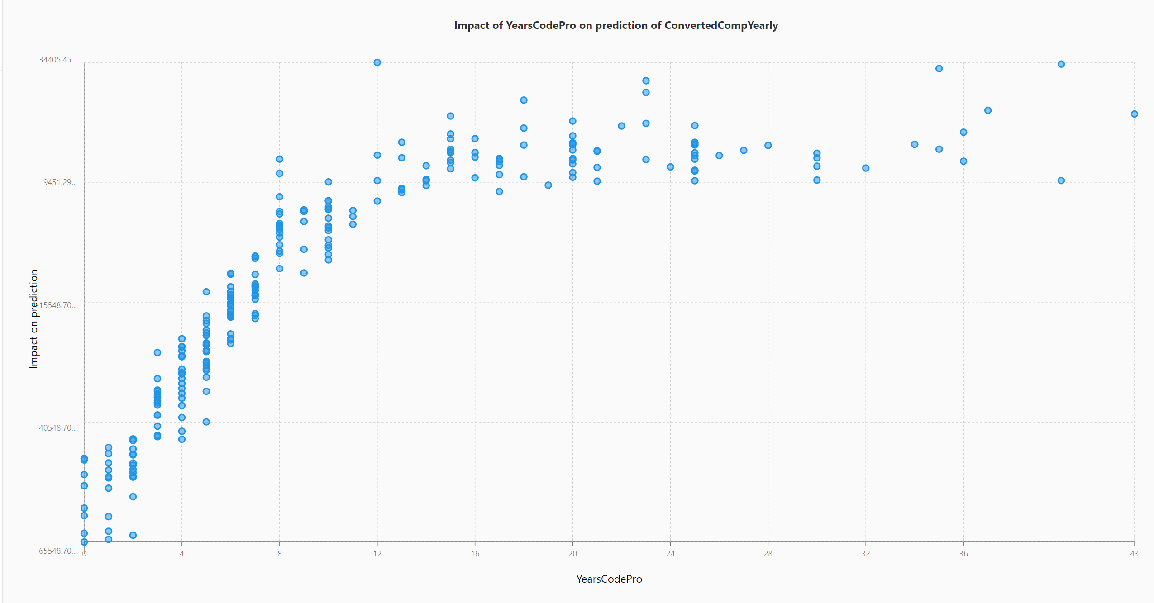

Slide 11
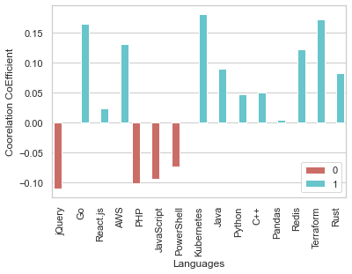
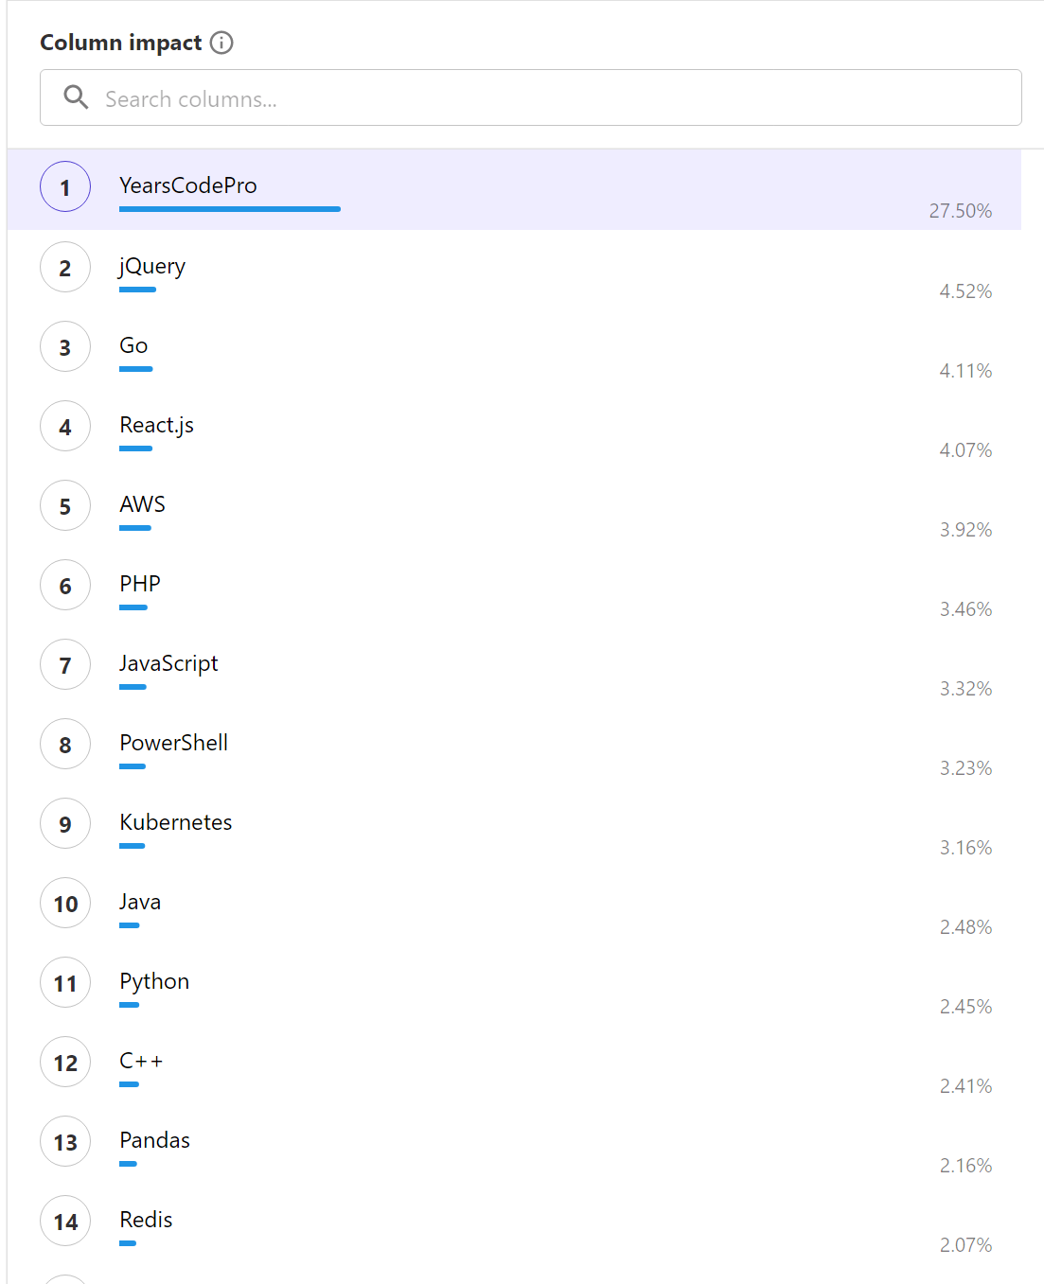
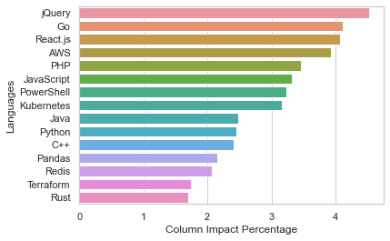
Column Impact = Feature Importance

Slide 12
Machine Learning Model

Slide 13
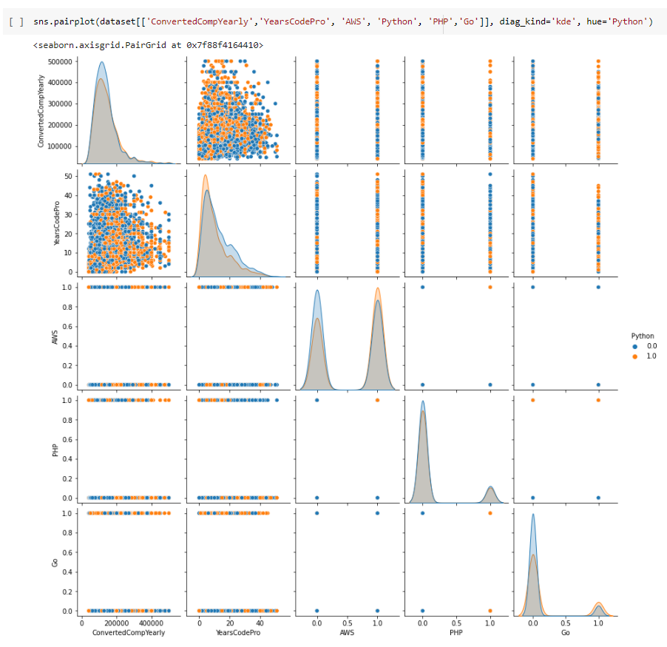
Deep Neural Network Model
Google Colab, Tensorflow, Keras
Final data formatting (float64)
Train test split
Models
One variable regression
Multiple Regression
One Variable DNN
All variables DNN

Slide 14
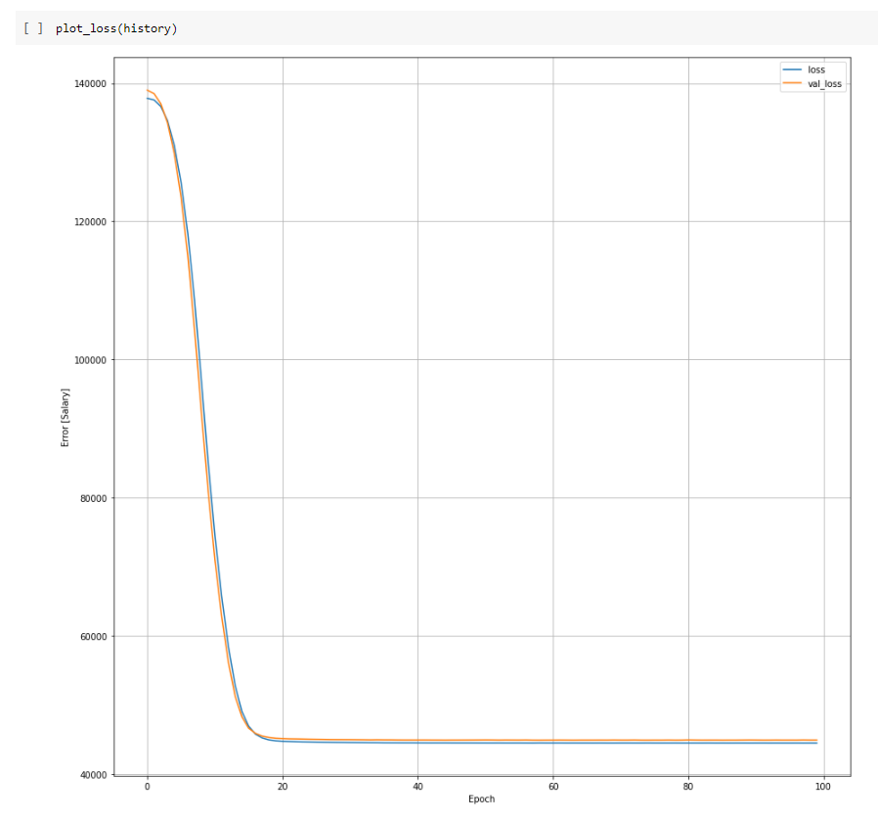
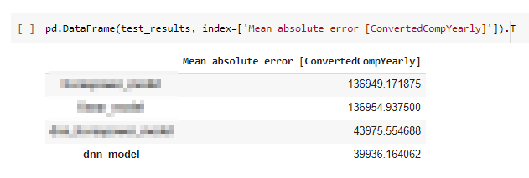
Deep Neural Network Model
MAE for DNN considerably lower than regression
Plot loss to fine tune model
Varied salary range
0 to $500,000 (MAE 39936)
0 to $250,000 (MAE 31137)
$250,000 to $500,000 (MAE 78312)

Slide 15
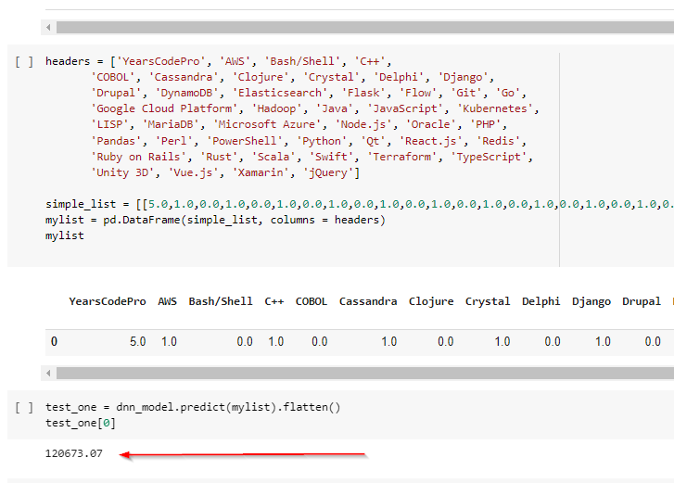
Deep Neural Network Model
Save/export model
Used trained model to predict
Test code needed to use the model in app

Slide 16
Application Development

Slide 17
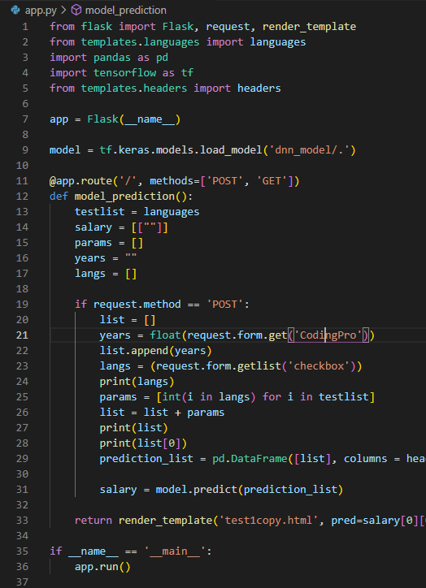
Trouble with UI
Post & get method for bringing in user input.
Reformatted data to send to the model.
Used Jinja to send the results back to the webpage.
Used Heroku CLI to Troubleshoot and Debug

Slide 18
Can we guess how much a coder will make? (coding-salary-prediction.herokuapp.com)

Slide 19
Area of further Investigations:
Top 20 Engineering Colleges (USA & Global)
Education Level
GPA
High School (AP Classes / Advanced Math including Algebra 2 / Calculus)
Technical Military Training
Method of Computer Science Instruction
Exposure to modern forms of CS Theory / Distributed Systems
Other STEM Degrees (Statistics, Biostatistics, Math, Physics, )
FAANG Company Experience
High Tech Companies
San Francisco, Seattle, NYC Tech Markets
Individual Excellence in programming ability (awards, career acceleration, coding test scores)
Demographics

