Slide 1
EMOJI PREDICTION
S.NAVITHA
au950021104033
ANNA UNIVERSITY REGIONAL CAMPUS TIRUNELVELI

Slide 2
AGENDA
Problem Statement
Project Overview
End Users
Solution and its value proposition
The “WOW” in the solution
Modelling
Results
Evaluation
Conclusion

Slide 3
PROBLEM STATEMENT
In the era of digital communication, conveying emotions accurately through text is challenging.
The absence of visual cues can lead to misunderstandings.
The problem lies in efficiently predicting emojis that best represent the sentiment conveyed in text inputs.

Slide 4
PROJECT OVERVIEW
With the exponential growth of online communication, the need for effective sentiment analysis tools is paramount.
Traditional text-based sentiment analysis often falls short in capturing nuanced emotions.
Integrating emojis into sentiment analysis can bridge this gap by providing visual context to textual data.

Slide 5
END USERS
End users of our solution include:
Social media platforms seeking to enhance user engagement and sentiment analysis.
Chatbot developers aiming to improve user interactions and understanding.
Sentiment analysis researchers and practitioners looking for more accurate emotion classification tools.

Slide 6
SOLUTION AND ITS VALUE PROPOSITION
The solution involves building a predictive model using LSTM networks and GloVe embeddings to accurately predict emojis based on textual inputs.
By harnessing the power of deep learning, The aim is to provide a more nuanced understanding of text-based sentiment analysis.
The value proposition lies in:
Enhancing user experience by accurately capturing emotions in digital communication.
Improving sentiment analysis accuracy for businesses and researchers.
Enabling better chatbot interactions through nuanced emotional understanding.

Slide 7
THE “WOW” IN THE SOLUTION
The incorporation of LSTM networks and GloVe embeddings enables the solution to capture complex linguistic patterns and semantic relationships, resulting in more accurate emoji predictions.
Additionally, the model's adaptability to different textual contexts and languages adds a layer of sophistication to traditional sentiment analysis tools, eliciting a "wow" factor in its performance and versatility.

Slide 8
MODELLING
LSTM networks are utilized alongside GloVe word embeddings to construct a model for emoji prediction from text.
LSTM's capability to capture long-term dependencies and GloVe's semantic embeddings enrich the model's comprehension of textual context.
Stacked LSTM layers followed by dense classification layers constitute the architecture.
During training, the model minimizes a chosen loss function through backpropagation.
Hyperparameter tuning and validation ensure optimal performance.
By combining deep learning and pre-trained embeddings, the model enhances sentiment analysis by accurately predicting emojis, fostering clearer and more expressive digital communication.

Slide 9
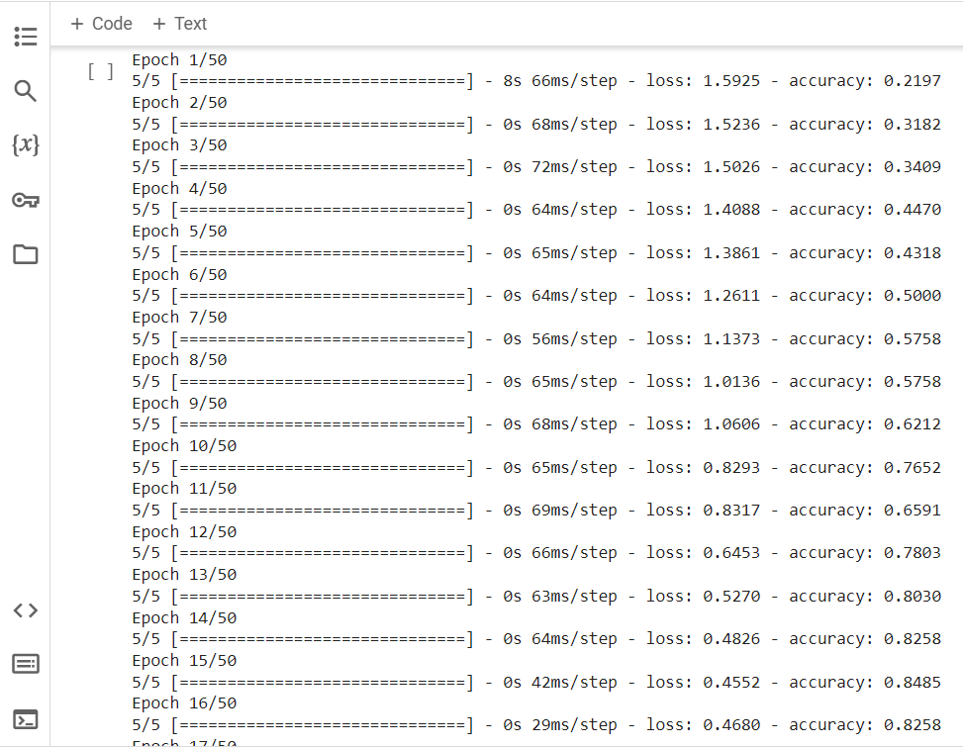
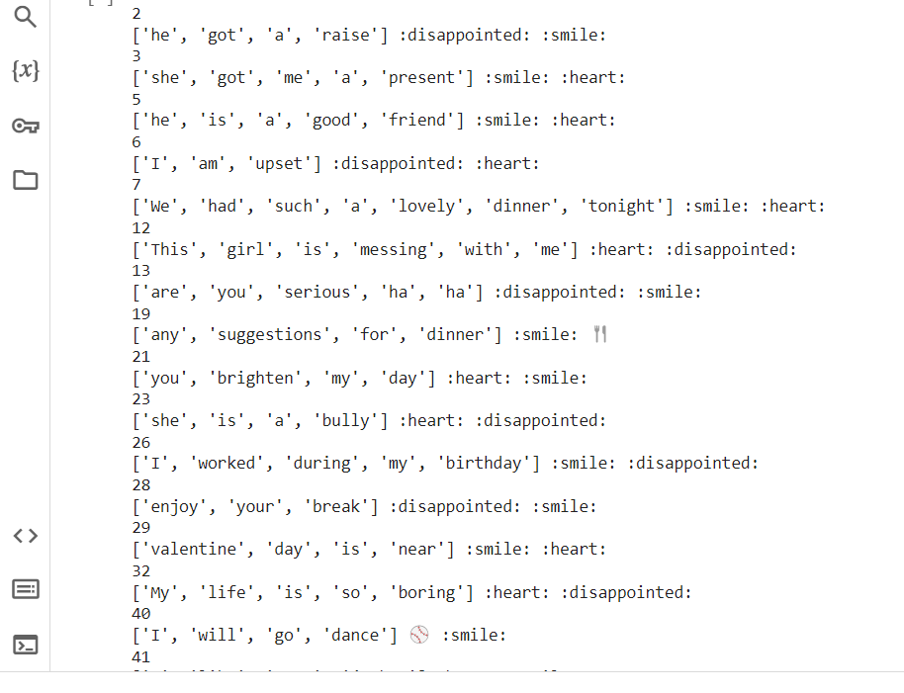
RESULTS

Slide 10
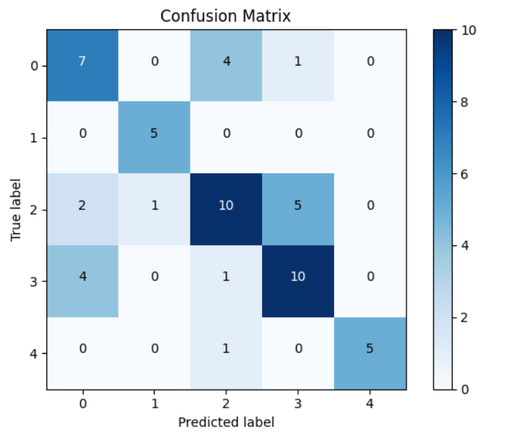
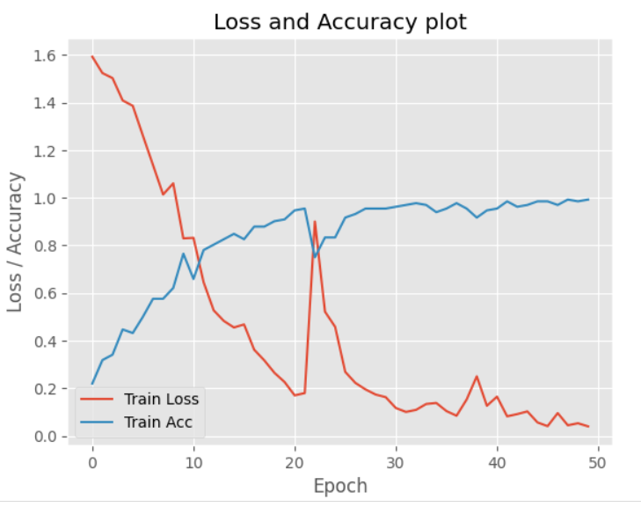
RESULTS

Slide 11
EVALUATION
Evaluation metrics such as accuracy, confusion matrix, and qualitative analysis of predictions are used to assess the model's performance.
Comparative analysis with baseline models or existing approaches provides insights into the superiority of the solution.

Slide 12
CONCLUSION
In conclusion, the emoji prediction model offers a robust solution to the challenge of accurately capturing emotions in text data.
By leveraging deep learning techniques and pre-trained embeddings, this provide a valuable tool for sentiment analysis, chatbot development, and social media engagement.
Moving forward, further refinement and adaptation of the model can continue to enhance its performance and applicability in real-world scenarios.

