Slide 1
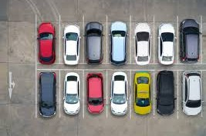
Capstone Project
Feb 2026
Building a data-driven parking management system to optimize utilization, improve compliance, and maximize revenue.
Parking Management Analytics
Tools Used: Power BI • MySQL • DAX
NAVIYA GARG

Slide 2
PROBLEM STATEMENT
Urban parking systems face operational inefficiencies due to the lack of centralized analytics and real-time visibility.
Uneven parking utilization across lots
Peak-hour congestion leading to delays
Revenue leakage from violations and suboptimal pricing
Limited visibility into compliance patterns
Absence of predictive insights for demand and pricing

Slide 3
OBJECTIVES & SOLUTION APPROACH
Project Objectives:
Analyze parking demand and utilization patterns
Identify revenue drivers and violation hotspots
Monitor compliance performance
Forecast demand and simulate pricing scenarios
Deliver data-driven optimization recommendations
Solution Approach:
Raw parking data imported into Power BI
Data cleaned and transformed using Power Query
Analytical data model built using fact & dimension tables
Relationships created for structured reporting
SQL used for advanced querying and validation
KPIs and forecasting logic implemented using DAX

Slide 4
DATA ARCHITECTURE
Excel Source Files
(Events, Lots, Slots, Payments, Violations)
Power BI - Power Query
(Data Cleaning & Transformation)
Analytical Data Model
(Relationships + Date Table)
DAX Measures & Power BI Dashboards
Data Preparation & Modelling in SQL

Slide 5
DATASET OVERVIEW
Tables
Lots Slots Events
Payments
Purpose
Stores parking lot master information
Contains individual parking slot details
Records each parking session (entry, exit, duration)
Captures payment transactions for parking
Dataset Summary
~49K parking sessions
Multiple parking locations and areas
Time range: Jan 2022 – Dec 2024
Contains operational, financial, and compliance metrics

Slide 6

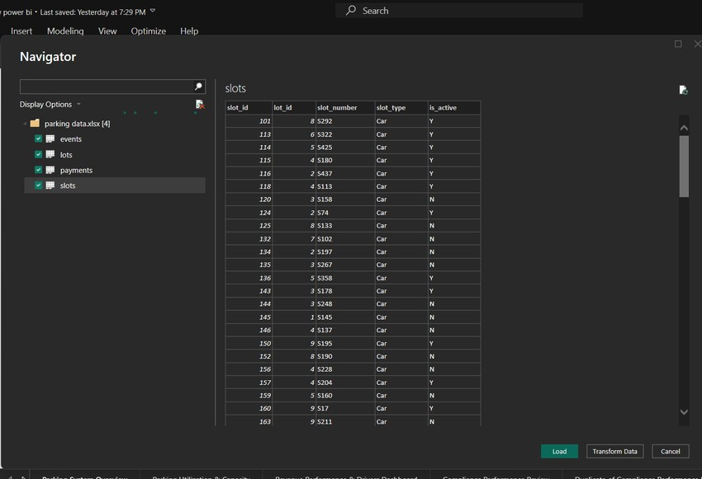
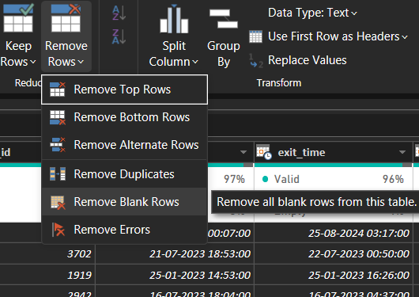
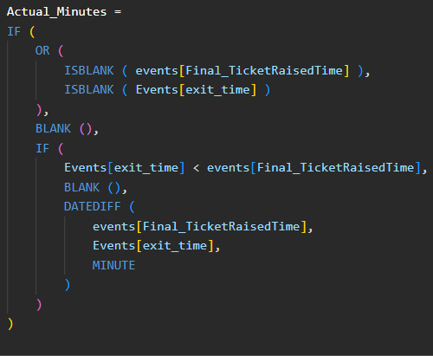
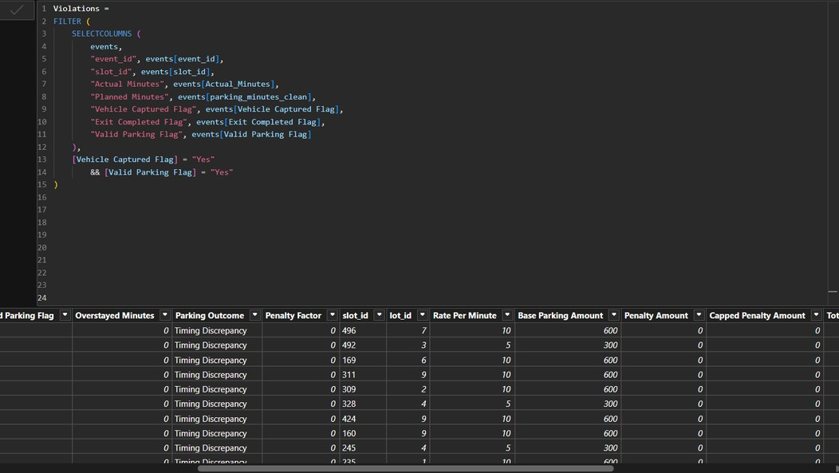
POWER QUERY CLEANING & TRANSFORMATION
Data Preparation Steps
Removed null and duplicate records and standardized categorical text values for consistency.
Standardized date and time formats
Converted text flags (Yes/No) to logical values
Created calculated columns (duration, hour extraction, actual minutes)
Handled missing and inconsistent values
Prepared clean analytical tables for modeling (Violations Table)

Slide 7
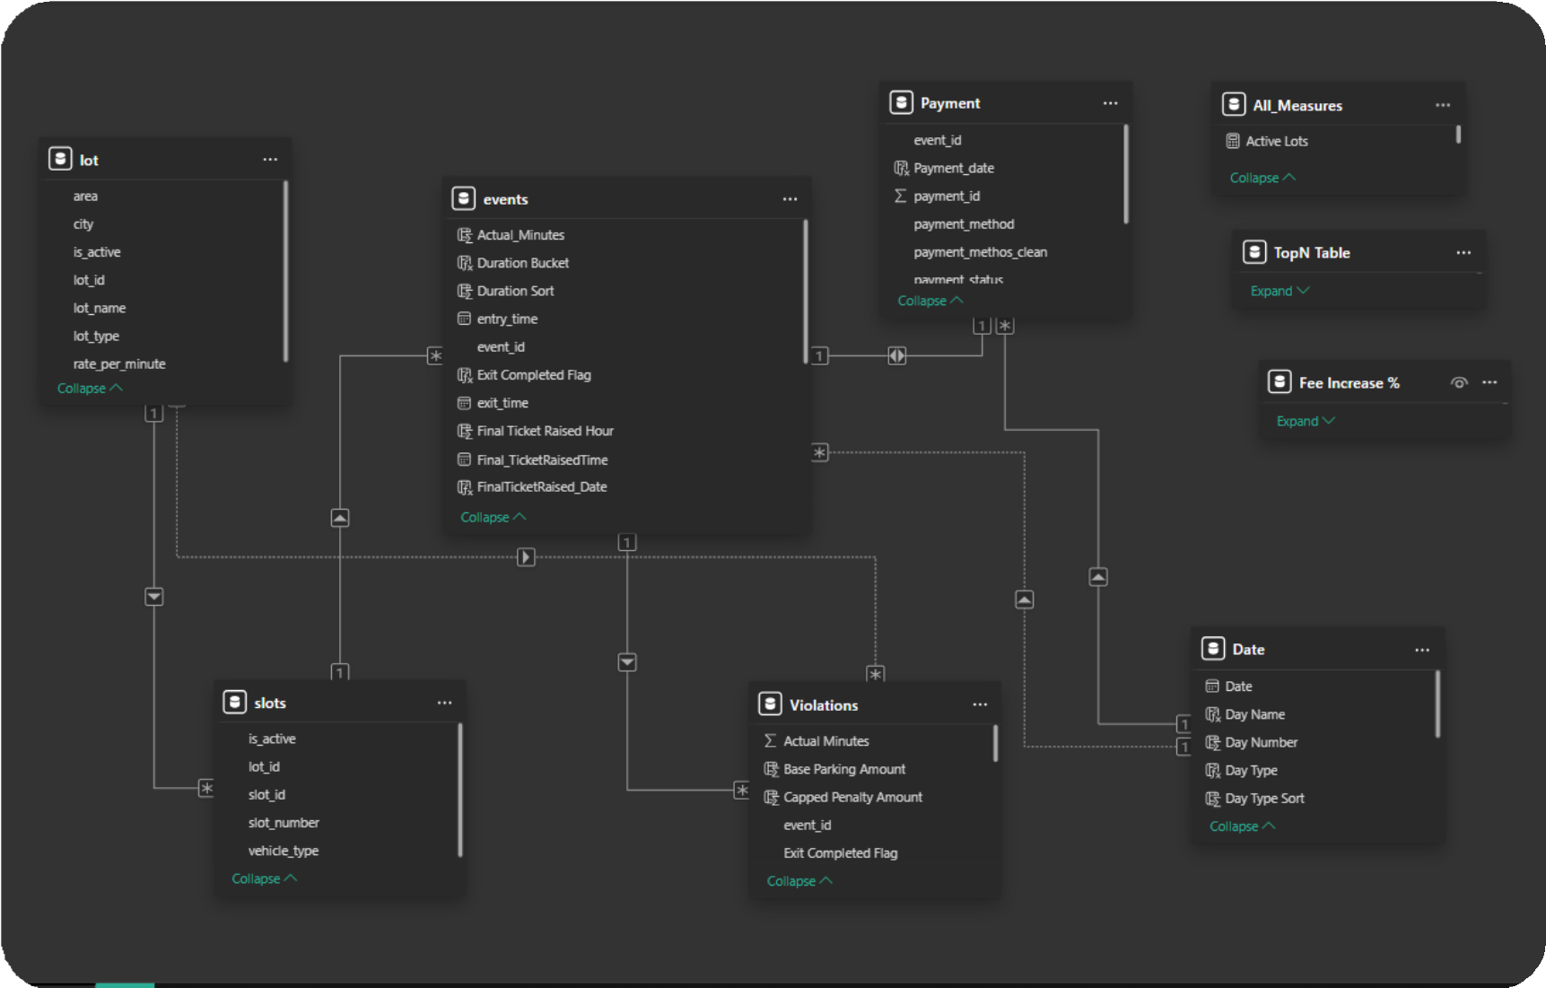
DATA MODEL
Challenges and Risk
Management
Events acts as the central fact table
Slots and Lots provide parking location context
Payments capture transaction
details
Violations track compliance outcomes
Date table enables time intelligence analysis

Slide 8
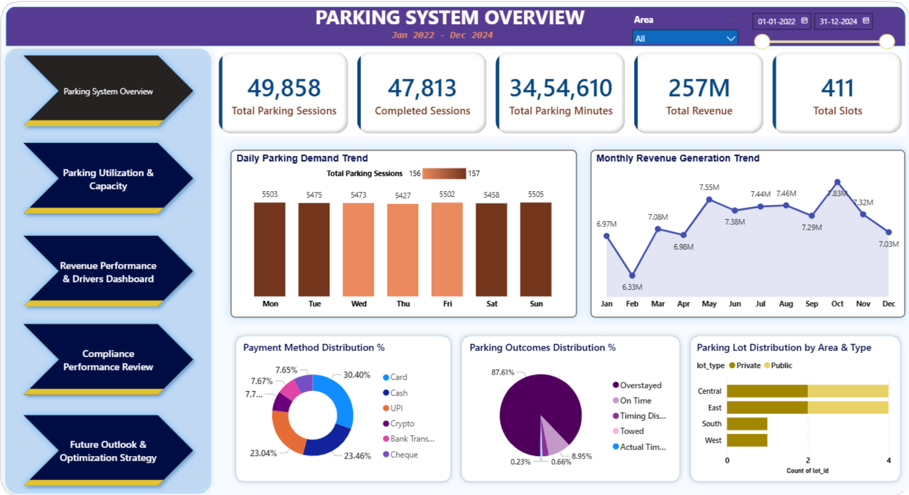
Parking System Overview
FAUGET COMPANY.
1. 49.8K total sessions, with 96% completion rate (47.8K) — system is operationally stable
Average ~5.4K sessions per weekday, indicating consistent daily demand
₹257M total revenue, peaking at
₹7.8M in October
4. Overstayed sessions
~88% of total revenue,
contribute showing
heavy dependency on violations
5. Card + UPI account for ~54% of payments, highlighting strong digital adoption

Slide 9
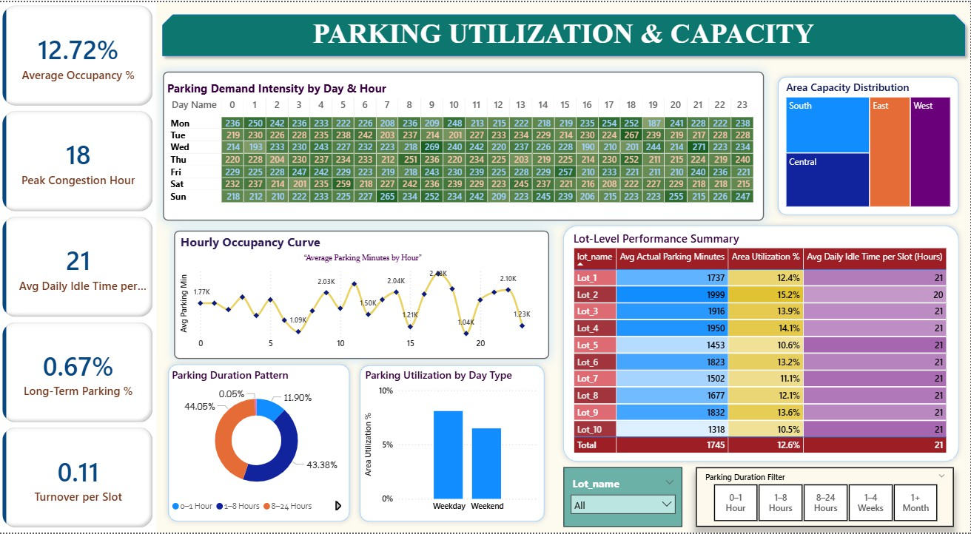
Parking Utilization & Capacity
FAUGET COMPANY.
Slots utilized only 12.7% on average — large optimization opportunity
Peak congestion at 18:00 (6 PM)
— strongest evening demand
Avg idle time = 21 hrs per slot, showing low asset utilization
Weekday utilization (~8%) higher than weekends (~6%) — demand is business-driven
55% sessions under 8 hrs → short-term parking dominates

Slide 10
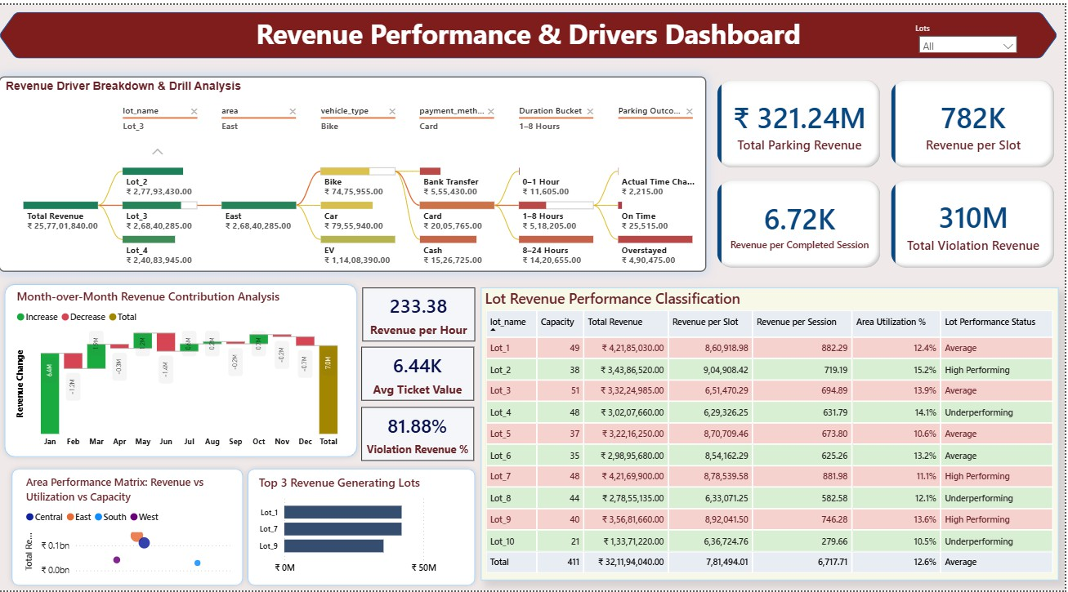
Revenue Performance & Drivers Dashboard
FAUGET COMPANY.
₹321.24M TOTAL REVENUE GENERATED ACROSS ALL LOTS
₹310M (≈96%) COMES FROM VIOLATIONS
→ REVENUE HEAVILY PENALTY-DRIVEN
AVG REVENUE PER SLOT = ₹782K, INDICATING UNEVEN LOT PRODUCTIVITY
AVG TICKET VALUE = ₹6.44K | REVENUE PER HOUR = ₹233.38**
TOP 3 LOTS DRIVE DISPROPORTIONATE REVENUE SHARE → CONCENTRATION RISK
HIGH-PERFORMING LOTS SHOW 13–15% UTILIZATION, OTHERS UNDERPERFORM AT ~10–12%
7. 81.88% OF REVENUE LINKED TO VIOLATIONS → PRICING & COMPLIANCE DEPENDENCY

Slide 11
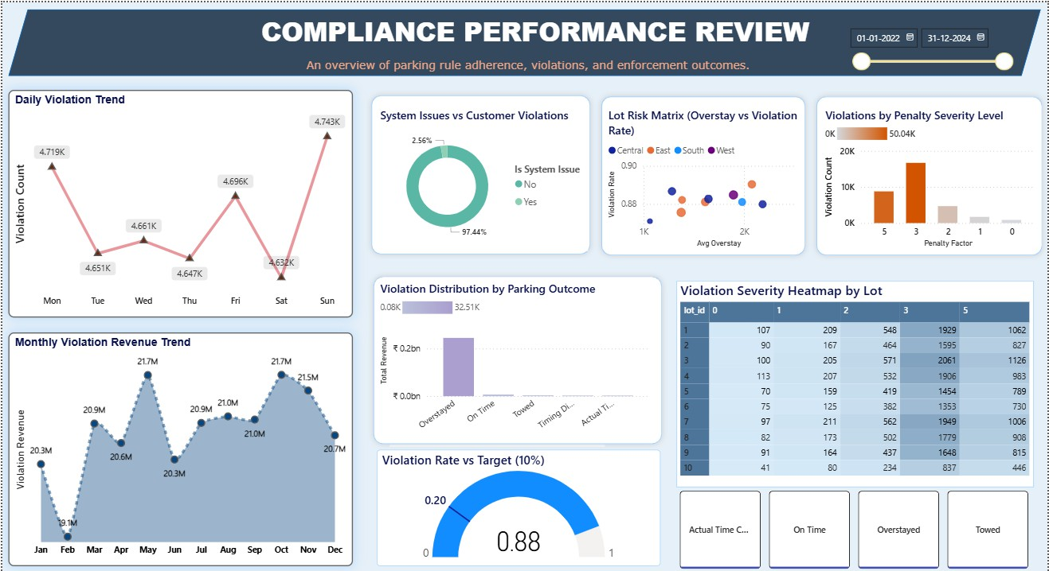
Compliance Performance Review
FAUGET COMPANY.
Violation rate = 88% vs target 10%
→ major compliance gap
97.44% violations are customer- driven, only 2.56% system issues
Peak daily violations on Sunday (~4.74K); lowest on Saturday (~4.63K)
Overstayed cases dominate (~32.5K) → primary violation type
Penalty factor “3” contributes highest volume (~50K violations)
Monthly violation revenue peaks at ₹21.7M (May & Oct)
High-risk lots show ~0.85–0.90 violation rate with 2K+ avg overstays

Slide 12
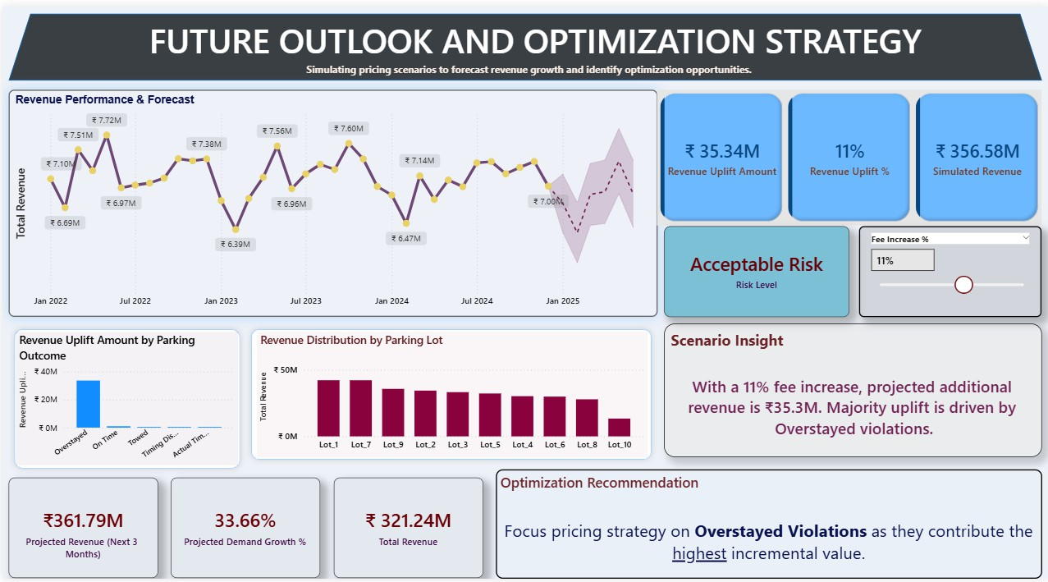
Future Outlook & Optimization Strategy
FAUGET COMPANY.
As the fee increase parameter rises, projected revenue increases, but risk level escalates — moving from acceptable to high-risk beyond certain thresholds.
Revenue is forecasted to grow significantly over the next three months, driven by strong demand momentum and pricing adjustments.
Revenue is forecasted to grow significantly over the next three months, driven by strong demand momentum and pricing adjustments.
Overstayed sessions consistently drive the majority of revenue uplift, making them the primary lever for optimization across all pricing scenarios.

Slide 13
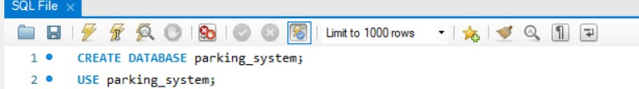
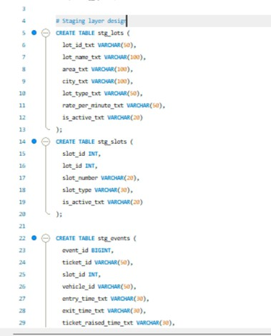
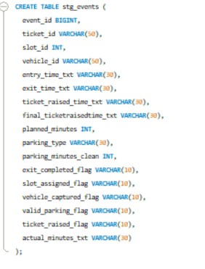
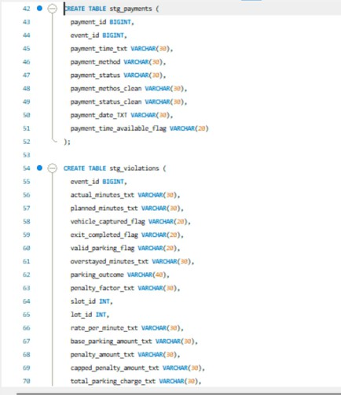
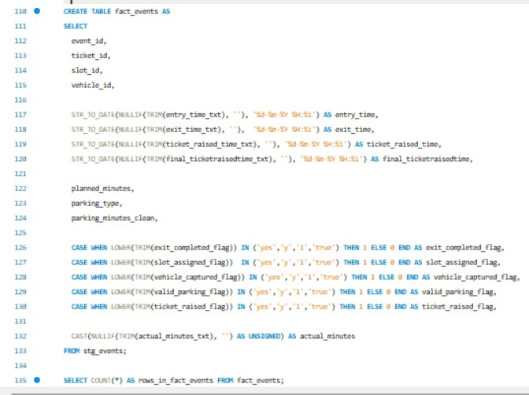
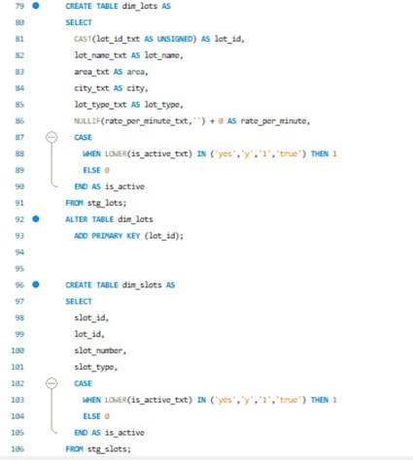
DATA PREPARATION & MODELLING IN SQL
CREATE AND USE THE DATABASE
CREATED STRUCTURED STAGING TABLES
CREATING FINAL CLEAR TABLES

Slide 14
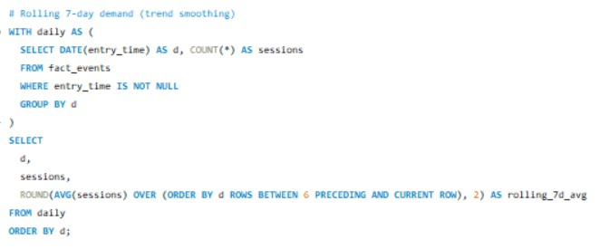
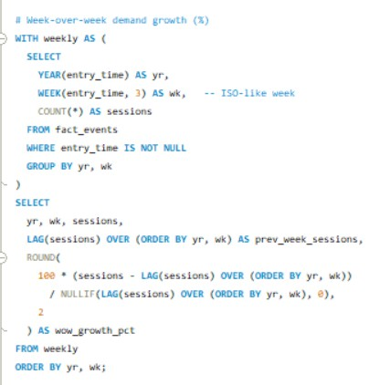
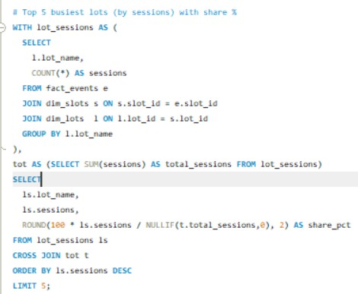
DEMAND TRENDS & HIGH-TRAFFIC LOT IDENTIFICATION
What SQL Did
Calculated daily demand with 7-day rolling average for trend smoothing Measured week-over-week demand growth % using window functions Identified Top 5 busiest parking lots and computed their share of total sessions
KEY INSIGHTS
DEMAND SHOWS CLEAR WEEKLY MOMENTUM, SUPPORTING SHORT-TERM FORECASTING
PARKING USAGE IS HIGHLY CONCENTRATED IN TOP 5 LOTS (NOT EVENLY DISTRIBUTED)
ROLLING AVERAGES REVEAL STABLE DEMAND PATTERNS BEYOND
DAILY NOISE
GROWTH FLUCTUATIONS HIGHLIGHT PERIODS NEEDING CAPACITY AND PRICING ATTENTION

Slide 15
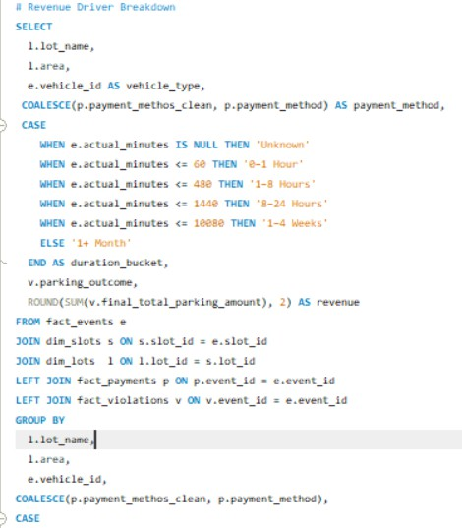
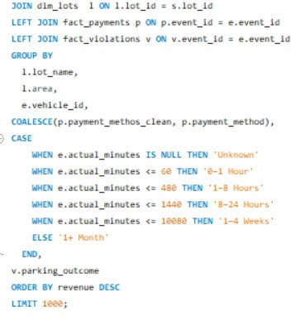
REVENUE DRIVER BREAKDOWN
What SQL Did
Joined events, lots, slots, payments, and violations to build a unified revenue view
Bucketed parking duration into time bands (0–1 hr, 1–8 hrs, 8–24 hrs, weeks, months)
Normalized payment methods using COALESCE Aggregated final parking revenue across:
Lot Area
Vehicle type Payment method Duration bucket Parking outcome
Key Insights
Revenue is primarily driven by specific lots +
medium-duration stays (1–8 hrs) Overstayed outcomes contribute disproportionately to total revenue
Digital payments dominate revenue compared to cash
Revenue concentration shows few combinations generate most earnings

Slide 16
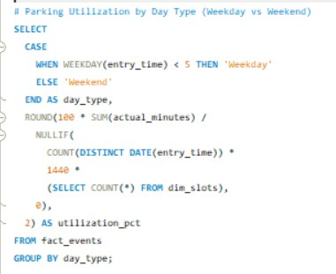
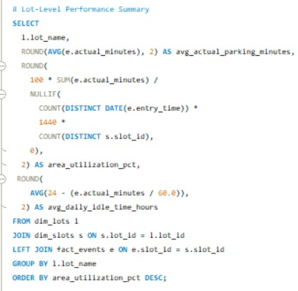
LOT-LEVEL UTILIZATION & CAPACITY ANALYSIS
What SQL Did
Calculated average parking duration per lot
Derived area utilization % using: Total actual parking minutes
Available minutes per slot per day (1440 × slots) Computed average daily idle time per slot Classified sessions into Weekday vs Weekend Compared utilization patterns across day types
Key Insights
Parking utilization varies significantly by lot, revealing high and under-
performing areas
Even top lots show substantial idle capacity (~20+ hours/day per slot) Weekday utilization exceeds weekend, indicating demand is business- driven
Overall utilization remains low, highlighting large optimization potential

Slide 17
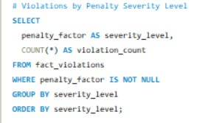
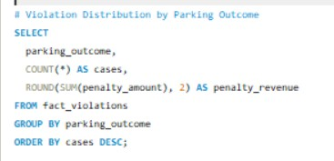
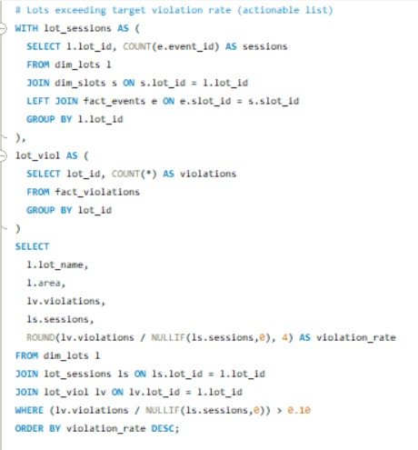
What SQL Did
COMPLIANCE PERFORMANCE & VIOLATION HOTSPOT ANALYSIS
Grouped violations by penalty severity level to understand risk distribution Aggregated violations by parking outcome and calculated associated penalty revenue
Computed lot-level violation rates by joining sessions with violations
Flagged lots exceeding the 10% target violation threshold to generate an actionable enforcement list
Key Insights
Higher penalty severity levels account for a disproportionate share of violations
Overstayed outcomes dominate both violation volume and penalty revenue
Several lots breach the 10% violation benchmark, indicating compliance hotspots
Violation rates vary significantly by location, enabling targeted operational intervention

Slide 18
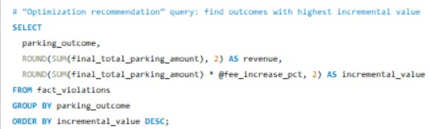
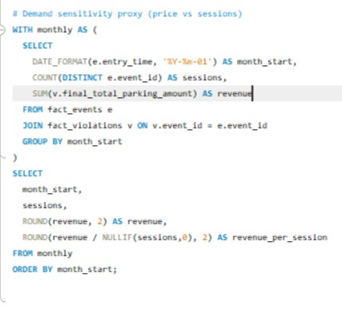
What SQL Did
PRICING OPTIMIZATION & DEMAND SENSITIVITY ANALYSIS
Calculated incremental revenue uplift per parking outcome using a configurable pricing parameter
Ranked outcomes by highest incremental value potential Aggregated monthly sessions and revenue to derive revenue per session
Built a proxy for price sensitivity by comparing demand volume with revenue trends over time
Key Insights
Overstayed outcomes generate the highest incremental uplift, making them the primary optimization lever
Revenue growth is driven more by pricing than session volume, indicating low short-term demand elasticity
Monthly revenue per session shows consistent upward movement, supporting controlled fee increases
Scenario analysis highlights the trade-off between revenue uplift and operational risk

Slide 19
RECOMMENDED ACTIONS
Optimize pricing on Overstayed Violations
--Focus fee adjustments on overstayed cases, as they contribute the highest impact on demand.
Introduce peak-hour dynamic pricing (6–9 PM)
incremental revenue uplift with minimal
--Apply higher rates during identified congestion hours to improve slot turnover and increase revenue efficiency.
Prioritize high-risk lots for enforcement
--Target lots exceeding the 10% violation rate threshold to reduce revenue leakage and improve compliance.
Rebalance capacity across underutilized lots
--Shift demand from overcrowded locations by promoting low-utilization lots through pricing or signage strategies.
Monitor fee-increase risk levels before deployment
--Keep pricing scenarios within the “Acceptable Risk” range to maximize revenue while avoiding customer drop-off

Slide 20
CONCLUSIONS
THIS PROJECT DEMONSTRATES HOW SQL-DRIVEN ANALYSIS AND POWER BI DASHBOARDS TRANSFORM RAW PARKING DATA INTO ACTIONABLE INSIGHTS — IMPROVING UTILIZATION VISIBILITY, COMPLIANCE TRACKING, AND REVENUE FORECASTING.
BY IDENTIFYING HIGH-RISK LOTS, PEAK CONGESTION PERIODS, AND OVERSTAYED-DRIVEN REVENUE, THE SOLUTION ENABLES DATA-BACKED PRICING STRATEGIES, OPERATIONAL OPTIMIZATION, AND CONTROLLED REVENUE GROWTH UNDER ACCEPTABLE RISK LEVELS.
THANKYOU!

