Slide 1

Optimum Human Resources, Less Wait Time
Notes:
Recently some months ago, there was a case in Nova Scotia where a patient's chronic disease became more reactive, only because of hospital wait time.
From our analysis, in QE2 hospital where a person diagnosed with breast cancer has to wait for 47 days for only consultation and 34 more days for undergoing surgery, which is approximately three months from being diagnosed.
This could happen to us also.

Slide 2
Problems
Health care constantly evolving, making future health workforce requirements uncertain.
Sometime hospital not being able to manage unforeseen flux of patients
The way the health system is organized makes it difficult to plan for future health workforce needs
Notes:
Today, we are addressing this problem of workforce management, not reflecting the realities of changing health system.
Hospitals are sometimes not being able to manage the unforeseen flux of patients.
Long wait times in patient care could make matters worse for Nova Scotians.

Slide 3




Design Flow
Data Collection
Visualize Data
Regression Analysis
Make Predictions
Notes:
To address this, we have taken four most prevalent chronic diseases that accounts to 64 percent of all deaths in Nova Scotia per year.
To help us with these issues and to make better decisions, we have performed and visualized the analysis on data gathered from NS Open Data portal and made a predictive model that will forecast the number of patients coming in for a disease. Our regression model will also give us insights about the least number of doctors required by number of patients coming in that year. Using this, hospitals can manage their staff according to the possible influx of patients.

Slide 4
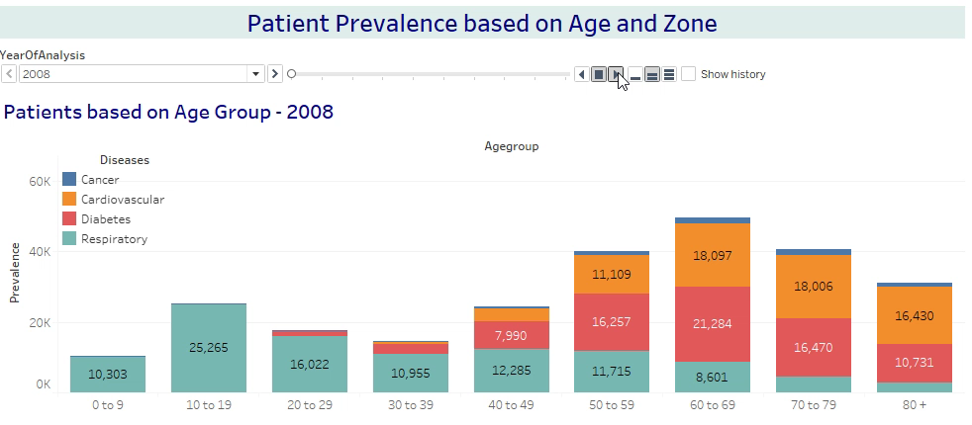
Notes:
The medical disparity seen by understanding the trends of patient prevalance by age, disease and zone, we found that people below 30 years of age are majorly suffering with repiratory problems and 30-60 age group, diabaties is the main disease seen in patients.But, After 70 years of age, cardiac diseases are very common in people.

Slide 5
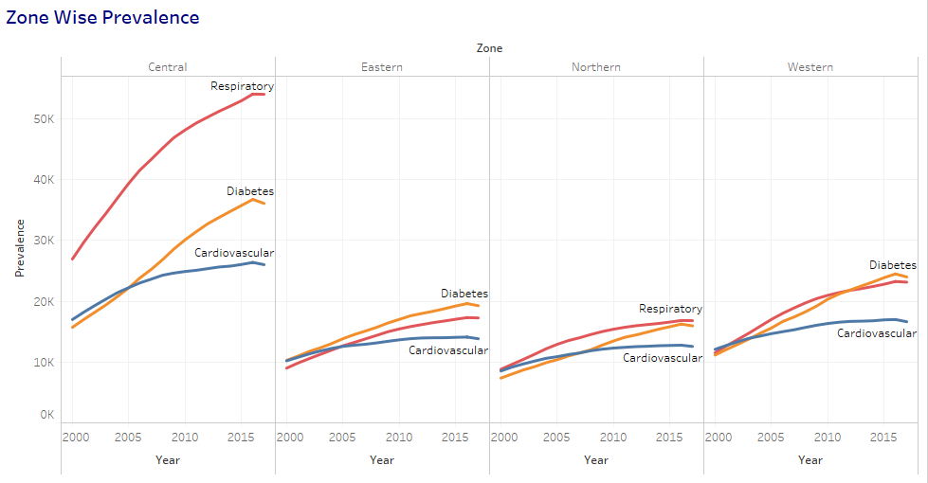
Notes:
Now we see, the number of patients for a disease per zone.

Slide 6
Notes:
By forecasting the number of patients having repiratory diseases, we can see an increase 10,000 patients in all age groups. Based on our prediction results, doctor and patient relationship can be defined by this equation.
In 2017, resp doctorr = 318 and by our prediction, in 2020 minimum no. of doctors required for respiratory diseases are 376. In order to decrease the wait times, government needs to employ more no of doctors than 376.

Slide 7
Conclusion
Determine
Determine the current and future health needs of Nova Scotia health system and forecasting optimum number of specialists required for patient care.
Establish
Better patient care, lesser wait times in hospitals and better management of human resources in healthcare.
Train and Retain
Focus more on providing education in the healthcare field.
Notes:
Right now, this solution is trained on yearly data, but once we have more granular time series data, our system will be able to forecast number of patients coming in for a disease on any given day.
Our solution will help the government to understand the lack of doctors for a particular specialization in the province and will encourage institutions to focus more on providing education in the same field.
This will result in better patient care, lesser wait times in hospitals and better management of human resources in healthcare.

Slide 8

Results

