Slide 1

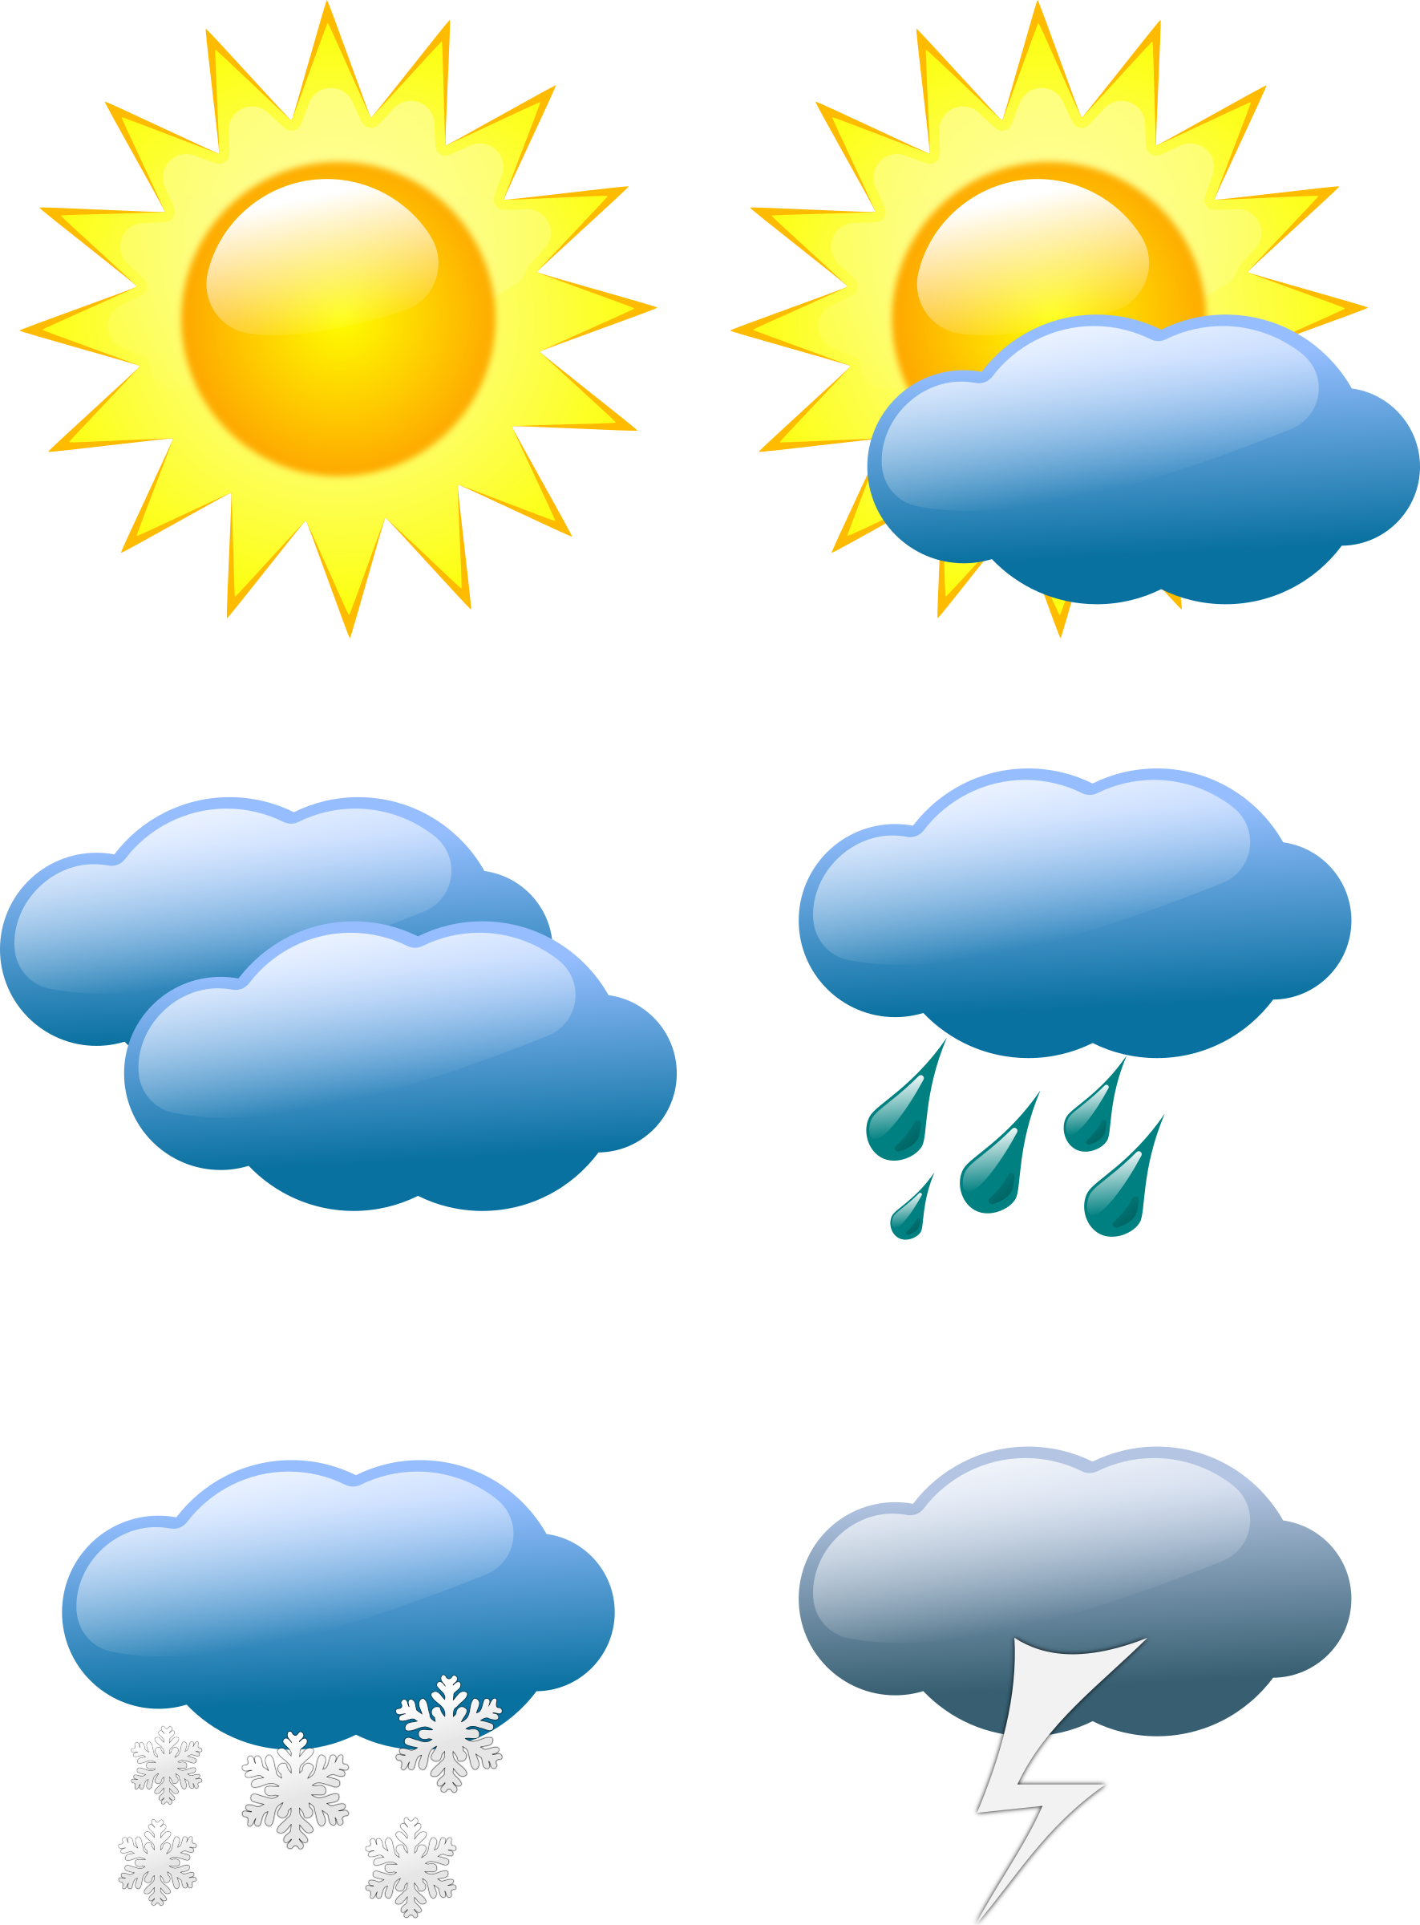

Presented by – Navjyoti Sharma
WEATHER APP USING PYTHON PROGRAMMING

Slide 2
PYTHON PROGRAMMING
Python is an interpreted , object-oriented , high-level programming language with dynamic semantics.
Python’s simple , easy to learn syntax emphasizes readability and therefore reduces the cost of program maintenance.
Python supports modules and packages , which encourages program modularity and code reuse.
The major focus behind creating it is making it easier for developers to read and understand , also reducing the lines of code.

Slide 3
WEATHER APP
Weather App is the application of science and technology to predict the conditions of the atmosphere for a given location and time.
People have attempted to predict the weather informally for millennia and formally since the 19th century.
In other words, it's a way of predicting things like cloud cover, rain, snow, wind speed, and temperature before they happen.

Slide 4
STEPS TO CREATE WEATHER APP
Install and import modules
OpenWeatherMap API
Initialize the Tkinter Window
Weather Function
Coding the GUI

Slide 5
INSTALL AND IMPORT MODULES
To install Tkinter , open the command prompt and give the command.
[ pip install tkinter]
To install requests , open the command prompt and give the command.
[ pip install requests]

Slide 6
PYTHON TKINTER
Python provides the standard library Tkinter for creating the graphical user interface for desktop based applications.
An empty Tkinter top-level window can be created by using the following steps.
Import the Tkinter module.
Create the main application window.
Add the widgets like labels , buttons , frames , etc. to the window.
Call the main event loop so that the actions can take place on the user’s computer screen.

Slide 7
STEPS TO GENERATE AN API KEY
Login in the Open Weather Map
Go to the API section. Then in the Current Weather Data section click on the Api doc.
Now in the API Call section, we have the link of api.openweathermap.org/data/2.5/weather?q={city name}&appid={API key}
Click on the API key on the link it will direct to the page from where you can get the key. The generated key looks like this:
Key Name
[3c91f2ad78ccc17451c13dd68f107148] gfg

Slide 8
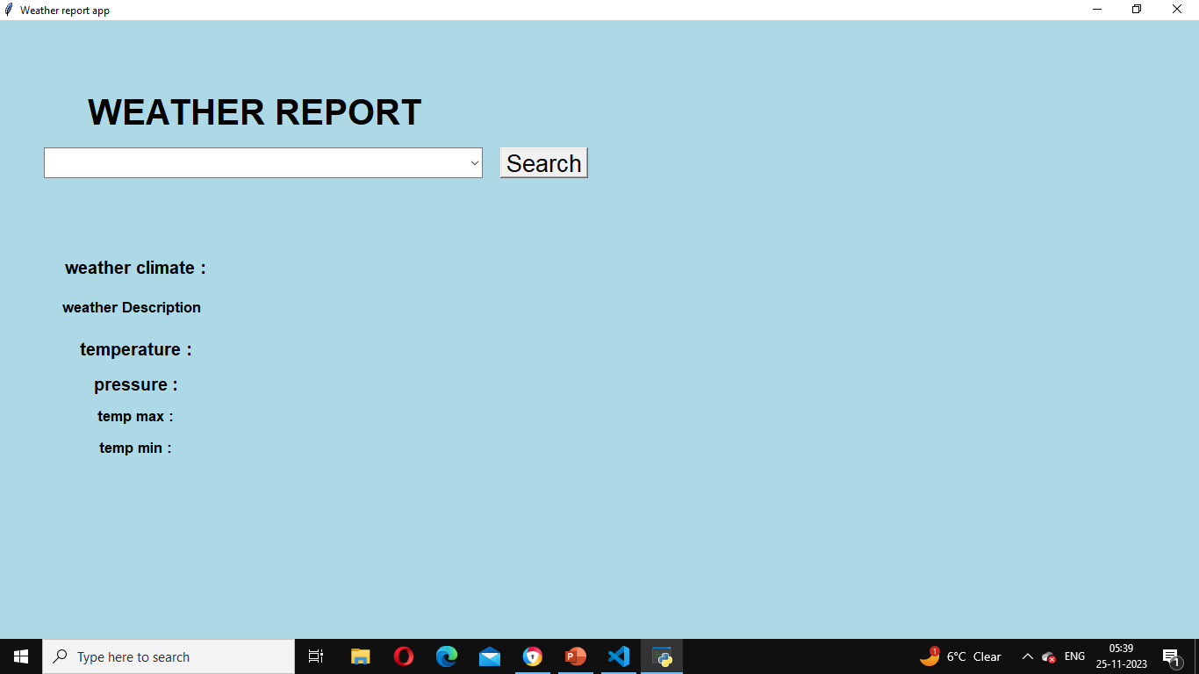
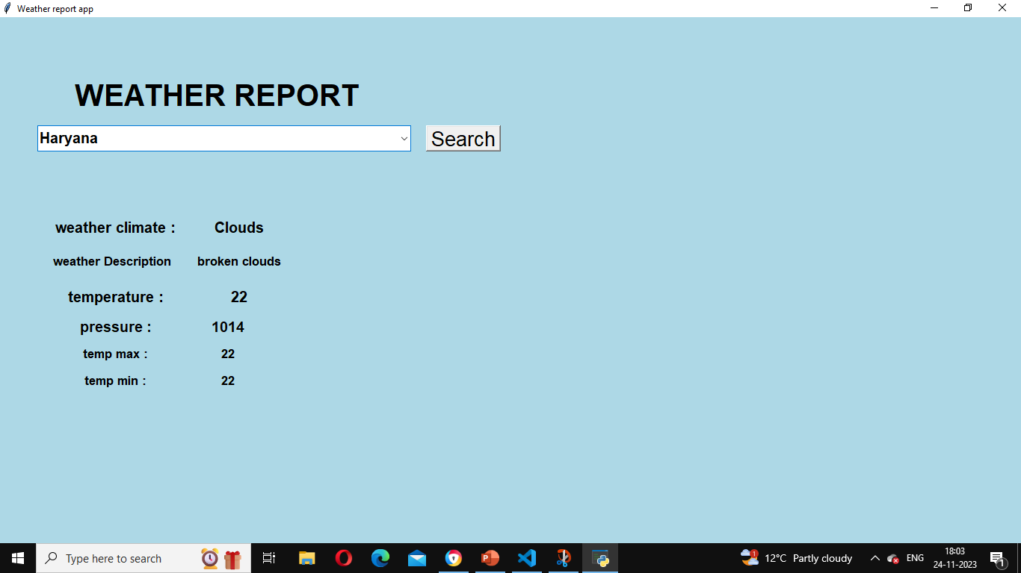
OUTPUT

Slide 9
CONCLUSION
Weather is apart of our everyday lives and we need to track of it so we can acclimate to its changes . We can keep track of weather using the different weather instruments.

Slide 10
THANK
YOU

