Slide 1

Software Development
Group 3 ETT

Slide 2
Outline
Problem Description
Implementation of the solution
Quality of the solution
Demo
Evaluation of the development process

Slide 3
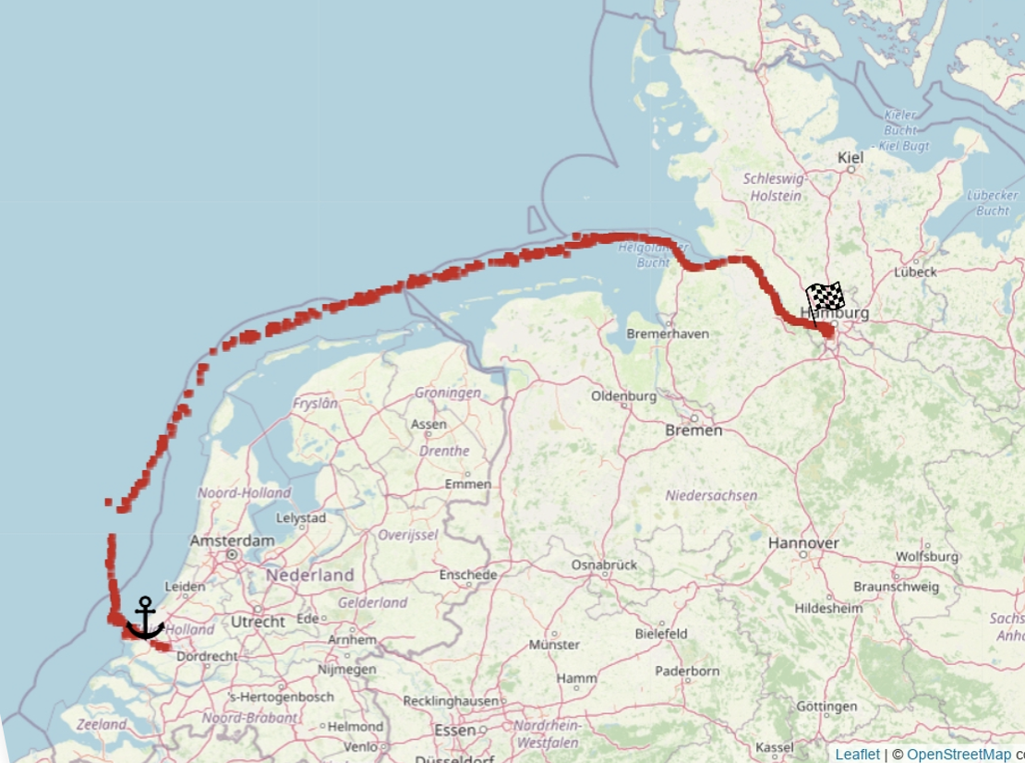
Problem Description
Estimate the travel time (ETT) of a vessel
Make use of historical data
Break down a complex problem into smaller local ones
Two routes: - Rotterdam - Hamburg
- Kiel - Gdynia

Slide 4
Implementation
Setting up the Development Infrastructure
Create Development Infrastructure in Gitlab
Implement CI/CD pipeline
Data Cleaning and Method Selection
Clean Data using Weka and Jupyter notebooks
Testing and selecting most reasonable features
Testing several algorithms in Weka (linear regression, nearest neighbour, decision trees, ANN)
ML method | Correlation Coefficient | Root relative squared error
Linear Regression | 0.4953 | 86.874 %
Nearest Neighbour | 0.9378 | 35.0515 %
Decision Trees | 0.989 | 14.8218 %
ANN | 0.7995 | 61.4141 %
Notes:
Data cleaning for the for the ML Algorithm

Slide 5
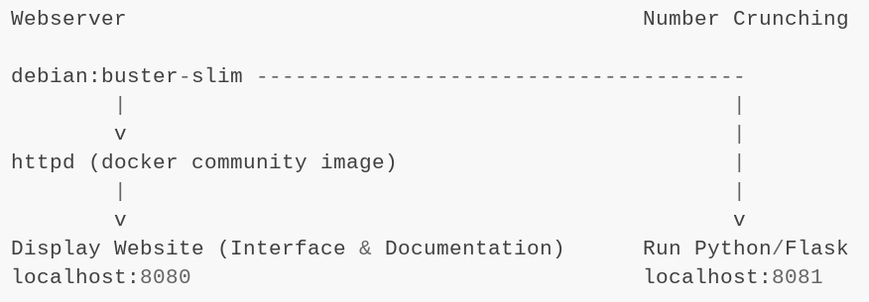
Implementation
Docker
To enable platform independent deployment
Make use of community-made images to increase development speed.

Slide 6
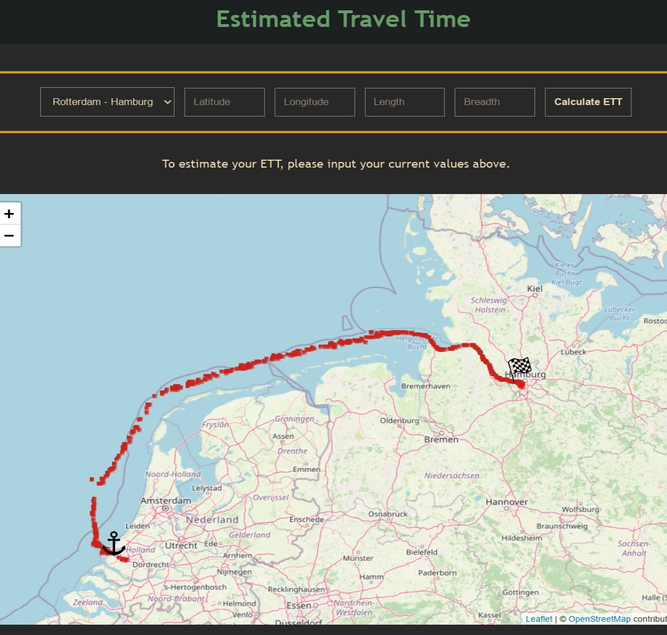
Implementation
Frontend
Website with OSM Integration
Unique random historical data Points for Visualization of Route
Backend
Python/Flask Server
Path Parameters to ensure data integrity
Trained decision tree models saved to Pickle files to ensure a quick response

Slide 7
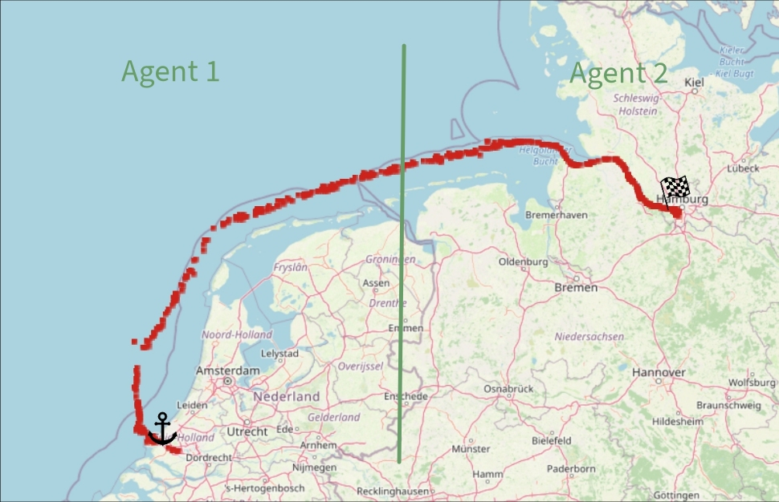
Implementation
Predictor Agent
Split the routes into two parts
Implement agent for each part
Broker combines the results of the agents
Missing
Using ML in order to predict the input of agent 2

Slide 8
Demo

Slide 9
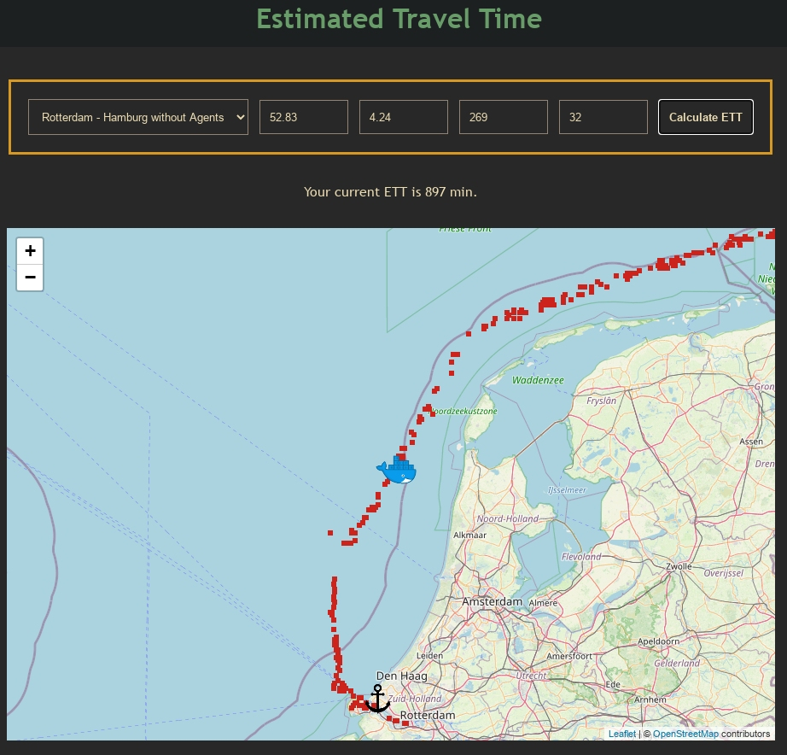
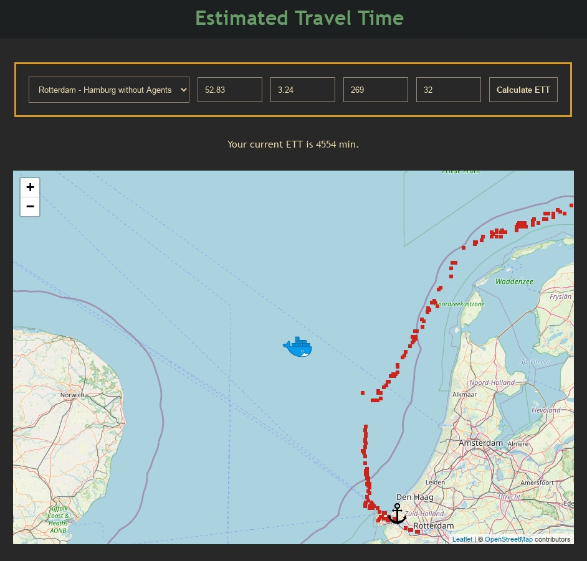
Quality of Solution

Slide 10
Quality of Solution
 | Agents | No Agents | Actual Travel Time | Accuracy with Agents | Accurracy without Agents
Kiel-Gdynia | 1543 min | 1744 min | 1739 min | 0.957 (Agent 1) 0.871 (Agent 2) | 0.723
Rotterdam-Hamburg | 1204 min | 897 min | 898 min | 0.874 (Agent 1) 0.774 (Agent 2) | 0.604
Conclusion
Model is adjusted to the routes -> Deviations lead to bad results
Model works more accurately without agents

Slide 11
Evaluation of the development process SCRUM
Good
Team work
Team members supported each other
Communication
Sprint plans were detailed and helped to work efficiently
Dailies
Fair
Assigning Tasks, got better with time
Punctuality

Slide 12
Sources
The Photo on the first slide by an unknown author is licensed under CC BY-SA.
Colorscheme gruvbox by morhetz “https://github.com/morhetz/gruvbox” licensed under MIT.

