Slide 1
Planning the Computer Program
Problem Solving
The most important skill of a computer programmer is problem solving
problem solving means – Ability to formulate problems(problem definition)
- Think creatively about solution
- Express solution clearly and accurately
The vehicle for computer solution to a problem is a set of unambiguous instructions expressed in a programming language
This set of instructions is called a program
A program must be planned before they are written

Slide 2
Programs:
Set of instructions expressed in any programming Language (C,C++,JAVA,VB,J2EE,.NET etc.,)
A program is the expression of an algorithm in a programming language.
Data structure:
A data structure is a way to store and organize data in order to facilitate access and modifications.
Program=Algorithm + Data structure

Slide 3
Planning or designing a computer program can be done by using tools -
§ Algorithm
§ Pseudocode
§ Flowchart
Algorithm
“Algorithm is any well-defined computational procedure or steps that takes some value, or set of values, as input and produces some value, or set of values, as output.
Step by step procedure for solving a problem
Solution to a problem that is independent of any Programming language
Correct algorithm halts with the correct output for every input instance
When an algorithm is represented in the form of a programming language, it becomes a program

Slide 4
Algorithm criteria:
All algorithms must satisfy the following criteria:
1) Input
2) Output
3) Definiteness
4) Finiteness
5) Effectiveness.
For example : sorting problem
Input: A sequence of n numbers 31, 41, 59, 26, 41, 58
Output: Reordering of the input sequence26, 31, 41, 41, 58, 59
Definiteness: Sorting Technique
Finiteness: Procedure for proper concerns
Effectiveness: High Throughput
.

Slide 5
Expressing Algorithms:
English description
Pseudo-code
Pseudo-code:
A program planning tool where program logic is written in an ordinary natural language using a structure that resembles computer instructions
“ Pseudo” means imitation or copy and “ Code” refers to the instructions written in a programming language. Hence, pseudocode is an imitation of actual computer instructions
Like a programming language but its rules are less
Written as a combination of English and programming constructs
Based on selection (if, switch) and iteration (while, repeat) constructs in high-level programming languages
Independent of actual programming language

Slide 6
Flowchart
Flowchart is a pictorial representation of an algorithm
Uses symbols (boxes of different shapes) that have standardized meanings to denote different types of instructions
Actual instructions are written within the boxes
Boxes are connected by solid lines having arrow marks to indicate the exact sequence in which the instructions are to be executed
Process of drawing a flowchart for an algorithm is called flowcharting
Basic symbols used to draw flowcharts

Slide 7
The Problem-Solving aspect:
Requirements for solving problems by computer
Algorithm
Data Structure
Programming Language
Problem
Algorithm & Programming Language with data structure
“computer”
input
output

Slide 8
The Problem solving aspect phases:
Problem definition phase
Getting started on a problem
The use of specific examples
Similarities among problems
Working backwards from the solution
General problem solving strategies
1. Problem Definition Phase:
Understand the problem
Work out what must be done rather than how to do it
That is, we must try to extract from problem statement a set of precisely defined tasks
Lot of care must be taken in working out what must be done
Example :
Finding the roots of quadratic equation
Finding the greatest common divisor
From the definition develop an algorithm

Slide 9
2.Getting started on a problem
There may be many ways to solve the problem and also many solutions to most problems.
Gather more detail about problem
In this step, it is advised not to go in detail of implementation before they have completely understood or worked out for solution
3.The use of specific examples
Use some properties to try to get a solution for the problem
Example : Find out the maximum number from the given set of numbers – choose particular set of numbers and work out for finding the maximum in this set
Use some geometrical or schematic diagrams representing certain aspects of the problem

Slide 10
4. Similarities among problems:
See if there are any similarities between the current problem and other problems that we have solved or we have seen solved
Try to solve the problem independently
5. Working backwards from the solution
If we do not know where to start on a problem,
We can work backwards to the starting conditions (if the expected result and initial conditions are known)
Whatever attempts that we make to get started on a problem write down the various steps and explorations we made
Once we have solved a problem we must remember the steps that we went about discovering the solution
The most important thing in developing problem-solving skills is practice

Slide 11
6.General Problem solving strategies:
There are number of general and powerful computational strategies :
Divide and Conquer
Binary doubling
Dynamic programming
Backtracking
Branch and Bound
Greedy method
Divide and Conquer:
It is defined as one large complex problem is divided into number of subproblems and find the solution. The subproblem solutions are combine to form the solution for large problem.
Example: Merge sort algorithm
Binary doubling:
convert the binary numbers to decimal numbers
Example:: 1→1,10→2,11→3,100→4,1000→8

Slide 12
Dynamic programming:
Dynamic programming is an algorithm that can be used when the solution to a problem can be viewed as the result of a sequence of intermediate steps.
Example: TRAVELING SALESMAN PROBLEM
Backtracking: During the search if infeasible solution is sensed then backtrack to previous node.
Example: 8-queens problem
Branch and Bound:
Branch- splitting procedure
Bound- computes upper and lower bounds
Example: Knapsack problem
Greedy method: Find the feasible solution from the set of solution for the given problem
Example: job scheduling

Slide 13
Structured programming
Any program logic can be expressed by using only following three simple logic structures:
1. Sequence logic,
2. Selection logic, and
3. Iteration (or looping) logic
Programs structured by using these three logic structures are called structured programs, and the technique of writing such programs is known as structured programming

Slide 14
Sequence Logic
It is used for performing instructions one after another in sequence.
Ex:
Selection Logic
Also known as decision logic, it is used for making decisions
Three popularly used selection logic structures are
1. IF...THEN : Ex:
2. IF...THEN...ELSE : Ex:
3. CASE : Ex:
Iteration (or Looping) Logic
Used to produce loops in program logic when one or more instructions may be executed several times depending on some conditions
Two popularly used iteration logic structures are
1. WHILE : Ex:
2. REPEAT...UNTIL : Ex:

Slide 15
Installing or updating Python on your system is the first step to becoming a Python developer.
There are many ways you can get started with setup and installation: you can download official Python distributions from Python.org,
install from a package manager(Anaconda), and even install specialized distributions for scientific computing, Internet of Things, and embedded systems.

Slide 16
Check if you already have Python installed
You might ask, How to Check Your Python Version on Windows?
You can check in the command-line application, such as PowerShell
Tip: Here’s how you open PowerShell:
Press the ⊞ Win key.
Type PowerShell or cmd.
Press Enter

Slide 17
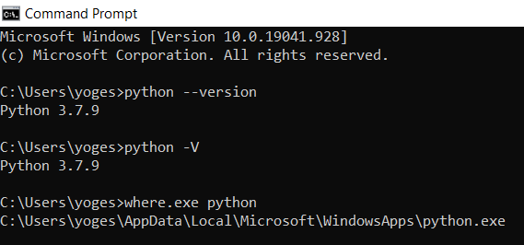

Slide 18
Install Python — Full Installer
Step 1: Select Version of Python to download Full Installer and install
The most stable Windows downloads are available from the Python for Windows page. On Windows, you have a choice between 32-bit (labeled x86) and 64-bit (labeled x86–64) versions, and several flavors of the installer for each. Underneath the Python Releases for Windows find the Latest Python 3 Release — Python 3.9.4

Slide 19
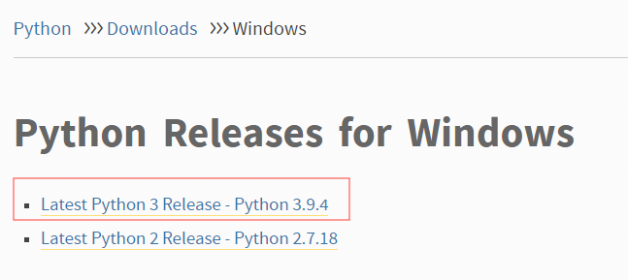

Slide 20
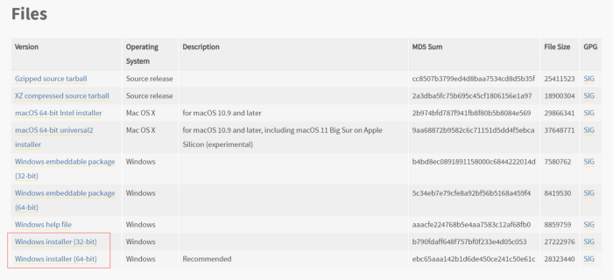

Slide 21
Step 2: Download Python Executable Installer and install it
Double-click the executable file, which is downloaded; the following window will open. Select Customize installation and proceed. Click on the Add Path check box, it will set the Python path automatically.
Run the Python Installer once downloaded. (In this example, we have downloaded Python 3.9.4)
Make sure you select the “Install launcher for all users” and “Add Python 3.9 to PATH” checkboxes.
Select Install Now — the recommended installation options.

Slide 22
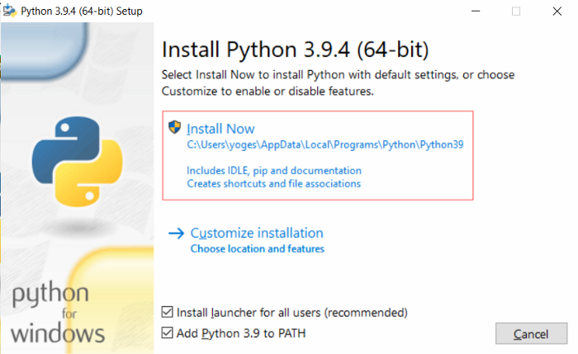

Slide 23
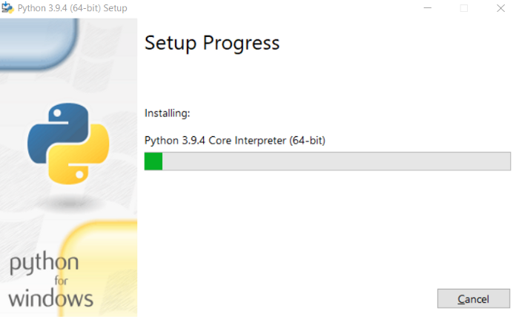

Slide 24
Step 4: Verification of installation of python in Windows
To check if Python 3.9.4 has been successfully installed in our system,
Open Cmd prompt in your system
Run “ Python --Version”

Slide 25
Step 5: Run python
Python has been installed in your system, Now go to
Windows search
Type IDLE
Open it.
Run your First Python code

Slide 26
