Slide 1
Database Management System
©w3resource

Slide 2
Introduction
► What is data?
Data is stored facts.
It can be numbers, words, measurements, observations or even just descriptions of things.
Example : Each student's test score is one piece of data.
► What is information?
Information is that which informs, i.e. that from which data can be derived.
Information is conveyed either as the content of a message or through direct or indirect observation of something.
Example : The average score of a particular subject is the information that can be concluded from the given data.
©w3resource

Slide 3
What is Database?
Stores organized information
Data are extracted from information
Knowledge is derived from data
©w3resource

Slide 4
What kind of data ?
Banking
Transport (Railways, Airlines)
University, Libraries
Online stores, supermarket
Finance
Manufacturing (production, inventory, orders, supply chain)
Telecommunication
Sales (customers, products, purchase)
► Enterprise data
► Recent data
Scientific data
Biological data
Semi structured data (XML)
Network data
©w3resource

Slide 5
What is Database Management System (DBMS)?
Collection of interrelated data
Provides an environment that is both convenient and efficient to use
Set of programs to store, update data
Answer queries about the data
Manages very large amounts of data
Supports concurrent access to large amounts of data
Supports secure, atomic access to large amounts of data
©w3resource

Slide 6
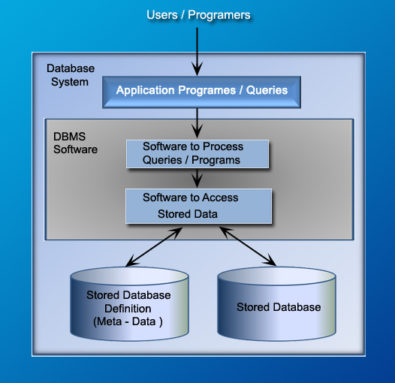
A simplified Database system environment
©w3resource

Slide 7
History of DBMS
1960 – First DBMS designed by Charles Bachman at GE.
1970 – Codd introduced relational DBMS.
1980 – Relational model became popular and accepted as the main database paradigm. SQL, ANSI SQL etc.
1980 – object-oriented
2000 – NoSQL and NewSQL
©w3resource

Slide 8
Why use a DBMS?
Data independence and efficient access
Controlling redundancy
Enforcing integrity constraint
Providing multiple user interfaces
Restricting unauthorized access
Uniform data administration
Increased productivity of application development
Providing backup and recovery
©w3resource

Slide 9
Example of DBMS
Microsoft SQL Server, Access
Oracle
IBM - DB2, Informix
Sybase
MySQL
PostgreSQL
SQLite
Firebird
©w3resource

Slide 10
Data abstraction
► The major purpose of a database system is to provide users with an abstract view of the system.
► System hides certain details of how the data is stored, created and maintained.
► It gives an architecture to separate the user applications and the physical database.
©w3resource

Slide 11
Levels of data abstraction
Physical level : The lowest level of abstraction describes how the data are actually stored, e.g. index, B-tree, hashing.
Logical level : The logical level describes data properties such as data semantics, relationships among data.
View level : The highest level of abstraction describes only part of the entire database, e.g. ATM in a bank get a view of customer balance, but not of transaction data.
©w3resource

Slide 12
View of Data
► An architecture of a database system
View Level
view - 1
view - 2
view - n
Logical
Level
Physical
Level
©w3resource

Slide 13
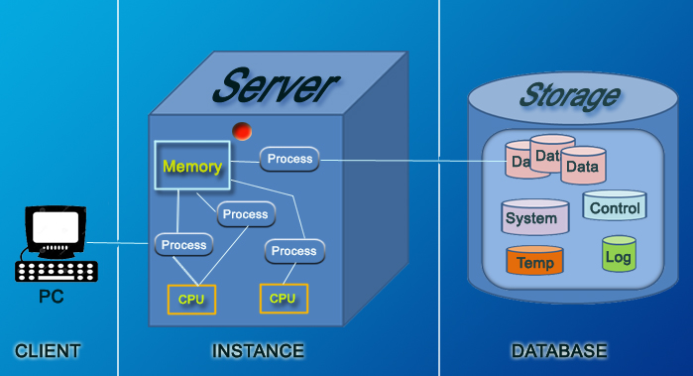
Instances
Capture the current state of data
Time dependent
Only one exit at any given time
©w3resource

Slide 14
Three schema approach
► The overall design of the database is called the database schema.
The three-schema approach, or the Three Schema Concept is an approach to build information systems and systems information management from 1970s. It proposes to use following types of schemas.
External Schema
Conceptual Schema
Internal Schema
©w3resource

Slide 15
Three schema approach
External Schema
The user’s view of the database.
Describes a subset of the database that a particular user group is interested in, according to the format user wants, and hides the rest.
May contain virtual data that is derived from the ﬁles, but is not explicitly stored.
©w3resource

Slide 16
Three schema approach
Conceptual Schema
The logical structure of the entire database as seen by DBA.
Hides the details of physical storage structures.
Concentrates on describing entities, data types, relationships, operations, and constraints.
©w3resource

Slide 17
Three schema approach
Internal Schema
Physical representation of the DB on the computer.
Describes the database design at the physical level, which is the lowest level of abstraction describing how the data are actually stored.
Physical implementation of the DB to achieve optimal runtime performance and storage space utilization.
©w3resource

Slide 18
The three schema architecture
End Users
External
View
External
View
Conceptual Schema
Internal Schema
Stored Database
©w3resource

Slide 19
Data Independence
► The main advantage of three-schema architecture is that it provides data independence. Data independence is the ability to change the schema at one level of the database system without having to change the schema at the other levels. There are two types of data independence :
Logical data independence
Physical data independence
©w3resource

Slide 20
Data Independence
Logical data independence
It has ability to change the conceptual schema without having to change external schema or application programs.
Example: Student (ID, Name, Class, Section)
A view including only ID and Name is not affected by changes in any other
attributes.
©w3resource

Slide 21
Data Independence
Physical data independence
It has the ability to change the internal schema without affecting the conceptual or external schema.
An internal schema may change to improve the performance, i.e. creating additional access structure.
Easier to achieve logical data independence, because application programs are dependent on logical structures.
©w3resource

Slide 22
Data Models
The way in which information (describing data, data relationships, data semantics and data constraints) is subdivided and managed within a database is referred to as the data model used by the DBMS. Each DBMS is based on a particular data model.
©w3resource

Slide 23
Why data models are important ?
Different views (designers, programmers, and end users) of same data lead to designs that do not reflect organization’s operation
Data modeling reduces complexities of database and help to create a sound database design
It helps to create database tables that do not contain duplicate data values that can become inconsistent
©w3resource

Slide 24
Types of Data Models
► Data models can be classified into three major groups. They are :
Object-based Logical Models
Record-based Logical Models
Physical Data Model
©w3resource

Slide 25
Object-based Logical Models
©w3resource

Slide 26
Object-based Logical Models
► These models are a collection of conceptual tools for describing data, data relationships, data semantics and data constraints. The following are the well known models in this group :
Entity-relationship model
Object-oriented model
Semantic model
Functional model
©w3resource

Slide 27
Entity-relationship Model
(Object-based Logical Models)
©w3resource

Slide 28
Entity-relationship model
It is based on simulation of the real world which consists of basic objects called entities and relationship among these objects.
The overall logical data structure of a database can be expressed graphically by an E-R diagram. Which consists of rectangle (entity), ellipse (attribute), diamond (relationship), and lines.
©w3resource

Slide 29
Entity, Attributes, Relationship
► Entity : An entity is an object, place, person, concept, activity about which an enterprise records data.
► Attributes : Attributes are data elements that describe an entity.
Entity | Attributes
Customer | Name, Address, Status
Book | ISBN, Title, Author, Price
Examples :
► Relationship : Relationship is an association between entities.
STUDENT
ENROLLS IN
COURSE
©w3resource

Slide 30
Graphical notation of E - R diagram
NAME
SYMBOL
FUNCTION
-Data in the system
-Uniquely identifiable by identifier
-Has attributes that describe it
Entity
Attribute
Describe an entity
-Relates two entities
-Uniquely identifiable by the identifier
Relationship
©w3resource

Slide 31
Degree of Relationship (E-R Model)
► The degree of relationship is the number of occurrences in one entity which are associated to the number of occurrences in another. It is also called Cardinality. There are three degrees of relationship, known as:
One to One (1 : 1)
One to Many (1 : N)
Many to Many (M : M)
©w3resource

Slide 32
One to One Relationship : (1 : 1 )
(E-R Model)
1
1
ORDER
REQUISITION
RAISES
PURCHASE
ORDER
One Order Requisition raises one purchase order.
One purchase order is raised by one order requisition.
©w3resource

Slide 33
One to Many Relationship : (1 : N)
(E-R Model)
N
1
EMPLOYEE
WORKS IN
DEPARTMENT
One employee works in at most one department.
One Department can have many employees.
©w3resource

Slide 34
Many to Many Relationship : (M : N)
(E-R Model)
M
N
ORDER
CONTAINS
ITEM
One order may contain many items.
One item can be contained in many orders.
©w3resource

Slide 35
Object-oriented model
(Object-based Logical Models)
©w3resource

Slide 36
Object-oriented Models
► In object oriented data model both data and their relationship are contained in a single structure known as an object.
An object contains values stored in instance variables within the object.
Unlike the record-oriented models, these values are themselves objects.
An object also contains bodies of code that operate on the the object.
These bodies of code are called methods.
Objects that contain the same types of values and behavior (methods) are grouped into classes.
Internal parts of the object, the instance variables and method code, are not visible externally.
Result is two levels of data abstraction.
©w3resource

Slide 37
Object-oriented Models
State, Behavior, Identity
► State : attribute types and values
► Behavior : how an object acts and reacts
- Behavior is expressed through operations that can be performed on it
► Identity : every object has a unique identity, even if all of its attribute values are the same
©w3resource

Slide 38
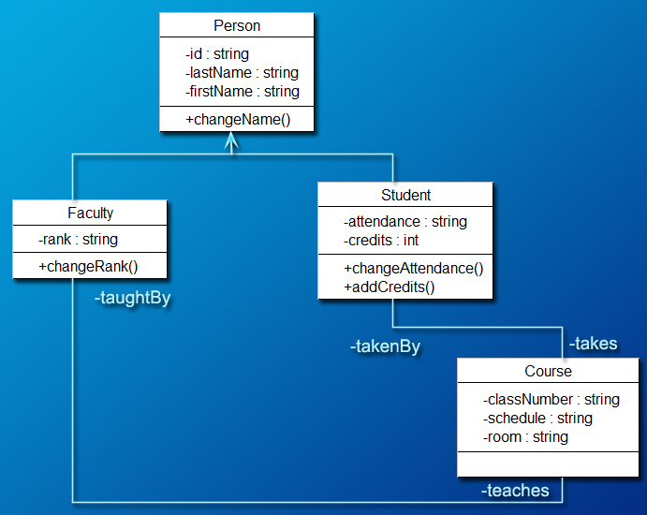
Example: Object-oriented Models
©w3resource

Slide 39
Semantic Model
(Object-based Logical Models)
©w3resource

Slide 40
Semantic Model
The Semantic Data Model (SDM), like other data models, is a way of structuring data to represent it in a logical way.
It focuses on providing more meaning of the data itself, rather than solely or primarily on the relationships and attributes of the data.
It provides a high-level understanding of the data by abstracting it further away from the physical aspects of data storage.
In SDM, an entity represents some aspect or item in the real world, such as an employee.
An entity is akin to a record in a relational system or an object in an object-oriented system.
These entities in SDM focus on types, which are more general, instead of sets of data.
In SDM, an entity is a very basic notion of a real-world or conceptual object that is defined by a single attribute.
©w3resource

Slide 41
Functional Model
(Object-based Logical Models)
©w3resource

Slide 42
Functional Model
The functional data model provides an unified approach to manipulation both data and procedures.
The functional data model is a definition of all components of an information system in the form of functions.
For example, the functional data model defines data objects, attributes and relationships as so-called database functions.
A Functional Data Manipulation Language is a number of data manipulation functions which can be applied to database functions.
©w3resource

Slide 43
Record-based Logical Model
©w3resource

Slide 44
Record-based Logical Models
Named so because the database is structured in fixed-format records of several types
Each record type denes a fixed number of fields or attributes and each field is usually of a fixed length
The use of fixed-length records simplifies the physical level implementation of the database
The relational model has established itself as the primary data model for commercial data processing applications
The first database systems were based on either the network model or the hierarchical model both of which are tied more closely to the underlying implementation of the database and are now decreasing in importance and real world use
©w3resource

Slide 45
Record-based Logical Models
► Continued from previous slide
Record-based models do not include a mechanism for direct representation of code in the database
Separate languages associated with the model are used to express database queries and updates
The three most widely-accepted models are the network, hierarchical and relational
©w3resource

Slide 46
Network Model
(Record-based Logical Models)
©w3resource

Slide 47
Network Model
A network database consists of a collection of records
Relationships among data are represented by links.
A record is in many respects similar to an entity in the E-R model
Each record is a collection of ﬁelds (attributes), each of which contains only one data value.
A link is an association between precisely two records.
Organization is that of an arbitrary graph.
©w3resource

Slide 48
Network Model
► Advantages
Flexible, fast, efficient
► Disadvantages
Complex
Restructuring can be difficult because of changing all the pointers
©w3resource

Slide 49
Network Model
(Database systems)
► Following database systems use the network model
Integrated Data Store (IDS)
IDMS (Integrated Database Management System)
RDM Embedded
RDM Server
TurboIMAGE
Univac DMS-1100
©w3resource

Slide 50
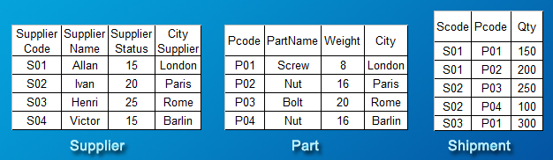
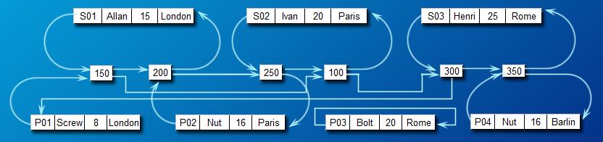
Network data Model
©w3resource

Slide 51
Hierarchical Model
(Record-based Logical Models)
©w3resource

Slide 52
Hierarchical Model
The hierarchical data model organizes data in a tree structure, rather than arbitrary graphs
There is a hierarchy of parent and child data segments
This structure implies that a record can have repeating information, generally in the child data segments
Data in a series of records, which have a set of field values attached to it
It collects all the instances of a specific record together as a record type
These record types are the equivalent of tables in the relational model and with the individual records being the equivalent of rows
To create links between these record types, the hierarchical model uses Parent Child Relationships
©w3resource

Slide 53
Hierarchical Model
► Advantages
Easy to search
Add new branches easily
► Disadvantages
Must establish the types of search prior to development of the hierarchical structure
©w3resource

Slide 54
Hierarchical Model
(Database systems)
► Currently following are the most widely used hierarchical database
IMS developed by IBM
Windows Registry by Microsoft
©w3resource

Slide 55
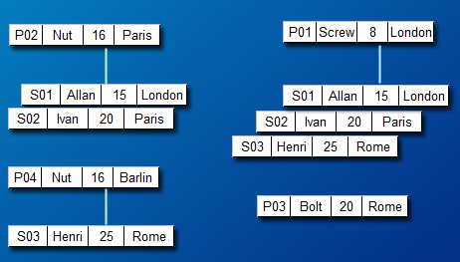
Hierarchical data Model
©w3resource

Slide 56
Database Normalization
©w3resource

Slide 57
Database Normalization
► Database normalization is a process to refine the data model built by the Entity-Relationship diagram and organizes the fields and tables of a relational database to minimize redundancy. Normalization usually involves dividing large tables into smaller (and less redundant) tables and defining relationships between them. The objective is to isolate data so that additions, deletions, and modifications of a field can be made in just one table and then propagated through the rest of the database using the defined relationships.
► Edgar F. Codd, the inventor of the relational model, introduced the concept of normalization and what we now know as the First Normal Form (1NF) in 1970.
©w3resource

Slide 58
Need for Normalization
Improve database design.
Ensures minimum redundancy of data
Reduces need to reorganize data when design is modified.
Reduce anomalies for database activities.
©w3resource

Slide 59
Steps in Normalization
► There are three steps in Normalization.
First Normal Form ( 1 NF )
Second Normal Form ( 2 NF )
Third Normal Form ( 3 NF )
©w3resource

Slide 60
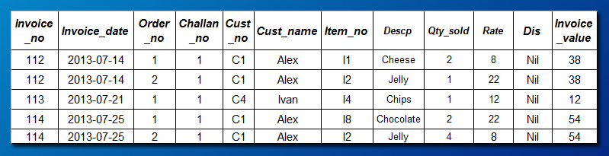
Unnormalized raw table
Example (invoice data)
©w3resource

Slide 61
First Normal Form (1 NF)
Identify repeating groups of fields.
Remove repeating groups of fields.
Identify the keys for the tables.
Key of parent tables is brought as part of the concatenated key of the second table
©w3resource

Slide 62
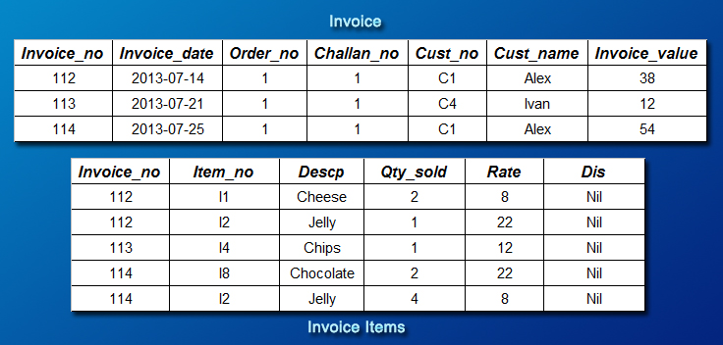
Example : First Normal Form (1 NF)
©w3resource

Slide 63
Second Normal Form (2 NF)
Check if all fields are dependent on the whole key
Remove fields that depend on part of the key
Group partially-dependent fields as separate table
Name the tables
Identify key(s) to the table
©w3resource

Slide 64
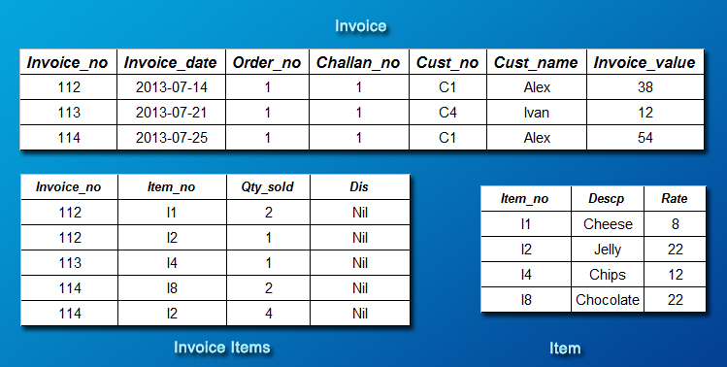
Example : Second Normal Form (2 NF)
©w3resource

Slide 65
Third Normal Form (3 NF)
Remove fields that
-- depend on other non-key fields
-- can be calculated or derived from logic
Group interdependent fields as separate tables, identify the key and name the table
©w3resource

Slide 66
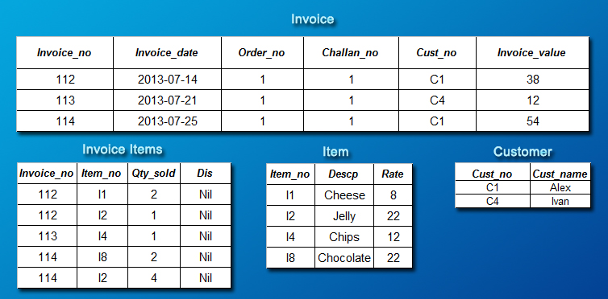
Example : Third Normal Form (3 NF)
©w3resource

Slide 67
Relational Model
(Record-based Logical Models)
©w3resource

Slide 68
Relational Model
Data is organized in terms of rows and columns in a table known as relation.
The position of a row in a table is of no importance.
The intersection of a row and column must give a single value.
All values appearing in the columns must give a single value.
Row must be unique.
Column Names must be unique.
All column values are atomic.
©w3resource

Slide 69
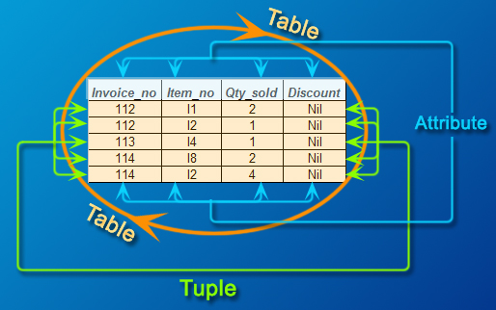
Relational database model
Fields ( columns ) in the table store attributes.
Each attribute has a specific domain.
Tuples ( or records or rows ) in the table store information.
Each tuple is a unique instance of an object.
Tables are composed of a set of tuples.
A table is also called a relation.
©w3resource

Slide 70
Relational database Term
Table
A collection of relevant data relating to one type of real world objects.
Column
A specific place for one type of data relating to one type of real world objects.
Domain
Set of all possible values for a specific column.
Row
Collection of data describing one real world object.
Primary Key
Columns, which are part of the row and uniquely identify any one row.
©w3resource

Slide 71
Relational database model (records)
Each record represents a logical entity (e.g. an invoice).
Each field represents an attribute of the logical entity.
invoice Table
Invoice_no | Invoice_date | Order_no | Challan_no | Cust_no | Cust_name | Invoice_value
112 | 2013-07-14 | 1 | 1 | C1 | Alex | 38
113 | 2013-07-21 | 1 | 1 | C4 | Ivan | 12
114 | 2013-07-25 | 1 | 1 | C1 | Alex | 54
©w3resource

Slide 72
Relational database model (key)
Each table has a primary key ( one field or a combination of fields) that has a unique value for each and every record in the table.
invoice Table
invoice_no is the primary key in this table(cust_name may be changed within the invoice).
Invoice_no | Invoice_date | Order_no | Challan_no | Cust_no | Cust_name | Invoice_value
112 | 2013-07-14 | 1 | 1 | C1 | Alex | 38
113 | 2013-07-21 | 1 | 1 | C4 | Ivan | 12
114 | 2013-07-25 | 1 | 1 | C1 | Alex | 54
©w3resource

Slide 73
Relational database model (relating tables)
Table can be related (joined) together based on their keys.
The idea is to decompose into separate tables with no redundancy and to provide a capability to reassemble with no information loss.
invoice Table
invoice_item Table
Invoice_no | Invoice_date | Order_no | Challan_no | Cust_no | Cust_name | Invoice_value
112 | 2013-07-14 | 1 | 1 | C1 | Alex | 38
113 | 2013-07-21 | 1 | 1 | C4 | Ivan | 12
114 | 2013-07-25 | 1 | 1 | C1 | Alex | 54
Invoice_no | Item_no | Qty_sold | Discount
112 | I1 | 2 | Nil
112 | I2 | 1 | Nil
113 | I4 | 1 | Nil
114 | I8 | 2 | Nil
114 | I2 | 4 | Nil
©w3resource

Slide 74
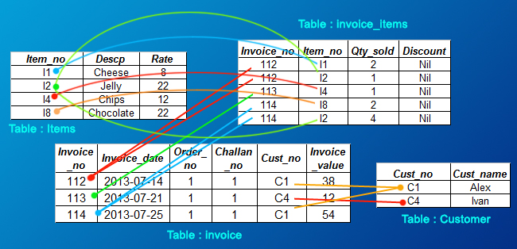
Relational database model (relating tables)
©w3resource

Slide 75
Properties of Relational Database
Represent data in the form of tables.
No hard-code relationship between tables.
Doesn’t require the user to understand the physical implementation.
Provides information about its content and structure in system table.
Supports the concept of NULL values
©w3resource

Slide 76
Codd’s 12 Rules for an RDBMS
Dr. Edgar Frank Codd (August 19, 1923 – April 18, 2003) was an computer scientist, while working for IBM he invented the relational model for database management ( theoretical basis for relational databases). Codd proposed thirteen rules (numbered zero to twelve) and said that if a Database Management System meets these rules, it can be called as a Relational Database Management System. These rules are called as Codd's 12 rules. Hardly any commercial product follows all.
Rule Zero : The system must qualify as relational, as a database, and as a management system. For a system to qualify as a relational database management system (RDBMS), that system must use its relational facilities (exclusively) to manage the database.
The other 12 rules derive from this rule. The rules are as follows :
©w3resource

Slide 77
Codd’s 12 Rules for an RDBMS
Rule 1 : The information rule
Rule 2 : The guaranteed access rule
Rule 3 : Systematic treatment of null values
Rule 4 : Active online catalog based on the relational model
Rule 5 : The comprehensive data sublanguage rule
Rule 6 : The view updating rule
Rule 7 : High-level insert, update, and delete
Rule 8 : Physical data independence
Rule 9 : Logical data independence
Rule 10 : Integrity independence
Rule 11 : Distribution independence
Rule 12: The non subversion rule
©w3resource

Slide 78
DBMS Languages
©w3resource

Slide 79
DBMS Language
► Data Definition Language (DDL)
► Storage Definition Language (SDL)
► View Definition Language (VDL)
► Data Manipulation Language (DML)
©w3resource

Slide 80
Data Definition Language (DDL)
©w3resource

Slide 81
Data Definition Language (DDL)
A DDL is a language used to define data structures within a database.
Basic idea : Hide implementation details of the database schemes from the users.
DDL statements are compiled, resulting in a set of tables stored in a special file called a data dictionary or data directory.
The data directory contains metadata (data about data)
It is typically considered to be a subset of SQL, but can also refer to languages that define other types of data.
The DDL concept and name was first introduced in relation to the Codasyl database model, where the schema of the database was written in a language syntax describing the records, fields, and sets of the user data model.
©w3resource

Slide 82
Data Definition Language (DDL)
► SQL DDL allows the specification of a set of relations and about each relation :
Schema of each relation
Domain of values of associated with each attribute
Integrity constraints
Set of indices for each relation
Physical storage of each relation on the disk
©w3resource

Slide 83
Data Definition Language (DDL)
► Data types (Domain types) in standard SQL-92
char(n) is fixed-length character string. character is equivalent.
varchar(n) is a variable-length character of a user-specified maximum of n.
int is an integer (machine-dependent). integer is equivalent.
numeric(p,d) is a fixed-point number with user-specified precision of pdigits and ddigits after the decimal point.
real, double precision are floating point and double-precision numbers, with machine-dependent precision.
float(n) is a floating point number, with user-specified precision of at least n precision.
date is a calendar date, containing a (four-digit) year, month, and day of the month.
time is the time of day, in hours, minutes, and seconds.
©w3resource

Slide 84
Data Definition Language (DDL)
► Here are some examples of Data Definition Language (DDL) statements which are used to define the database structure or schema.
CREATE - to create objects in the database
ALTER - alters the structure of the database
DROP - delete objects from the database
©w3resource

Slide 85
Storage Definition Language (SDL)
©w3resource

Slide 86
Storage Definition Language (SDL)
► Specifies internal schema
Physical structure
Bytes per field
Order of fields
Sorting
Access (hash, B-tree)
File structure
Mixed records etc.
► Some DBMSs have no distinction between these schemas and thus the DDL and the SDL are the same
©w3resource

Slide 87
View Definition Language (VDL)
©w3resource

Slide 88
View Definition Language (VDL)
► Specifies external schemas (in DBMSs where this level exists)
Define Subsets of records available to classes of user.
Create “virtual tables” from base table.
View appears to user like conceptual level.
©w3resource

Slide 89
Data Manipulation Language (DML)
©w3resource

Slide 90
Data Manipulation Language (DML)
Data Manipulation is retrieval, insertion, deletion, modification of information in the database
A DML is a language which enables users to access and manipulate data.
A popular data manipulation language is that of Structured Query Language (SQL), which is used to retrieve and manipulate data in a relational database
The DDL concept and name was first introduced in relation to the Codasyl database model, where the schema of the database was written in a language syntax describing the records, fields, and sets of the user data model.
©w3resource

Slide 91
Data Manipulation Language (DML)
► Here are some examples of Data Manipulation Language (DML) statements which are used for managing data within schema objects.
INSERT - insert data into a table
UPDATE - updates existing data within a table
DELETE - deletes all records from a table, the space for the records remain
©w3resource

Slide 92
Database Manager
©w3resource

Slide 93
Database Manager
► The database manager is a program module which provides the interface between the low-level data stored in the database and the application programs and queries submitted to the system.
©w3resource

Slide 94
Responsibility of Database Manager
Interaction with the file manager : Storing raw data on disk using the file system. The database manager must translate DML statements into low-level file system commands for storing, retrieving and updating data in the database.
Integrity enforcement: Checking that updates in the database do not violate consistency constraints (e.g. no bank account balance below $50)
Security enforcement: Ensuring that users only have access to information they are permitted to see
Concurrency control: Preserving data consistency when there are concurrent users.
©w3resource

Slide 95
Database Administrator
©w3resource

Slide 96
Database Administrator
► The database administrator (also known as a database administration manager, data architect, or information center manager) is a person having central control over data and programs accessing that data. In order to perform its duties, the database administrator must have solid knowledge on system analysis and programming.
©w3resource

Slide 97
Role of a Database Administrator
Selection of hardware and software
-- Keep up with current technological trends
-- Predict future changes
Managing Data Integrity
-- Integrity controls protects data from unauthorized use
-- Data consistency
-- Maintaining data relationship
-- Domains- sets allowable values
Managing data security and privacy
-- Establishment of user privileges
-- Protection of data against accidental loss, destruction, or misuse
-- Firewalls
©w3resource

Slide 98
Role of a Database Administrator
► Continued from previous slide
Data backup
-- Automatic dump
-- Periodic backup
-- Backups stored in a secure, off-site location
Database recovery
-- Strategies for reinstallation of database after crash
-- Recovery facilities include backup, recovery manager etc.
©w3resource

Slide 99
Thank you for your Time and Attention!
©w3resource

