Slide 1
JAVASCRIPT 2023

Slide 2
1. JavaScript Basics

Slide 3
Weakly Typed Language
let name = “abhishek” ;
let object= {name: “abhishek”} ;

Slide 4
Strongly Typed Language
Integer num =
1 ;
Cat cat = Cat() ;
Strongly Typed Language
C C++ Java

Slide 5
Attaching JS
<!DOCTYPE html>
<html lang="en">
<head>
<title>Document</title>
<script src="index.js"></script>
</head>
<body>
</body>
</html>
JS filename (same dir)

Slide 6
Attaching JS
<!DOCTYPE html>
<html lang="en">
<head>
<title>Document</title>
<script src=“../index.js”></script>
</head>
<body>
</body>
</html>
JS filename (parent dir)
index.html

Slide 7
Print Statement of JavaScript
console.log(“hello”);
index.js
prints hello
https://www.youtube.com

Slide 8

Not Printed in Main Page
Printed in Console
DevTools > Console
THIS PARA 1
THIS PARA 2
THIS PARA 3
THIS PARA 4
THIS PARA 5
Elements
 | Console |  | Source
Network
> hello
>
you can code here also
https://www.youtube.com

Slide 9
JavaScript Variables
let name ;
variable declaration

Slide 10
SemiColon
semicolon are optional
let name ;

Slide 11
JavaScript Variables
let name = “abhishek” ;
assignment operator

Slide 12
JavaScript Variables
let name = “abhishek”
Value of type “String”

Slide 13
JavaScript Variables
let name = “abhishek”
when assigned at declaration time we call it “initialisation”

Slide 14
Data Types : 1. Number
let name =
20
;
Number

Slide 15
Data Types : 1. Number
let name =
20.66
Number

Slide 16
Data Types : 2. String
let name = “abhishek”
String

Slide 17
Data Types : 3. Boolean
let name =
false
true
Boolean

Slide 18
Data Types : 4. Object
let person = {name: ‘abhishek’} ;
Object

Slide 19
Data Types : 5. Array*
let numbers = [3,11,18,4,40,25] ;
Array
* Array is Object only. But a Special Kind of Object

Slide 20
6. Undefined Type
let name ;
if nothing is assigned - value is “undefined”

Slide 21
7. Null Type
let name =
null
null is also a special “object”

Slide 22
Printing in JS
console.log( name ) ;
Value of name will be printed
No quotes = variable

Slide 23
Printing in JS
console.log(“name”) ;
“name” will be printed
quotes = String

Slide 24
VAR vs LET vs CONST
var let
never use it (old style, creates error) when you need to re-assign values,
may or may not be initialised at declaration
;
const
when you never want to re-assign
, also always initialised at declaration

Slide 25
Scope of VAR
Global Scope
var count = 1;
COUNT
function sum(a, b, c){
Sum Function
var count = 0;
COUNT
return a + b + c;
}
if(age>18){
IF block
var count = 2;
COUNT
console.log(count)
}

Slide 26
Scope of VAR
var count = 1;
function sum(a, b, c){
Only
Function Blocks
creates new Scope with
Var
var count = 0;
return a + b + c;
}
if(age>18){
var count = 2;
console.log(count)
}

Slide 27
Scope of Variables ( let )
Global Scope
let count = 1;
COUNT
function sum(a, b, c){
Sum Function
let count = 0;
COUNT
return a + b + c;
}
if(age>18){
IF block
let count = 2;
COUNT
console.log(count)
}

Slide 28
VAR v/s LET
LET
VAR
All block { } have separate scope
No block { } scope is created
Can be re- declared
Only declared once in scope
ost

Slide 29
Const
const count = 1;
count = 4;
ERROR
const person = {};
person = anotherPerson;
NO Re-assignment
ERROR

Slide 30
Const
const person = {};
person.name = “abhishek”;
const cities = [];
cities.push(“mumbai”);
this works as “person” is not re-assigned

Slide 31
Some Instruction for Slides
sign will represent Return value
camelCase
javascript prefers camel case in variable names.
UpperCamelCase Some variables like Class will use upper
camel case.

Slide 32
String Literals : Style 1
let title = “hi” ; let name = “raj” ;
Concat
title + name
title + “ ” + name
hiraj
hi raj

Slide 33
String Literals : Style 2 (template)
let title = “mr” ; let name = “raj” ;
let sentence = `We welcome ${title} ${name}` ;
variable
Back Ticks
Back Ticks

Slide 34
String : Access Character by Index
let name = “raj”; ;
;
name[0] “r”
index starts from 0
name[2] “j”

Slide 35
let words = “Hello World”
String : length property
1 space also
words.length
11
* What is a property ?? we will explain later

Slide 36
let words = “Hello”
String Method* : upperCase / lowerCase
words.toUpperCase()
words.toLowerCase()
“HELLO”
“hello”
* What is a Method ?? we will explain later

Slide 37
let words = “Hello”
String Method : indexOf
1
-1
words.indexOf(‘e')
words.indexOf(‘z’)

Slide 38
Mutating vs Non-Mutating methods
Mutating
Non-Mutating
doesn’t changes the variable which called it
changes variable which called it
example array.push()
example
.indexOf()
* There are no Mutating methods on String => String are Immutable

Slide 39
Immutability of String
var word = “Hello”
“H”
= “B”
“Hello”
word[ 0 ]
word[ 0 ]
word
String can’t be modified once initialised. Only a new string can be made

Slide 40
let words = “Hello”
String Method : includes
true false
words.includes(‘e’)
words.includes(‘z’)
not found

Slide 41
let words = “ Hello ”
String Method : trim
remove white space at start & end
words.trim()
“Hello”

Slide 42
let words = “Hello”
String Method : Slice
start index
end index(excluded)
“el”
“ello”
words.slice(1,3)
words.slice(1)
words.slice(-1)
“o”
go till end of string
negative means from end
st

Slide 43
let words = “hello world”
String Method : Split
separator
[ “hello”, “world”]
[ [“hello world”]]
[ “h”, “llo world”]
words.split(“ ”)
words.split( )
words.split(“e”)
no separator mean “,” (comma)

Slide 44
let words = “hello”
String Method : Split
[ “h”,”e”,”l”,”l”,”o”] [ “he”,””,”o”]
[ “hell”, “”]
words.split(“”)
words.split(“l”)
words.split(“o”)

Slide 45
typeof
let age = 20;
let name = “john”;
let address = {};
let cities = [];
let course;
Number String Object
Object
typeof age
typeof name
typeof address
typeof cities
typeof course undefined
https://www.youtu

Slide 46
Arithmetic Operations
let a = 5 let b = 6 ;
a + b a - b
11
-1
30
0.8333
5
Sum
Diff
Multiply a * b
a / b
Divide
Modulo a % b

Slide 47
Arithmetic Operations : Precedence
let a = 6/6 + 2*7 + (7-2)*8 55
( )
**
Brackets
First priority
Power
Multiply / Divide / Modulo * / %
+ -
Last priority
Add / Subtract
In case of same priority - Left to Right evaluation happens

Slide 48
Arithmetic Operations
let a = 5
;
6
7
4
3
a++ a+=2
a-- a-=2
Increment
Increment
Decrement
Decrement
All operation done to “a=5”

Slide 49
Logical Operations
let a = true let b = false ;
a || b a && b a == b
a != b
OR
true
false
false true
AND
Equality
Non-equality
logical operation always return Boolean

Slide 50
Logical Operations
let b = 6 ; a>b
a<b a>=b a<=b
let a = 5
Greater than
false
true
false true
Less than
Greater than equal
Less than equal

Slide 51
Loose Equality (==)
let age = “20”;
var age = 20;
true
if(age == 20){
console.log("adult")
}

Slide 52
Strict Equality (===)
let age = “20”;
var age = 20;
ftarlusee
if(age === 20){
console.log("adult")
}

Slide 53
Type Coercion
let a = 5 let b = “6” ;
a + b a*b a-b
concat
“56”
30
-1
Multiply
Subtract

Slide 54
Type Coercion
let a = 5 let b = “hi” ;
a + b a*b a-b
Concat
“5hi”
NaN NaN
Multiply
Subtract
NaN = Not a Number

Slide 55
Type Conversion
let a = “5” let b = 6
;
Number(a) String(b)
String to Number
5
“6”
Number to String

Slide 56
Array
3 11 18 4 40 25
Index
0 1 2 3
4 5

Slide 57
numbers
Initialising Array in JS
3 11 18 4 40 25
Empty Array
let numbers = [ ] ;
let numbers = [3,11,18,4,40,25] ;

Slide 58
Reading Array
numbers
3 11 18 4 40 25
3
40
numbers[0] numbers[4]

Slide 59
Writing Array
numbers
6 11 18 4 10 25
3
40
numbers[0]= 6
numbers[4] ⁼ 10

Slide 60
numbers
Array : length property
6 11 18 4 10 25
3
40
numbers.length
6

Slide 61
Mutating vs Non-Mutating methods
Mutating
Non-Mutating
doesn’t changes the variable which called it
changes variable which called it
example array.push()
example array.indexOf()

Slide 62
numbers
PUSH function
6
11 18
10 12 16
3
numbers.push(10 ) numbers.push(12 ) numbers.push(16 )
4
5
6
Mutating Method
array length after push

Slide 63
POP function
16
10
12
numbers
6
11 18
3
numbers.pop( ) ¹⁶
numbers.pop( ) 12
numbers.pop( ) 10
Mutating Method

Slide 64
indexOf function
words
cat dog horse
0
-1
words.indexOf( “cat” )
words.indexOf( “fox” )
Non-Mutating Method
https://ww

Slide 65
CONCAT function
animals
cat dog
hawk eagle
horse
birds
animals.concat( birds )
cat dog horse hawk eagle

Slide 66
CONCAT function
animals
cat dog
hawk eagle
horse
birds
birds.concat( animals )
hawk eagle cat dog horse
Non-Mutating Method
https://ww

Slide 67
2. Flow control

Slide 68
FOR Loop
var array = [1,2,3];
for(
let index = 0
;
index < array.length
;
index++)
{
var element = array[index];
console.log(element);
}
Step change
iterator init
condition

Slide 69
FOR Loop
ITERATION 1
var array = [1,2,3];
for(
let index = 0;
index < array.length
;
index++)
{
0
true
3
var element = array[index];
array[0]
1
0
console.log(element);
> 1
}

Slide 70
FOR Loop
ITERATION 2
var array = [1,2,3];
Index 1
for(let index = 0;
index < array.length
;
index++)
{
1
true
3
var element = array[index];
array[1]
2
1
console.log(element);
> 1
> 2
}

Slide 71
FOR Loop
ITERATION 3
var array = [1,2,3];
Index 2
for(let index = 0;
index < array.length
;
index++)
{
2
true
3
var element = array[index];
array[2]
3
2
console.log(element);
> 1
> 2
> 3
}

Slide 72
FOR Loop
ITERATION 4
var array = [1,2,3];
Index 3
for(let index = 0;
index < array.length
;
index++)
{
3
false
3
var element = array[index];
console.log(element);
> 1
> 2
> 3
}

Slide 73
WHILE Loop
var array = [1,2,3]; var index = 0;
while(index < array.length){
console.log(array[index]);
index++;
}
condition
iterator init
Step change
https://www.youtube.com/@co

Slide 74
WHILE Loop
BEFORE LOOP
var array = [1,2,3]; var index = 0;
while(index < array.length){
console.log(array[index]);
index++;
}

Slide 75
WHILE Loop
ITERATION 1
var array = [1,2,3]; var index = 0;
while(index < array.length){
0 true 3
console.log(array[index]);
> 1
index++;
}
Index 1

Slide 76
WHILE Loop
ITERATION 2
var array = [1,2,3]; var index = 0;
while(index < array.length){
1 true 3
console.log(array[index]);
> 1
> 2
index++;
}
Index 2

Slide 77
WHILE Loop
ITERATION 3
var array = [1,2,3]; var index = 0;
while(index < array.length){
2 true 3
console.log(array[index]);
> 1
> 2
> 3
index++;
}
Index 3

Slide 78
WHILE Loop
ITERATION 4
var array = [1,2,3]; var index = 0;
while(index < array.length){
3 False 3
console.log(array[index]);
> 1
> 2
> 3
index++;
}

Slide 79
Break
let i = 0;
while (i < 6) { if (i === 3)
break;
}
i = i + 1;
}
Loop ends here
{
prints 3
console.log(i);

Slide 80
Continue
let text = '';
for (let i = 0; i < 10; i++) {
if (i === 3) { continue;
}
Loop skips 3 here
text = text + i;
}
prints 012456789
console.log(text);

Slide 81
If/Else conditions
var age = 10;
var age = 20;
false
true
if(age>18){
console.log("adult")
}else{
console.log("kid")
}

Slide 82
If/Else conditions
var age = 15;
var age = 5;
false
true
if(a
)
ge<10
{
console.log(“kid")
true
}else if(a )
ge<18
{
console.log(“teen")
}
e
lse{
console.log(“adult")
}

Slide 83
If/Else conditions
var age = 25;
var age = 5;
var age =
false
if(age<10){
console.log(“kid")
false
}else if(age<18){
console.log(“teen")
}else{
console.log(“adult")
}

Slide 84
Switch Statement
var code = “IN”;
switch(code){
case "IN":
console.log("India") case "US" :
console.log("United States"); case "PK" :
console.log("Pakistan");
}
prints all values
https://www.youtube.com
/@coderdost

Slide 85
Switch Statement
var code = “IN”;
switch(code){
prints “India”
case "IN":
console.log(“India”); break;
case "US" :
console.log("United States”); break;
case "PK" : console.log("Pakistan");
break;
}

Slide 86
Switch Statement
var code = “US”;
switch(code){
case "IN":
console.log(“India”);
break;
prints “United States”
case "US" :
console.log("United States”); break;
case "PK" : console.log("Pakistan");
break;
}

Slide 87
Switch Statement
var code = “CN”;
switch(code){
case "IN":
console.log(“India”); break;
case "US" :
console.log("United States”); break;
case "PK" : console.log("Pakistan");
break;
prints “Not Matched
default :
console.log(“Not Matched");
}

Slide 88
Truthy / Falsy values
var age = 20;
true
if(age>18){
console.log("adult")
}else{
console.log("kid")
}

Slide 89
Truthy / Falsy values
var age = 20;
true
if(age){
console.log("adult")
}else{
console.log("kid")
}

Slide 90
Truthy / Falsy values
true 10
“0”
“a” “hello”
[ ] { }
yo
false
0
“”
undefined
null

Slide 91
Ternary Operators ( ? : )
var age = 20;
if(age < 18){
text = “kid”
}else{
text = “adult”
}
This statement can be easily written using TERNARY

Slide 92
Ternary Operators ( ? : )
var age = 20;
text =
? : "adult";
age <18
"kid"
“adult"
Condition
On true
On false

Slide 93
3. Functions

Slide 94
Functions
move( “right”,10 )
move( “right” )
move( “right” )
functions are special objects which can contain multiple JS statement, and can be re-used

Slide 95
Defining Functions : Normal Style
move( “right”,10 )
function move(direction, steps){
//some action
}
function name

Slide 96
Defining Functions
move( “right”,10 )
function move(direction, steps){
//some action
}
First Parameter

Slide 97
Defining Functions
move( “right”,10 )
function move(direction, steps){
//some action
}
Second Parameter

Slide 98
Calling Functions
move( “right”,10 )
First Argument
Second Argument

Slide 99
Defining Functions
sum( 2,3,4 )
9
function sum(a, b, c){
return a + b + c;
}
Output of Function

Slide 100
Defining Functions
sum( 2,3,4 )
undefined
function sum(a, b, c){
console.log( a + b + c );
}
No return value

Slide 101
Defining Function : function expression
var sum = function(a, b, c){
return a + b + c;
}
Declared like variable
No name (anonymous function
sum( 2,3,4 )
9

Slide 102
Both Type of definition work Same
function sum(a, b, c){
return a + b + c;
}
var sum = function(a, b, c){
return a + b + c;
}
sum( 2,3,4 )
9

Slide 103
Normal function definition can be called before initialisation
sum( 2,3,4 )
9
function sum(a, b, c){
return a + b + c;
}
Reason : Hoisting

Slide 104
function expression Can’t be called before initialisation
sum( 2,3,4 )
ERROR
var sum = function(a, b, c){
return a + b + c;
}

Slide 105
Hoisting
sum( 2,3,4 )
9
function sum(a, b, c){
return a + b + c;
}
JS Interpreter reads function definition before executing code
https://www.youtube.com

Slide 106
Default Parameters
let weight = function(m, g=9.8){ return m * g;
}
weight(10,9)
90
weight(10)
98
10 *9.8
https://www.youtube.com

Slide 107
Arrow Functions
let sum = function(a, b, c){
return a + b + c;
}
let sum =
(a, b, c)
=> {
return a + b + c;
}
parameters
Arrow
https://www.youtube.com

Slide 108
Arrow Functions
let sum = function(a, b, c){
return a + b + c;
}
let sum =(a, b, c) => { return a + b + c;}
let sum =(a, b, c) => a + b + c;
No Braces implicitly mean return
https://www.youtube.com

Slide 109
Functions v/s Arrow Functions
Functions
Arrow functions
d
Good for multi-line logic
Good for single line returns
Creates a new “this” context
Doesn’t create a “this” context
https://w
ww.youtube.com/@coder
ost

Slide 110
Higher order functions
Functions which contain other function to do some task
other function can be argument (Callback function)
other function can be inner return value (closure)

Slide 111
1. Callback Functions
function sum(a, b){
return a + b;
}
FUNCTIONS ARE OBJECTS
can be passed to as arguments

Slide 112
1. Callback Functions
var sum =
function(a, b){
return a + b;
}
Higher Order function
fx(sum)
Callback function

Slide 113
1. Callback Functions
var talk = function(fx){
fx();
sayHi()
‘sayHi’
}
called by ‘talk’
var sayHi = function(){
at later stage
console.log(“hi”);
}
talk
(sayHi)

Slide 114
1. Callback Functions
var calc = function(fx,a,b){
return fx(a,b);
}
var sum = function(x,y){
return a+b;
}
calc(sum,4,5)
9

Slide 115
Callback Functions
var calc = function(fx,a,b){
return fx(a,b);
}
var diff = function(x,y){
return a-b;
}
calc(diff,4,5)
-1

Slide 116
2. Function returning function
function makeFunc() { const name = "Mozilla"; function displayName() {
console.log(name);
}
return displayName;
}
same functionality as displayName, but can access “name” variable
const myFunc = makeFunc(); myFunc();
this is also example of a “Closure” which we will cover at last

Slide 117
IIFE- Immediately Invoked Function Expression
function is made as expression using ( ) - so function doesn’t require name
(function () {
// protect inner code from access, protects global scope
})();
expression executed immediately

Slide 118
Timer Functions
setTimeout(fx,3000,arg1,…)
argument for fx
Callback function
Delay time (milli sec)
Executes after 3 secs

Slide 119
Timer Functions
setTimeout ( function( ) {
console.log(“hello”)
}, 3000 )

Slide 120
Timer Functions
setInterval(fx,3000,arg1,..)
arguments for fx
Callback function
Delay time (milli sec)
Executes every 3 secs

Slide 121
Timer Functions
setInterval( function( ) {
console.log(“hello”)
}, 3000 )
Callback function

Slide 122
4. Objects

Slide 123
Objects
Name
abhishek
Age
30
Address
Street 10, mumbai, india
Mobile
888888888
person

Slide 124
Objects
var person = {
name ,
:
"abhishek"
age :30 ,
address : "street 10, Mumbai, India",
phone:8888888888
}
key
value
person

Slide 125
Accessing Objects (dot)
var person = {
name : "abhishek",
age :30 ,
address : "street 10, Mumbai, India",
phone:8888888888
}
person.name
“abhishek” 30
person.age

Slide 126
Accessing Objects (bracket style)
var person = {
name : "abhishek",
age :30 ,
address : "street 10, Mumbai, India",
phone:8888888888
}
“abhishek” 30
person.[“name”]
person.[“age”]

Slide 127
Writing Objects (dot)
var person = {
name : "ajay", age :40 ,
address : "street 10, Mumbai, India", phone:8888888888
}
var person = {
name : "abhishek", age :30 ,
address : "street 10, Mumbai, India", phone:8888888888
}
=
=
“ajay” 40
person.name
person.age

Slide 128
Nested Objects
Name
abhishek
Age
30
Address
Street 10, mumbai, india
Mobile
888888888
person

Slide 129
Nested Objects
var person = {
name : "abhishek", age :30 ,
address : {
street:“street 10”, city:“mumbai”, country:“india”
},
phone:8888888888
}
“mumbai”
“india”
person.address.city
person.address.country

Slide 130
Deleting Properties
var person = {
name : "abhishek", age :30 ,
address : "street 10, Mumbai, India",
phone:8888888888
}
delete
delete
person.name
person.age

Slide 131
Function vs Methods
var person = {
name : "abhishek",
age :30 ,
address : "street 10, Mumbai, India",
phone:function(){ return this.age}
}
methods = function of an object

Slide 132
this
const person = {
name : “p1”, getName: function(){
return this.name
}
}
person.getName()
“p1”
‘this’ here will refer to calling object (person)

Slide 133
forEach()
const cities = [“NY”,”LA”,”TX”];
const lowerCased = [];
cities.forEach((city) => lowerCased.push(city))
lowerCased
[“ny”,”la”,”tx”]

Slide 134
Math Library
2
3
3
4
8
Math.abs(-2)
Math.round(2.66)
Math.floor(3.55)
Math.ceil(3.45)
Math.pow(2,3)

Slide 135
Math Library
 | Math.sqrt(4) |  | 2
 | Math.max(4,5,100,0,1) |  | 100
 | Math.min(4,5,100,0,1) |  | 0
 | Math.random() |  | 0.45537377
 | Math.trunc(-99.9) |  | -99

Slide 136
Call
const person = {
name : “p1”,
args
getName: function(){
return this.name
}
}
const p2 = { name : “p2” }
new value of ‘this’
person.getName.call(p2)
“p2”
person.getName.call(p2, args)

Slide 137
Apply
const person = {
name : “p1”,
args
getName: function(){
return this.name
}
}
const p2 = { name : “p2” }
new value of ‘this’
person.getName.apply(p2)
“p2”
person.getName.apply(p2, [args])

Slide 138
Bind
const person = {
name : “p1”, getName: function(){
return this.name
}
}
const p2 = { name : “p2” }
new value of ‘this’
const p2.getName = person.getName
p2.getName.bind(person)
newGetNameFx
newGetNameFx()
“p1”

Slide 139
Call by Reference
var person = {
name : "abhishek",
age :30 ,
address : "street 10",
phone:8888888888
}
var anotherPerson = person;
anotherPerson
.name = “jack”;
?
person
.name
“jack”

Slide 140
Call by Reference
OBJECT
person
anotherPerson
otherPerson
let anotherPerson = person;
let otherPerson = anotherPerson;

Slide 141
Reference Change
OBJECT1
person
let person = object1;

Slide 142
Reference Change
person
OBJECT1
OBJECT
let person = object1; person = object2;

Slide 143
Const : Avoid changing reference
OBJECT
person
const person = {};
person = somethingElse;

Slide 144
Copying JS Objects : Wrong way
var person = {
name : "abhishek",
age :30 ,
address : "street 10",
phone:8888888888
}
var anotherPerson = person;
anotherPerson
.name = “jack”;
person
.name
“jack”

Slide 145
Copying JS Objects : Right way
var person = {
name : "abhishek",
age :30 ,
address : "street 10",
phone:8888888888
}
var anotherPerson = {…person};
anotherPerson.name = “jack”;
person.name
“abhishek”
Spread operator(…) explained later

Slide 146
for-in loop
const object = { a: 1, b: 2, c: 3 };
for (const property in object) { console.log(`${property}: ${object[property]}`);
}
these properties are called enumerable

Slide 147
5. DOM

Slide 148
HTML DOM
HTML
<html>
<head>
<title>sitename<title>
</head>
<body>
<div id=“myDiv”>
<p class=“bold”> Hello
</p>
</div>
</body>
</html>
HEAD
BODY
element
element
attribute
ID
TITLE
DIV
element
element
myDiv
attribute
CLASS
sitename
P
text
element
bold
Hello
text
HTML
DOM TREE

Slide 149
document
<html>
<head>
HTML
<title>sitename<title>
</head>
<body>
HEAD
BODY
<div id=“myDiv”>
TITLE
DIV
ID
<p class=“bold”>
myDiv
Hello </p>
</div>
sitename
P
CLASS
</body>
bold
</html>
Hello
document = {
document
title : “sitename",
location :"http://localhost" ,
getElementById : function(),
getElementsByClassName : function(),
getElementsByTagName : function(),
… … 100 more
}

Slide 150
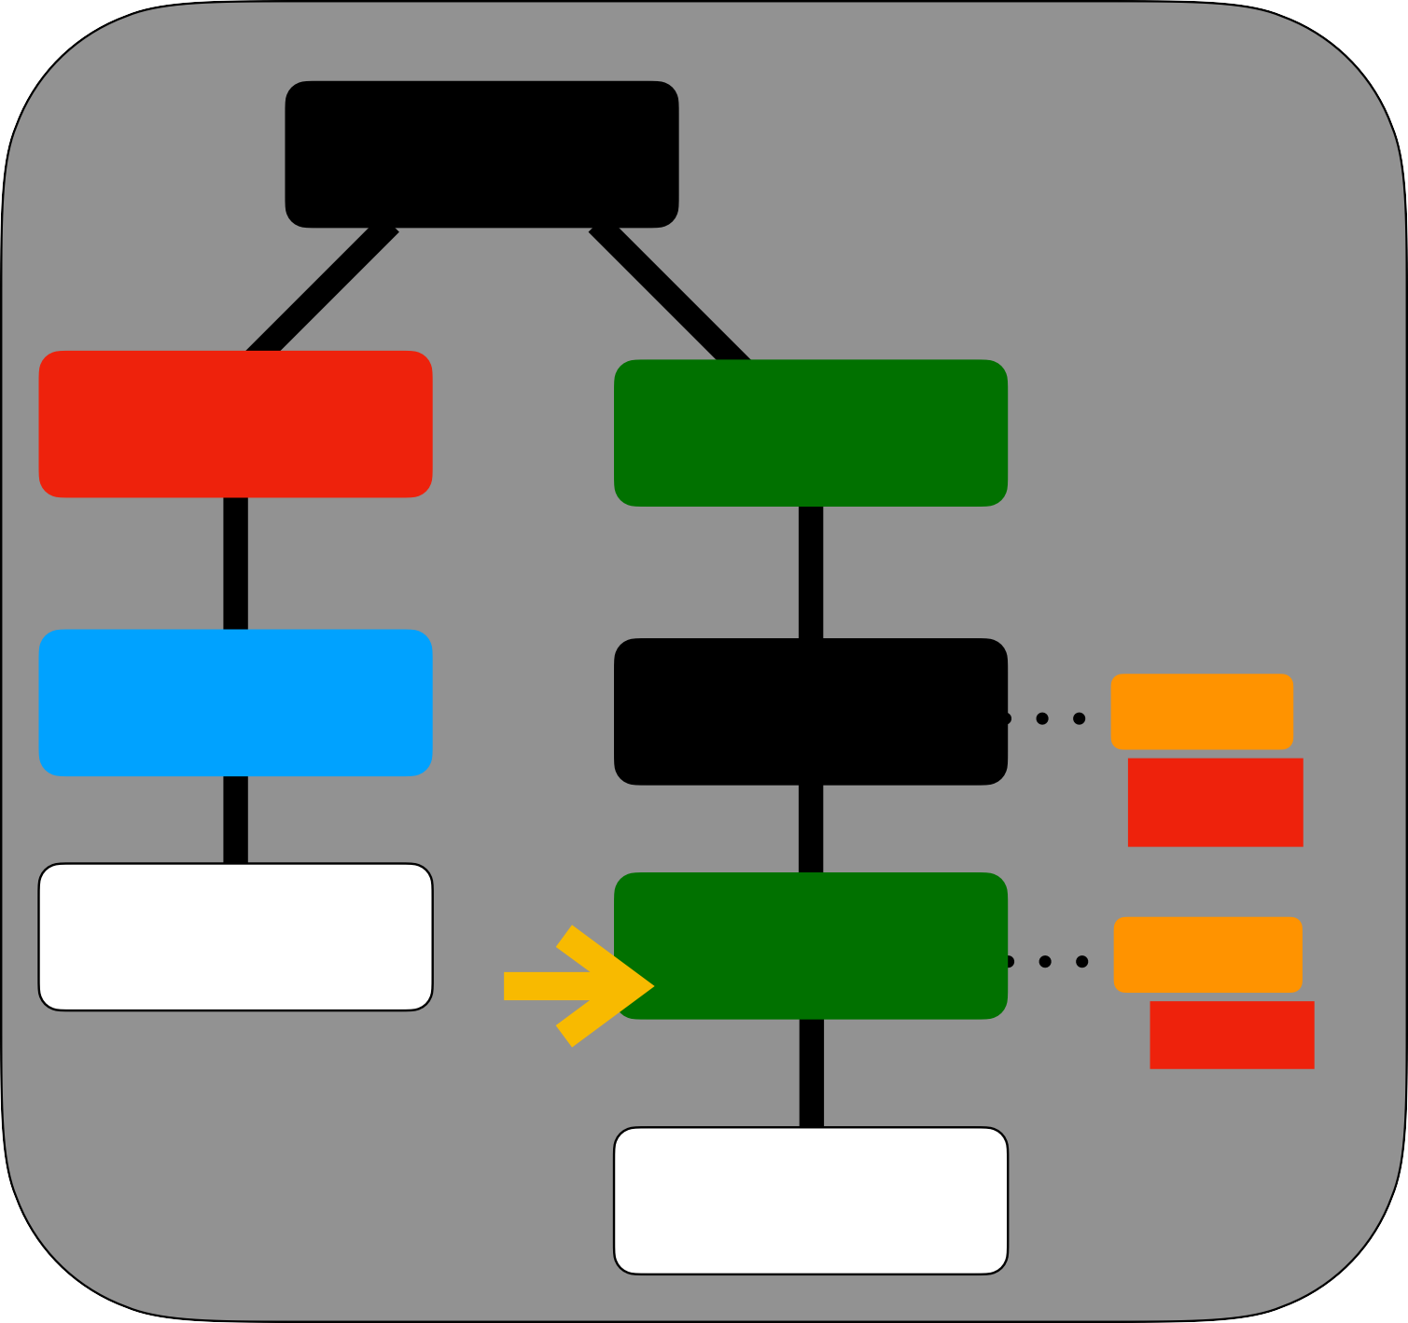
Select Elements
HTML
<html>
<head>
<title>sitename<title>
</head>
<body>
<div id=“myDiv”>
<p class=“bold”> Hello </p>
</div>
</body>
</html>
HEAD
BODY
TITLE
DIV
ID
myDiv
sitename
P
CLASS
bold
Hello
document
document .querySelector ( “.bold” )
HTMLElement JS Object

Slide 151
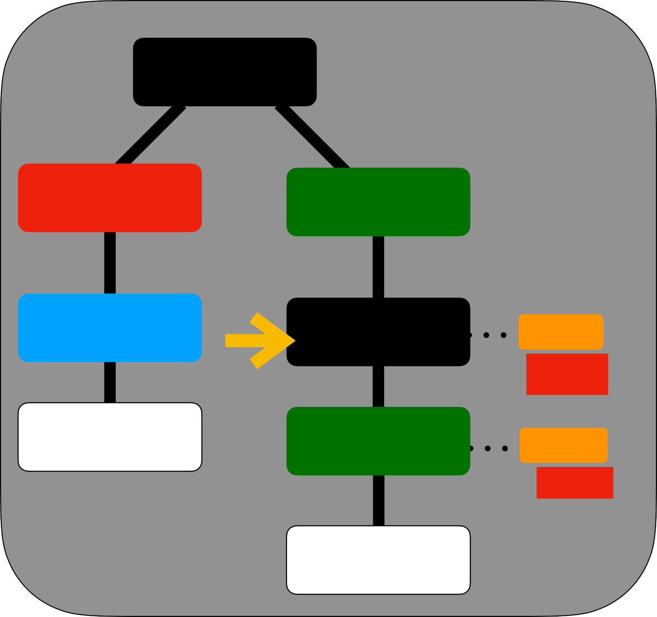
Select Elements
HTML
<html>
<head>
<title>sitename<title>
</head>
<body>
<div id=“myDiv”>
<p class=“bold”> Hello </p>
</div>
</body>
</html>
HEAD
BODY
TITLE
DIV
ID
myDiv
sitename
P
CLASS
bold
Hello
document
document .querySelector ( “#myDiv” )
HTMLElement

Slide 152
Select Elements
HTML
<html>
<head>
<title>sitename<title>
</head>
<body>
<div id=“myDiv”>
<p class=“bold”> Hello </p>
</div>
</body>
</html>
HEAD
BODY
TITLE
DIV
ID
myDiv
sitename
P
CLASS
bold
Hello
document
document .querySelectorAll ( “.bold” )
NodeList [ p ]
[ HTMLelememt ]

Slide 153

Select Elements
HTML
<html>
<head>
<title>sitename<title>
</head>
<body>
<div id=“myDiv”>
<p class=“bold”> Hello </p>
</div>
</body>
</html>
HEAD
BODY
TITLE
DIV
ID
myDiv
sitename
P
CLASS
bold
Hello
document
document .getElementById ( “myDiv” )
HTMLElement

Slide 154
Select Elements
HTML
<html>
<head>
<title>sitename<title>
</head>
<body>
<div id=“myDiv”>
<p class=“bold”> Hello </p>
</div>
</body>
</html>
HEAD
BODY
TITLE
DIV
ID
myDiv
sitename
P
CLASS
bold
Hello
document
document .getElementsByClassName ( “bold” )
HTMLCollection
[ p ]
[ HTMLelememt ]

Slide 155
Select Elements
HTML
<html>
<head>
<title>sitename<title>
</head>
<body>
<div id=“myDiv”>
<p class=“bold”> Hello </p>
</div>
</body>
</html>
HEAD
BODY
TITLE
DIV
ID
myDiv
sitename
P
CLASS
bold
Hello
document
document .getElementsByTagName ( “p” )
HTMLCollection
[ p ]
[ HTMLelememt ]

Slide 156
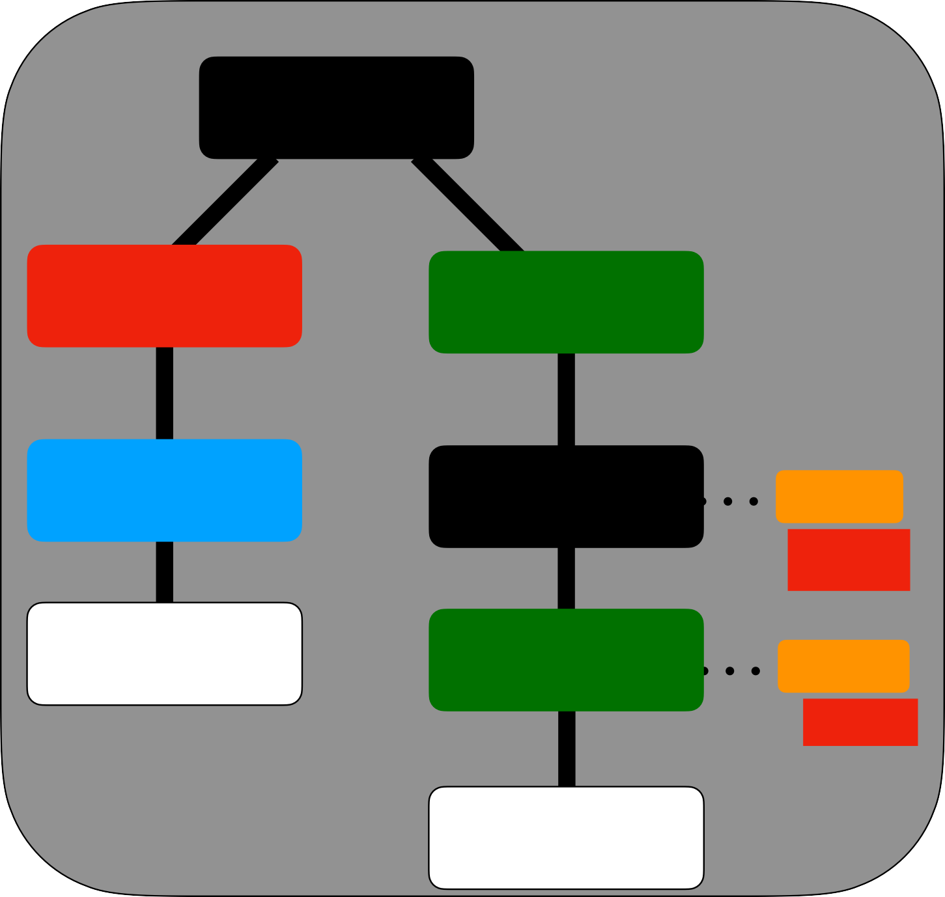
HTMLElement (reading)
HTML
const el = document .querySelector ( “#myDiv” )
HEAD
BODY
el.innerText
el.innerHTML el.id
“”
TITLE
DIV
ID
myDiv
<p class=“bold”> Hello </p>
sitename
P
CLASS
bold
“myDiv”
Hello
const el = document .querySelector ( “.bold” )
<html>
<head>
<title>sitename<title>
e.className
e.innerText
“bold”
</head>
<body>
<div id=“myDiv”>
“Hello”
<p class=“bold”>
Hello </p>
</div>
</body>
</html>

Slide 157
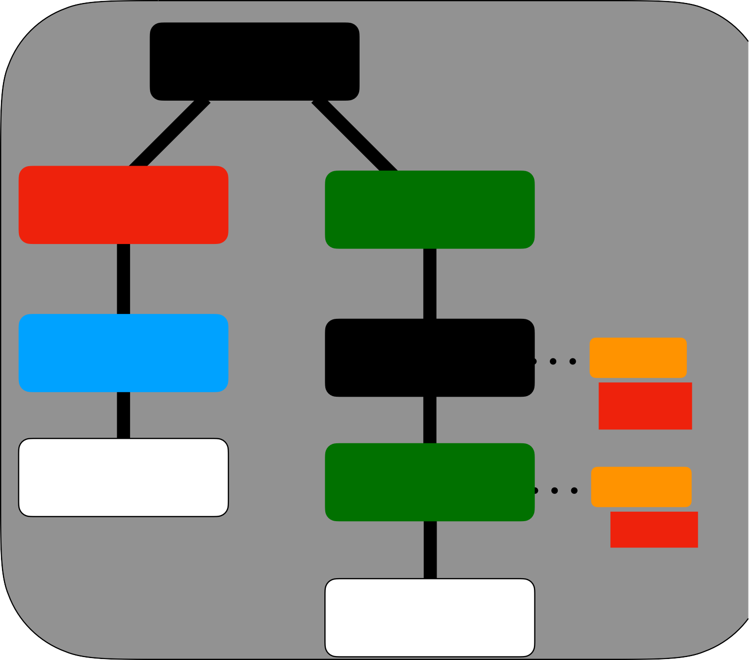
HTMLElement (writing)
const el = document .querySelector ( “#myDiv” )
HTML
HEAD
BODY
TITLE
DIV
ID
myDiv
=
=
el.innerHTML
el.id
<p class=“bold”> Hey </p>
sitename
P
CLASS
bold
“myDiv”
Hello
const el = document .querySelector ( “.bold” )
<html>
<head>
=
=
<title>sitename<title>
e.className
e.innerText
“bold”
</head>
<body>
<div id=“myDiv”>
“Hello”
<p class=“bold”>
Hey </p>
</div>
</body>
</html>

Slide 158
Attributes
HTML
HEAD
BODY
const el = document .querySelector ( “.bold” )
TITLE
DIV
ID
myDiv
el.getAttribute(“class”)
“bold”
sitename
P
CLASS
bold
el.setAttribute(“class”, “bold dark”)
Hello
<html>
<head>
<title>sitename<title>
</head>
<body>
<div id=“myDiv”>
<p class=“bold”>
Hello
</div>
</body>
</html>
</p>

Slide 159
CSS Styles
HTML
HEAD
BODY
const el = document .querySelector ( “.bold” )
TITLE
DIV
ID
myDiv
el.style.color
“black”
sitename
P
CLASS
bold
el.style.color
=
“blue”
Hello
el.style.backgroundColor =
“yellow”
<html>
<head>
=
<title>sitename<title>
el.style.border
“1px solid red”
</head>
<body>
<div id=“myDiv”>
<p class=“bold”>
Hello </p>
</div>
</body>
</html>

Slide 160
ClassList
HTML
HEAD
BODY
const el = document .querySelector ( “.bold” )
TITLE
DIV
ID
myDiv
el.classList.add(“dark”)
sitename
P
CLASS
bold
el.classList.remove(“dark”)
Hello
<html>
<head>
el.classList.replace(“bold”, “dark”)
<title>sitename<title>
</head>
<body>
<div id=“myDiv”>
<p class=“bold”>
Hello </p>
</div>
</body>
</html>

Slide 161
Children / Parent / Sibling
HTML
HEAD
BODY
const el = document .querySelector ( “#myDiv” )
TITLE
DIV
ID
myDiv
el.children
P
Body null
null
sitename
P
CLASS
bold
el.parentElement
el.previousSibling el.nextSibling
Hello
<html>
<head>
<title>sitename<title>
</head>
<body>
<div id=“myDiv”>
<p class=“bold”>
Hello
</div>
</body>
</html>
</p>

Slide 162
Events
HTML
HEAD
BODY
const el = document .querySelector ( “.bold” )
TITLE
DIV
ID
myDiv
el.addEventListener( “click”, function(){
sitename
P
CLASS
bold
} )
Hello
runs on every click
<html>
<head>
<title>sitename<title>
</head>
<body>
<div id=“myDiv”>
<p class` =“bold”>
Hello
</div>
</body>
</html>
</p>

Slide 163
Event Object
HTML
HEAD
BODY
const el = document .querySelector ( “.bold” )
TITLE
DIV
ID
myDiv
el.addEventListener( “click”, function(e){
sitename
P
CLASS
bold
} )
Hello
<html>
<head>
event Object
<title>sitename<title>
</head>
<body>
e.target.innerText
<div id=“myDiv”>
<p
class=“bold”>
Hello
</div>
</body>
</html>
</p>
target = element

Slide 164
Add Elements
HTML
HEAD
BODY
const el = document .querySelector ( “.bold” )
TITLE
DIV
ID
myDiv
const child = document.createChild(‘span’)
sitename
P
CLASS
bold
el.appendChild(child)
Hello
el.prependChild(child)
<html>
<head>
add element after
<title>sitename<title>
</head>
<body>
add element before
<div id=“myDiv”>
<p
class=“bold”>
Hello
</div>
</body>
</html>
</p>

Slide 165
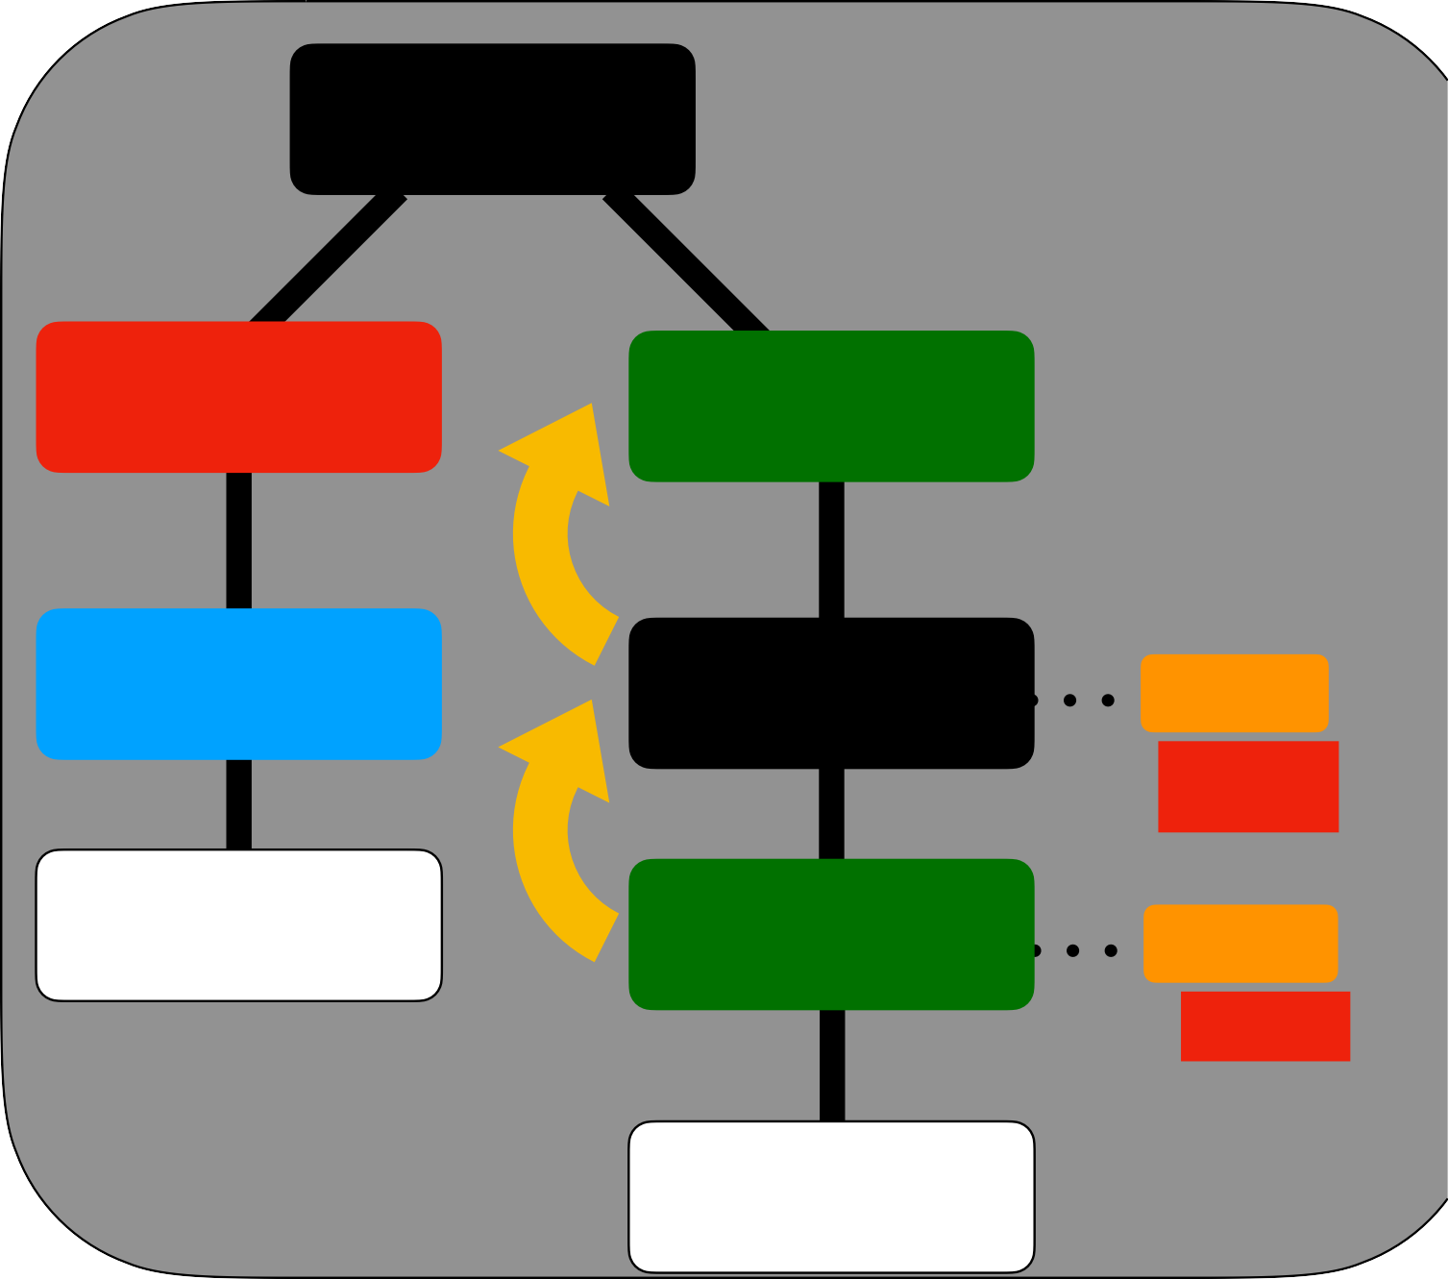
Event Bubbling
HTML
const body = document .querySelector ( “body” )
HEAD
BODY
TITLE
DIV
ID
myDiv
sitename
P
CLASS
bold
Hello
<html>
<head>
<title>sitename<title>
“click” started here, and it bubbles “up”
</head>
<body>
<div id=“myDiv”>
<p
class=“bold”>
P => Div => Body
Hello
</div>
</body>
</html>
</p>

Slide 166
Event Delegation
HTML
const body = document .querySelector ( “body” )
HEAD
BODY
body.addEventListener( “click”, function(e){
TITLE
DIV
ID
myDiv
sitename
P
CLASS
bold
} )
Hello
“body” will also
capture “click” / we can delegate “events” to body
<html>
<head>
<title>sitename<title>
</head>
<body>
“click” started here, and it bubbles “up”
<div id=“myDiv”>
<p class=“bold”>
Hello </p>
P => Div => Body
</div>
</body>
</html>

Slide 167
Mouse Events
mousedown event mouseenter event mouseleave event mousemove event mouseout event mouseover event mouseup event click event dblclick event

Slide 168
Keyboard Events
keyup event keydown event keypress event

Slide 169
Document Events
scroll event copy event cut event paste event

Slide 170
Promise : States
Promise
initial State
PENDING
RESOLVED
REJECT
DATA
ERROR

Slide 171
6. DOM forms

Slide 172
Forms
<form name="myForm" action="/serverAPI" method="post"> Name: <input type="text" name=“fname">
<input type="submit" value="Submit">
</form>
const form = document.querySelector ( “form” )
const nameInput = form.fname
access inputs by “name” attribute
el.addEventListener( “submit”, function(e){
nameInput.value
} )
value of input
event on submit button click

Slide 173
Validate Forms
<form name="myForm" action="/serverAPI" method="post"> Name: <input type="text" name=“fname">
<input type="submit" value="Submit">
</form>
const form = document.querySelector ( “form” ) const nameInput = form.fname
const regexPattern = /^(?:\d{3})([-/.])\d{3}\1\d{4}$/
el.addEventListener( “submit”, function(e){
const result = regexPattern.test(nameInput.value)
pattern for phone 111-222-333
} )

Slide 174
BOM- Browser Object Model
window = {
location :Location object
,
document : DOM Object,
THIS
alert : function(),
confirm : function(),
THIS
THIS THIS THIS
scrollX : 0,
scrollY : 100px,
innerWidth : 900px,
innerHeight : 900px,
open : function(),
close : function(),
scrollTo: function()
… … 100 more
}

Slide 175
7. Arrays

Slide 176
REVERSE method
numbers
6
11 15 10
[ 10,15,11,6 ]
numbers.reverse( )
numbers
[ 10,15,11,6 ]
Mutating Method

Slide 177
JOIN function
words
cat dog horse
words.join()
cat,dog,horse
separator
Non-Mutating Method

Slide 178
JOIN function
words
cat dog horse
words.join(“-”)
cat-dog-horse
separator

Slide 179
SLICE function
6
numbers
11
12 16
3
15 30
18
10
numbers.slice(1, 3 )
[ 11,15 ]
EXCLUDED
Start index
End index

Slide 180
SPLICE function
numbers
6
11 18 10 12 16
3
numbers.splice( 1, 1 )
Start index
No. Of elements to be deleted

Slide 181
SPLICE function
numbers
6
11 18 10 12 16
3
numbers.splice( 1, 1 )
[ 11 ]
[ 6,18,10,12,16 ]
numbers
Mutating Method

Slide 182
SPLICE function (return value)
numbers
6
11 18 10 12 16
3
numbers.splice( 2, 2 )
[ 18,10 ]

Slide 183
SPLICE function
15 30
numbers
6
11 18 10 12 16
3
numbers.splice( 2, 2,15, 30 )
[18,10 ]
numbers
[ 6,11,15, 30,12,16 ]

Slide 184
AT method
numbers
6
11 15 10
6
10
numbers.at(0)
numbers.at(-1)

Slide 185
Mixed Array
cat 1
animals
true
animals = [“cat”, 1 , true ]
NO ERRORS

Slide 186
Nested Array
cat dog
animals
birds
birds
hawk
eagle
animals = [“cat”, “dog” , [ “hawk”, “eagle”] ]

Slide 187
Accessing Nested Array
animals = [“cat”, “dog” , [ “hawk”, “eagle”] ]
animals[2][1]
“eagle”
“hawk”
animals[2][0]

Slide 188
Higher order functions : map()
var numbers = [1,2,3];
numbers.map(item => item * 2)
[2, 4, 6]
iterator
mapping

Slide 189
Higher order functions : map()
var numbers = [1,2,3];
numbers.map(item => item * 2)
ITERATION 1
1
2
ITERATION 2
2
4
ITERATION 3
3
6
[2, 4, 6]

Slide 190
Higher order functions : map()
var users = [{name:“adam”},{name:“bill”},{name:“eve”}];
users.map(item => item.name.length)
ITERATION 1
adam
4
ITERATION 2
bill
4
ITERATION 3
eve
3
[4, 4, 3]

Slide 191
Higher order functions : map()
Input Collection
Output Collection
toLowerCase()
“NY”
“ny"
toLowerCase()
“LA”
“la”
toLowerCase()
“AR”
“ar”
toLowerCase()
“UK”
“uk”
toLowerCase()
“TX”
“tx”

Slide 192
map()
const cities = [“NY”,”LA”,”TX”];
cities.map((city) => city.toLowerCase())
ITERATION 1
“NY”
“ny”
ITERATION 2
“LA”
“la”
ITERATION 3
“TX”
“tx”

Slide 193
map()
const cities = [“NY”,”LA”,”TX”];
const low = cities.map((city) => city.toLowerCase());
low
[“ny”,”la”,”tx”]

Slide 194
Higher order functions : filter()
Input Collection
Output Collection
> 30
25
> 30
30
> 30
35
35
> 30
40
40
> 30
45
45

Slide 195
filter()
const ages = [25,30,35,40,45];
const ageGreat =
ages.filter((age) => (age > 30));
ageGreat
[35,40,45]
Iterator
condition

Slide 196
Higher order functions : reduce()
Input Collection
Accumulator
0
+
25
25
+
30
55
+
35
90
+
40
130
+
175
45

Slide 197
Reduce
const numbers = [25,30,35,40,45];
const r =
numbers.reduce((acc, num) => num + acc, 0)
r
175
Accumulator
Iterator
Accumulator initial value

Slide 198
Find
first value which “condition” returns true
const array1 = [5, 12, 8, 130, 44];
const found = array1.find(el => el > 10);
condition

Slide 199
findIndex
first index for which “condition” returns true
1
const array1 = [5, 12, 8, 130, 44];
const found = array1.findIndex(el => el > 10);
condition

Slide 200
some
even if 1 element satisfied
the condition we get true
const array1 = [5, 12, 8, 130, 44];
const res = array1.some(el => el > 10);
condition

Slide 201
every
even if 1 element don’t satisfied the condition we get false
const array1 = [5, 12, 8, 130, 44];
const res = array1.every(el => el < 100);
condition

Slide 202
flat
const arr1 = [0, 1, 2, [3, 4]];
console.log(arr1.flat());
[0, 1, 2, 3, 4]
const arr2 = [0, 1, 2, [[[3, 4]]]];
console.log(arr2.flat(2));
[0, 1, 2, [3, 4]]
depth of flattening

Slide 203
flatMap
flat() + map()
const arr1 = [1, 2, [3], [4, 5], 6, []];
const flattened = arr1.flatMap(num => num);
[1, 2, 3, 4, 5, 6]

Slide 204
Sorting Array
const arr = ['March', 'Jan', 'Feb', 'Dec']; arr.sort( compareFn )
function compareFn(a, b) {
if (a < b) {
return -1;
}
if (a > b) {
return 1;
}
// a must be equal to b
return 0;
}

Slide 205
Function chaining
var word = “Hello”
word.split( “” )
[ “H”,”e”,”l”,”l”,”o”]
word.split( “” )
.reverse()
[ “o”,”l”,”l”,”e”,”H”]
[ “H”,”e”,”l”,”l”,”o”]
word.split( “” ).reverse()
.join(“”)
“olleH”
[ “o”,”l”,”l”,”e”,”h”]

Slide 206
Function chaining
word.gx( ).fx( ).hx( )
gx( )
return value compatible type with fx()
fx( )
return value compatible type with hx()

Slide 207
8. Date Library

Slide 208
Date Library
var d = new Date()
Milisecs
d
2019-10-07T11:09:34.031Z
Month
Hour (24)
Sec
Year
Day
Mins

Slide 209
Date Library
var d = new Date( 2019 , 11 , 24 , 10 , 33 , 30 , 0)
Month
Hour
Sec
Year
Day
Mins

Slide 210
Date Library
JAN =0
FEB =1
MAR = 2
…
DEC = 11
2
24
11
2019
d.getDay()
SUN = 0
MON = 1
TUE = 2
WED = 3
THU = 4
FRI = 5
SAT = 6
d.getDate()
d.getMonth()
d.getFullYear()

Slide 211
Date Library
var d = new Date(2019, 11, 24, 10, 33, 30, 0)
d.getTime()
1577163810000
Millisecs from 1st Jan 1970
d.toUTCString()
"Tue, 24 Dec 2019 05:03:30 GMT”
d.toISOString()
"2019-12-24T05:03:30.000Z"

Slide 212
9. LocalStorage

Slide 213
LocalStorage
its a API of Browser (window Object) to Store data Locally
Every Origin separately stores data e.g.
google.com will have different database, and facebook.com have different storage on your browser

Slide 214
LocalStorage
window.localStorage
OR
localStorage

Slide 215
LocalStorage: Adding Data
localStorage.setItem(“name”,”abhishek”)
key = String only
value = String only
value = String only
value = String only

Slide 216
LocalStorage: Adding Data
localStorage.getItem(“name”)
“abhishek”
key
value
if “key” is not found , returns “null”

Slide 217
LocalStorage: removing Data
localStorage.removeItem(“name”)
key

Slide 218
LocalStorage: Clear All Data
localStorage.clear()
removes all keys for that origin

Slide 219
JSON to String/ String to JSON
var sourceObject = {
JSON.stringify(sourceObject)
name : “abhishek”,
age: 30,
course : {
STRING
name : “nodejs”
}
}
JSON.parse(STRING)
targetObject

Slide 221
10. Object Oriented JS

Slide 222
Constructor
const person = {
this is shortcut
name : “p1”,
}
const person = new Object({
this is full form
name : “p1”,
})
constructor function

Slide 223
Constructor
function Person(name){
this.name = name;
)
const person = new Person(‘p1’)
Every function in JavaScript is also a Constructor
constructor function

Slide 224
prototype - property
function Person(name){
this.name = name;
)
Person.prototype.printName = function(){
console.log(this.name)
}
const person = new Person(‘p1’)
person.printName()

Slide 225
prototype - property
function Person(name){
this.name = name;
)
const person = new Person(‘p1’)
person.
proto Person.prototype
Constructor uses .prototype
instance uses proto

Slide 226
prototype
Array.prototype.push = function(){
}
Array.prototype.pop = function(){
}
You can also over-write existing methods

Slide 227
Prototype Inheritance
Object
age
person
age
name
proto
proto property tells about the ProtoType of this instance. You can start searching from there
searching for ‘age’ in “person”

Slide 228
Prototype Inheritance
Object
age
found here
Object
subject
proto
you search for “age” property till end of ProtoType chain (null)
person
age
proto
name
https://w

Slide 229
Built-in Prototypes
Object.prototype
Array.prototype
Function.prototype

Slide 230
ES6 - Class
Name
abhishek
Age
30
Address
Street 10, mumbai, india
Mobile
888888888
person
we want to store all this info of person

Slide 231
Objects
var person = {
name
: "abhishek",
age :30 ,
address : "street 10, Mumbai, India",
phone
:8888888888
}
var person1 = {
fullname
: "ajay",
age :30 ,
address : "street 10, Mumbai, India",
mobile
:8888888888
person
}
But issue can be there if do it manually
- mismatching keys

Slide 232
Class
class Person {
}
Name
p2₁
constructor( name) {
this.name = name;
}
let p1 = new Person(“jay”);
Person
let p2 = new Person(“jack”);
Constructor Call

Slide 233
Class Properties
Name
let p1 = new Person(
“ajay”,30,”street 10”,88888
Age
);
Address
Mobile
Person

Slide 234
Class Methods
class Person {
constructor( name) { this.name = name;
}
getName() {
return this.name;
}
setName(name) { this.name = name;
} }
Name
CLASS METHODS
Person

Slide 235
Accessor Properties
const person = {
firstName : “john”, lastName : “smith”, get fullName(){
return this.firstName +” ”+ this.lastName
}
}
person.fullName
“john smith”

Slide 236
Accessor Properties
const person = {
firstName : “john”, lastName : “smith”, get fullName(){
return this.firstName +” ”+ this.lastName
}
set fullName(name){
this.firstName = name.split(‘’)[0] this.lastName = name.split(‘’)[1]
}
}
person.fullName =“Jon Snow”

Slide 237
Static Methods
Class.staticMethod = function(){
}
can be declared with prototype
Class.staticMethod()
instance will not have static method

Slide 238
Static Methods
class Class {
static staticMethod() {
// …
}
can be declared in Class also with “static”
}
Class.staticMethod()

Slide 239
Inheritance
class ParentClass { constructor(name) {
this.name = name
}
}
class ChildClass extends ParentClass {
}
const child = new ChildClass(“john”)
instance will be having “name”
= “john”

Slide 240
Inheritance
class ParentClass { constructor(name) {
this.name = name
}
}
class ChildClass extends ParentClass { constructor(name, age) {
super(name)
this.age = age;
call parent’s constructor and passes values
}
}
const child = new ChildClass(“john”, 30)

Slide 241
11. Asynchronous JavaScript

Slide 242
Async JavaScript
function double(x){ return x*2};
setTimeout(()=>{
double(4);
},4000)
how can I use this value
Callbacks ?

Slide 243
Async JavaScript
function double(x){ return x*2};
setTimeout((cb)=>{
cb(double(4));
3rd argument
},
4000,
callback function
print)
function print(result){ console.log(result)
}

Slide 244
Async JavaScript
Console.log (1) AsyncFx ( function(){
Console.log (3)
} )
Console.log (2)
Callback function

Slide 245
Async JavaScript
AsyncFx ( function(){
AsyncFx ( function(){
AsyncFx ( function(){
} )
} )
} )
Callback Hell

Slide 246
Promise
function delayedFx(){
setTimeout(function(){
someAction();
}, 3000);
}
delayedFx()
undefined
As “someAction” will run late - its output can’t be returned

Slide 247
Promise
function delayedFx(){
setTimeout(function(){
someAction();
}, 3000);
return promise;
}
delayedFx()
promise
A ‘promise’ is something which can return value in future

Slide 248
Promise : States
Promise
initial State
PENDING
Promise Listeners
RESOLVED
REJECT
DATA
ERROR

Slide 249
Promise : States
promise
new Promise(function(resolve,reject){
resolve(data);
})
PENDING
runs after a long operation
RESOLVED
DATA

Slide 250
Promise : States
promise
new Promise(function(resolve,reject){
reject(error);
})
PENDING
runs after a long operation
REJECTED
ERROR

Slide 251
Promise
function delayedFx(){
let promise = new Promise((resolve, reject)=>{ setTimeout(function(){
resolve(someAction());
}, 3000);
resolve will send data to
}
Promise listeners (.then)
return promise;
}
delayedFx()
promise
A ‘promise’ is returned but it will “resolve” later
https://www.youtube.com

Slide 252
Promise : .then() & .catch()
const p = new Promise(function(resolve,reject){
})
then will run but Callback waits
p.then(function(data){
}).catch(function(data){
catch will run but Callback waits
})

Slide 253
Promise : Resolved
const p = new Promise(function(resolve,reject){
resolve(data);
})
p.then(function(data){
callback runs after resolve()
}).catch(function(data){
})

Slide 254
Promise : Rejected
const p = new Promise(function(resolve,reject){
reject(data);
})
p.then(function(data){
}).catch(function(data){
callback runs after reject()
})

Slide 255
Fetch
fetch(URL, optionsObject)
fetch(“http://google.com/)
fetch(“http://cricket.com/, {
“method” : “POST”,
promise
“body” : “match score”
})

Slide 256
Fetch
fetch(“http://cricket.com/, {
“method” : “POST”,
“body” : “match score”
})
.then(function(HTTPResponse){
}).catch(function(ErrorResponse){
})

Slide 257
Await
const P = new Promise(function(resolve,reject){
resolve(data);
})
await will sleep at this line
const data = await P
console.log(data)
This line runs after resolve

Slide 258
Async
const P = new Promise(function(resolve,reject){
resolve(data);
})
async function(){
const data = await P
console.log(data)
}
We always use “async” for await based functions

Slide 259
JSON (JavaScript Object Notation)
{
“name” : "abhishek",
“age” : ”30” ,
“address” : "street 10, Mumbai, India", “phone”: “888888888”
}
quotes on properties
HashMaps
Dictionary

Slide 260
Universal Data Transfer
{
“name” : "abhishek",
“age” : ”30” ,
“course” : "nodejs",
}
Can be understood by any Programming Language

Slide 261



Universal Data Transfer format (JSON)
name age course
abhishek 30 nodejs
abhishek
???
30
nodejs
CLIENT
{
WEB SERVER
“name” : "abhishek",
“age” : ”30” ,
“course” : "nodejs",
}

Slide 262
12. ES 6 JavaScript

Slide 263
De-structuring Assignment Array
nums = [1, 2, 4];
const [a,b,c] = nums;
a
1
b
2
c
4

Slide 264
De-structuring Assignment Objects
var person = {
name : "abhishek", age :30 , phone:8888888888
}
const {name,age,ph} = person;
name
“abhishek”
age
30
ph
undefined

Slide 265
Spread Operator
Math.max(4, 5, 100, 0, 1)
100
const numbers = [4, 5, 100, 0, 1];
Math.max(numbers)

Slide 266
Spread Operator
const numbers = [4, 5, 100, 0, 1];
…numbers
4, 5, 100, 0, 1
Math.max(…numbers)
Math.max(4, 5, 100, 0, 1)

Slide 267
Rest Parameters
let max = function(...nums){
// function body
}
max(1,2,4,5)
nums = [1, 2, 4, 5];

Slide 268
Rest Parameters
let max = function(...nums){
// function body
}
max(1,2)
max(1,2,3)
nums = [1, 2];
nums = [1, 2, 3];

Slide 269
Short Circuiting
var person = {
name: 'Jack',
age: 34
}
console.log(person.job || 'unemployed');
will stop at first value which is “truthy”
console.log(person.job && 'unemployed');
will stop at first value which is “falsy”

Slide 270
Nullish Coalescing (??)
const foo = null ?? 'default string’;
default string
const baz = 0 ?? 42;
0

Slide 271
FOR OF Loop
let array = [1,2,3];
for(let number of array){
console.log(number);
}
collection
iterator

Slide 272
FOR OF Loop
ITERATION 1
let array = [1,2,3];
for(let number of array){
1
console.log(number); |  | > | 1
}

Slide 273
FOR OF Loop
ITERATION 2
let array = [1,2,3];
for(let number of array){
2
console.log(number);
1
>
}
> 2

Slide 274
FOR OF Loop
ITERATION 3
let array = [1,2,3];
for(let number of array){
3
console.log(number);
1
>
}
> 2
> 3

Slide 275
FOR V/S FOR OF Loop
FOR
FOR OF
Difficult to Write
Easy to Write
Error chances high
Error chances low
More flexible
Good for Loops which iterate each element

Slide 276
Object Literals: properties
var person = {
name : "abhishek", age :30 , phone:8888888888
}

Slide 277
Object Literals: properties
var name = “abhishek";
var age = 30 ;
var phone = 8888888888 ;
var person = {
Shorthand Object Literals
name ,
age , phone
}

Slide 278
Object Literals : methods
let shape = {
name: 'rectangle', height: 100,
width:100,
area() {
return this.height * this.width;
}
}
function not required

Slide 279
Object Literals : Computed keys
let keyName = “nameofShape"
let shape = {
[keyName]: 'rectangle',
height: 100,
key is variable here
width:100,
}
shape.nameofShape
“rectangle”

Slide 280
Optional Chaining (?.)
let person = { username: 'Jack', age: 34
}
const fName = person?.name?.firstName;
undefined
checks if a property exists then only moves ahead.
Avoids error

Slide 281
Object Methods
Used for creating Objects.
But we generally use { } for easier writing
new Object ()
Object Constructor

Slide 282
var person = {
name : "abhishek",
age :30 ,
address : "street 10",
phone:8888888888
}
Object.keys(person)
[“name”,”age”,”address”,”phone”]
[“abhishek”,30,”street 10”,8888888888] [ [“name:“abhishek”],
[“age”,30] , [“address”: “street 10”], [“phone”: 8888888888]
]
Object.values(person)
Object.entries(person)

Slide 283
Set : Add
let set = new Set()
set.add(1)
Set(1) {1}
set.add(5)
Set(2) {1,5}
set.add(4)
Set(3) {1,5,4}
set.add(5)
Set(3) {1,5,4}
set.add(1)
Set(3) {1,5,4}
set.add(10)
Set(4) {1,5,4,10}
A Set only keeps unique value
https://www.youtube.com

Slide 284
Set : size
Set(4) {1, 2, 3, 4}
set.size
4

Slide 285
Set : Delete
Set(4) {1, 2, 3, 4}
set.delete(1)
Set(3) {2, 3, 4}
set.delete(2)
Set(2) {3, 4}
set.delete(4)
Set(1) {3}

Slide 286
Set : has & clear
Set(4) {1, 2, 3, 4}
set.has(3)
true
set.has(5)
false
set.clear()
Set(0) { }

Slide 287
Map Data Type
MAP
“name”
“cities” 0
[1,2]
{ name:”abhishek” }
“abhishek"
[“delhi”,”mumbai”] 5
[1,4]
{ age:30 }

Slide 288
Map : Write and Read
let map = new Map()
map.set(“name”,”abhishek”)
map.set([1, 2],[1, 4])
map.get([1, 2])
[1, 4]
map.get(“name”)
”abhishek”

Slide 289
Map : Check Exists
let map = new Map()
map.set(“name”,”abhishek”)
map.set([1, 2],[1, 4])
map.has(“age”)
false

Slide 290
Map : Delete
let map = new Map()
map.set(“name”,”abhishek”)
map.set([1, 2],[1, 4])
map.delete(“name”)

Slide 291
Map : Clear all
let map = new Map()
map.set(“name”,”abhishek”)
map.set([1, 2],[1, 4])
map.clear()
Clear all values
https://www.youtube.com

Slide 292
Map : Length
let map = new Map()
map.set(“name”,”abhishek”)
map.set([1, 2],[1, 4])
map.size
2

Slide 293
13. Misc Tools

Slide 294
Import in JS
<!DOCTYPE html>
<html lang="en">
<head>
<title>Document</title>
<script src=“index.js"
type=“module”
>
</script>
</head>
<body>
ES module enable
</body>
index.html

Slide 295
Named Export / Import
const a = 5; const b = 6;
function sum(a,b){
return a+b;
 | import | {a,b,sum} | from "./app.js"
 | console.log(sum(a,b))
index.js
}
export
{a,b,sum};
app.js
named exports

Slide 296
Default Export / Import
const a = 5; const b = 6;
function sum(a,b){
return a+b;
 | import | sum | from "./app.js";
 | console.log(sum(4,5))
index.js
}
export default sum;
app.js
default export

Slide 297
Alias
function sum(a,b){ return a+b;
}
import {sum as add} from "./app.js console.log(add(a,b))
export {sum};
index.js
app.js
named exports

Slide 298
Top Level Await
Now its allowed to use Await without Async at top- level of file/module
const x = await resolveAfter2Seconds(10);
console.log(x)
blocks the code

Slide 299
Modular code - IIFE
let sum = (function (a,b) { return a + b
})();
protects inner variables

Slide 300
14. Advanced Concepts

Slide 301
Closure
function makeAdder(x) { return function (y) {
return x + y;
};
this “x” is accessible to inner function
}
const add5 = makeAdder(5);
x=5
const add10 = makeAdder(10);
x=10
console.log(add5(2)); // 7
console.log(add10(2)); // 12

Slide 302
THANKS

