Slide 1

APACHE SQOOP

Slide 2
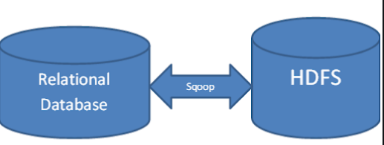
SQOOP OVERVIEW
Introduction
History
Why Sqoop

Slide 3
Introduction
2011 Sqoop came into the market and there in incubator for testing for 9 months and then it became Open source.
Sqoop only transfer data from RDBMS to HDFS and not to any other system.
Before 2010 , we used SFTP , FTP (File transfer Protocol) to bring the data from RDBMS to HDFS with high transfer protocols.
Before SQOOP came into market , we need to depend on an operation person who do the data transfer from RDBMS to HDFS .
Since All data present in SQL , there will be no access to MYSQL.
After Sqoop Launch , Sqoop can create the database and create the table and insert the data using Hadoop terminal itself.

Slide 4
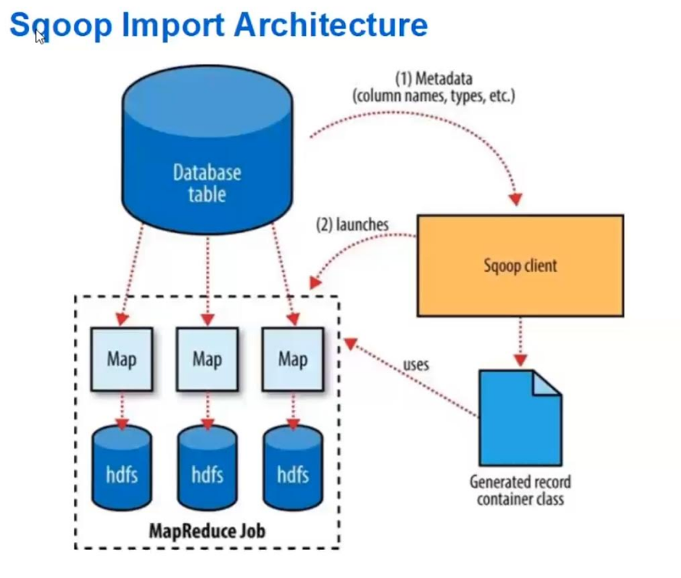
SQOOP IMPORT ARCHITECTURE

