Slide 1


Slide 2

HADOOP
INTRODUCTION
EVOLUTION
FEATURES

Slide 3
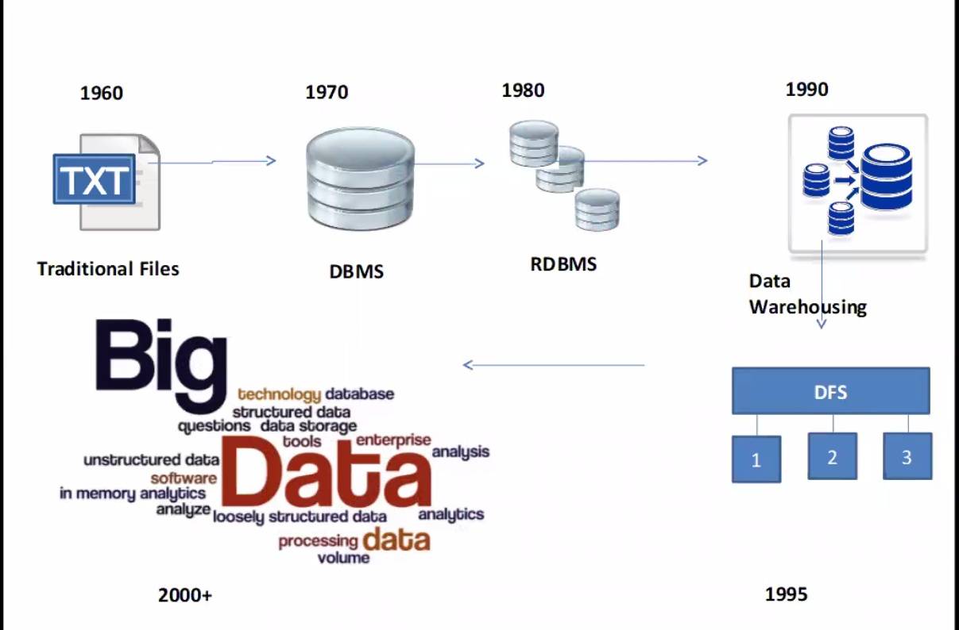
Evolution of Data

Slide 4
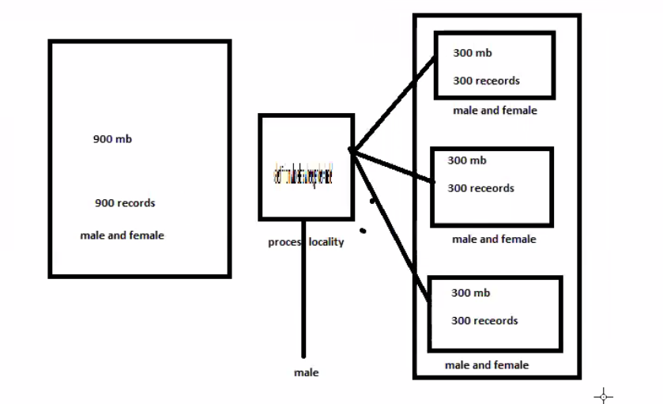
DFS – Distributed File System

Slide 5
Evolution of Data (Cont.…)
Main evolution happened in Year 2003.
Google → Released the paper in a single patent on how the data is processed and the CONCEPT of GFS.
In 2004 again Google released one more paper and its on MAP REDUCE.
NDFS → Nutch Distributed File system
2005 → NDFS renamed as HDFS

Slide 6
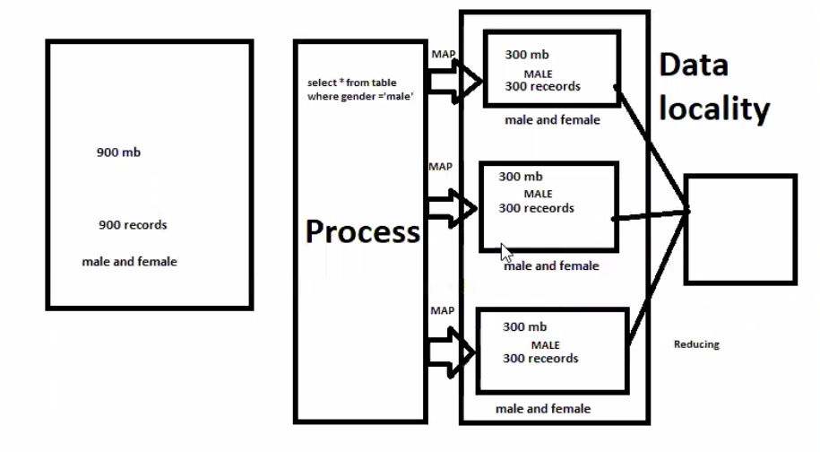
Map Reduce

Slide 7
Data Source
Business Process -1X
OLTP
Human – 10X
Email
Documents
Machine -100X
CCTV
Mike
Sensors
Satellites (Maps,DTH)

Slide 8
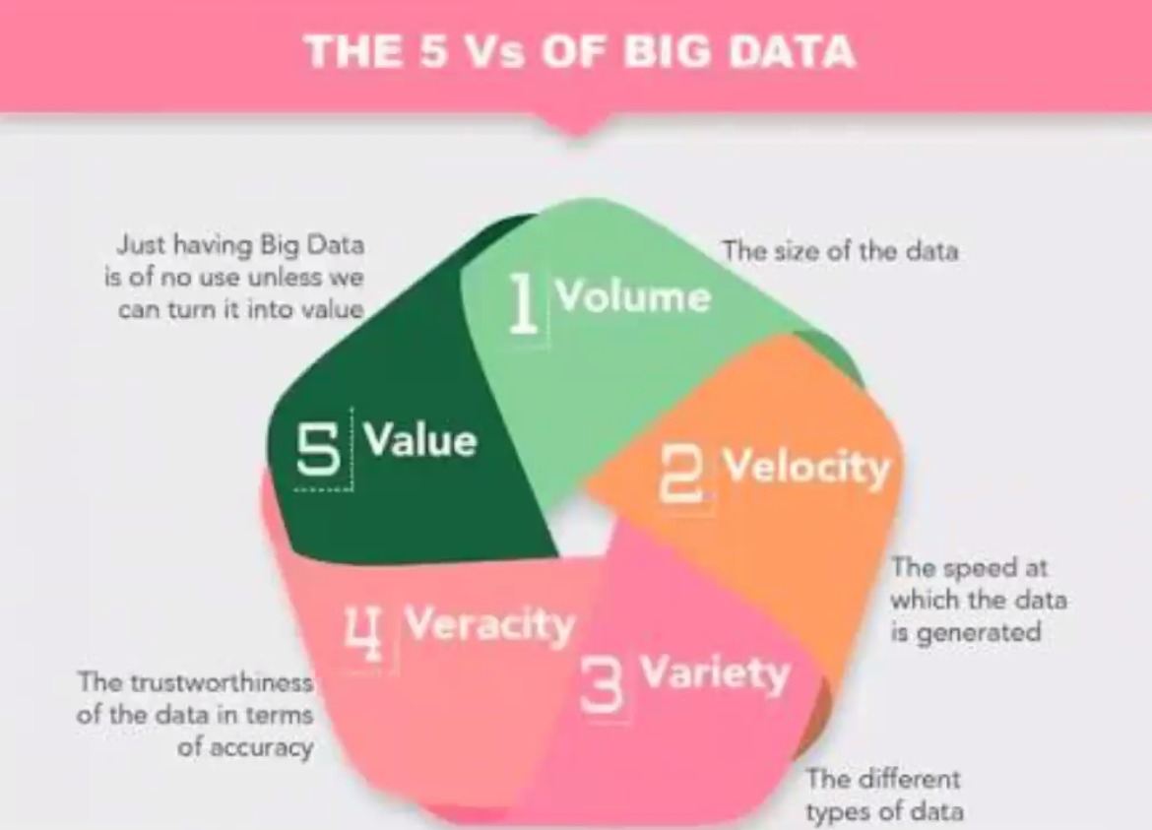

Slide 9
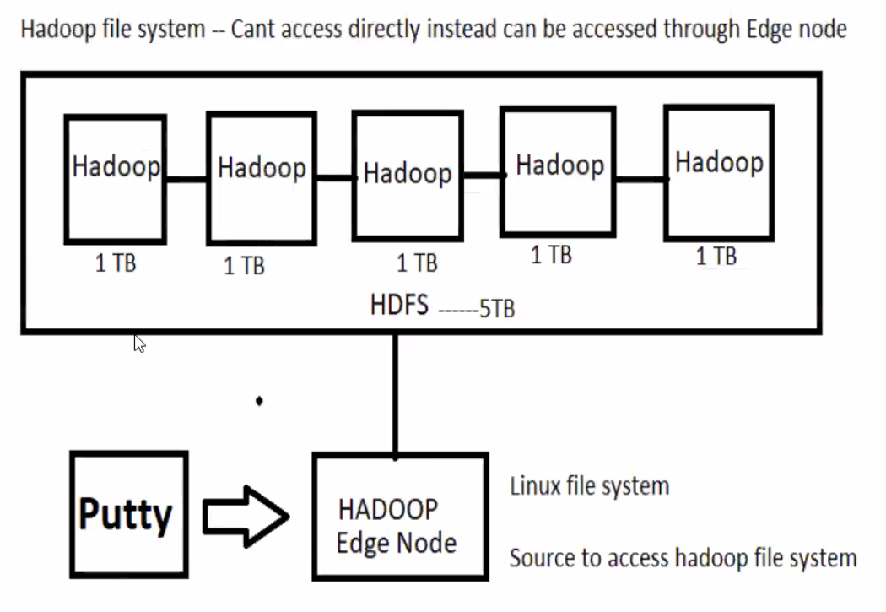
Hadoop System

Slide 10
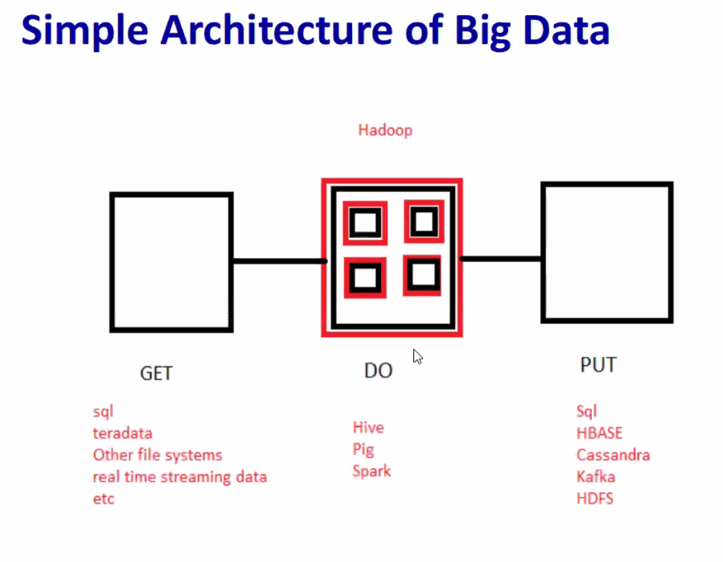

Slide 11
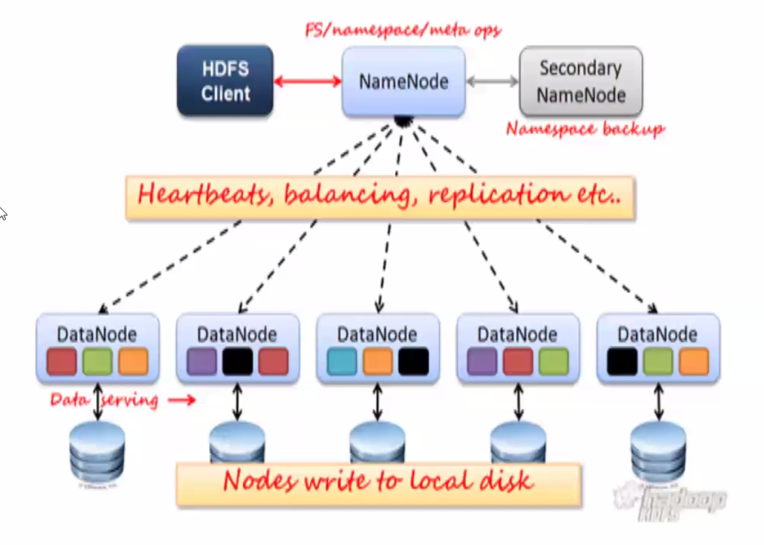
Hadoop 1.0 Architecture

Slide 12
Hadoop 1.0 – Name Node Uses
Cluster Administration
Meta Data Management
Secondary Name Node is not a back up of Name Node in Hadoop 1.0
Disadvantages of Hadoop 1.0 :
Single Point Of Failure
Name Node memory cannot be increased

Slide 13
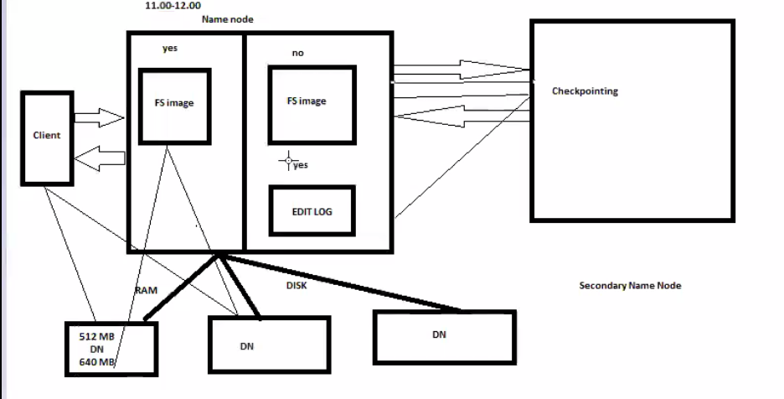
Metadata management

Slide 14
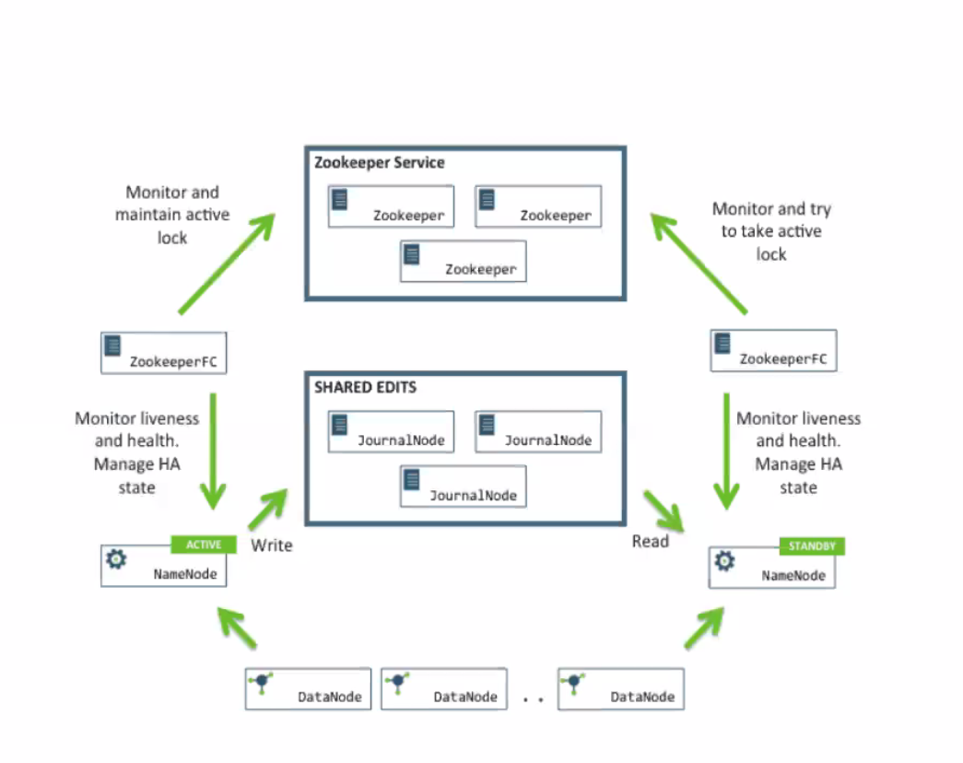
Hadoop 2.0 architecture

