Slide 1

To Predict Loan Status
Excelr-P53-Group no 4
Navnath Satre, Vaibhav Bhasker Bansode, Divya Bagadi, Sandeep Khandelwal, Bharath A V
Mentored By
Mr. Parth
07/05/21

Slide 2
Business Problem:
To predict Loan Status
Objective:
To predict the impact of the incident raised by the customer..

Slide 3
Dataset Evaluation
Data Visualization
Modelling
Re-Build Model
Predictions
Data Processing
Feature Engineering
Project Flow

Slide 4
Data set details
The dataset contains total 614 records 13 features.
It’s not at all easy to get a loan from the bank.
Getting a loan approved requires a complex mix of factors not the least of which is a steady income!
So this ML project aims to create a model that will classify how much loan the user can obtain based on various factors such as the user’s marital status, income, education, employment prospects, number of dependents, etc.
The dataset attached provides details about all these factors which can then be used to create an ML model that demonstrates the amount of loan that can be approved

Slide 5
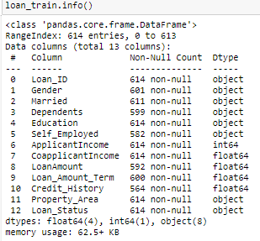
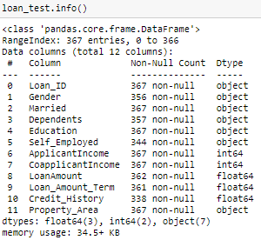
Exploratory Data Analysis (EDA)
Training Dataset
Test Dataset

Slide 6
Exploratory Data Analysis-(EDA)
**steps involved to understand, clean and prepare our data for building model**
Variable identification
Univariate Analysis
Bi-Variate Analysis
Missing Values Treatment
Outliers Treatment
Variable Transformation
Variable Creation Finally we iterate steps 4-7 till we get good model.

Slide 7
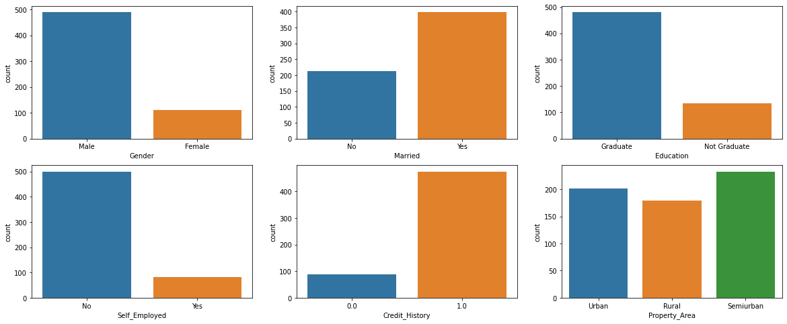
Exploratory Data Analysis (EDA)
Univariate Analysis( Categorical )
Mostly, those who Male, Married, Graduated, Not Self-employed they applied for Loan.
Those who a high Credit History (1.0) they mostly applied for Loan.
From any Property Area people applied for Loan.

Slide 8
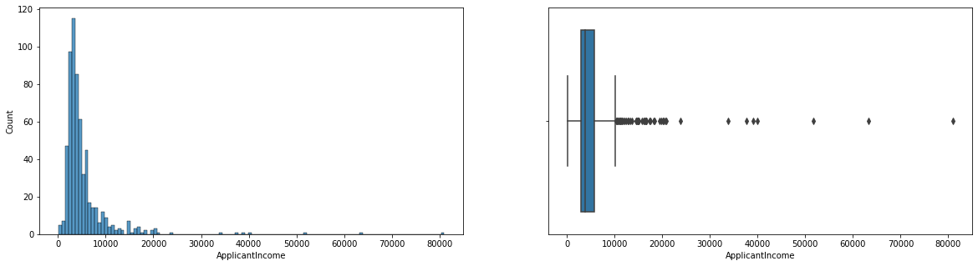
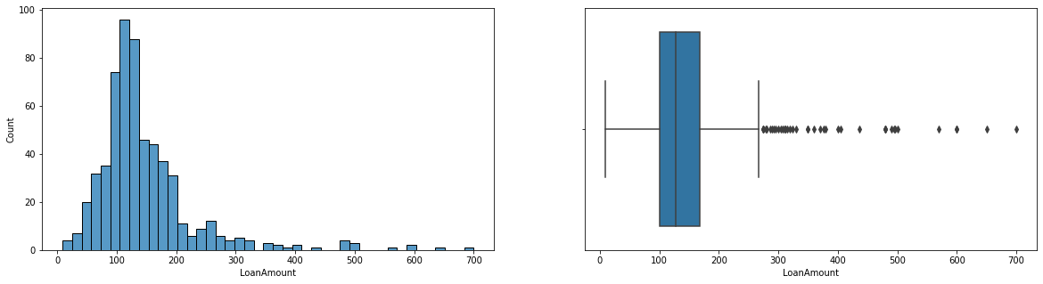
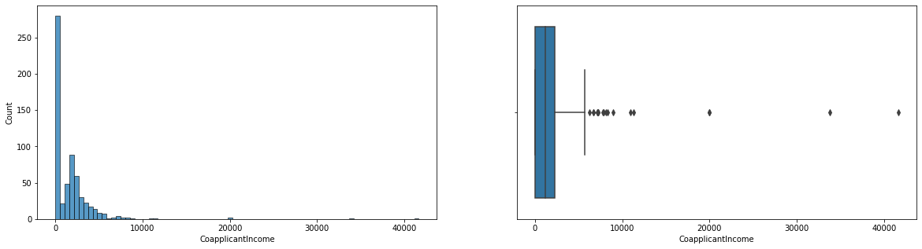
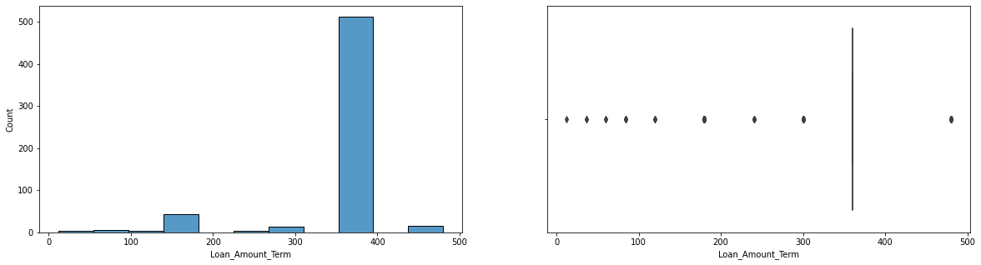
Numeric data
Our data is Not Normal (Right Skewed) and Outliers in Applicant Income, Coapplicant Income, Loan Amount.
Most Loan Amount Term is 360 only.

Slide 9
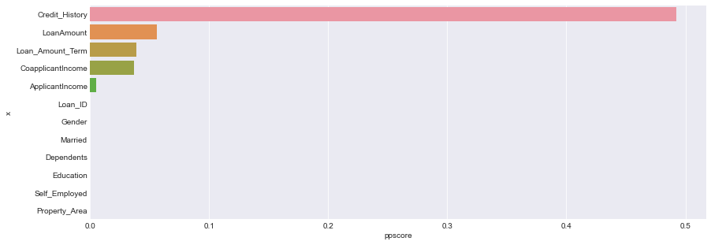
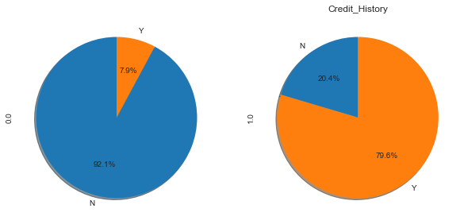
The People who have good Credit History they got loan most of the Time and other variables plays less importance role.

Slide 10
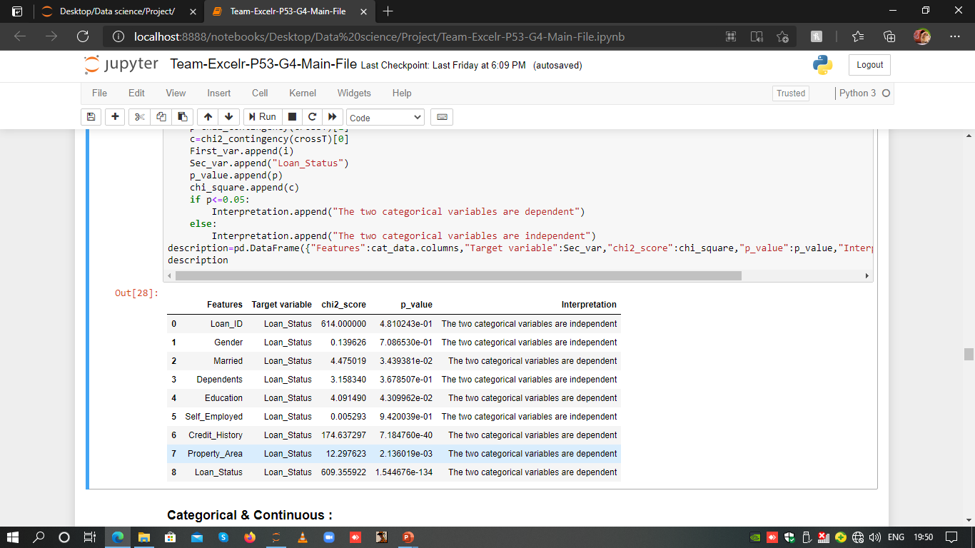
Chi-Square Test:
If p<=0.05 Interpretation the two categorical variables are dependent else, interpretation the two categorical variables are independent.

Slide 11
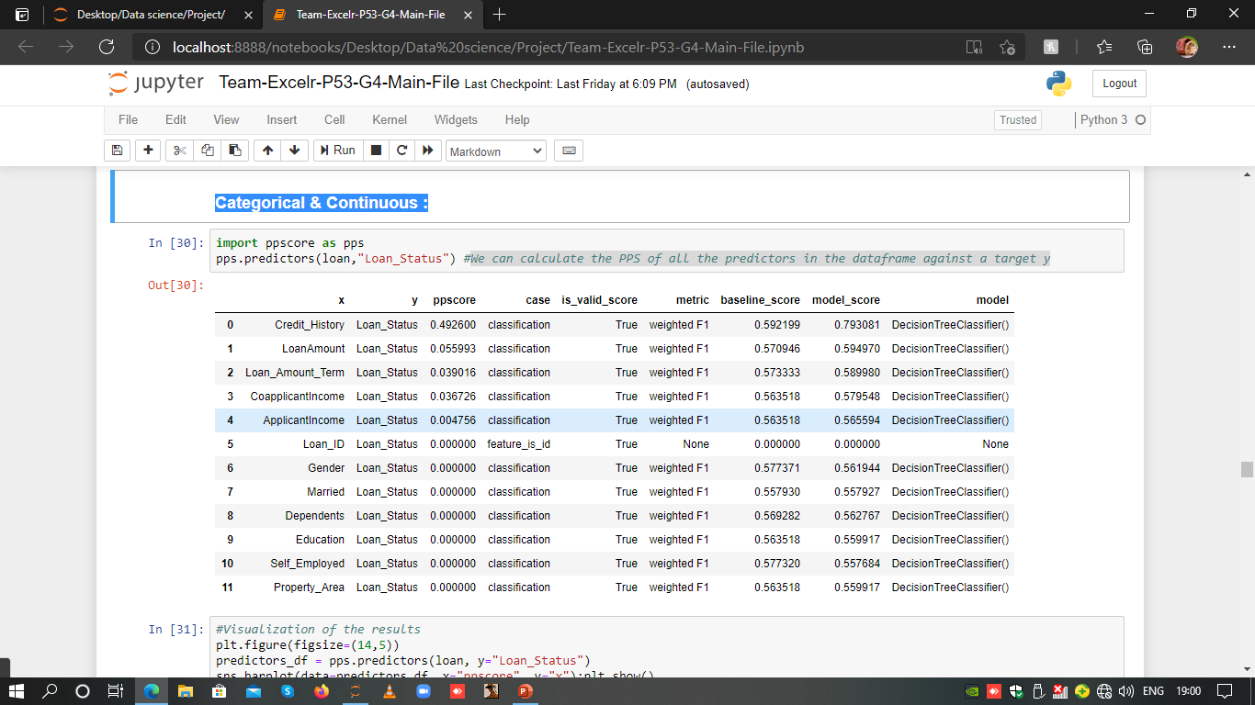
Categorical & Continuous :
We can calculate the PPS of all the predictors in the data frame against a target y

Slide 12
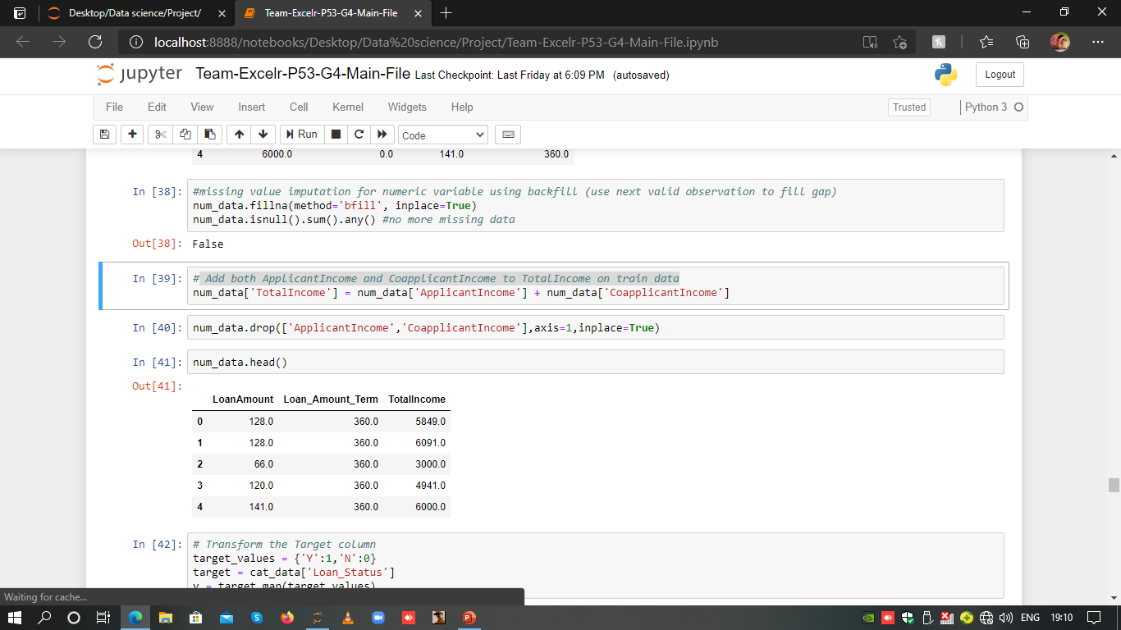
We have Added both Applicant Income and Coapplicant Income as Total Income on train data.

Slide 13
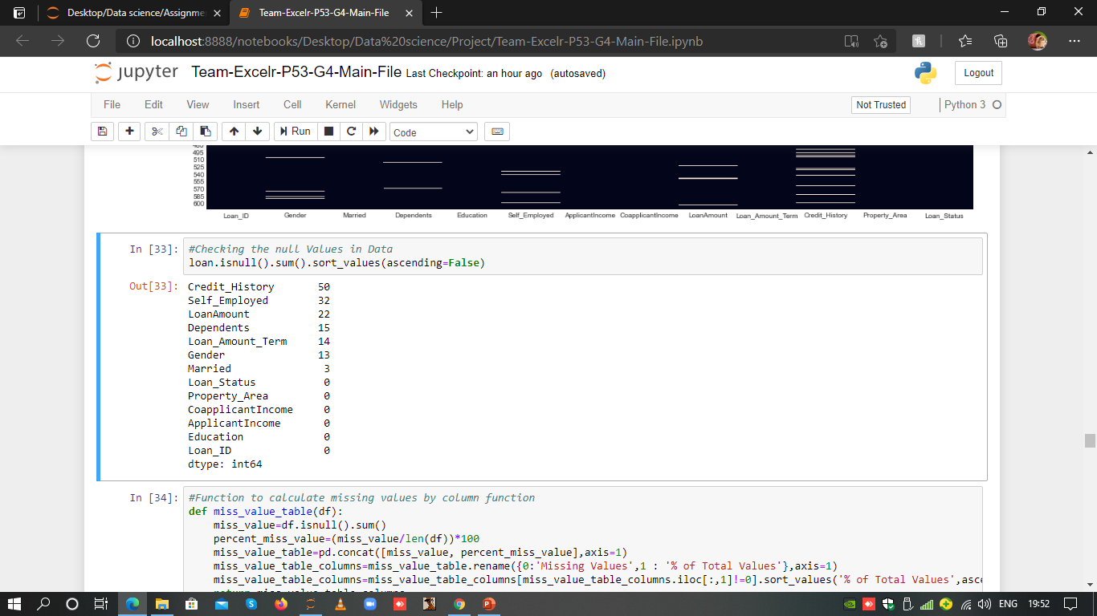
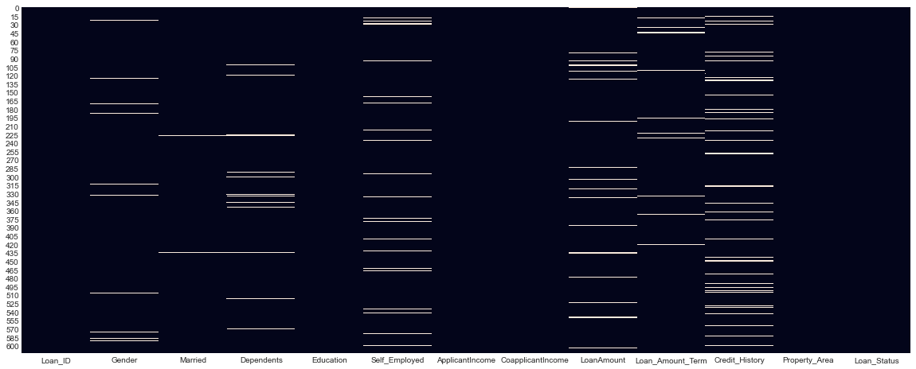
Missing Value Treatment
The Missing values are filled by two methods
For Categorical data we have used mode.
For Numeric data we have used bfill method.

Slide 14
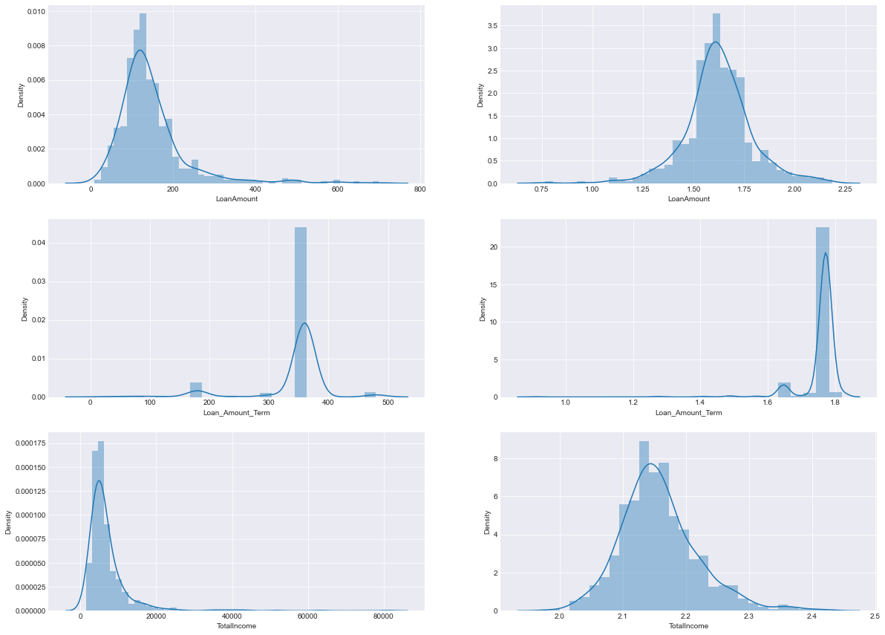
Variable Transformation
We have used Log Function to normalization the Numeric data

Slide 15

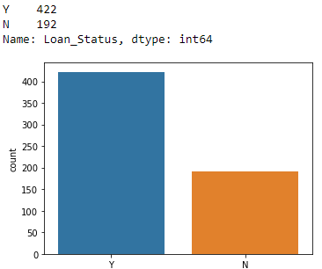
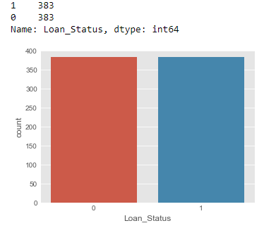
Balancing the data(SMOTETomek)
Y:1
N:0

Slide 16
Model Summary

Slide 17
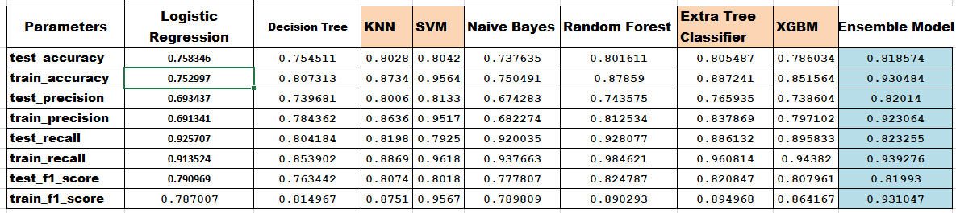

Slide 18
Model Deployment Using Streamlit

Slide 19
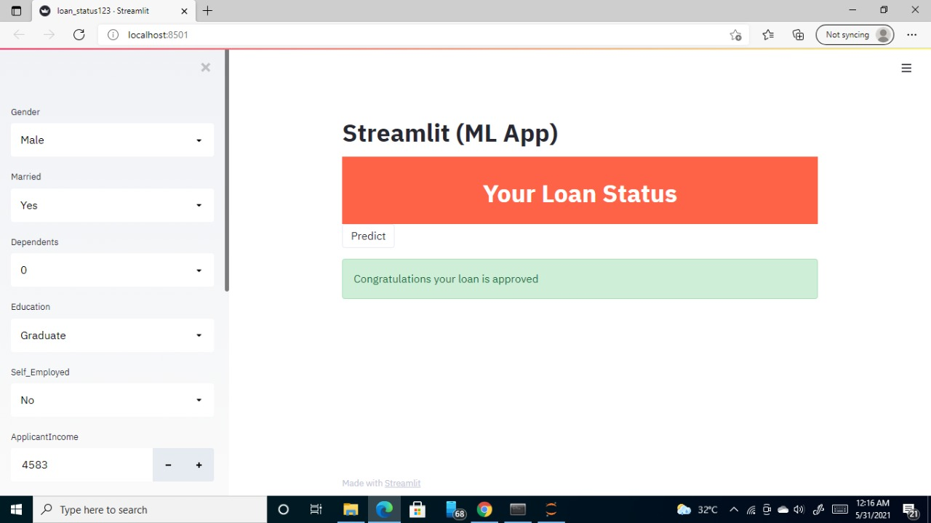

Slide 20
Challenges faced?
Balancing the Imbalance Data
Missing Values
To increase the Model Accuracy
How did you overcome?
By using SMOTETomek
Impute Cat data using Mode and Num data using Bfill Method
We tuned hyperparameters

Slide 21
Thank you

