Slide 1

Team 31
Navneet Agarwal (2018348)
Nitin Gupta (2018251)
Swastik Jain (2018269)
Github Repository [Link]

Slide 2

Problem Statement
As we know most of the auctioning platforms available online/offline are run by a centralized entity and face the issue of stringent rules and regulations set by that entity. Problems faced on these platforms are as follows:
Their application depends on proprietary software inaccessible to the general public which leads to a lack of transparency and unwanted added costs to the users such as commission fees etc.
An e-auction leads to lack of trust between the parties involved in the transaction. This may often create transaction misbehavior in cases like the seller might not deliver the commodity or the buyer might refuse to pay the agreed price.

Slide 3
Related Work
We studied about various bidding system. Primarily there are two type of bidding system
Sealed-Bid - No bidder knows what other people have bid.
Open-bid - All participants know the bids of every other participant at any given time.
Sealed-bid provides much more anonymity between participants as compared to Open-bid. Whereas active competition in open-bid system allows the seller/owner to get a better value for the item as compared to a sealed-bid auction.

Slide 4
Non-blockchain based Existing System
The auction system proposed by Brandt did not rely on trusted third parties (auctioneers). ElGamal encryption was used in this system to protect the bidders’ privacy. But the proposed method is time-consuming as the computations were only performed by the auctioneer.
Lee proposed a securely sealed-bid auction system that claimed to have the secrecy of the bidding process, verifiability, and non-reputability. It used a group signature scheme with authenticated encryption.
Cheng had proposed a sealed-bid auction scheme that used digital signatures to verify bidders and encrypt the bid price. The problem that this system faced was the verification and determination of winning bid prices by the third-party auctioneer.

Slide 5
Blockchain based Existing System
Galal and Youssef had proposed the sealed-bid auction on the Ethereum blockchain with smart contracts. Their method implemented the validity, secrecy, and fairness of the auction transaction but they used a third-party auctioneer.
Peng published an article on a sealed-bid auction system with concurrent signatures to protect the privacy of the participants and hide the bid price. This strategy was also flawed since they were not able to verify the winning bid confidently.
Yu modified a two-party comparison protocol, by zero-knowledge proof and proposed a scheme with semi-honest judge parties. But this means that partial security still depends on the honesty of the judge party.

Slide 6
What we offer
We offer a blockchain based solution which solves the problem faced in the auction industry. Use of blockchain technology will make our platform
Transparent - All the records can be viewed by anyone
Reliable - System is independent of any third party
Scalable - Anyone with the valid cryptocurrency wallet can create and bid on the auction

Slide 7
Features
Anyone with the cryptocurrency wallet can create an auction by providing:
Title of the item to be auctioned
Start Time of the Auction
End time of the Auction
Description of the item
Minimum Bidding price (in ETH)
Anyone can place bids in an ongoing auction provided:
Enough Funds
He is not the owner of the contract
Anyone can withdraw his funds provided:
He did not win the auction
The auction is not over until then

Slide 8
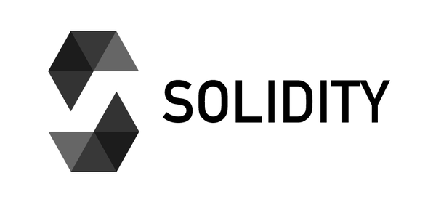


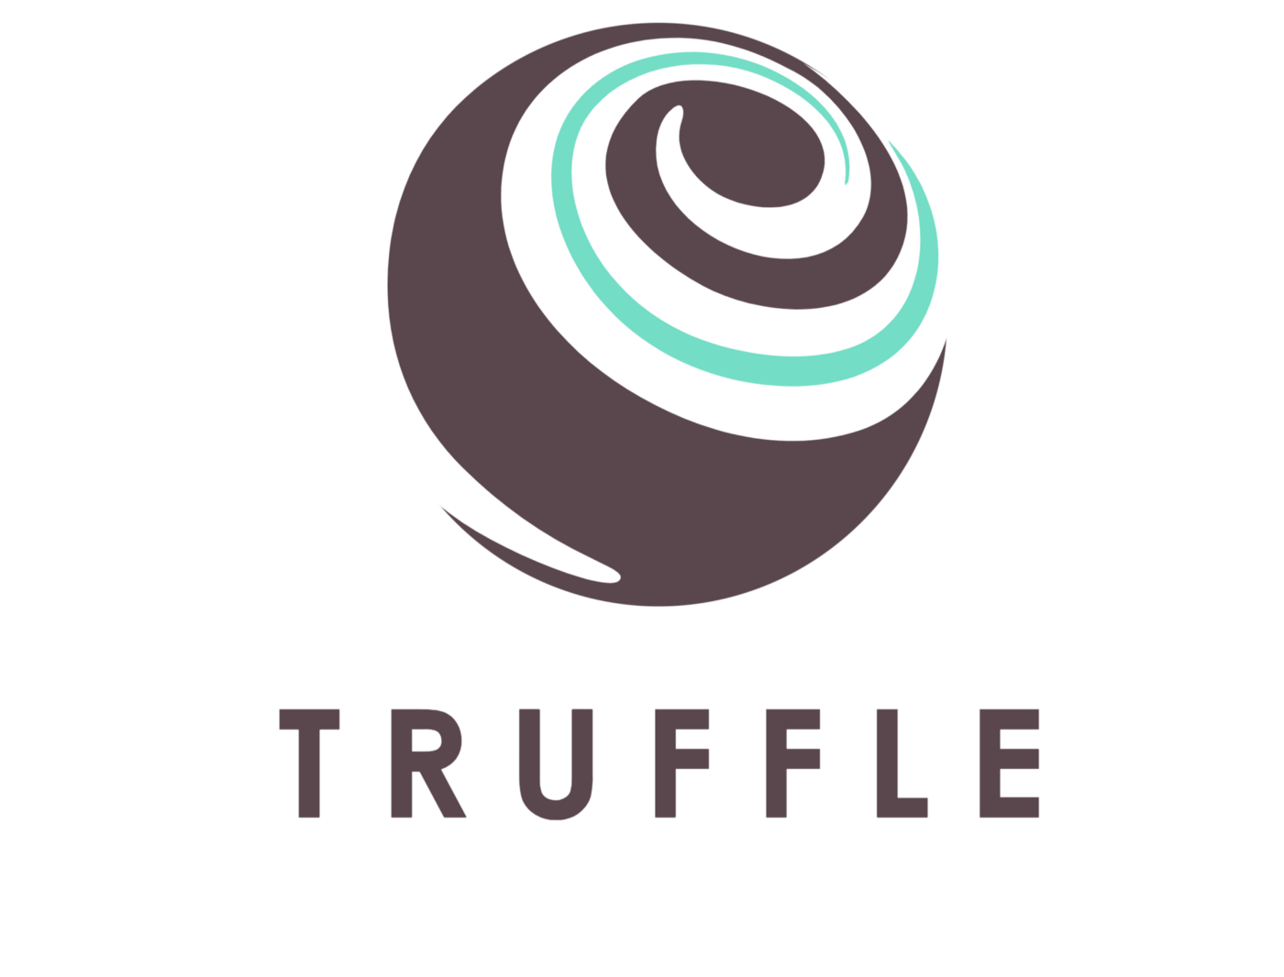
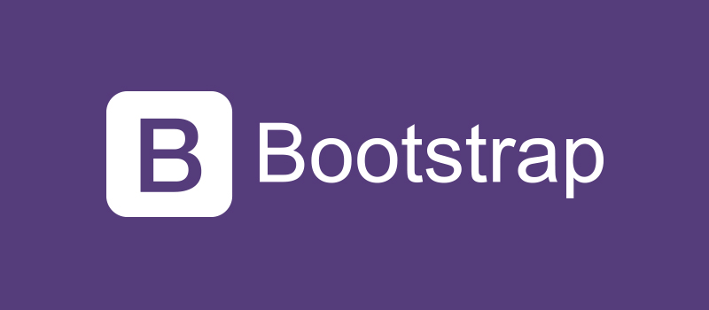
Tech Stack
Solidity is an object-oriented, high-level language for implementing smart contracts. Smart contracts are programs which govern the behaviour of accounts within the Ethereum state.
Metamask A crypto wallet & gateway to blockchain apps
Truffle A world class development environment, testing framework and asset pipeline for blockchains using the Ethereum Virtual Machine (EVM), aiming to make life as a developer easier.
React JS A JavaScript library for building user interfaces
Bootstrap is the world’s most popular framework for building responsive, mobile-first sites, with jsDelivr and a template starter page.

Slide 9
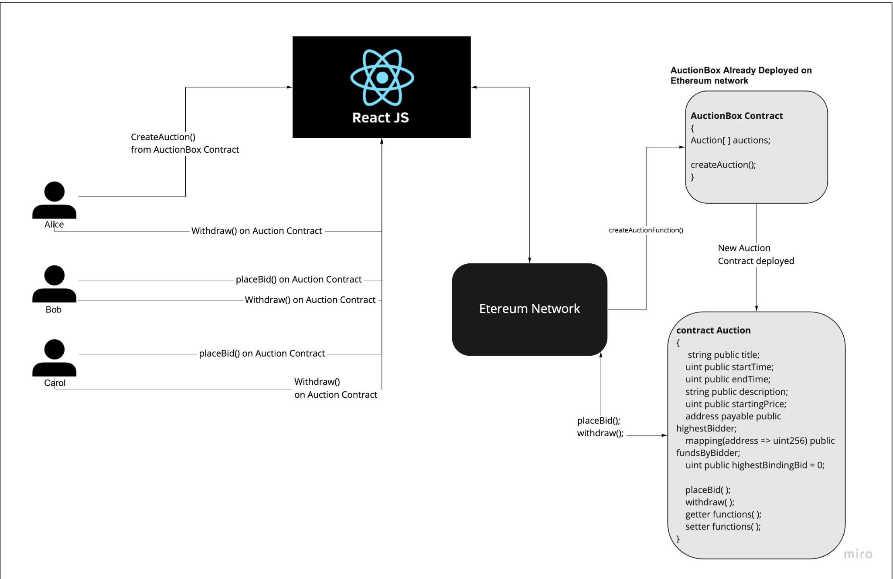
Workflow Diagram

Slide 10
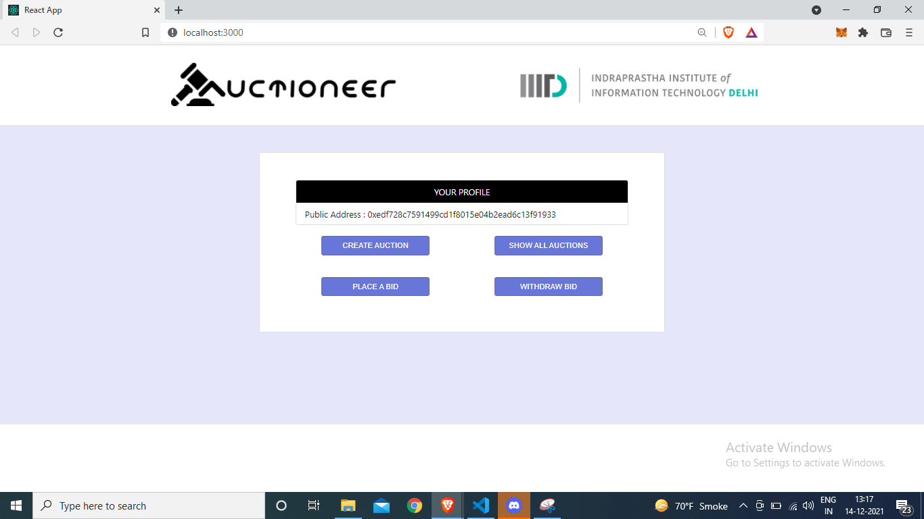
Profile Page

Slide 11
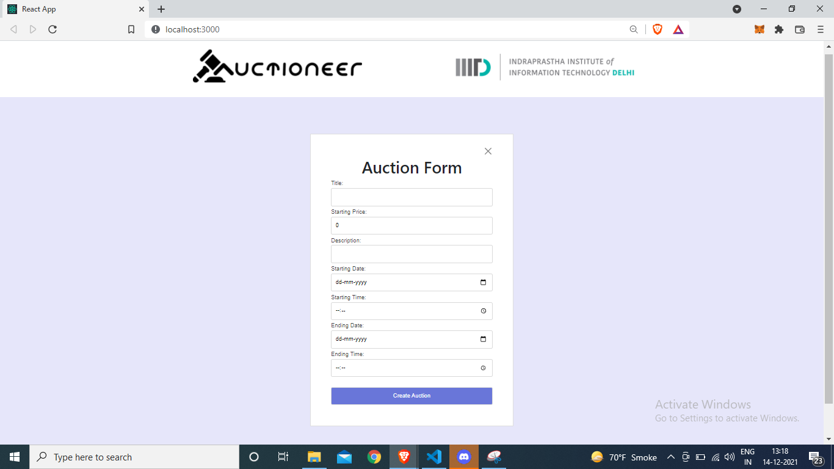
Create auction - 1

Slide 12

Create auction - 2

Slide 13
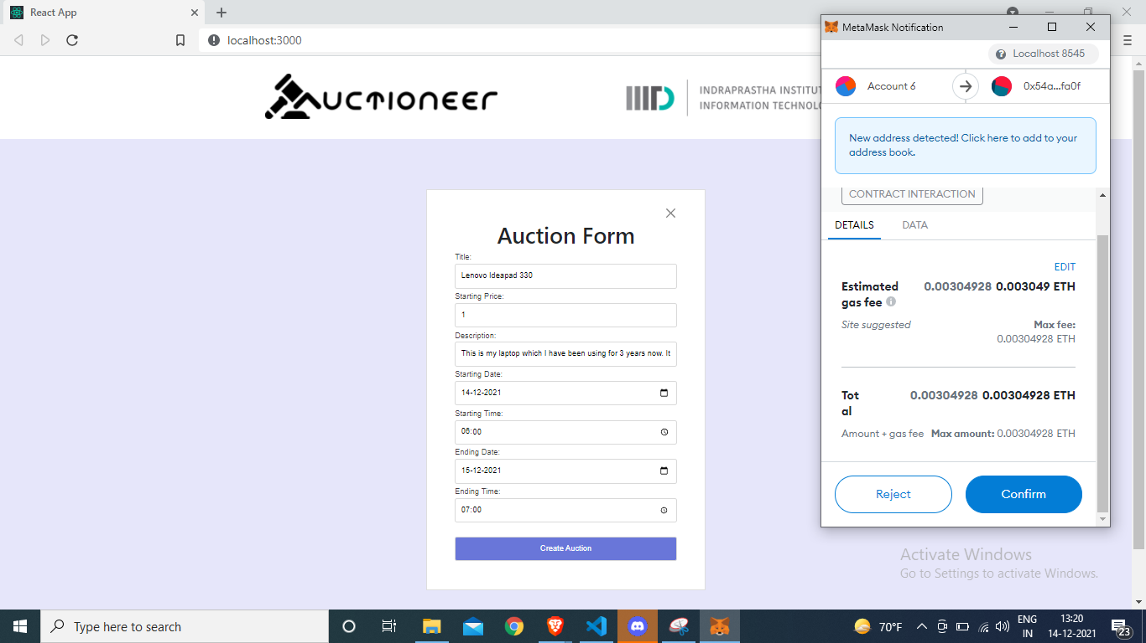
Create auction - 3

Slide 14
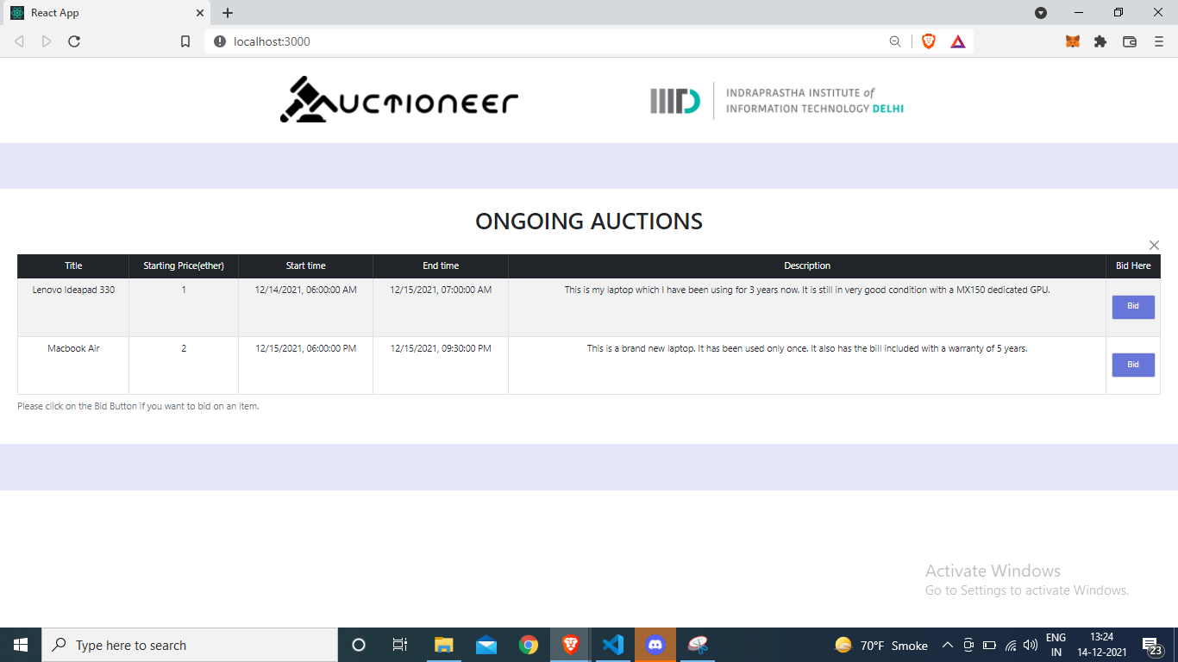
Viewing all auctions

Slide 15
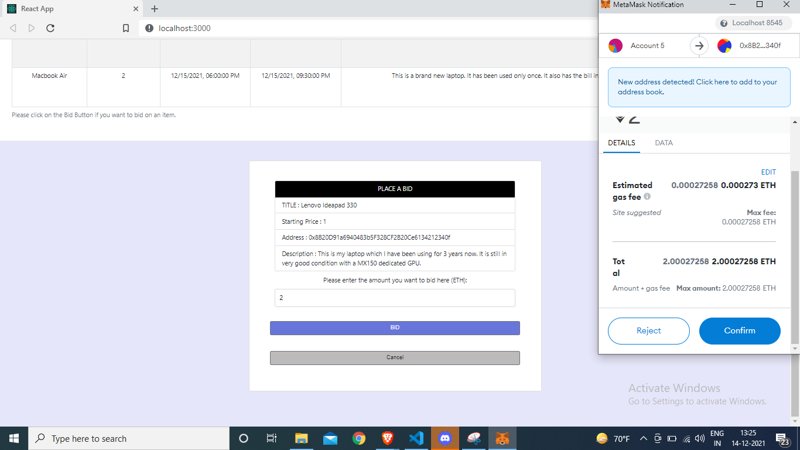
Bidding for Auction - 1/2

Slide 16
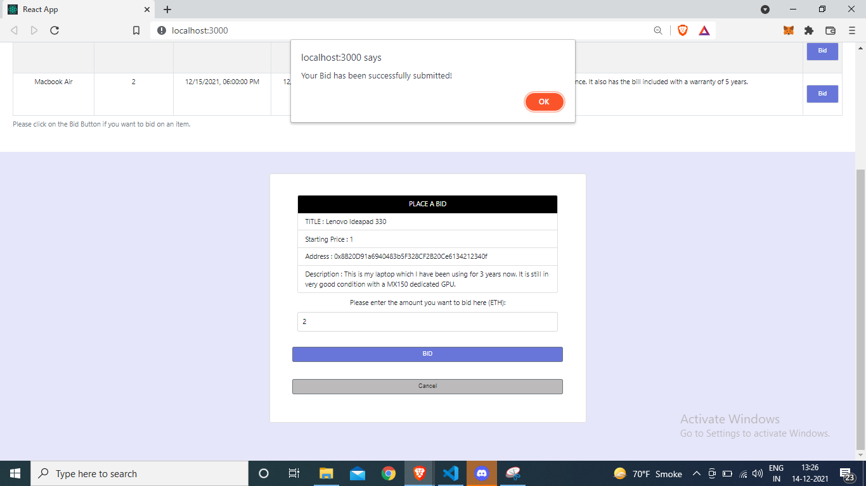
Bidding for Auction - 2/2

Slide 17
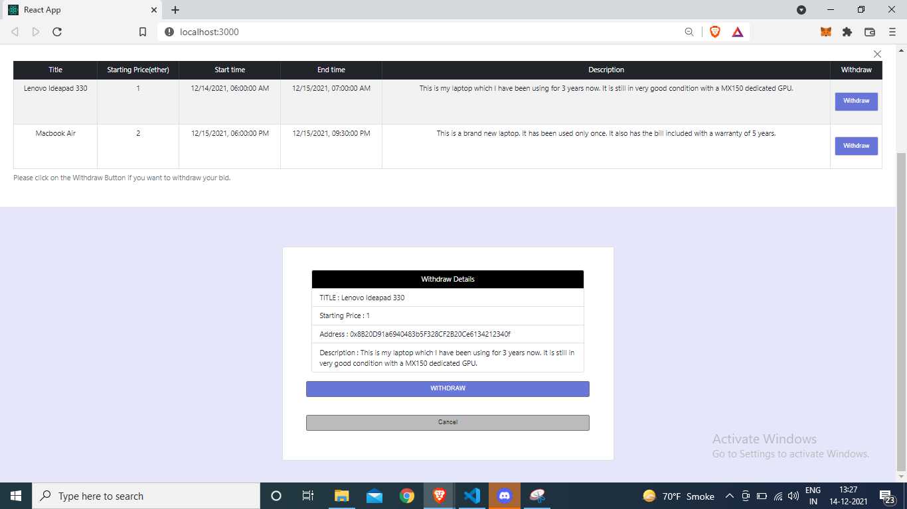
Withdraw

Slide 18
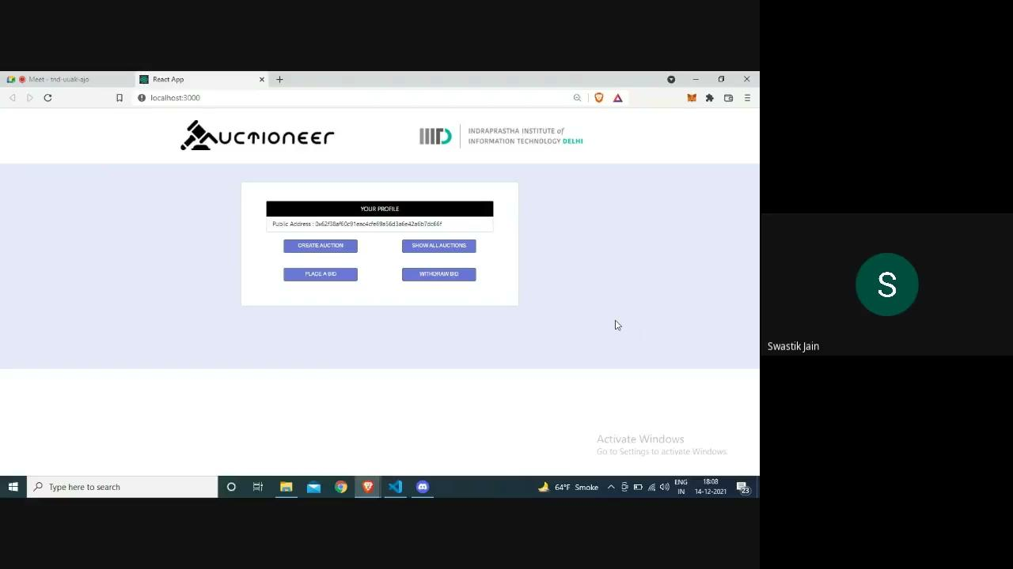
Demo Video
[LINK TO VIDEO]

Slide 19
References
Omar, I., Hasan, H., Jayaraman, R., Salah, K. and Omar, M., 2021. Implementing decentralized auctions using blockchain smart contracts. Technological Forecasting and Social Change, 168, p.120786.
Li, Honglei, and Weilian Xue. “A Blockchain-Based Sealed-Bid e-Auction Scheme with Smart Contract and Zero-Knowledge Proof.” Edited by Leandros Maglaras. Security and Communication Networks 2021 (May 19, 2021): 1–10.
Qusa, Hani, Jumana Tarazi, and Vishwesh Akre. “Secure E-Auction System Using Blockchain: UAE Case Study,” 1–5, 2020.
Lee, Cheng-Chi & Ho, Pi-Fang & Hwang, Min-Shiang. (2009). A secure e-auction scheme based on group signatures. Information Systems Frontiers. 11. 335-343. 10.1007/s10796-008-9094-3.
W. Chen and F. Lei, "A Simple Efficient Electronic Auction Scheme," Eighth International Conference on Parallel and Distributed Computing, Applications and Technologies (PDCAT 2007), 2007, pp. 173-174, doi: 10.1109/PDCAT.2007.60.
H. S. Galal and A. M. Youssef, “Verifiable sealed-bid auction on the Ethereum blockchain,” in Proceedings of the 2018 Financial Cryptography, pp. 265–278, Springer, Nieuwpoort, Curaçao, March 2018
Qusa, Hani & Tarazi, Jumana & Akre, Vishwesh. (2020). Secure E-Auction System Using Blockchain: UAE Case Study. 1-5. 10.1109/ASET48392.2020.9118213.
https://trufflesuite.com/
https://reactjs.org/
https://getbootstrap.com/docs/5.1/getting-started/introduction/
https://docs.soliditylang.org/en/v0.8.10/
https://metamask.io/
https://eprint.iacr.org/2018/704.pdf

