Slide 1
Student Dropout Prediction: A Supervised Learning Approach
This project addresses the critical issue of student attrition in higher education by developing a predictive model to identify at-risk students early in their academic journey. The dataset comprises 4,424 unique student observations, each described by 35 distinct features encompassing academic, demographic, and socio-economic variables. The primary goal is to leverage supervised machine learning classifiers to distinguish between students who will graduate, drop out, or remain enrolled.

Slide 2
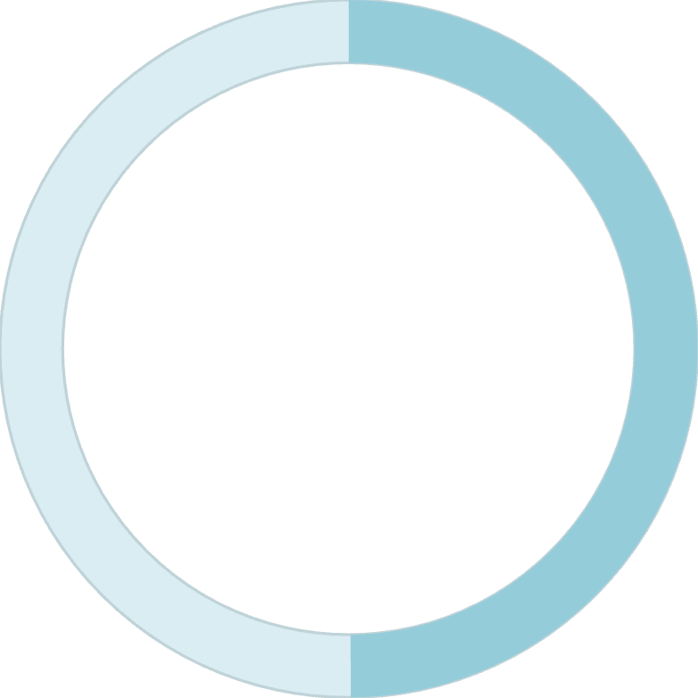

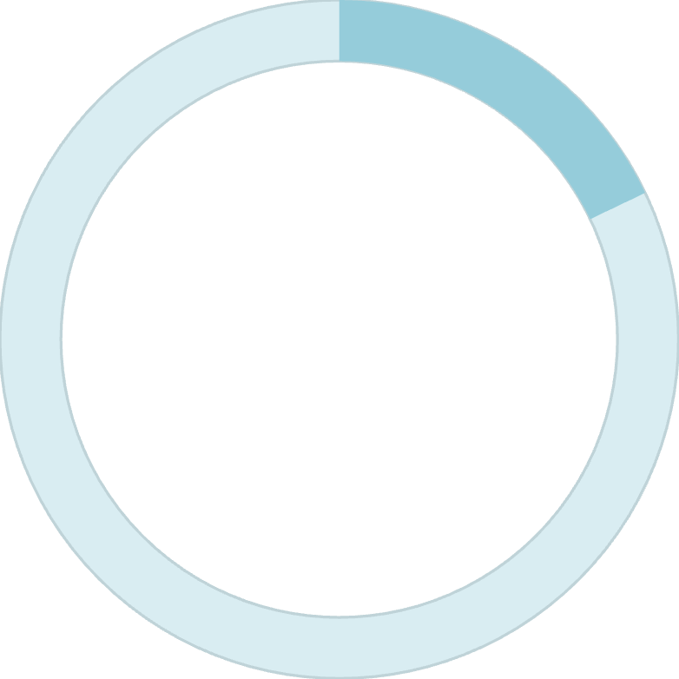
Exploratory Data Analysis: Target Distribution
49.9%
32.1%
17.9%
Graduation Rate
Dropout Rate
Currently Enrolled
Students who successfully complete their degree programs
Students who leave without completing their studies
Students where predictions are most actionable
Analysis of the target variable reveals a distribution that reflects real-world higher education challenges. The dropout rate of 32.1% represents a significant portion of the cohort that requires targeted intervention. The currently enrolled students make up the remaining 17.9% of the dataset, representing the group where predictions are most actionable and where early intervention strategies can have the greatest impact.

Slide 3


EDA: Demographic Insights - Gender and Age
Gender Distribution
Gender Disparity in Outcomes
The student body is predominantly female, accounting for 64.8% of total enrollments compared to 35.2% for males.
There is a clear gender disparity in outcomes: male students exhibit a significantly higher dropout rate of 45.1%, compared to 25.1% for females.
45.1%
25.1%
Male Dropout Rate
Female Dropout Rate
Age at enrollment is right-skewed, with most students entering in their late teens; however, dropout rates notably increase for students enrolling in their mid-20s to early 30s. This finding suggests that non-traditional students face unique challenges that require specialized support systems.

Slide 4
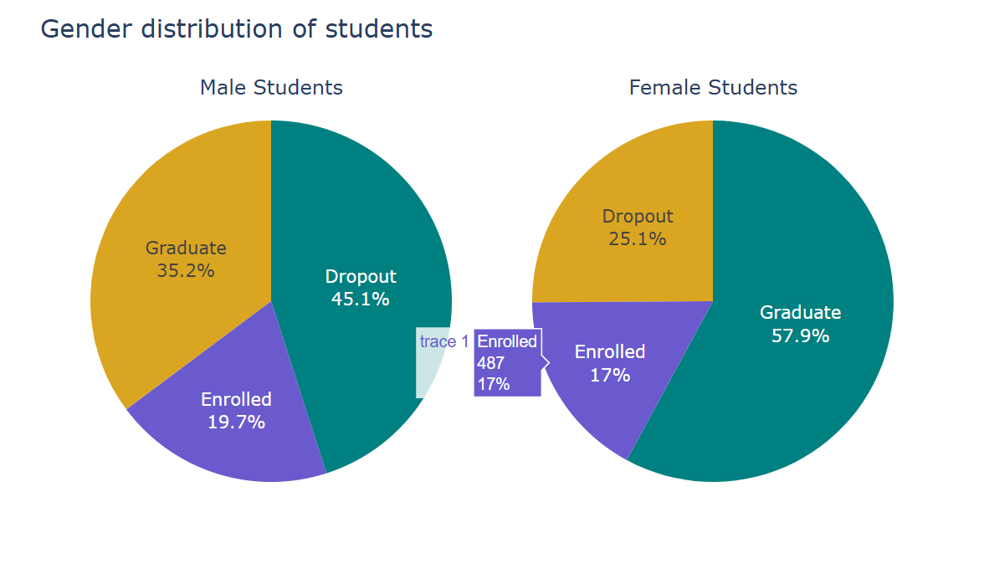

Slide 5
EDA: Academic and Course-Level Trends
Discipline Variation
Performance Indicators
Application Factors
Enrollment varies widely across disciplines, with "Nursing" showing the highest student count and "Biofuel Production Technologies" showing the lowest.
Academic performance in the first and second semesters—specifically curricular units approved and grades—serves as a primary indicator of student success.
The analysis explores how different application modes and previous qualifications impact the final academic standing of students.
The wide variation in enrollment across disciplines suggests that program-specific factors may influence student retention. Understanding these patterns can help institutions allocate resources more effectively and develop targeted retention strategies for programs with higher attrition rates.

Slide 6
Methodology: Data Pre-processing Strategy
01
02
03
Data Cleaning
Feature Scaling
Dimensionality Reduction
Standardizing column names (e.g., correcting "Nacionality" to "Nationality") and verifying that no null values were present in the dataset.
Implementing StandardScaler to normalize numerical variables, ensuring all features contribute equally to the model's distance calculations.
Considering Principal Component Analysis (PCA) to streamline the 35 features into the most impactful components.
These pre-processing steps were essential for ensuring data quality and model performance. By standardizing column names and verifying data completeness, we established a clean foundation for analysis. Feature scaling was particularly important for algorithms that rely on distance calculations, while dimensionality reduction through PCA offered the potential to identify the most influential factors driving student outcomes.

Slide 7










Machine Learning: Supervised Classifiers Used
Logistic Regression
Support Vector Classifier
Random Forest
Employed as a baseline linear model for its interpretability and efficiency in binary and multi-class classification tasks.
Utilized for its ability to handle high-dimensional data and capture non-linear relationships in the dataset.
Included to provide diverse perspectives on data clustering and rule-based decision paths through ensemble methods.
K-Nearest Neighbors
Decision Trees
Used for its ability to identify patterns based on similarity measures and local data structure.
Implemented to provide interpretable, rule-based predictions that can be easily communicated to stakeholders.
Each classifier was selected to provide a different perspective on the data, from linear relationships to complex non-linear patterns. This diverse approach allowed for comprehensive model comparison and ensemble methods.

Slide 8



Model Optimization: Hyperparameter Tuning
GridSearchCV
Parameter Optimization
Cross-Validation
Implemented exhaustive search over specified parameter grids to identify optimal configurations.
Focused on tuning critical parameters such as the number of neighbors in KNN and the regularization strength in Logistic Regression.
Utilized during tuning to ensure models generalize well to unseen data and avoid overfitting.
The hyperparameter tuning process was critical for maximizing model performance. By systematically exploring parameter combinations through GridSearchCV, we identified configurations that balanced bias and variance. Cross-validation ensured that our models would perform reliably on new student data, rather than simply memorizing patterns in the training set.

Slide 9



Results: Model Evaluation and Metrics
Accuracy Score
Confusion Matrices
AUC-ROC
Overall proportion of correctly classified students across all three outcome categories (graduation, dropout, enrolled).
Visualized classification errors to identify specific patterns of misclassification and areas requiring model improvement.
Area Under the Curve of the Receiver Operating Characteristic, measuring the model's discriminative ability across different classification thresholds.
Model performance was evaluated using multiple complementary metrics to provide a comprehensive assessment. The confusion matrices revealed specific patterns of misclassification, such as whether the model tended to over-predict graduation or dropout. The AUC-ROC metric was particularly valuable as it provided a threshold-independent measure of the model's ability to distinguish between at-risk and continuing students.

Slide 10
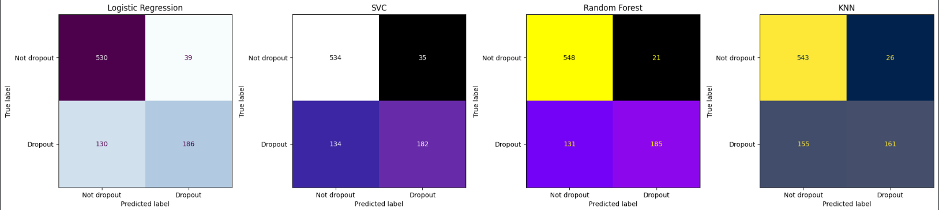

Slide 11
Key Findings: Final Model Performance
0.78
AUC Score
Area Under the Curve demonstrating strong discriminative ability
The final model achieved a good performance level with an AUC score of 0.78. This score indicates that the model can successfully classify 78% of the positive cases (at-risk students) and 22% of the negative cases. While these results are strong, the analysis highlights that there is still room for further improvement through additional feature engineering or ensemble methods.
An AUC of 0.78 represents a meaningful improvement over random guessing (AUC of 0.5) and demonstrates practical utility for identifying students who would benefit from intervention. However, the model's performance suggests opportunities for enhancement through more sophisticated feature engineering, incorporation of additional data sources, or advanced ensemble techniques that combine multiple classifiers.

Slide 12
Conclusion and Recommendations
Effective Identification
Targeted Interventions
Real-Time Monitoring
Supervised machine learning effectively identifies students at risk of dropping out by analyzing a combination of academic, demographic, and economic factors.
Higher education institutions should focus intervention efforts on male students and non-traditional students (aged 25+) who show higher attrition rates.
Future work could involve real-time monitoring of student grades in the first semester to deploy support systems before the dropout occurs.
This project demonstrates the practical application of machine learning to address a critical challenge in higher education. By identifying at-risk students early, institutions can deploy targeted support systems including academic counseling, financial aid, and peer mentoring programs. The findings suggest particular attention should be paid to male students and non-traditional students who enroll in their mid-20s to early 30s.
Future research directions include implementing real-time monitoring systems that track first-semester performance indicators, developing personalized intervention strategies based on individual student profiles, and conducting longitudinal studies to measure the impact of interventions on actual dropout rates. The model framework established in this project provides a foundation for ongoing refinement and expansion as additional data becomes available.

