Slide 1
Unit Testing
patrick.kua@oracle.com
Australian Development Centre
Brisbane, Australia

Slide 2
Aims
Unit Testing vs Traditional Testing
Benefits of Unit Testing
Introduction to xUnit (using JUnit) frameworks
Advanced Unit Testing Strategies

Slide 3
Traditional Testing
Test the system as a whole
Individual components rarely tested
Errors go undetected
Isolation of errors difficult to track down
Notes:
Software is made up of a number of components. Each component is used by other parts of the system to form some either the application or some major part of the end application. Traditional testing leaves the validation of the system to the end. Due to a number of reasons, the system may not operate correctly:
Poor interface/API design
Procedures/functions/methods not written correctly
Integration not correctly performed
Requirements not clearly defined
When bugs are found, or when the functionality of the system is not operating how it should, the task of tracking down exactly what goes wrong is extremely difficult. This mess can be further compounded when changes are made to the code. Since testing is performed at the highest level, there is no guarantee that the system will operate exactly as it was before because there is no guarantee that other parts of the code are going to break.
Question: How can we be certain that the system will operate correctly when we can’t guarantee that the smallest parts of the system are going to work independently? Alternatively, when putting together parts that don’t work, aren’t we going to be guaranteed that the system as whole is not going to work?
We can reduce the number of bugs in the system, but validating that each component on its own operates correctly. The traditional testing can then validate that the pieces of code all operate together.

Slide 4
Traditional Testing Strategies
Print Statements
Use of Debugger
Debugger Expressions
Test Scripts
Notes:
Print Statements
Intent is usually not described in the output
Other developers need to imply or deduct the purpose of the print statements
Very messy and easy to get lost in what the problem is
Difficult to track
Usually transient as it cannot be included in source – considered a side effect of testing and thus must be removed
Debugger Expressions
Not usually portable outside of that specific debugger
Difficult to add to some form of source control
Test Scripts
Difficult to maintain in sychronisation with the source
Lots of work to establish framework for testing application
Usually system level testing

Slide 5
Unit Testing
Each part tested individually
All components tested at least once
Errors picked up earlier
Scope is smaller, easier to fix errors
Notes:
Unit testing aims at testing each of the components that a system are built upon. As long as each of them work as they are defined to, then the system as a whole has a better chance of working together.
Where possible, all units that could possibly fail are tested at least one. Judgement is needed to decide what parts need testing. Some things such as accessors/mutators generally don’t need to be tested.
Components that are erroneous can be detected earlier. The scope of unit tests is even smaller that your traditional tests. If errors are detected, they are generally easier to fix.

Slide 6
Unit Testing Ideals
Isolatable
Repeatable
Automatable
Easy to Write

Slide 7
Why Unit Test?
Faster Debugging
Faster Development
Better Design
Excellent Regression Tool
Reduce Future Cost
Notes:
Reasons to bother unit testing:
Faster Debugging
Unit tests smaller amounts of code, easily isolating points of error and narrowing the scope for errors.
Faster Development
Less time debugging with unit tests
Encourage aggressive refactoring resulting in better design and easier maintenance.
Adding enhancements can be performed with confidence that existing behaviour of the system continues to operate in the same manner.
Better Design
As mentioned before, unit testing encouraging more refactoring.
Unit tests make developers focus more on the contracts of a class and those classes that might use it
Excellent Regression Tool
Major refactorings and restructuring of the code can be performed.
Reduce Future Cost
Unit testing is an investment in the project. It takes time to ramp up, but in the long-term provides a useful basis for the project.

Slide 8
Unit Tests
Simple Standalone Classes
High Level Classes
Database based Classes
Integrated Framework Classes

Slide 9
JUnit (www.junit.org)
Java-based unit testing framework
Elegantly simple
Easy to write unit tests
Easy to manage unit tests
Open source = Free!
Mature Framework
De facto java standard
Ant integration
Generic testing framework
Notes:
JUnit has been around for a while. First registered as a sourceforge project in late 2000, it has only been around for a few years. Its usefulness has been communicated across numerous IT websites and conferences, especially within the Agile Software community. Its stability as an open source project and its maturity and acceptance by many software groups has also lead to a large amount of knowledge sharing in order to maximise the usefulness of JUnit.
JUnit is a java-based unit testing framework. This means that the framework and the tests that are to be written in java, allowing developers to use the framework to write tests without having to learn a new language. It also means that the unit tests can be placed under the same source control system as the code base that it is testing. Java’s OO nature makes it ideal for writing unit tests. With a good design, most classes should be able to function in isolation. Each class should operate on their own data, allowing for unit tests to be written easily. C++, Ruby, Python and C#, also OO languages have this in common.
The framework is so simple that it only takes one class to write a test, and another one to organise them. The simplicity of the framework drastically reduces the learning curve, which means that any developers can quickly be trained to use it when writing their own code every day.
The fact that it is open source means that the cost of using it is only the training cost and that any that you don’t like about the framework can be changed. More likely than not, there will be no bugs, and its maturity in the opensource space means that you can also leverage a number of benefits. These include:
Add-ons or extensions for customised testing of particular types of programs.
Learn from other people’s mistakes by learning best-practices, or testing techniques to make the most use out of the JUnit framework
New developers coming on to projects may have worked with it and can bring their expertise on board.
The fact that it is becoming a de facto java standard also helps in many other aspects because many more IDEs are supporting JUnit test writing and even the creation of skeleton test methods can now be generated quickly and easily. Its close ties with the Ant (build management project) also help
JUnit is also generic enough to be used to write other system tests and automate the process of many other jobs
There are a number of other Xunit testing frameworks built from JUnit, but some that I personally haven’t used.
VBUnit is another (http://www.xprogramming.com/software.htm). www.vbunit.org

Slide 10
JUnit Is Not Perfect
GUI testing
  Marathon Man, WinRunner
EJB Components
  HttpUnit, Cactus
Limited Reporting mechanism
  Artima
Time to set up
Testing of non-java objects difficult
Notes:
JUnit is not the answer for all testing needs. Even though it can be customised or extended for a number of forms of testing, it still is not useful on its own for a number of circumstances. What JUnit lacks shouldn’t discourage any one from writing unit tests because it is always better to test something than nothing at all.
GUIs are notoriously hard to test because of the fact that generally a human needs to drive the process and analyse the outcome. There are a number of techniques for validating GUI classes on their own are acting correctly, but JUnit is still limited to this. There are a number of programs available (e.g. Marathon man, WinRunner) that allow one to record and execute scripts against a GUI.
EJB Components are also difficult to test automatically. The loose coupling between the EJB classes that need to be defined and the nature of the deployment environment makes unit testing extremely difficult. Then again, it is always difficult testing framework code in a generic manner. Another open source project, Cactus is used for EJB/Servlets/JSP/Tag libs testing, while HttpUnit provides easy ways of unit testing code that interacts over HTTP.
Artima provides an extension to Junit by enhancing the reporting mechanism of JUnit. It allows for multiple reports to be generated from a single unit test execution and builds upon a number of other issues that JUnit has in certain environments.
Setting up any test environment to operate effectively in any development environment is difficult, and there are still a number of decisions that need to be made by senior developers in the organisation. Issues such as where the tests go, how the tests are executed, who gets reports need to be considered when setting up the test environment. Unit testing standards need to be created and communicated to the development team.
As JUnit was created for unit testing of java objects, it is not ideal for testing other types of code, especially written in different languages. Tests can be written for meta-data type things such as XML, DTDs, etc and there are extensions for this, but it does not provide a good clean way for testing, for example, c code. There are of course a number of alternatives for this with a number of other xUnit testing frameworks available.

Slide 11
Key Concepts in JUnit
Test interface
Assert
TestCase
  assertTrue
  assertEquals
  fail
TestSuite
TestDecorator/TestSetup
Failures vs Errors
Assert
<Test>
run(TestResult)
TestCase
setUp()
tearDown()
TestSuite
run(TestResult)
Notes:
JUnit’s simplicity revolves around two main classes (TestCase and TestSuite). Both of these classes implement the Test interface. The Test interface’s key method is the run(TestResult) one so that both TestCase and TestSuite are considered executable tests.
The TestCase class is where each of the unit tests are defined. One would typically extend this class to act as a container to write unit tests in. It extends the Assert interface which defines a number of methods to state in formal terms the expectations for the test. What this means to a developer is that you can formally state a number of statements that should hold true. Any that are incorrect fail the test being run.
The TestSuite class is used to manage unit tests. A TestSuite can embed a single, or multiple tests, and even single or multiple test suites. The recursive nature allows a hierarchy of unit tests to be build. It also provides a way for developers to quickly specify the unit tests that they may want to execute locally.
The TestDecorator class is part of the extensions to the junit framework. These classes provide additional classes that are not considered essential to writing unit tests, but may provide useful functionality in writing tests. The javadoc from JUnit describes this class ‘as the base class for defining new test decorators. Test decorator subclasses can be introduced to add behaviour before or after a test is run.’ An example of the TestSetup is provided in the document.
JUnit’s approach to result reporting is very simple and takes a bit of adjusting to traditional testing. Typical unit tests require manual validation to verify the tests are passing. JUnit takes the approach of highlighting tests to developers only if they are not operating correctly. This is because if all unit tests are passing, then it means that no more additional code needs to be added for functionality. Thus, it is only important for a developer to pay attention if their unit test is not passing. When a test doesn’t pass, then there are two results – a failure or an error. A failure is a result of an assertion not passing, or as part of a programmatic call to a fail() method. An error is when an exception is thrown from the unit test method. The end result for a test is still the same, but sometimes it is useful to distinguish between the two. What this means is that for developer’s to correctly write unit tests, these are the only ways that a unit test will not pass.

Slide 12
JUnit is Easy
…
public void testInvalidPersonName()
{
person.setFirstName(null);
person.setLastName(“Smith”);
try
{
personService.createPerson(person);
fail(“An invalid person name should be thrown”);
} catch (InvalidPersonName ipn) {
// Exception expected
}
}
…

Slide 13
Writing a Unit Test
Create a class to hold the unit tests
Initialise objects (setUp() method)
(State assertions – preconditions)*
Call operations on the objects that are being unit tested
State assertions/failures expected
Clean up (tearDown() method)
Execute the unit test

Slide 14
JUnit Best Practices
Setting up unit tests
Running unit tests
Writing unit tests

Slide 15
Setting up Unit Tests
public class SomeClass
{
..
public void someMethod()
{
..
}
..
}
ctb
src
oracle
apps
ctb
…
test
oracle
apps
ctb
…
public class SomeClassTest
{
public void testSomeMethod()
{
..
}
}
Notes:
Best practices for setting up unit tests
Source/Test separation
Clean separation
Alignment of packages still allows protected methods to be tested
Focus on public methods (this is the contract exposed by each class – a fine balance between too much and not enough testing).
Define a standard naming Convention
Easily identify
Tests
Test Suites
High level test suites
Easily runnable (junit target in ant – can execute classes matching a certain pattern)
Make the process of writing tests easy
Create helper classes to perform tasks that might be too complex
Customise the framework to suit your development environment

Slide 16
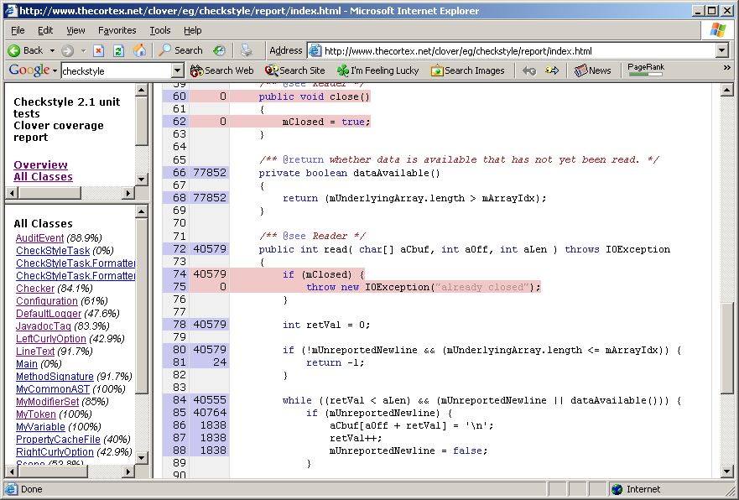
Running Unit Tests
Define standard Ant targets
Run unit tests automatically and continuously
Implement code coverage tools
Line not
executed
Number of times
executed
Executed line
Notes:
Best Practices for Running Unit Tests
Define standard Ant targets
Ant is a build management tool that acts like make in many ways. It also builds upon it by providing a simple way of defining a number of tasks that can be
Run unit tests automatically and continuously
Have test reports generated automatically as often as possible.
Email them to developers, or customise it so that it only emails if there are errors.
Implement code coverage tools

Slide 17
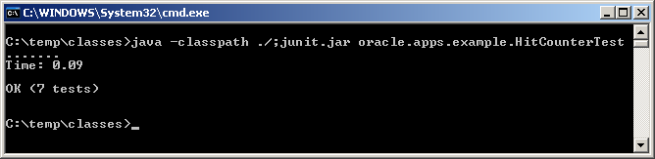
Quality of Unit Tests
Number of Unit Tests
Code Coverage

Slide 18
Writing Unit Tests
Avoid setup in constructor
Define tests correctly
Minimise side-effects of unit tests
Leverage Junit’s assertions and failures to their fullest
Keep tests small and fast
Automate all processes
Write effective exception handling code
Add a test case for every bug exposed
Refactor, refactor, refactor

Slide 19
Advanced Unit Testing
Mock Objects
What to Test and How Much to Test
  Bugs
  New Functionality
Optimize Running Time
Code Coverage
Environment Management
  Continuous Integration
  Local and remote development

Slide 20
Conclusion
Unit testing adds enormous value to software development
JUnit makes testing java programs easy
Advanced Unit Testing Concepts

Slide 21
Questions?

