Slide 1
Intro to J2EE Concepts

Slide 2
J2EE Introduction
What does J2EE stand for
What is its purpose
Why should I learn to develop Web Applications using J2EE technologies

Slide 3
What is J2EE (or JEE)
Short for Java 2 Platform Enterprise Edition.
J2EE is a platform-independent, Java-centric environment from Sun/Oracle for developing, building and deploying Web-based enterprise applications online.
The J2EE platform consists of a set of services, APIs, and protocols that provide the functionality for developing multi-tiered, Web-based applications.

Slide 4














Java: Broadest Industry Adoption
9,000,000 JAVA DEVELOPERS
DEPLOYING TO 18 COMPLIANT APPLICATION SERVERS
Notes:
The talk is about Java EE 7, but lets take a quick look at Java EE 6 first.
But why does this matter?
More than 18 EE 6-compliant app servers
Strategic to almost every major technology vendor, including Oracle
EE 6 adopted quickly, anticipate EE 7 standard to continue trend
EE affects the way the world does business, and that’s why we’re so excited
This has been the fastest roll out by Java EE application server vendors with a great variety of open source and commercial application servers. Java EE Web Profile allowed new vendors like Caucho and Apache to easily participate. This page shows the list of Java EE compliant vendors. The complete list is at: http://www.oracle.com/technetwork/java/javaee/overview/compatibility-jsp-136984.html
This is the #1 development platform for enterprise applications and preferred choice for enterprise developers.
There is a mix of open source and commercial vendors. Java EE 6 has seen the fastest implementation of a Java EE release ever.

Slide 5
Differences between Java EE and Java SE
Java technology is both a programming language and a platform.
The Java programming language is a high-level object-oriented language that has a particular syntax and style.
A Java platform is a particular environment in which Java programming language applications run.
There are several Java platforms.
Many developers, even long-time Java programming language developers, do not understand how the different platforms relate to each other.

Slide 6
Java SE
When most people think of the Java programming language, they think of the Java SE API.
Java SE's API provides the core functionality of the Java programming language.
It defines everything from the basic types and objects of the Java programming language to high-level classes that are used for networking, security, database access, graphical user interface (GUI) development, and XML parsing.
In addition to the core API, the Java SE platform consists of a virtual machine, development tools, deployment technologies, and other class libraries and toolkits commonly used in Java technology applications.

Slide 7
Java EE
The Java EE platform is built on top of the Java SE platform.
The Java EE platform provides an API and runtime environment for developing and running
large-scale
multi-tiered
scalable
reliable
secure network applications

Slide 8
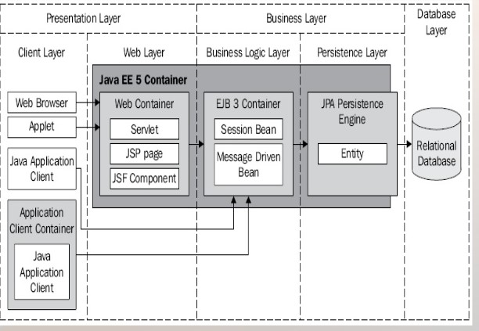
A glance at J2EE architecture

Slide 9
Distributed Multi-tiered Applications
The Java EE platform uses a distributed Multi-tiered application model for enterprise applications.
Application logic is divided into components according to function
The application components that make up a Java EE application are installed on various machines depending on the tier in the Multi-tiered Java EE environment to which the application component belongs.

Slide 10
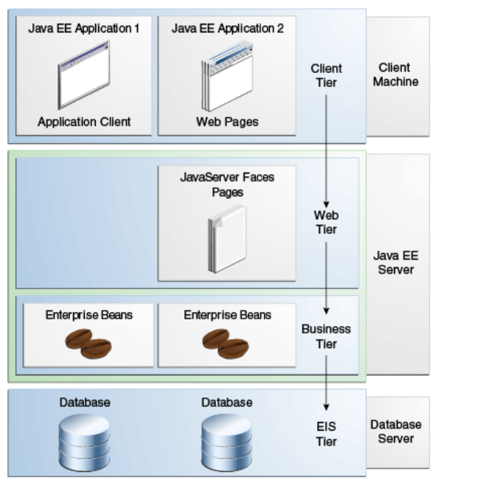
Multi-tiered Applications

Slide 11
Three-tiered Applications
Although a Java EE application can consist of all tiers shown in the prior slide, Java EE Multi-tiered applications are generally considered to be three-tiered applications because they are distributed over three locations:
Client machines
The Java EE server machine, and the database or legacy machines at the back end.
Three-tiered applications that run in this way extend the standard two-tiered client-and-server model by placing a multithreaded application server between the client application and back-end storage.

Slide 12
Java EE Components
Java EE applications are made up of components.
A Java EE component is
a self-contained functional software unit that
is assembled into a Java EE application with its related classes and files
communicates with other components.
The Java EE specification defines the following Java EE components:
Application clients and applets are components that run on the client.
Java Servlet, JavaServer Faces, and JavaServer Pages (JSP) technology components are web components that run on the server.
EJB components (enterprise beans) are business components that run on the server.

Slide 13
Java EE Components
Java EE components are written in the Java programming language and are compiled in the same way as any program in the language.
The differences between Java EE components and "standard" Java classes:
Java EE components are assembled into a Java EE application
they are verified to be well formed and in compliance with the Java EE specification
they are deployed to production, where they are run and managed by the Java EE server.

Slide 14
Java EE Components
Client-tier components run on the client machine.
Web-tier components run on the Java EE server.
Business-tier components run on the Java EE server.
Enterprise information system (EIS)-tier software runs on the EIS server.

Slide 15
Java EE Clients
A Java EE client is usually either a web client or an application client.

Slide 16
Web Clients
A web client consists of two parts:
Dynamic web pages containing various types of markup language (HTML, XML, and so on), which are generated by web components running in the web tier
A web browser, which renders the pages received from the server
A web client is sometimes called a thin client.
Thin clients usually do not query databases, execute complex business rules, or connect to legacy applications.
When you use a thin client, such heavyweight operations are off-loaded to enterprise beans executing on the Java EE server, where they can leverage the security, speed, services, and reliability of Java EE server-side technologies.

Slide 17
Application Clients
An application client runs on a client machine and provides a way for users to handle tasks that require a richer user interface than can be provided by a markup language.
An application client typically has a graphical user interface (GUI) created from the Swing API or the Abstract Window Toolkit (AWT) API, but a command-line interface is certainly possible.
Application clients directly access enterprise beans running in the business tier.
However, if application requirements warrant it, an application client can open an HTTP connection to establish communication with a servlet running in the web tier.
Application clients written in languages other than Java can interact with Java EE servers, enabling the Java EE platform to interoperate with legacy systems, clients, and non-Java languages.

Slide 18
JavaBeans Component Architecture
The server and client tiers might also include components based on the JavaBeans component architecture (JavaBeans components) to manage the data flow between the following:
An application client or applet and components running on the Java EE server
Server components and a database
JavaBeans Components have get() and set() methods for accessing those properties.
JavaBeans components used in this way are typically simple in design and implementation
Should conform to the naming and design conventions outlined in the JavaBeans component architecture.

Slide 19
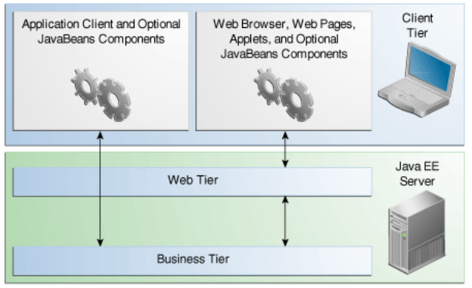
Java EE Server Communications
Shows the various elements that can make up the client tier.
The client communicates with the business tier running on the Java EE server
either directly or, as in the case of a client running in a browser
by going through web pages or
servlets running in the web tier.

Slide 20
Web Components
Java EE web components are either servlets or web pages created using JavaServer Faces technology and/or JSP technology (JSP pages).
Servlets are Java programming language classes that dynamically process requests and construct responses.
JSP pages are text-based documents that execute as servlets but allow a more natural approach to creating static content.
JavaServer Faces technology builds on servlets and JSP technology and provides a user interface component framework for web applications.
Static HTML pages and applets are bundled with web components during application assembly but are not considered web components by the Java EE specification.
Server-side utility classes can also be bundled with web components and, like HTML pages, are not considered web components.

Slide 21
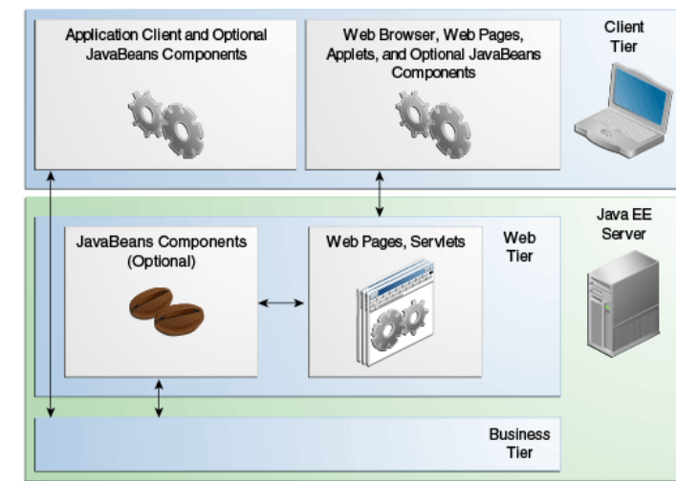
Web Tier and Java EE Applications
The web tier, like the client tier, might include a JavaBeans component to
manage the user input and send that input to enterprise beans running
in the business tier for processing.

Slide 22
Business Components
Business code, which is logic that solves or meets the needs of a particular business domain such as banking, retail, or finance, is handled by enterprise beans running in either the business tier or the web tier.
An enterprise bean receives data from client programs, processes it (if necessary), and sends it to the enterprise information system tier for storage.
An enterprise bean also retrieves data from storage, processes it (if necessary), and sends it back to the client program.

Slide 23
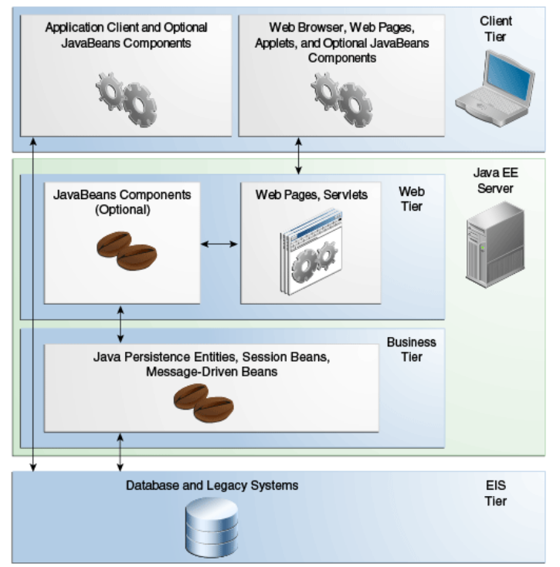
Business and EIS Tiers

Slide 24
Enterprise Information System Tier
The enterprise information system tier handles EIS software and includes enterprise infrastructure systems, such as
enterprise resource planning (ERP)
mainframe transaction processing, database systems
other legacy information systems
For example, Java EE application components might need access to enterprise information systems for database connectivity.

Slide 25
Java EE Containers
Normally, thin-client Multi-tiered applications are hard to write because they involve many lines of intricate code to handle
transaction and state management
multithreading
resource pooling
other complex low-level details.
The component-based and platform-independent Java EE architecture makes applications easy to write because business logic is organized into reusable components.
In addition, the Java EE server provides underlying services in the form of a container for every component type.
Because you do not have to develop these services yourself, you are free to concentrate on solving the business problem at hand.

Slide 26
A glance at J2EE architecture
Containers provide services for :
Security
Transaction
Persistence
Concurrency
Availability
Lifecycle Management

Slide 27
Container Services
Containers are the interface between a component and the low-level, platform-specific functionality that supports the component.
Before it can be executed, a web, enterprise bean, or application client component must be assembled into a Java EE module and deployed into its container.
The assembly process involves specifying container settings for each component in the Java EE application and for the Java EE application itself.
Container settings customize the underlying support provided by the Java EE server, including such services as
security
transaction management
Java Naming and Directory Interface (JNDI) API lookups
remote connectivity.

Slide 28
Container Services
The Java EE security model lets you configure a web component or enterprise bean so that system resources are accessed only by authorized users.
The Java EE transaction model lets you specify relationships among methods that make up a single transaction so that all methods in one transaction are treated as a single unit.
JNDI lookup services provide a unified interface to multiple naming and directory services in the enterprise so that application components can access these services.
The Java EE remote connectivity model manages low-level communications between clients and enterprise beans.
After an enterprise bean is created, a client invokes methods on it as if it were in the same virtual machine.

Slide 29
Container Services
Because the Java EE architecture provides configurable services, components within the same application can behave differently based on where they are deployed.
For example, an enterprise bean can have security settings that allow it a certain level of access to database data in one production environment and another level of database access in another production environment.
The container also manages non-configurable services such as
enterprise bean and servlet lifecycles,
database connection resource pooling,
data persistence,
access to the Java EE platform APIs

Slide 30
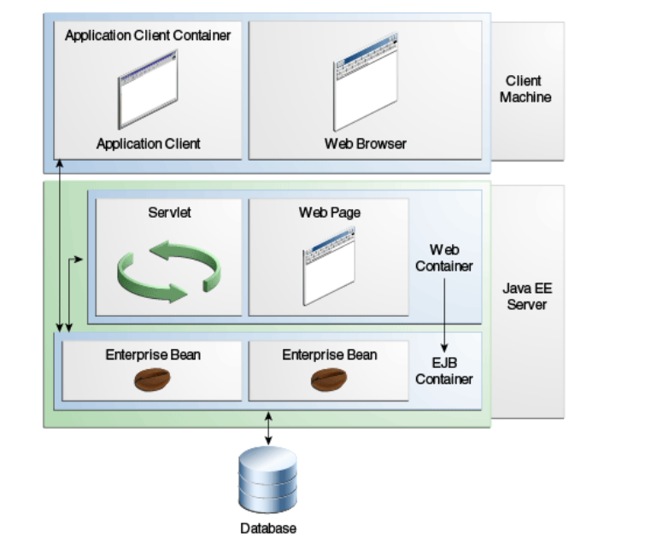
Container Types
The deployment process installs Java EE application components in the Java EE containers

Slide 31
Servers and Containers
Java EE server: The runtime portion of a Java EE product. A Java EE server provides EJB and web containers.
EJB container: Manages the execution of enterprise beans for Java EE applications. Enterprise beans and their container run on the Java EE server.
Web container: Manages the execution of web pages, servlets, and some EJB components for Java EE applications. Web components and their container run on the Java EE server.
Application client container: Manages the execution of application client components. Application clients and their container run on the client.
Applet container: Manages the execution of applets. Consists of a web browser and a Java Plug-in running on the client together.

Slide 32
J2EE Development Lifecycle
Develop components for
Persistence (Entities)
Business Logic (EJBs)
Presentation (JSF, XHTML)
Configure/Prepare deployment descriptors
Build Components in packages (JARs, WARs, EARs)
Deploy packages on Container (J2EE Server)

Slide 33
Java EE Application Assembly and Deployment
A Java EE application is packaged into one or more standard units for deployment to any Java EE platform-compliant system.
Each unit contains
A functional component or components, such as an enterprise bean, web page, servlet, or applet
An optional deployment descriptor that describes its content
Once a Java EE unit has been produced, it is ready to be deployed.
Deployment typically involves using a platform's deployment tool to specify location-specific information, such as a list of local users who can access it and the name of the local database.
Once deployed on a local platform, the application is ready to run.

Slide 34
J2EE Technologies
Java Persistence API (JPA)
Enterprise Java Beans (EJB)
eXtended Markup Language (XML)
Java Server Faces (JSF)
eXtensible HyperText Markup Language(XHTML)

Slide 35
Other Related Technologies
Cascading Style Sheets (CSS)
JavaScript & Jquery
Ajax
Dependency Injection Frameworks

Slide 36
EJB Overview
What is EJB?
A platform for building portable, reusable, and scalable business applications using Java
A piece of Java code that executes in a specialized runtime environment called the EJB container
EJB is both a component and a framework

Slide 37
EJB Overview
EJB as a component
Persistence
Entity Beans
Business Logic
Session Beans
MessageDriven Beans

Slide 38

EJB Overview
EJB as a framework
Out of the box services
Available to all components during execution via EJB Container
Annotations : The magic wand
Specify services, types and behavior
Service Oriented Architecture
Fast and easy Web Service Creation

Slide 39
JSF Overview
What is Java Server Faces
A component architecture
A standard – extendable set of UI Widgets
An application infrastructure
Basic Characteristics
Event oriented components
Powerful architectures for different Uis (desktop browsers, mobile devices etc.)
Flexible Navigation System

Slide 40
JSF Overview
Basic Characteristics
Syncronization with Java Objects through backing beans
Internationaliztion
Validators & Converters
Several popular implementations
RichFaces
IceFaces
PrimeFaces

Slide 41
XHTML Overview
Why XHTML instead of HTML
A more clean and standard way to write HTML
Take advantages of all XML goodies
Allows a larger percentage of browsers or code parsers to properly parse pages
Use of Templates to facilitate page reusability and “inheritance”

Slide 42
XHTML Overview
Differences with HTML
XHTML elements must be properly nested
XHTML elements must always be closed
XHTML elements must be in lowercase
XHTML documents must have one root element
Documents can be validated much easier

Slide 43
XHTML Overview
Documents can be transformed via tools like XSLT into other documents for consumption by devices like handhelds
Fragments of documents can be retrieved faster
Text can be stored more efficiently in object oriented databases

