Slide 1
Log4J

Slide 2
Introduction
Using the Log4J as a standard approach to logging.
Logging defined as “A record, as of the performance of a machine or the progress of an undertaking.”(Dictionary.com)

Slide 3
Topics of Discussion
The value of logging
Approaches to logging-tracing
Log4J Background
Log4J Configuration
Using Log4j
Examples

Slide 4
The Value of logging
Do programmers use debuggers or Loggers?
  Logging is often faster then using a debugger.
  Logging can be used to diagnose problems in the field.
  Debugging is difficult in a distributed computing environment.
  Note: The key to using a logger for debugging is to have lots of events recorded.

Slide 5
Logging activities
Note how similar this activities are.
  Tracing
  Debugging
  Error Handling
  Logging
  (All write output to a storage device. Only the type of information written is different)

Slide 6
What is logged?
Types of information logged
  Program flow
  Detailed information about what occurs in a method at a granular level.
  Information about a specific error that has occurred in the system.
  Document historical business events that have occurred.

Slide 7
Approaches to Logging
System.out.println
  Poor performance
  All or none – Example below
  Some people use a class like
  Class foo{
    public static final boolean debug = true;
    public void test(){
      If(debug)System.out.println(“I exist only in a test environmnet”);
    }
  }
Custom log api
  More code to maintain
  Classic build vs buy (or use) decision
Open Source (like Log4j)

Slide 8
Log4J background
In early 1996, the E.U. SEMPER project decided to write its own tracing API
Later developed by IBM at their Zurich research lab.(www.zurich.ibm.com)
Currently maintained by Source Forge(www.sourceforge.net).
Open source
Release 1.0+ documentation at http://jakarta.apache.org/log4j/index.html

Slide 9
Logging performance
Log4j claims to be fast and flexible: speed first, flexibility second. Although log4j has a many features, its first design goal was speed. Some log4j components have been rewritten many times to improve performance.

Slide 10
Basic API
As of 1.0, printing messages are of the form:.
debug(Object message, Throwable t)
debug(Object message)
If the 1st argument is a String object, it will be written in its present form. Other objects rendered by a registered Object renderer for its class or using the Object.toString method.

Slide 11
Basic Usage Example
Standard usage.
class Foo {
category log = null;
public Foo(){
log = Category.getInstance(getClass());
log.info(“Constructing foo”);
}
Public String doStuff(Long x){
log.debug(“doing stuff”);
}
}

Slide 12
Priorities
Five recognized message priorities:
  DEBUG,INFO,WARN,ERROR ,FATAL
Priority specific log methods following the the form:
  debug(Object message);
  debug(Object message, Throwable throwable);
General log methods for wrappers and cutom priorites:
  log(Priority level, Object message);
  log(Priority level, Object message,Throwable throwable);
Localized log methods supporting ResourceBundles:
  L7dlog(Priority level, String message, Throwable throwable)
  L7dlog(Priority level, Object[] params, Throwable throwable)
  setResourceBundle(ResourceBundle);

Slide 13
Categories
The notion of categories lies at the heart of log4j.
Categories define a hierarchy and give the programmer run-time control on which statements are printed or not.
Categories are assigned priorities. A log statement is printed depending on its priority and its category.
Used to support output to multiple logs (Appenders) at the same time.
Log4j.category.com.mycompany.finance=INFO, FIN_Appender
This will direct all log messages in package com.mycompany.finance with priority > INFO.

Slide 14
Category Names
You can name categories by locality. It turns out that instantiating a category in each class, with the category name equal to the fully-qualified name of the class, is a useful and straightforward approach of defining categories.
However, this is not the only way for naming categories. A common alternative is to name categories by functional areas. For example, the "database" category, "RMI" category, "security" category, or the "XML" category.

Slide 15
Benefits of using fully qualified class names for categories.
It is very simple to implement.
It is very simple to explain to new developers.
It automatically mirrors your application's own modular design.
It can be further refined at will.
Printing the category automatically gives information on the locality of the log statement.

Slide 16
Root category
If no category is defined via a configuration file or programmatically, then all messages will be sent to the root category.
All Categories define a priority level and an Appender.
Ex of definition in (log4j.properties):
Log4j.rootCategory=WARN, ROOT_Appender

Slide 17
Appenders
An Appender is a object that sends log messages to their final destination.
FileAppender – Write to a log file
SocketAppender – Dumps log output to a socket
SyslogAppender – Write to the syslog.

Slide 18
Appenders
NTEventLogAppender – Write the logs to the NT Event Log system.
RollingFileAppender – After a certain size is reached it will rename the old file and start with a new one.
SocketAppender – Dumps log output to a socket
SMTPAppender – Send Messages to email
JMSAppender – Sends messages using Java Messaging Service
Or create your own. Not that difficult.

Slide 19
PatternLayout – Customize your message
Used to customize the layout of a log entry. The format is closely related to conversion pattern of the printf function in ‘c’ The following options are available:
c - Used to output the category of the logging event.
C - Used to output the fully qualified class name of the caller issuing the logging request.
d - Used to output the date of the logging event. The date conversion specifier may be followed by a date format specifier enclosed between braces. For example, %d{HH:mm:ss,SSS} or %d{dd MMM yyyy HH:mm:ss,SSS}. If no date format specifier is given then ISO8601 format is assumed
F - Used to output the file name where the logging request was issued.
l - Used to output location information of the caller which generated the logging event. (C+M+L)
L - Used to output the line number from where the logging request was issued.

Slide 20
PatternLayout – Customize your message
n - Outputs the platform dependent line separator character or characters.
M - Used to output the method name where the logging request was issued.
p - Used to output the priority of the logging event.
t - Used to output the name of the thread that generated the logging event.
x - Used to output the NDC (nested diagnostic context) associated with the thread that generated the logging event.

Slide 21
Sample log4j.properties
# Set options for appender named "ROOT_Appender"
# It should be a RollingFileAppender, with maximum file size of 10 MB# using at most one backup file. The layout is using a pattern layout. ISO8061 date format with context printing enabled.
log4j.appender.ROOT_Appender=org.log4j.RollingFileAppender
log4j.appender.ROOT_Appender.File=out.log
log4j.appender.ROOT_Appender.MaxFileSize=10MB
log4j.appender.ROOT_Appender.MaxBackupIndex=1
log4j.appender.ROOT_Appender.layout=org.log4j.PatternLayout
log4j.appender.ROOT_Appender.layout.ConversionPattern=%d{ISO8601} %p %t %x - %m%n
# Root category set to DEBUG using the ROOT_Appender appender defined above.
log4j.rootCategory=INFO, ROOT_Appender
log4j.category.com.emaritz.registration.ejb=DEBUG

Slide 22
Architecture
The Log4j package is distributed under the Apache Software License
The latest Log4j version can be found at http://logging.apache.org/log4j/
Log4j has been ported to the C, C++, C#, Perl, Python, Ruby, and Eiffel languages

Slide 23
Continue...
Why Log4j is so popular
  Log4j is designed to be fast and extensible
  Log4j is simple and easy to use
  Able to disable certain log statements while allowing others to print unhindered
Log4j has three main components:
  Logger: handling the majority of log operations
  Appender: controlling the output of log operations
  Layout: formatting the output for Appender

Slide 24
Component --- Logger
Logger has 7 levels
  ALL
  DEBUG
  INFO
  WARN
  ERROR
  FATAL
  OFF

Slide 25
Loggers - continued
The behaviour of loggers is hierarchical
  A logger is said to be an ancestor of another logger if its name followed by a dot is a prefix of the descendant logger name
  For example, the logger named “ca.hippo" is a parent of the logger named "ca.hippo.bugtracking“
  The root logger resides at the top of the logger hierarchy

Slide 26
Logger - continued
Logging requests
  debug, info, warn, error, fatal and log are methods of a logger instance to log a message
  logger.info("Hippo starts") is a logging request of level INFO
  A logging request is said to be enabled if its level is higher than or equal to the level of its logger. Otherwise, the request is said to be disabled

Slide 27
Logger - continued...
  A logger without an assigned level will inherit one from the hierarchy
  This rule is at the heart of log4j
  Example
    Logger parentlogger = Logger.getLogger("ca.hippo");
    parentLogger.setLevel(Level.INFO);
    Logger childLogger = Logger.getLogger("ca.hippo.bugtracking");

Slide 28
Loggers - continued
  parentLogger.warn("Reach the capacity");
  /* enabled */
  parentLogger.debug("Users number = 1000");
  /* disabled */
  childLogger.info(“A new bug is added");
  /* enabled */
  childLogger.debug("The new bug is numbered 00132"); /*disabled */

Slide 29
Component --- Appender
An output destination of a loggeris is called an appender
Currently, appenders exist for:
  console, files, GUI components, remote socket servers, JMS, NT Event Loggers, and remote UNIX Syslog daemons. It is also possible to log asynchronously

Slide 30
Appenders - Continued
Accordingly we have many appender type:
  ConsoleAppender, DailyRollingFileAppender, FileAppender, RollingFileAppender, WriterAppender, WriterAppender, SocketAppender, SocketHubAppender, SyslogAppendersends, TelnetAppender
Log4j allows logging requests to print to multiple destinations

Slide 31
Appenders - continued
The addAppender method adds an appender to a given logger
Appenders are inherited additively from the logger hierarchy
  Each enabled logging request for a given logger will be forwarded to all the appenders in that logger as well as the appenders higher in the hierarchy

Slide 32
Appenders - continued
Appender accumulation is no longer additive by setting the logger’s additivity flag to false
  L1.L2.L3.L4
  L1(f1), L2(f2), L3(f3, false), L4(f4)
Examples: together with Layout

Slide 33
Component --- Layout
Layout is responsible for formatting the output for Appender
There are three types of Layout available:
  SimpleLayout: (Level - log message)
  PatternLayout formats the output based on a conversion pattern specified, or if none is specified, the default conversion pattern
  HTMLLayout formats the output as a HTML table

Slide 34
Example1
import org.apache.log4j.Level;
import org.apache.log4j.Logger;
import org.apache.log4j.PatternLayout;
import org.apache.log4j.ConsoleAppender;
public class Hippo {
static Logger logger = Logger.getLogger(Hippo.class);
public static void main(String args[]) {
String pattern = "Milliseconds since program start: %r %n";
pattern += "Classname of caller: %C %n";
pattern += "Date in ISO8601 format: %d{ISO8601} %n";
pattern += "Location of log event: %l %n";
pattern += "Message: %m %n %n";
PatternLayout layout = new PatternLayout(pattern);
ConsoleAppender appender = new ConsoleAppender(layout);
logger.addAppender(appender); logger.setLevel((Level) Level.DEBUG);
logger.debug("Here is some DEBUG");
}
}

Slide 35
Output from Example1
Milliseconds since program start: 0
Classname of caller: Hippo
Date in ISO8601 format: 2002-08-16 14:58:30,393
Location of log event: Hippo.main(Hippo.java:22)
Message: Here is some DEBUG

Slide 36
Example2
import org.apache.log4j.*;
public class Demo {
static Logger log = Logger.getLogger(Demo.class.getName());
public static void main(String[] args) {
BasicConfigurator.configure();
log.info("Starting up...");
log.setLevel(Level.WARN);
log.info("This message should not appear!");
try {
// Divide by zero.
int x = 5;
int y = 20 / (5 - x);
} catch (Exception e) {
log.error("Oops!", e);
}
}
}

Slide 37
Output from Example2
0 [main] INFO Demo - Starting up...
10 [main] ERROR Demo - Oops!
java.lang.ArithmeticException: / by zero
at Demo.main(Demo.java:17)

Slide 38
Using external configuration file
Options do not have to be hard-coded within the software
Options can be changed without having to recompile the software
It is slightly slower
There are two ways in which one can specify the external configuration file:
  Plain text file (PropertyConfigurator)
  XML file (DOMConfigurator)

Slide 39
Example3: log4j.properties
Example:
“log4j.properties”
log4j.rootLogger=DEBUG, myAppender
log4j.appender.myAppender=
org.apache.log4j.ConsoleAppender
log4j.appender.myAppender.layout=
org.apache.log4j.PattenLayout log4j.appender.myAppender.layout.
ConversionPattern=%-4r [%t] %-5p %c %x -
%m%n

Slide 40
Example3: Usage in Java
import org.apache.log4j.Logger;
import org.apache.log4j.PropertyConfigurator;
public class Hippo
{
static Logger logger = Logger.getLogger(Hippo.class);
public static void main(String args[])
{
PropertyConfigurator.configure("log4j.properties");
logger.debug("Here is some DEBUG");
logger.info("Here is some INFO");
logger.warn("Here is some WARN");
logger.error("Here is some ERROR");
}
}

Slide 41
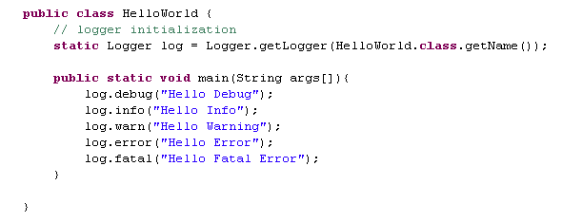
Example4 (using external configuration)

Slide 42
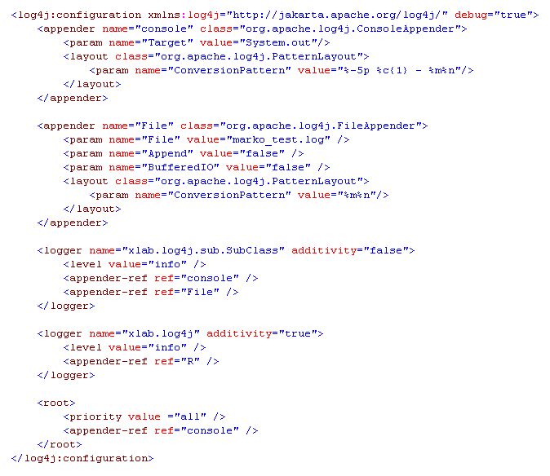
Example5: XML-based Configuration

