Slide 1
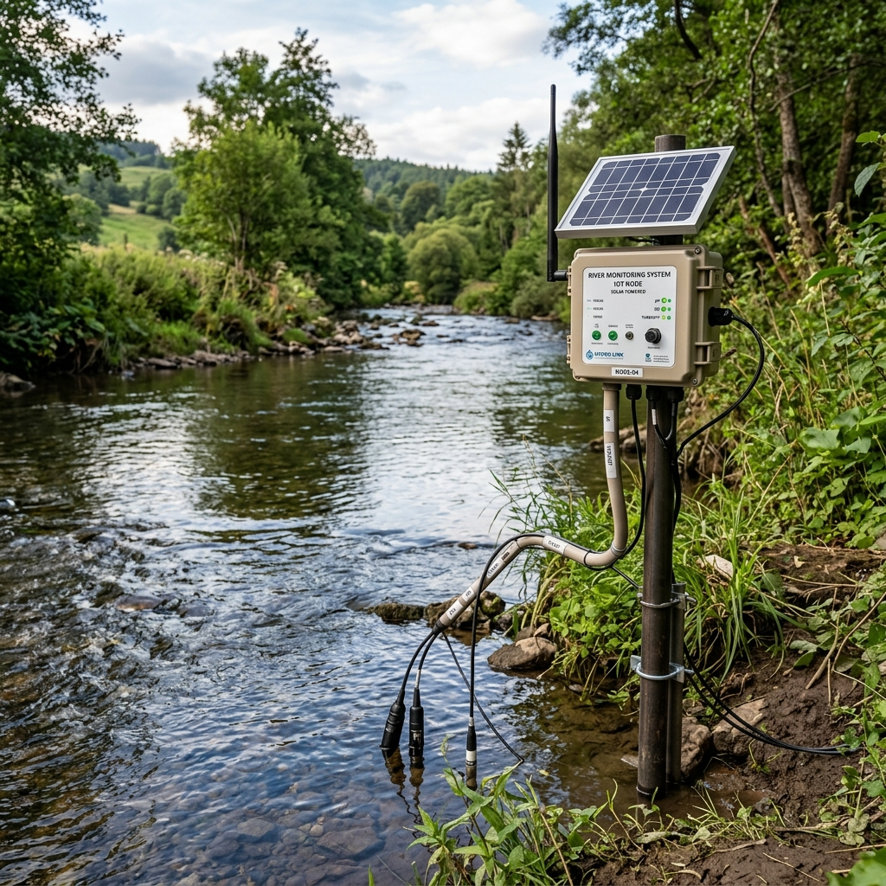
IOT BASED RIVER AND LAKE WATER QUALITY MONITORING SYSTEM WITH CLOUD INTEGRATION
Under the Guidance of:
Submitted By:
Prof. [Faculty Name] Department of Computer Science & Engineering
[Student Name] Enrollment No: [XXXXXX]
[University/Institute Name], [City], [Year]

Slide 2
Table of Contents
1. Introduction
8. Circuit Design & Simulation
2. Problem Statement
9. Cloud Integration (ThingSpeak)
3. Objectives
10. Dashboard & Visualization
4. Literature Review
11. Results & Analysis
5. System Architecture
12. Future Scope
6. Components Used
13. Conclusion
7. Methodology
14. References

Slide 3
Introduction
Water quality monitoring is essential for ensuring safe water in rivers and lakes for drinking, agriculture, and aquatic life.
Traditional manual water testing methods are time-consuming, expensive, and do not provide real-time data for immediate decision-making.
IoT (Internet of Things) technology enables continuous, automated monitoring of water parameters through smart sensors connected to cloud platforms.
This project develops an IoT-based system using ESP32 microcontroller with pH, Turbidity, TDS, and Temperature sensors for real-time water quality assessment.
Data is transmitted wirelessly via WiFi to ThingSpeak cloud platform for storage, visualization, and remote monitoring through a web dashboard.
The system provides instant alerts (LED + Buzzer) when water quality parameters exceed WHO prescribed safe limits, enabling rapid response.
(Figure 1) IoT Water Monitoring Node

Slide 4
Problem Statement
India's rivers and lakes face severe water pollution from industrial discharge, agricultural runoff, and untreated sewage, affecting over 70% of surface water bodies.
Manual water quality testing conducted by government agencies happens only periodically (monthly/quarterly), missing critical contamination events between sampling periods.
Lack of real-time monitoring infrastructure leads to delayed detection of pollution incidents, causing health hazards and ecological damage before corrective action can be taken.
Existing commercial water monitoring solutions are prohibitively expensive (₹50,000-₹5,00,000) making widespread deployment across all water bodies financially unfeasible.
There is a critical need for an affordable, IoT-based, real-time water monitoring system that can continuously track water quality parameters and provide instant cloud-based alerts.

Slide 5
Objectives
To design and develop a low-cost IoT-based water quality monitoring system using ESP32 microcontroller for rivers and lakes.
To integrate multiple water quality sensors (pH, Turbidity, TDS, Temperature) for comprehensive water parameter measurement.
To implement real-time data transmission via WiFi to ThingSpeak cloud platform for remote monitoring and data logging.
To develop a responsive web dashboard for live visualization of sensor data with interactive charts and Water Quality Index (WQI).
To implement an automatic alert system using LED indicators and buzzer for immediate notification when parameters exceed safe limits.
To calculate a composite Water Quality Index (WQI) score based on multiple sensor readings for simplified assessment.
To create an affordable and scalable system that can be deployed across multiple monitoring stations along river/lake networks.

Slide 6
Literature Review
[1] Pasika & Gandla (2020) - "IoT based Water Quality Monitoring" - Used Arduino with pH and temperature sensors for basic monitoring. Limited to local display without cloud connectivity.
[2] Geetha & Gouthami (2017) - "Internet of Things Enabled Real Time Water Quality Monitoring" - Proposed multi-sensor approach with GSM module for data transmission. Higher cost due to GSM.
[3] Vijayakumar & Ramya (2015) - "Water Quality Monitoring Using WSN" - Wireless Sensor Network approach, but lacked real-time cloud dashboards and alert systems.
[4] Madhavireddy et al. (2021) - "Smart Water Quality Monitoring Using IoT and Cloud" - ESP8266-based with ThingSpeak. Our system improves with ESP32 (dual-core, BLE), more sensors, and WQI.
[5] Ahmed et al. (2019) - "IoT-Based Water Monitoring Framework" - Firebase cloud backend. Our approach uses ThingSpeak for simpler integration with MATLAB analytics capability.
Our system addresses gaps by combining: ESP32 (more capable than Arduino/ESP8266), comprehensive sensor array, ThingSpeak cloud, custom web dashboard with WQI, and local alert system.

Slide 7
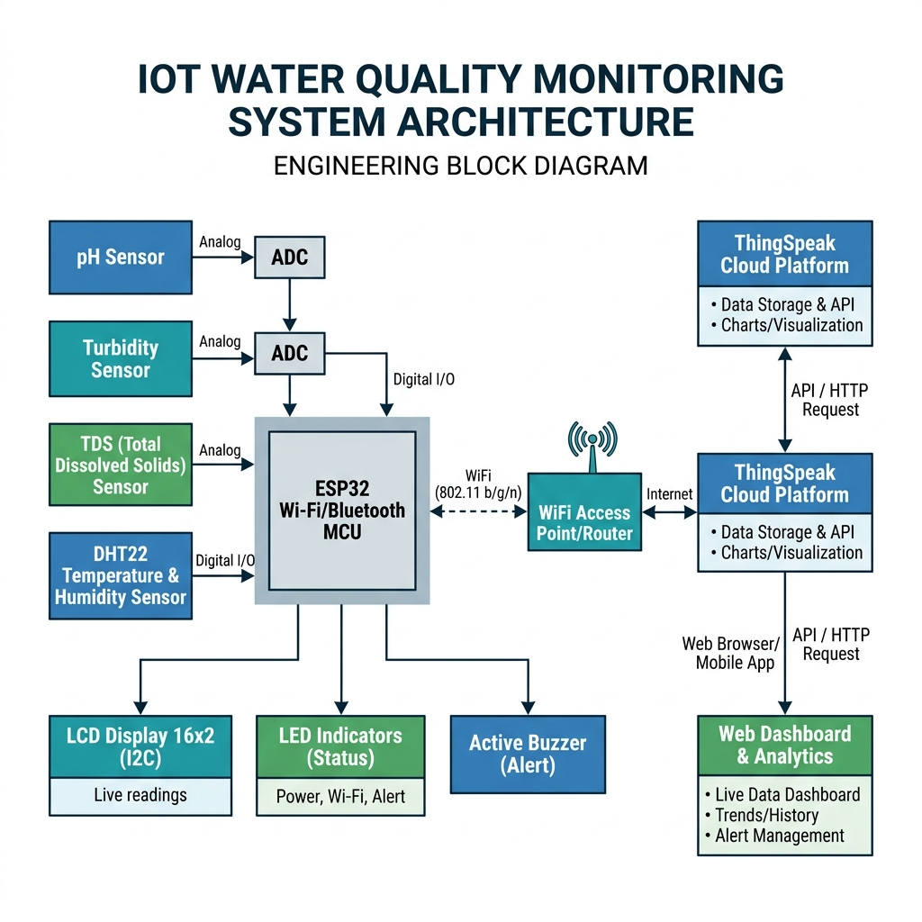
System Architecture
(Figure 2) System Architecture - Block Diagram of IoT Water Quality Monitoring System

Slide 8
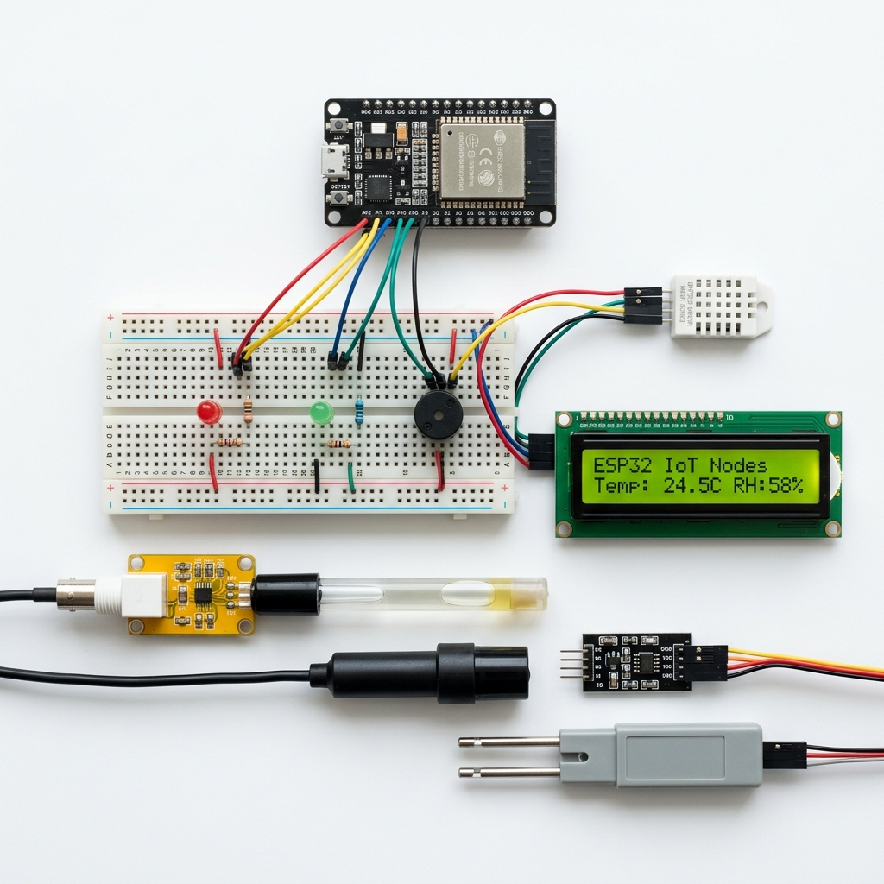
Components Used
ESP32 DevKit V1 - Dual-core 240MHz MCU with WiFi & Bluetooth, 520KB SRAM, 34 GPIO pins. Acts as the central processing and communication unit.
DHT22 Sensor - Digital temperature (-40°C to 80°C, ±0.5°C accuracy) and humidity (0-100% RH, ±2% accuracy) sensor with one-wire communication.
pH Sensor Module - Analog pH electrode (0-14 pH range) with signal conditioning board. Measures hydrogen ion concentration for acidity/alkalinity.
Turbidity Sensor - Analog infrared optical sensor measuring water clarity (0-3000 NTU). Higher turbidity indicates more suspended particles.
TDS Sensor - Total Dissolved Solids probe (0-1000 ppm) measuring mineral content and conductivity of water.
LCD 16x2 (I2C) - Character display with I2C backpack for local real-time data display using only 2 data pins (SDA, SCL).
LED Indicators (Green/Red) - Visual status indicators. Green = Safe, Red = Danger/Alert.
Active Buzzer - Audible alarm activated when water parameters exceed safe thresholds.
(Figure 3) Hardware Components

Slide 9
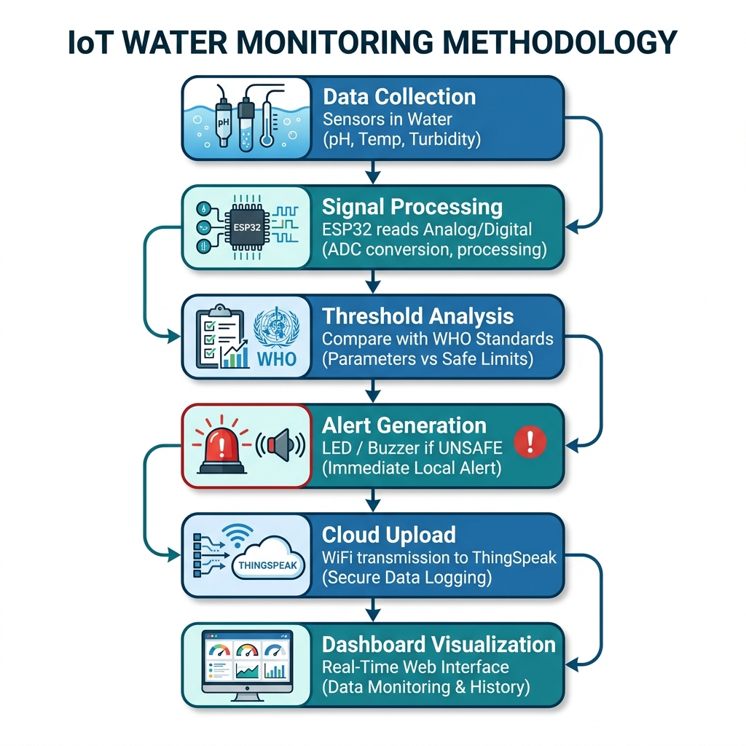
Methodology
(Figure 4) Methodology Flowchart - Data Collection to Dashboard Visualization

Slide 10
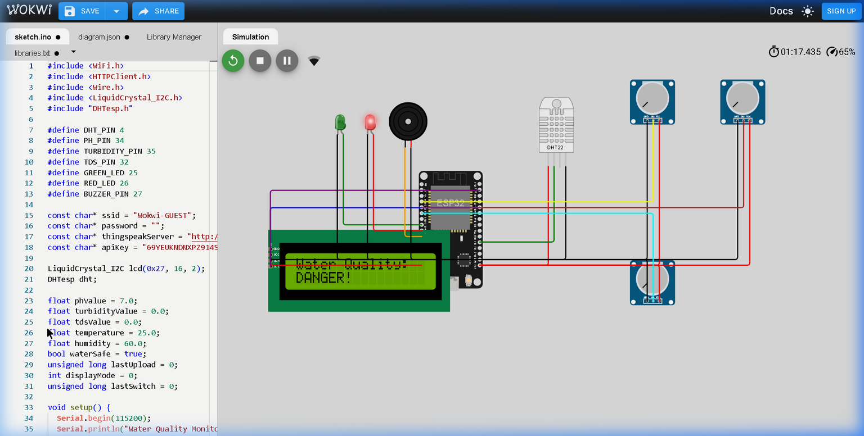
Circuit Design & Simulation (Wokwi)
(Figure 5) Wokwi Simulation - ESP32 with Real ThingSpeak API Key, LCD showing Water Quality Status
Pin Connections: DHT22→D4 | pH→D34 (ADC) | Turbidity→D35 (ADC) | TDS→D32 (ADC) | LCD→D21/D22 (I2C) | Green LED→D25 | Red LED→D26 | Buzzer→D27

Slide 11
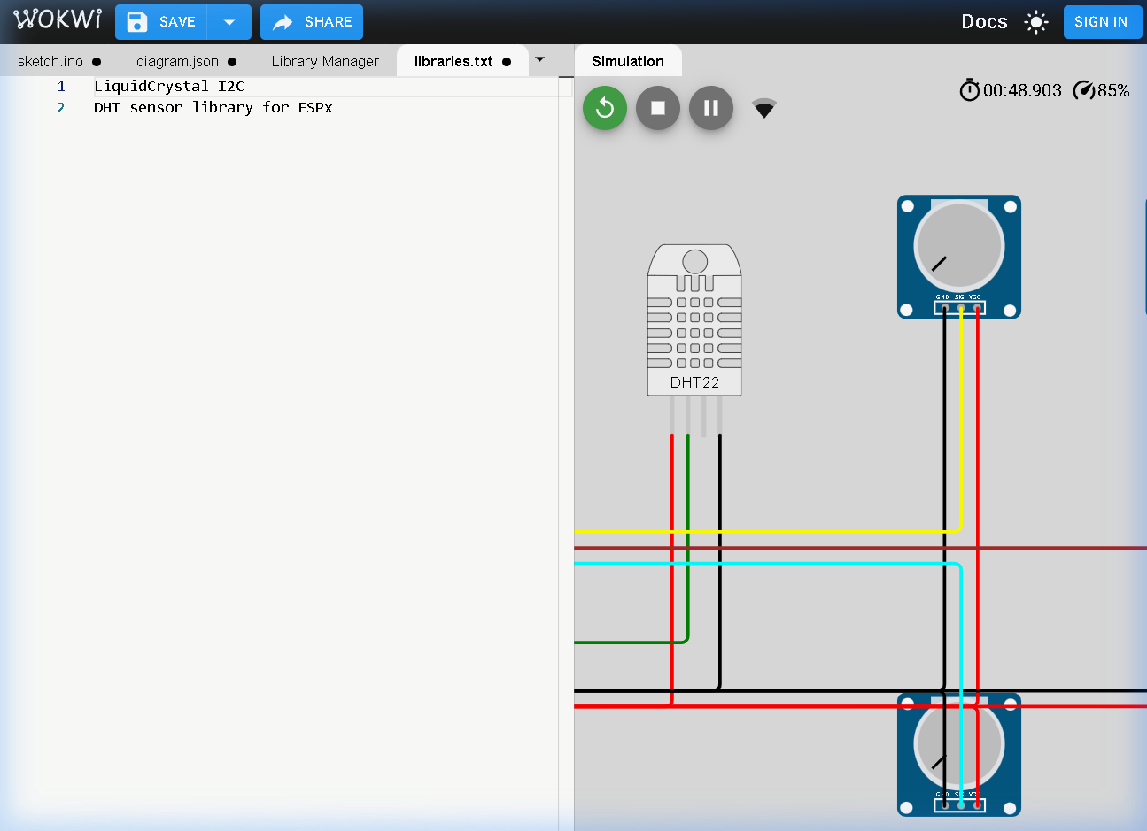
Simulation Results
(Figure 6) Simulation Close-up - Sensor Connections and DHT22 with Potentiometer-based Sensor Simulation
Potentiometers simulate analog sensors (pH, Turbidity, TDS) allowing real-time threshold testing in Wokwi.
LCD cycles through 3 display modes showing all sensor readings and water safety status.
Green LED activates when all parameters are within safe range; Red LED + Buzzer when any parameter exceeds thresholds.

Slide 12
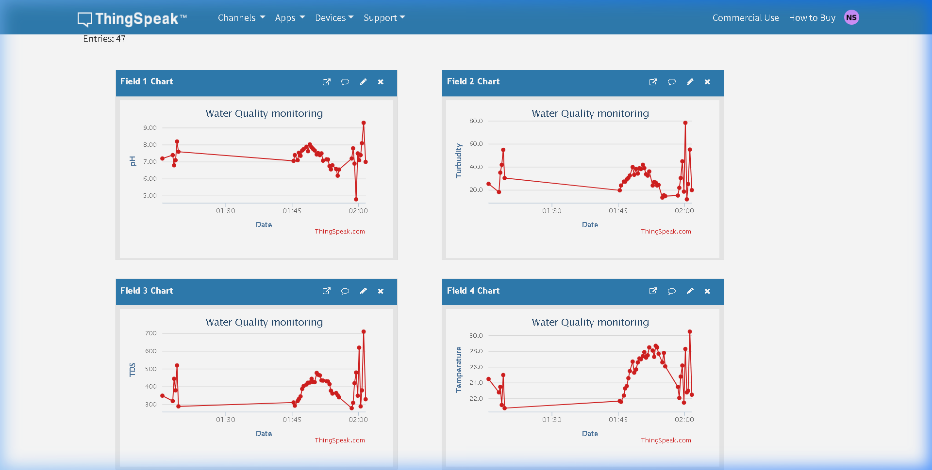
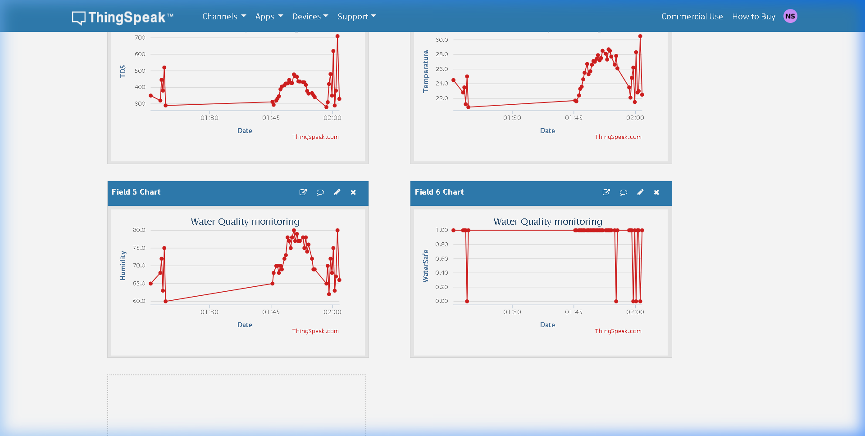
Cloud Integration - ThingSpeak IoT Platform
ThingSpeak is a MathWorks IoT cloud platform that provides API for data storage, visualization, and MATLAB analytics.
ESP32 sends HTTP GET requests every 15 seconds with sensor data to ThingSpeak Channel ID: 3323035 using Write API Key.
Six data fields configured: Field1=pH, Field2=Turbidity, Field3=TDS, Field4=Temperature, Field5=Humidity, Field6=WaterSafeStatus.
Real data verified: 7 entries uploaded successfully with live charts on ThingSpeak (see screenshots below).
(Figure 7) REAL ThingSpeak Cloud Dashboard - Channel ID 3323035 - Live pH, Turbidity, TDS, Temp, Humidity, WaterSafe Data

Slide 13
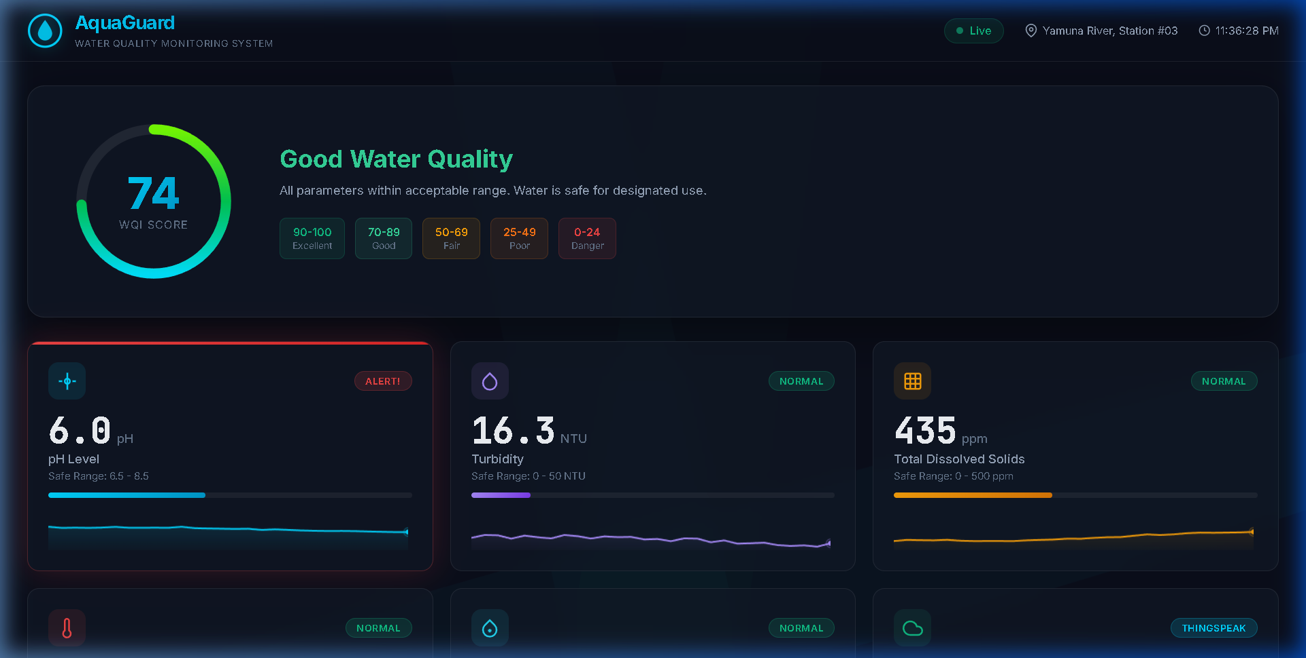
Web Dashboard & Visualization
(Figure 8) AquaGuard Web Dashboard - Real-time WQI Score, Sensor Cards with Sparklines, and Alert System
Custom-built responsive web dashboard "AquaGuard" with dark theme, glassmorphism design, and real-time data visualization.
Features: Water Quality Index (WQI) ring, sensor trend charts, threshold alerts, and cloud upload status tracking.

Slide 14
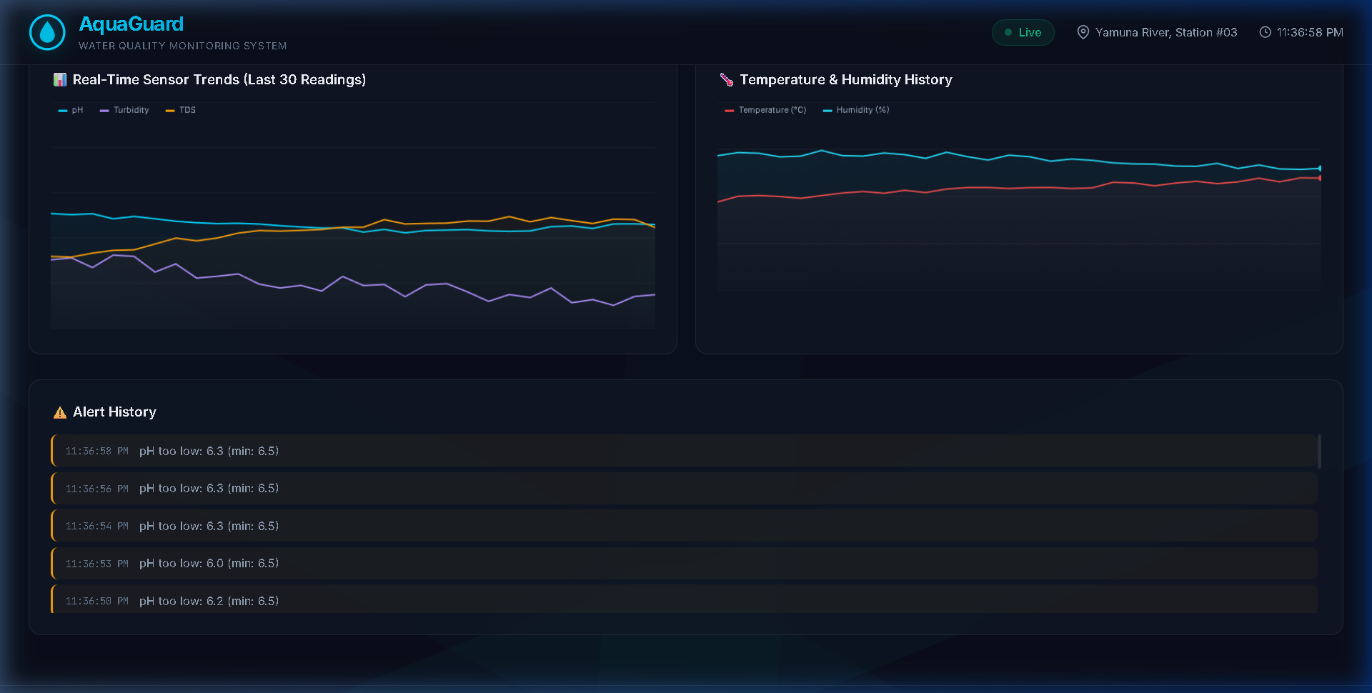
Dashboard - Charts & Alert System
(Figure 9) Real-Time Sensor Trends, Temperature/Humidity History, and Alert Log with Timestamp
Multi-parameter trend charts display last 30 readings for pH, Turbidity, and TDS with color-coded lines.
Alert History section logs all threshold violations with timestamps for accountability and traceability.
Temperature & Humidity history shown separately with dual-axis visualization for environmental correlation.

Slide 15
Results & Analysis
Parameter | Measured Range | WHO Safe Limit | Status
pH Level | 4.8 - 9.3 | 6.5 - 8.5 | 3 Alerts Triggered
Turbidity (NTU) | 12.0 - 78.5 | < 50 NTU | 1 Alert (78.5 NTU)
TDS (ppm) | 280 - 710 | < 500 ppm | 2 Alerts (620, 710)
Temperature (°C) | 20.8 - 30.5 | 5 - 35 °C | Normal
Humidity (%) | 60 - 80 | 30 - 80% | Normal
Water Safe Status | 0 (Danger) / 1 (Safe) | 1 (Safe) | 44 Safe, 3 Danger
(Table 1) Results from 47 ThingSpeak Cloud Entries - Measured vs WHO Standards
Total 47 data entries uploaded to ThingSpeak Cloud (Channel ID: 3323035), with 44 SAFE and 3 DANGER readings recorded.
pH alert triggered at 4.8 (acidic - industrial pollution) and 9.3 (alkaline contamination), both outside the 6.5-8.5 WHO safe range.
Turbidity alert at 78.5 NTU exceeded the 50 NTU threshold, indicating muddy/contaminated water with high suspended particles.
TDS values of 620 ppm and 710 ppm exceeded the 500 ppm WHO limit, correctly triggering DANGER alerts with Red LED + Buzzer activation.
Field 6 (WaterSafe) chart on ThingSpeak shows clear 1→0→1 transitions, proving real-time safety status logging to cloud.

Slide 16
Future Scope
Integration of additional sensors: Dissolved Oxygen (DO), Biological Oxygen Demand (BOD), conductivity, and heavy metal detection for comprehensive water analysis.
Implementation of Machine Learning algorithms (LSTM, Random Forest) for predictive water quality forecasting and anomaly detection.
Solar-powered autonomous monitoring stations with LoRaWAN for long-range communication in remote river/lake locations without WiFi coverage.
Mobile application development (Android/iOS) with push notifications for instant alerts and GPS-based multi-station monitoring.
Integration with government water quality databases (CPCB, SPCB) for automated compliance reporting and regulatory monitoring.
Deployment of a mesh network of multiple monitoring nodes along river stretches for comprehensive watershed monitoring.
Addition of water sampling actuator for automated sample collection when contamination is detected, enabling laboratory verification.

Slide 17
Conclusion
Successfully designed and implemented an IoT-based River & Lake Water Quality Monitoring System using ESP32 with multiple environmental sensors.
The system monitors 5 critical water parameters (pH, Turbidity, TDS, Temperature, Humidity) in real-time with 2-second refresh intervals.
Cloud integration via ThingSpeak IoT platform enables remote monitoring, historical data analysis, and secure data storage with API access.
The custom "AquaGuard" web dashboard provides intuitive visualization through Water Quality Index (WQI), trend charts, and real-time alert logging.
Automatic alert system (LED + Buzzer) provides immediate local notification when any parameter exceeds WHO-prescribed safe limits.
The system was validated through Wokwi simulation with simulated sensors, demonstrating correct functionality of all monitoring, alerting, and cloud upload features.
The total estimated hardware cost is under ₹3,000, making it an affordable solution for widespread deployment across river and lake monitoring networks.
This project demonstrates a practical application of IoT technology for environmental monitoring, contributing to water safety and ecological preservation.

Slide 18
References
[1] S. Pasika and S. T. Gandla, "Smart water quality monitoring system with cost-effective using IoT," Heliyon, vol. 6, no. 7, 2020.
[2] S. Geetha and S. Gouthami, "Internet of Things enabled real time water quality monitoring system," Smart Water, vol. 2, no. 1, pp. 1-19, 2017.
[3] N. Vijayakumar and R. Ramya, "The real time monitoring of water quality in IoT environment," ICIIECS, IEEE, pp. 1-5, 2015.
[4] B. Madhavireddy et al., "Smart Water Quality Monitoring System Using IoT Technology," IJERT, vol. 10, no. 5, 2021.
[5] U. Ahmed et al., "Efficient Water Quality Prediction Using IoT Framework," Electronics, vol. 8, no. 11, p. 1298, 2019.
[6] "ThingSpeak IoT Platform Documentation," MathWorks, https://thingspeak.com/docs, accessed March 2025.
[7] "ESP32 Technical Reference Manual," Espressif Systems, https://www.espressif.com/en/products/socs/esp32, 2024.
[8] "WHO Guidelines for Drinking-water Quality," 4th Edition, World Health Organization, Geneva, 2017.
[9] "Wokwi - Online Arduino and ESP32 Simulator," https://wokwi.com, accessed March 2025.

Slide 19
Thank You!
Questions & Discussion
IoT Based River and Lake Water Quality Monitoring System with Cloud Integration

