Slide 1

NodeJS and Express.js Introduction

Slide 2

Trainer Introduction
Navneet Chourey
Expertise Area
Node.js,Java,MongoDB,Oracle,MySql

Slide 3
Agenda
Introduction
History
Architecture
Node.js Frameworks
How Node Works, Event loop
Installing Node
Your First Node Program

Slide 4
NodeJS Prerequisites
The following concepts are also key to understand asynchronous programming, which is one fundamental part of Node.js:
Asynchronous programming and callbacks
Timers
Promises
Async and Await
Closures
The Event Loop

Slide 5
FRONTEND to BACKEND communication
SERVER
REQUEST
RESPONSE
CLIENT (mobile or browser)
REQUEST HANDLER

Slide 6

NodeJS Definition
NodeJS is a JavaScript runtime built on Chrome's V8 JavaScript engine. NodeJS uses an event-driven, non-blocking I/O model that makes it lightweight and efficient. It is is an open source, cross-platform runtime environment for building server side and networking applications using JavaScript

Slide 7

History of NodeJS
Node.js is the brainchild of Ryan Dahl. He was inspired by a flikr file upload demo which displayed the progress of the file being uploaded. Doing this on a larger scale was difficult during those days because someone uploading a particular file that could be going on for several minutes at the same time and you have this extra request coming in that needs a response concurrently.
This led to the using non-blocking sockets and pairing it with JavaScript to create Node.js. The project was demonstrated at the inaugural European JSConf on November 8, 2009.

Slide 8
History of NodeJS
2009
Node.js is born
The first form of npm is created
2010
Express is born
Socket.io is born
2011
npm hits version 1.0
Larger companies start adopting Node.js: LinkedIn, Uber, etc.
hapi is born
2012
Adoption continues very rapidly
2013
First big blogging platform using Node.js: Ghost
Koa is born

Slide 9
History of NodeJS
2014
The Big Fork: io.js is a major fork of Node.js, with the goal of introducing ES6 support and moving faster
2015
The Node.js Foundation is born
IO.js is merged back into Node.js
npm introduces private modules
Node.js 4 (versions 1, 2 and 3 never previously released)
2016
Yarn is born
Node.js 6
.mjs experimental support

Slide 10
History of NodeJS
2017
npm focuses more on security
Node.js 8
HTTP/2
V8 introduces Node.js in its testing suite, officially making Node.js a target for the JS engine, in addition to Chrome
3 billion npm downloads every week
2018
Node.js 10
ES Modules .mjs experimental support

Slide 11
Traditional vs Non-blocking I/O
Traditional
Request
Request
Request
Request
Thread
Server creates new Thread from limited pool
OR
Waits for available thread
Waiting
Server

Slide 12
Traditional vs Non-blocking I/O
Non-blocking I/O
Request
Request
Request
Request
Thread
Handles event-based callback on a single thread
Waiting
Server

Slide 13
Event Driven Programming
Event driven programming is a programming paradigm in which the flow of the program is determined by events such as user actions (mouse clicks, key presses), sensor outputs, or messages from other programs/threads. Today, this concept is largely using in GUI Applications wherein a mechanism is in place that listens for events and executes an action once the event occurs. This is the basic principle behind node.js!
The EVENT LOOP gives Node the capability to handle highly concurrent requests while still running “single-threaded”.
In any event-driven application, there is generally a main loop that listens for events, and then triggers a callback function when one of those events is detected. Similarly, the event loop delegates I/O operations via POSIX interface while it still handles new requests and callbacks.

Slide 14
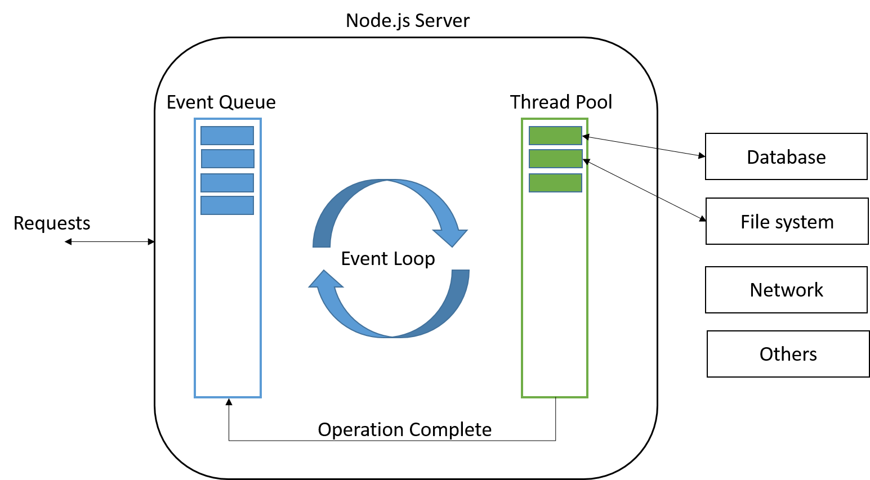
The Event Loop

Slide 15
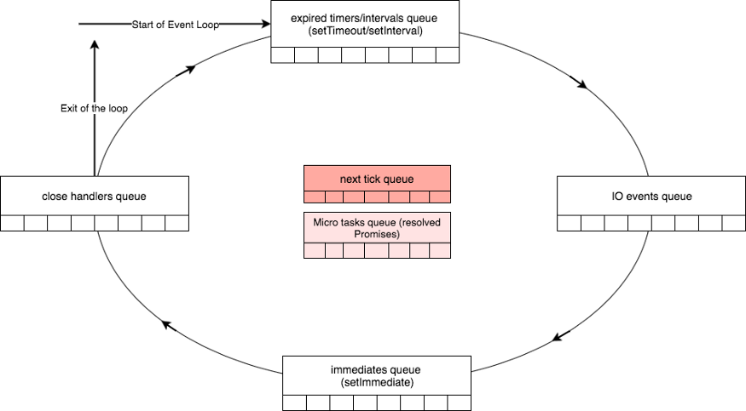
The Event Loop - Queues

Slide 16
NodeJS Architecture
Node.js API
Node.js Bindings
C / C++ Addons
c-ares
(DNS)
HTTP Parser
crypto
(Open SSL)
zlib
(Compression)
LibUv
On the top, we have Node.js API which are core APIs provided out of the box by Node.js. This is written in Javascript and is directly exposed to the developer to call from his Node.js applications. Below the Core API, we have the bindings that really bind the JavaScript with C / C++ libraries. Node.js also provides Addons which are dynamically linked shared objects. They provide glue to C/C++ libraries. This means that you can take pretty much any C/C++ library and create an addon that will allow you to use it in Node.js.

Slide 17
NodeJS Architecture
V8: It is Google’s open source JavaScript engine built for Google Chrome. It’s written in C++ and can run either standalone or embedded into any C++ application. It basically compiles JavaScript code to native machine code instead of using an interpreter.
V8 provides the runtime environment in which JavaScript executes.
The DOM, and the other Web Platform APIs are provided by the browser.
The cool thing is that the JavaScript engine is independent by the browser in which it's hosted.
This key feature enabled the rise of Node.js. V8 was chosen for being the engine chosen by Node.js back in 2009, and as the popularity of Node.js exploded, V8 became the engine that now powers an incredible amount of server-side code written in JavaScript
Other browsers have their own JavaScript engine:
Firefox has Spidermonkey
Safari has JavaScriptCore (also called Nitro)
Edge has Chakra

Slide 18
NodeJS Architecture
libuv: It is a multi-platform support library with a focus on asynchronous I/O. Initially, Node.js started using libuv as an abstraction layer for libev and libio, but recently libuv have become more powerful and have replaced underlying libraries to become multi-platform. When V8 handle the execution of Javascript, libuv handles the event loop and async I/O operations. Together they form the power house of Node.js.
Features of libuv:
Full-featured event loop backed by epoll, kqueue, IOCP, event ports.
Asynchronous TCP and UDP sockets
Asynchronous DNS resolution
Asynchronous file and file system operations
File system events
ANSI escape code controlled TTY
IPC with socket sharing, using Unix domain sockets or named pipes (Windows)
Child processes
Thread pool
Signal handling
High resolution clock
Threading and synchronization primitives

Slide 19
NodeJS Architecture
c-ares: It’s a C library for asynchronous DNS request including name resolves. It is intended for applications which need to perform DNS queries without blocking, or need to perform multiple DNS queries in parallel.
http_parser: Is a HTTP request and response parser written in C. It does not make any syscalls nor allocations, it does not buffer data, and can be interrupted at anytime. Its features include:
No dependencies
Handles persistent streams (keep-alive).
Decodes chunked encoding.
Upgrade support
Defends against buffer overflow attacks.
OpenSSL: Is an open source implementation of Secure Sockets Layer (SSL v2/v3) and Transport Layer Security (TLS v1) protocols as well as a full-strength general purpose cryptography library. It is based on SSLeay library and built using C. It provides all the necessary cryptography methods like hash, hmac, cipher, decipher, sign and verify methods.
Zlib: Is a general purpose data compression library written in C.

Slide 20
NodeJS Architecture
Pros:
A major benefit of Node.js is Asynchronous I/O which is a good match to common web and network driven applications. Node.js is able to scale to large volume of clients because I/O tasks are handled asynchronously.
Node.js is built on JavaScript and you will use the same language on the backend and frontend. There is no technology switching involved and you may share same code / library with both server and client.
It’s easy to start with! Unlike other stacks be it .Net, LAMP or whatever as a developer you don’t have to go through knowing a separate server product (IIS, Apache etc) and how to deploy to them and other nitty-gritty things involved. Node.js comes with the server the necessary tools that makes development and deployment swift and easy.
Active and vibrant community that shares lots of code on public repositories like github. The npm community is very rich and growing at a fast pace. This provides lots of ready to use modules.
Cons:
Number one disadvantage would be using Node.js for CPU-intensive tasks like generated report, analytics etc.
Using the event driven methodology without proper knowledge might lead to bad code in the applications ( callback hell etc)
Node.js is a “teenager”! Even though most of the core libraries have reached stability, you will still find few still in experimental state. Surely this disadvantage will move away as Node.js matures.

Slide 21
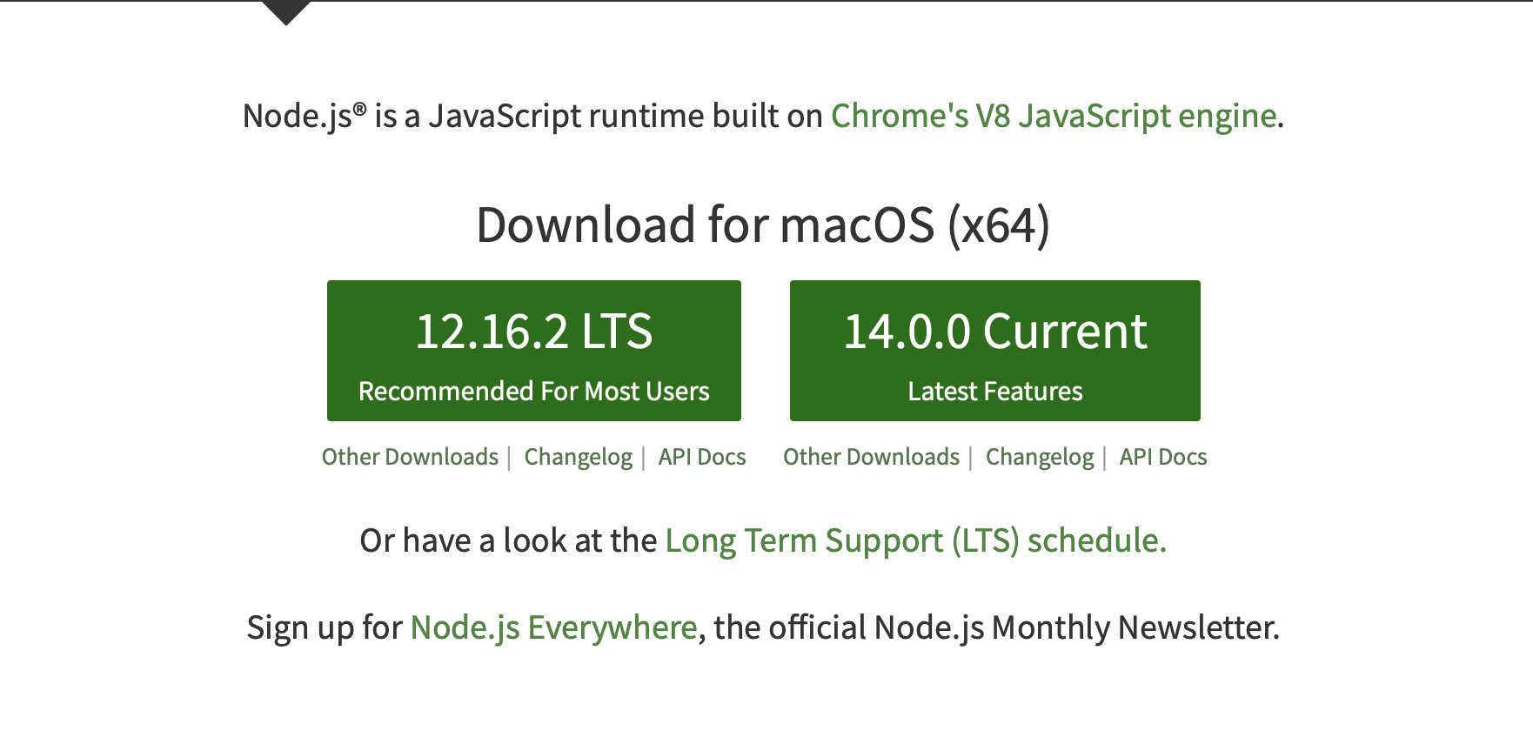
Installing NodeJS
Node.js can be installed in different ways. We will concentrate on the most common and convenient ones.
Official packages for all the major platforms are available at https://nodejs.org/en/download/
One very convenient way to install Node.js is through a package manager. In this case, every operating system has its own.

Slide 22
Installing NodeJS
On macOS, Homebrew is the de-facto standard, and - once installed - allows to install Node.js very easily, by running this command in the CLI:
brew install node
Other package managers for Linux and Windows are listed in
https://nodejs.org/en/download/package-manager/

Slide 23
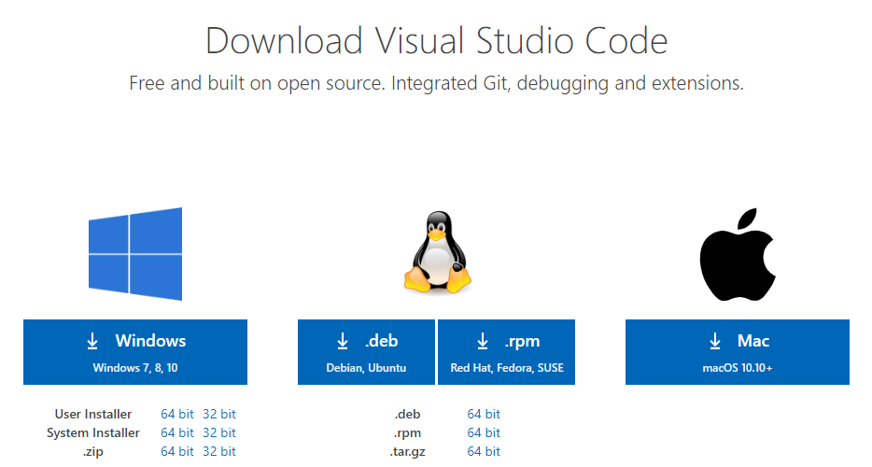
Download Visual Studio Code
https://code.visualstudio.com/download

Slide 24
Verifying NodeJS Installation
Once installation is successful, open terminal & type-in command:
$ node --version
You should see a result something like this:
$ v10.16.0

Slide 25
Your First NodeJS Program
Let's get started by creating the simplest Node.js application, "Hello World".
Create an empty folder called "hello", navigate into and open VS Code:
$ mkdir hello
$ cd hello
$ code .
Picked Up directly from VS Code getting started: https://code.visualstudio.com/docs/nodejs/nodejs-tutorial

Slide 26
Your First NodeJS Program
Create a simple string variable in app.js and send the contents of the string to the console:
var msg = 'Hello World';
console.log(msg);
The usual way to run a Node program is to call the node globally available command (once you install Node) and pass the name of the file you want to execute.
If your main Node application file is in app.js , you can call it by typing
node program execute
$ node app.js
node command globally available

Slide 27
Your First NodeJS Program
You should see the result in terminal:
$ node app.js
Hello World.
Congratulations! You have successfully written your first NodeJS script.
program output

Slide 28
Thank You!

