Slide 1
Loan Approval Prediction
Prepared by Navneet Kumar

Slide 2
Problem Statement
Small Business Loan Approval Prediction
A bank wants to automate the approval process for small business loans. The goal is to predict whether a small business loan application will be approved based on various features like business revenue, credit history, industry type, and the owner's personal financial details

Slide 3
Steps Followed
Data Gathering
EDA
Dealing with Missing Values
Data Splitting → Train/Test/Validation
Modelling → Trying Different Models
Upsampling
Downsampling
Testing
Productionizing
Note →This ppt covers till step 8.

Slide 4
Data
Data Source - Loan Approval Prediction
Independent Features
Object
Loan_ID
Gender
Married
Dependents
Education
Self_Employed
Property_Area
Numerical
Dependent Feature
ApplicantIncome
CoapplicantIncome
LoanAmount
Loan_Amount_Term
Credit_History
Object
Loan_Status

Slide 5
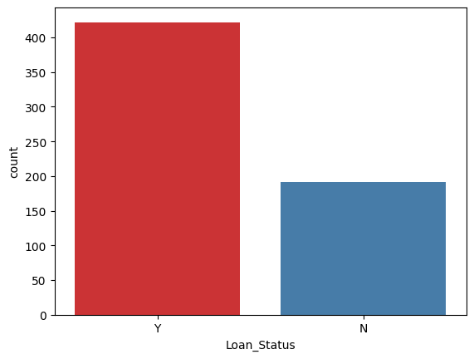
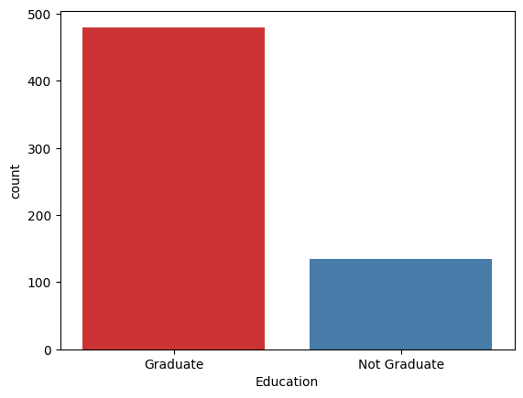
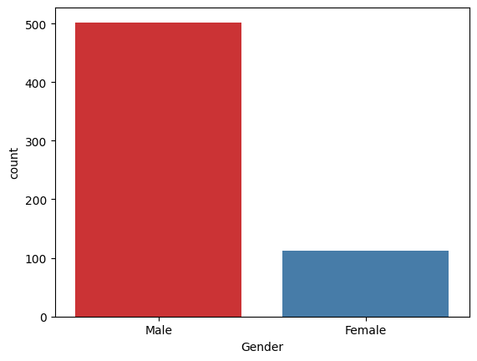
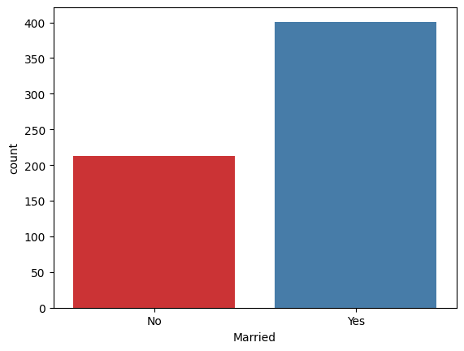
Categorical Feature Distribution

Slide 6
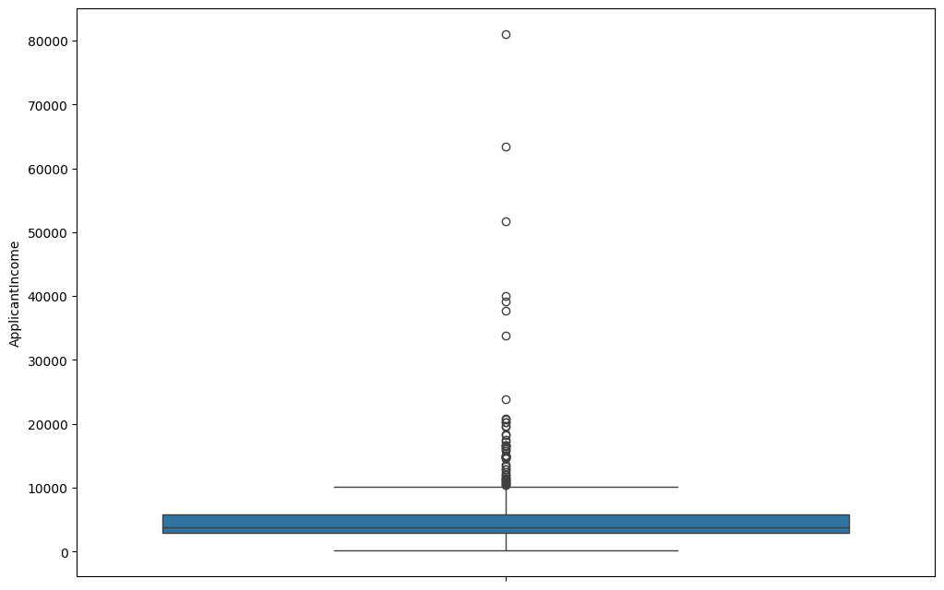
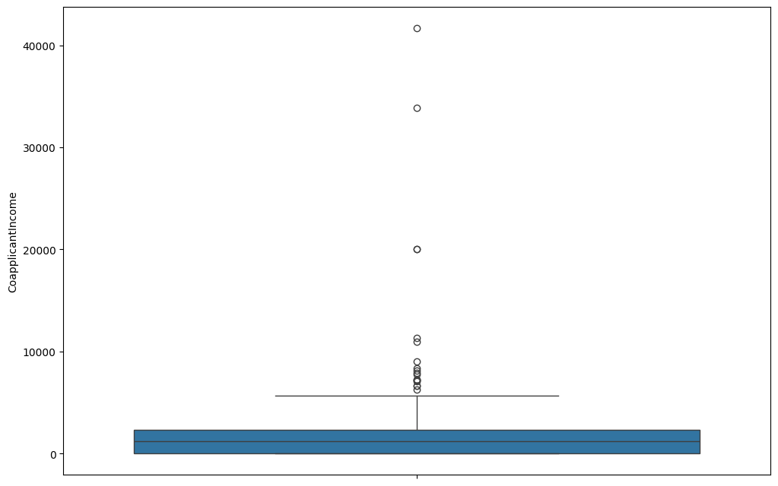
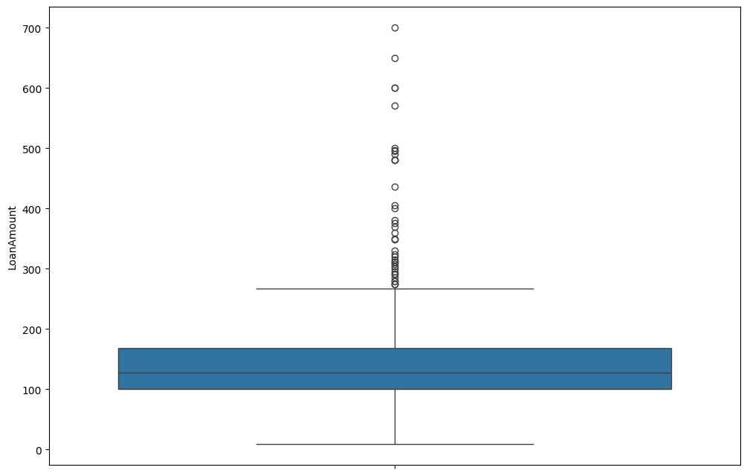
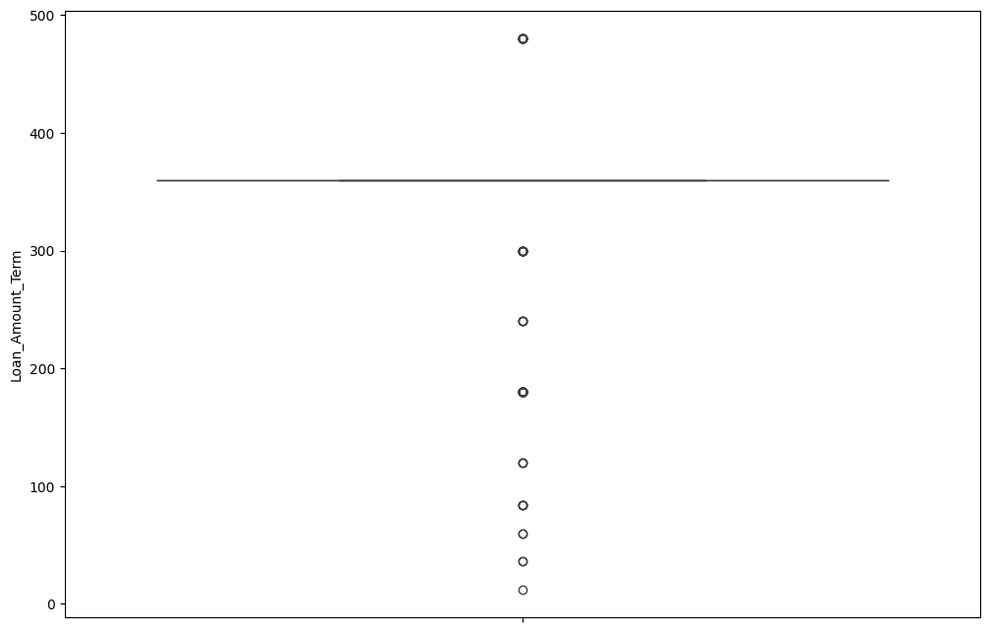
Anomalies In Numeric Features

Slide 7
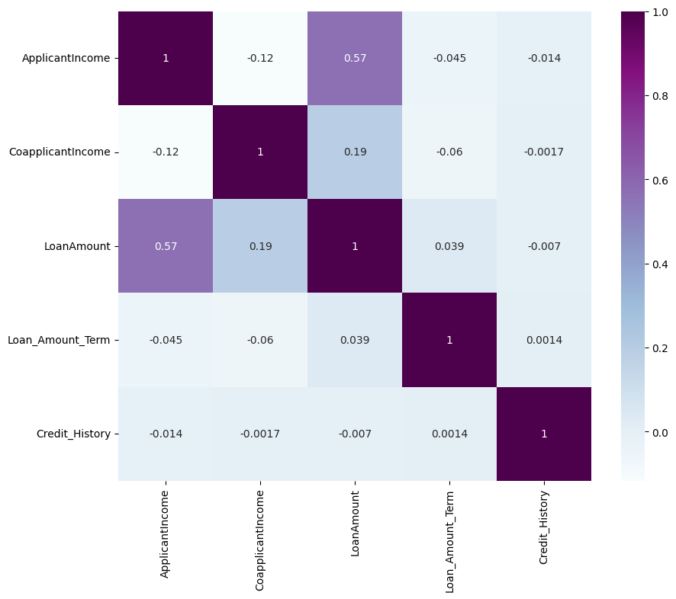
Correlation
I
There is no correlation among the the independent features.

Slide 8
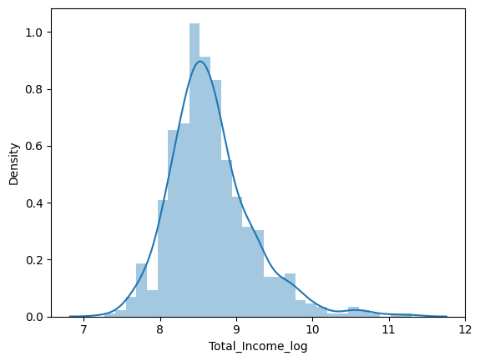
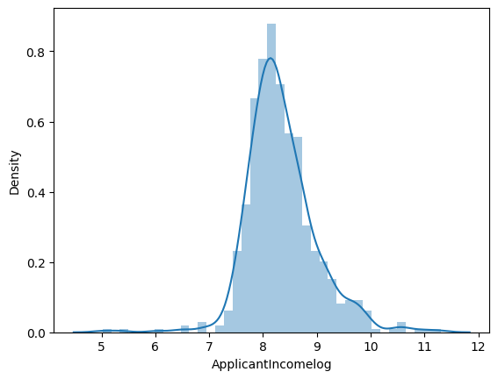
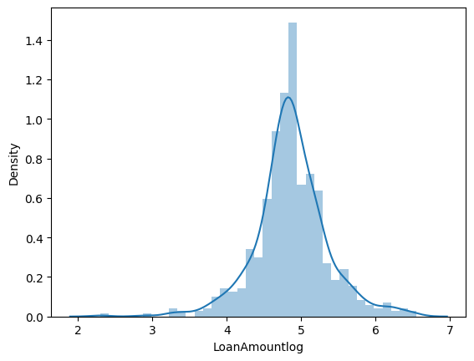
Log Amount/Income Distribution

Slide 9
Results Before Oversampling
Model | Accuracy % | F1 % | Precision % | Recall %
Logistic Regression | 77 | 70 | 83 | 68
Decision Tree | 72 | 69 | 69 | 68
Random Forest | 80 | 74 | 84 | 73
KNN Classifier | 71 | 66 | 69 | 65

Slide 10
Results After Oversampling
Model | Accuracy % | F1 % | Precision % | Recall %
Logistic Regression | 77 | 71 | 78 | 69
Decision Tree | 74 | 70 | 72 | 69
Random Forest | 76 | 70 | 77 | 69
KNN Classifier | 68 | 65 | 68 | 68

Slide 11
Results After Downsampling
Model | Accuracy % | F1 % | Precision % | Recall %
Logistic Regression | 75 | 68 | 75 | 67
Decision Tree | 66 | 66 | 66 | 68
Random Forest | 74 | 72 | 72 | 73
KNN Classifier | 67 | 64 | 64 | 65

Slide 12
Conclusion
Random Forest is performing better compared to all other algorithms
Oversampling of training data helped model produce better f1 and accuracy.

Slide 13
Future Works
Different encodings.
Trying Boosting Algorithms or Neural Nets
Getting more data.
Productionizing

