Slide 1


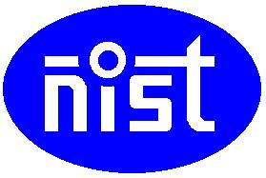
Joint User and Receive Antenna Selection Algorithms for MU-MIMO Systems with Reduced Complexity
Project ID:21010
Student1:KabyashreeTripathy
Roll No: 201711588
BPUTRegn.No:1701202012
Student 2: Navneet Nipu
Roll No: 201710518
BPUT Regn. No:1701202158
By
Under the guidance of
Mr. Swadhin Mishra
Notes:
B-TECH PROJECT MID-SEM PRESENTATION 2011
BY KHUSHBU KHAN & ISAN SAHOO

Slide 2
Contents
Aims/Objectives
Introduction
System Model
JURAS Scheme for MU-MIMO
Suboptimal Algorithms
Outputs
Conclusions
References
Notes:
B-TECH PROJECT MID-SEM PRESENTATION 2011
BY KHUSHBU KHAN & ISAN SAHOO
2

Slide 3
Aims/Objectives
The aim is to show that a joint user and receive antenna selection (JURAS) scheme potentially provides significant sum capacity over a user selection (US) scheme.
Two sub-optimal joint user and antenna selection algorithms with dynamic data stream allocation are also going to analysed.

Slide 4
Introduction
MU-MIMO schemes have recently attracted attention due to their capability of offering significant gain in system capacity.
When users are equipped with multiple antennas, joint user and receive antenna selection may be performed and it potentially provide superior performance.
There are some techniques which provide theoretical sum capacity are DPC (Dirty Paper Coding) ,ZF (Zero Forcing), BD (Block Diagonalization) but they suffer due to high complexity.

Slide 5
Introduction
JURAS is used to achieve high sum capacity at high SNR.
sub optimal algorithms are used to provide near theoretical sum capacity having reduced complexity.
These algorithms will find the best combination of user and their receive antennas which will provide maximum possible data rates or sum capacity thereby increasing the data transfer rates.
Although they are suboptimal but they are very useful when number of receive antennas and users increase.

Slide 6
System Model
W₁
W*₁ H*₁
S₁
.
.
.
USER1
L₁ data
streams
N_{t}
S₁
H₁
Y₁
.
.
.
.
.
.
.
.
.
.
.
.
.
.
.
.
.
.
.
.
.
.
.
.
.
.
.
.
.
.
.
.
.
.
.
W_{k}
+
.
.
.
Available:N_{r,1}
Active:M₁
S_{k}
L_{k} data
streams
H_{k}
W*_{k} H*_{k}
.
.
.
USER K
S_{k}
Y_{k}
Adjust precoding matrices
Adjust number of data sreams
Available:N_{r,k}
Active:M_{k}
User Scheduling and precoding design

Slide 7
System Model
The model consists of a single cell downlink MU MIMO network.
The Base Station has N_{t} number of transmitting antennas whereas there are K users having N_{r} receiving antennas with them where M_{k} receiving antennas will be active at a time for a particular user where M_{k} <= Nr .

Slide 8
System Model
Our objective function i.e. sum capacity is dependent on the SINR based precoding matrix which has been given in next slides.
We will assume equal power per data stream power scheme while calculating the SINR for the system (EPS ).

Slide 9
System Model
The received signal at the mobile station is given as,
$${ y}_{j}=H_{j}W_{j}s_{j}+H_{j}\sum_{k∈U_{i}k≠j}{ }W_{k}s_{k}+v_{j}$$
Received signal
White zero mean complex gaussian noise
Desired signal
Interfering undesired signals

Slide 10
JURAS Scheme for MU-MIMO
JURAS means the joint user and receive antenna selection scheme which is being implemented in this project using two suboptimal algorithms.
Suboptimal algorithm-1 works by updating the user’s precoding matrices and evaluate sum capacity(time complexity is somewhat less).
Suboptimal algorithm-2 works by considering each receiving antenna as a single user during user selection process and then computes the precoding matrices used for data transmission (time complexity is more ) .

Slide 11
Suboptimal Algorithms
Suboptimal algorithm 1
This suboptimal algorithm can be divided into two phases. The first phase extends the ideas of the capacity-based iterative user selection algorithm.
It selects a receive antenna with the highest capacity. Then, from the remaining unselected antennas, it finds the next receive antenna providing the largest sum capacity.

Slide 12
Suboptimal Algorithms
This phase terminates when the sum capacity would reduce as a result of adding one more receive antenna (equivalent to one more data stream).
In the second phase, the algorithm researches the remaining unselected antennas of the selected users without increasing the number of allocated data streams.
The algorithm terminates when no extra sum capacity is achieved by the receive beamforming.

Slide 13
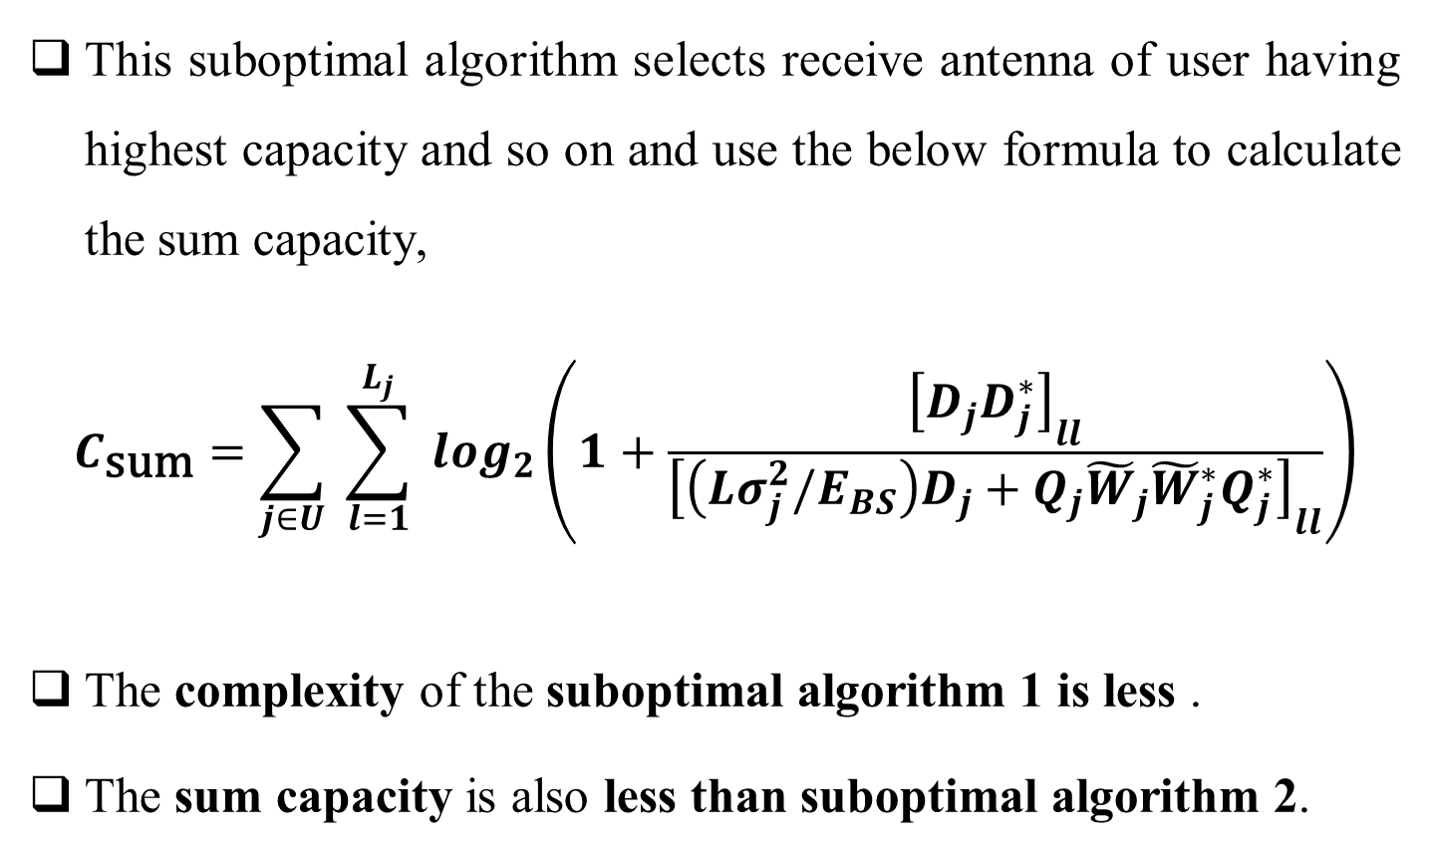
Suboptimal Algorithms
This suboptimal algorithm selects receive antenna of user having highest capacity and so on and use the below formula to calculate the sum capacity,
$$C_{\text{sum}}=\sum_{j∈U}{ }\sum_{l=1}^{L_{j}}{ }\log_{2}\left(1+\frac{{\left[D_{j}D_{j}^{∗}\right]}_{ll}}{{\left[\left(Lσ_{j}^{2}/E_{BS}\right)D_{j}+Q_{j}{\tilde{W}}_{j}{\tilde{W}}_{j}^{∗}Q_{j}^{∗}\right]}_{ll}}\right)$$
The complexity of the suboptimal algorithm 1 is less .
The sum capacity is also less than suboptimal algorithm 2.

Slide 14
Suboptimal Algorithms
SA-1 PSEUDOCODE

Slide 15
Suboptimal Algorithms

Slide 16
Suboptimal Algorithms
elseif phase $=1$
$ℛ=$ remaining antennas of users in $u,$
not been selected in $δ$ phase $=2$
Else
flag $=0$
End
End
Output: $𝓢,𝓤,l$

Slide 17
Suboptimal Algorithms
Suboptimal algorithm 2
It is seen that the main computational burden of SA1 focuses on updating users’ precoding matrices and evaluating the sum capacity.
Thus, the algorithm is only required to compute the beamforming vector of the candidate antenna without updating the precoding matrices of the selected ones.

Slide 18
Suboptimal Algorithms
Treating each receive antenna as an individual user provides more robustness to the errors from outdated precoding matrices than considering multiple antennas at each user.
By treating each antenna as a separate user, no receive beamforming can be exploited. Thus, procedures in the second phase are excluded from SA2 and the number of data streams is always equal to the number of selected antennas.

Slide 19
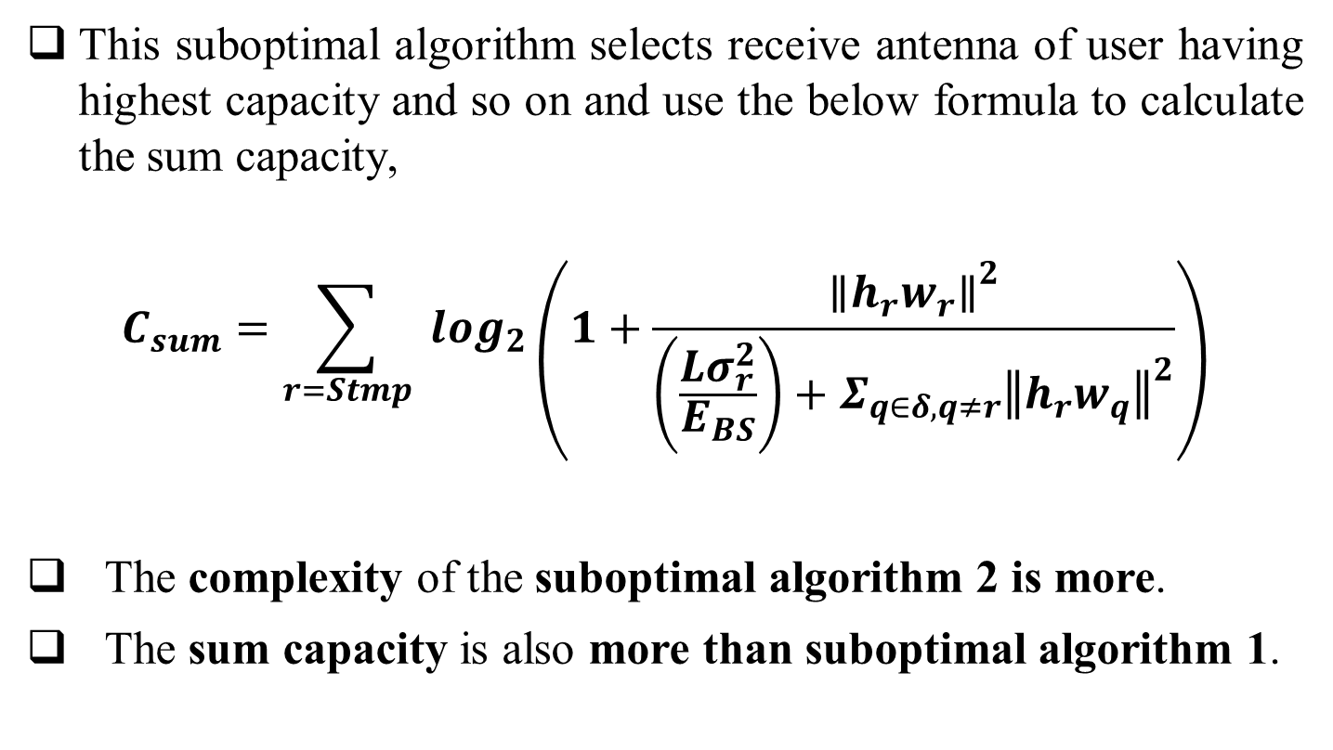
Suboptimal Algorithms
This suboptimal algorithm selects receive antenna of user having highest capacity and so on and use the below formula to calculate the sum capacity,
$$C_{sum}=\sum_{r=Stmp}{ }\log_{2}\left(1+\frac{{∥h_{r}w_{r}∥}^{2}}{\left(\frac{Lσ_{r}^{2}}{E_{BS}}\right)+Σ_{q∈δ,q≠r}{∥h_{r}w_{q}∥}^{2}}\right)$$
The complexity of the suboptimal algorithm 2 is more.
The sum capacity is also more than suboptimal algorithm 1.

Slide 20
Suboptimal Algorithms
SA-2 PSEUDOCODE

Slide 21
Suboptimal Algorithms

Slide 22
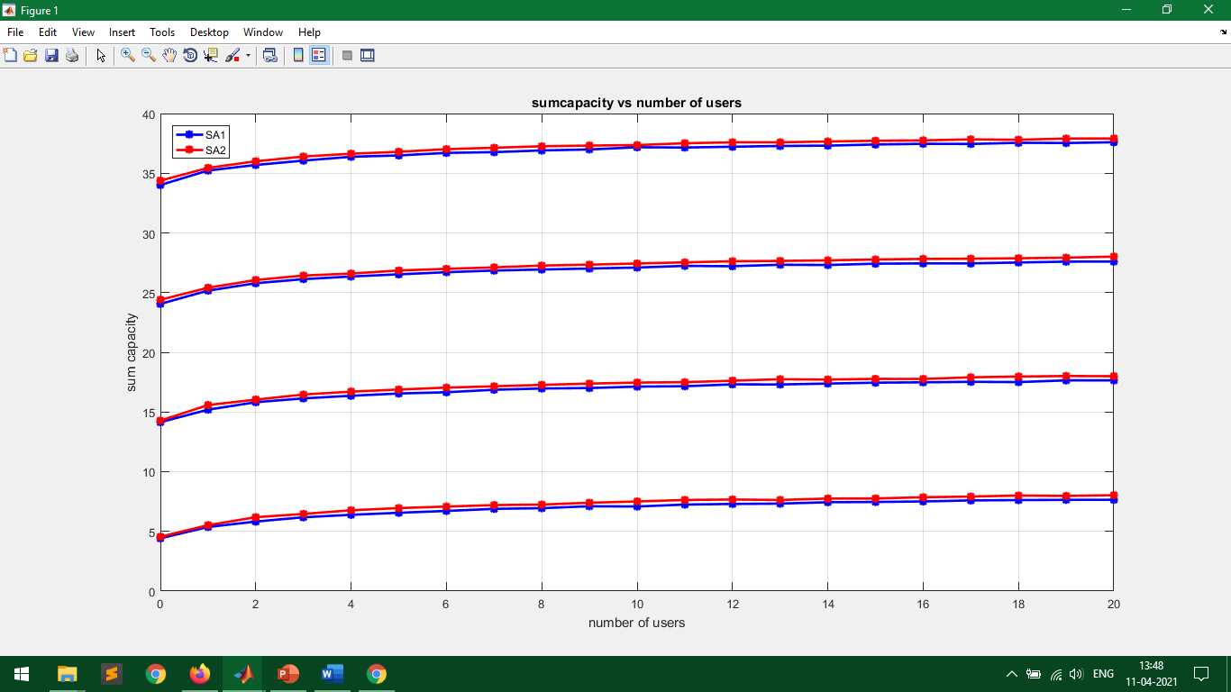
Outputs
Nt=4,Nr=2
SNR = 30 dB
SNR = 20 dB
SNR = 10 dB
SNR = 0 dB

Slide 23
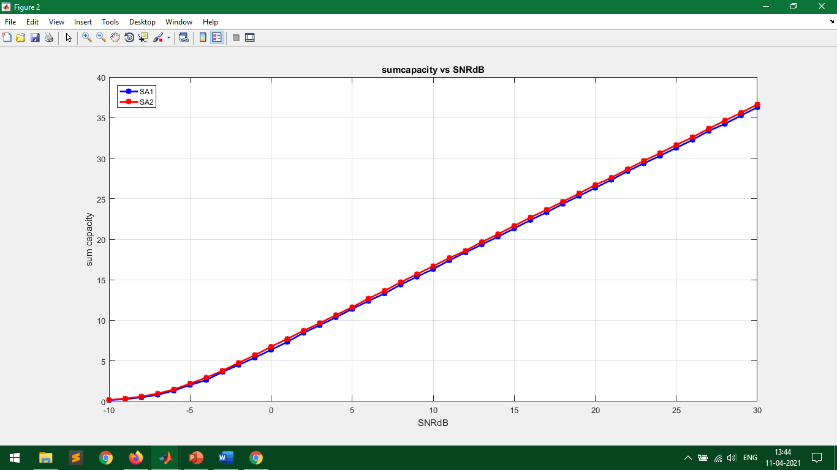
Outputs
Nt=4,Nr=2,USERS=5

Slide 24
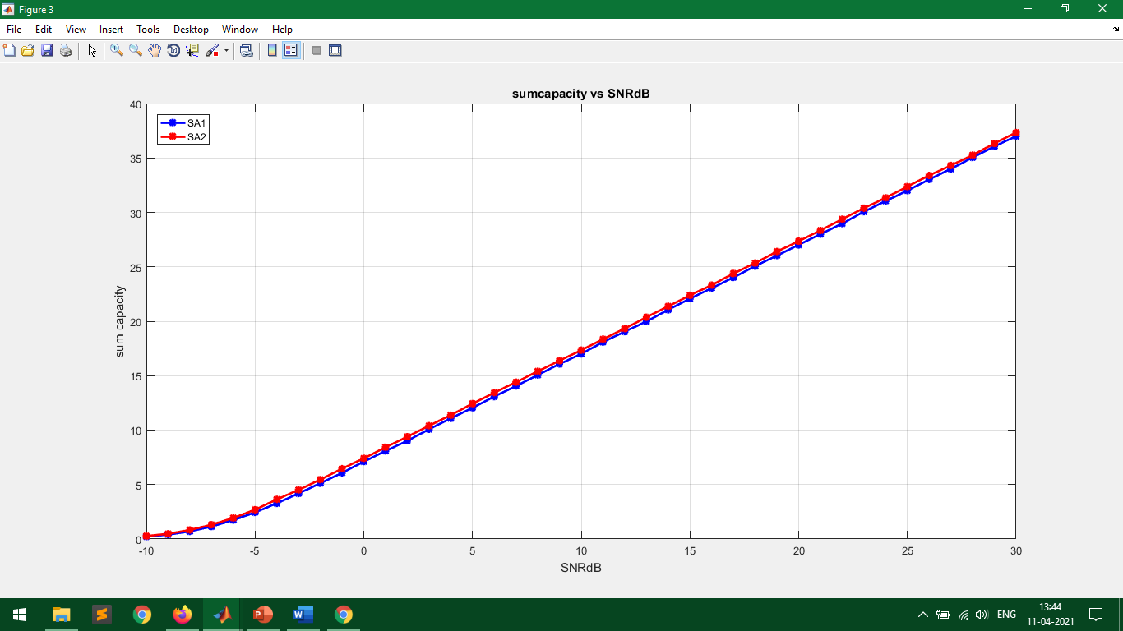
Outputs
Nt=4,Nr=2,USERS=10

Slide 25
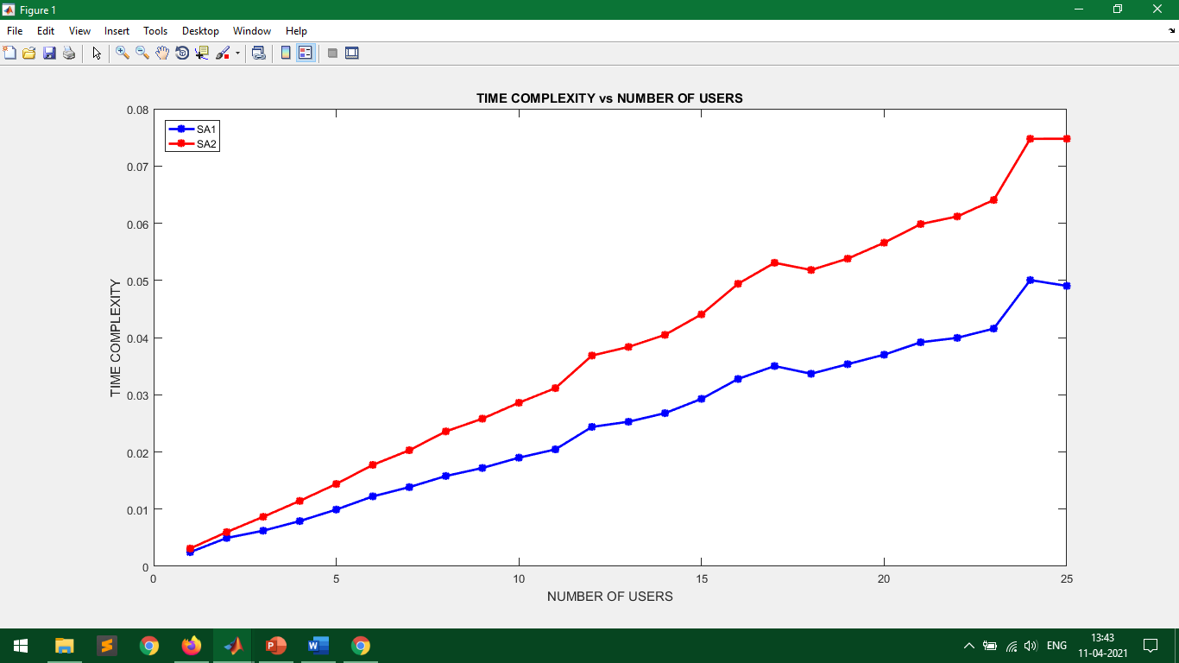
Outputs
Nt=4,Nr=2,SNR = 0dB

Slide 26
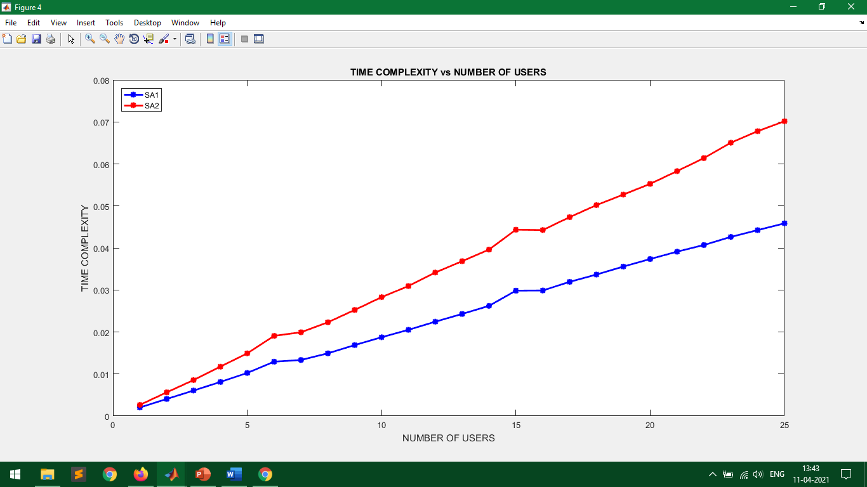
Outputs
Nt=4,Nr=2,SNR =30dB

Slide 27
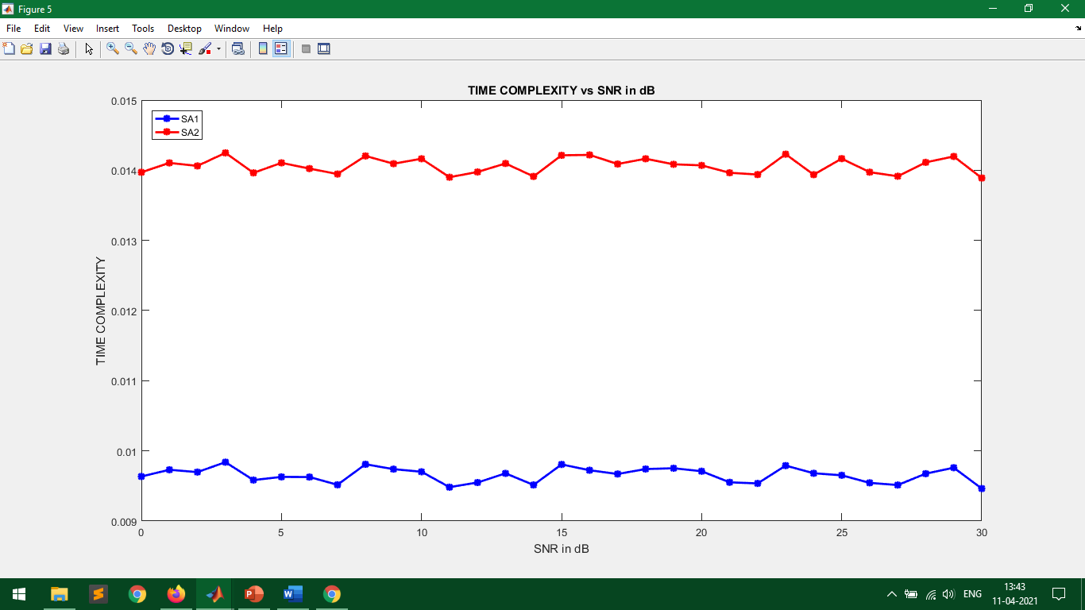
Outputs
Nt=4,Nr=2,USERS = 5

Slide 28
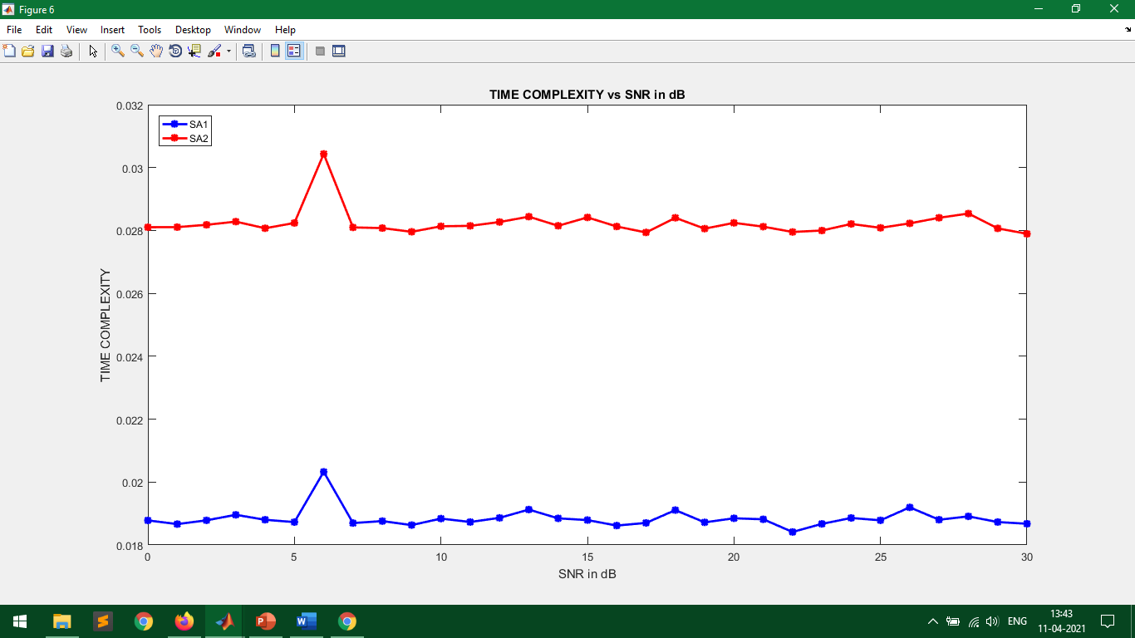
Outputs
Nt=4,Nr=2,USERS = 10

Slide 29
Conclusions
The JURAS scheme enhances the sum capacity when the number of users increases.
The JURAS scheme sum capacity is significant at high SNR where SA1 has somewhat lower capacity than SA2.
The two algorithms reduced the complexity of computation where SA1 has somewhat lower complexity than SA2.

Slide 30
References
M. Sadek, A. Tarighat, and A. H. Sayed, "A Leakage-Based Precoding Scheme for Downlink Multi-User MIMO Channels," IEEE Transactions on Wireless Communications, vol. 6, no. 5, May 2007.
M. Sadek, A. Tarighat, and A. H. Sayed, "Active Antenna Selection in Multiuser MIMO Communications," IEEE Transactions on Signal Processing, vol. 55, no. 4, pp. 1498 - 1510, Apr 2007.
M. Costa, "Writing on Dirty Paper," IEEE Transactions on Information Theory, vol. 29, no. 3, pp. 439-441, May 1983.

Slide 31
References
G. Caire and S. S. (Shitz), "On the Achievable Throughput of a Multiantenna Gaussian Broadcast Channel," IEEE Transactions on Information Theory, vol. 49, no. 7, pp. 1691-1706, Jul 2003.
Q. H. Spencer, A. L. Swindlehurst, and M. Haardt, "Zero-Forcing methods for Downlink Spatial Multiplexing in Multiuser MIMO channels," IEEE Transactions on Signal Processing, vol. 52, no. 2, pp. 461-471, Feb 2004.

Slide 32
Thank You

