Slide 1
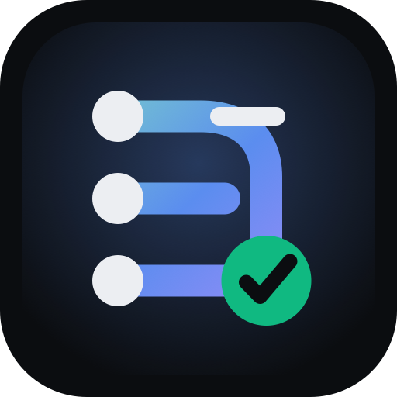
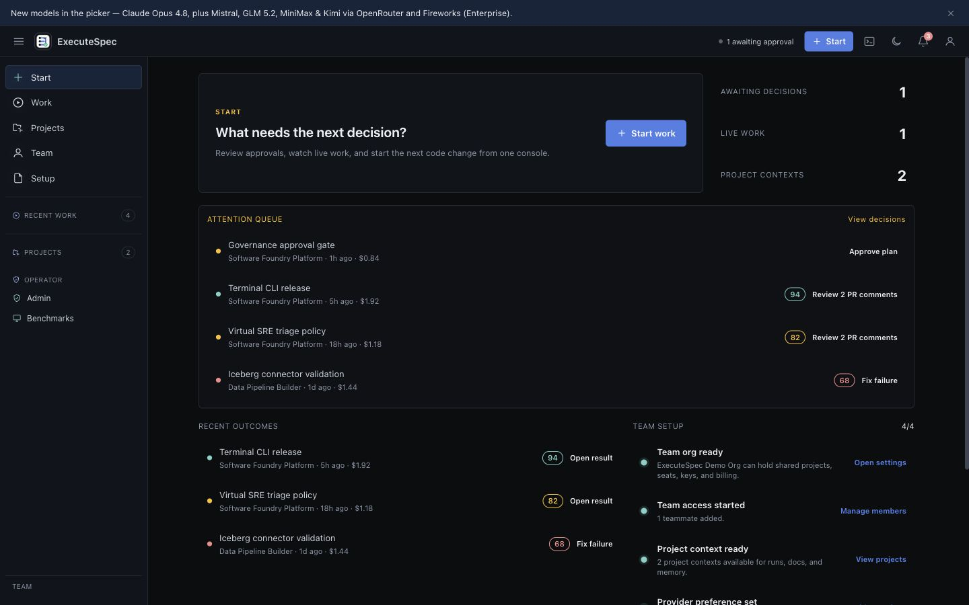
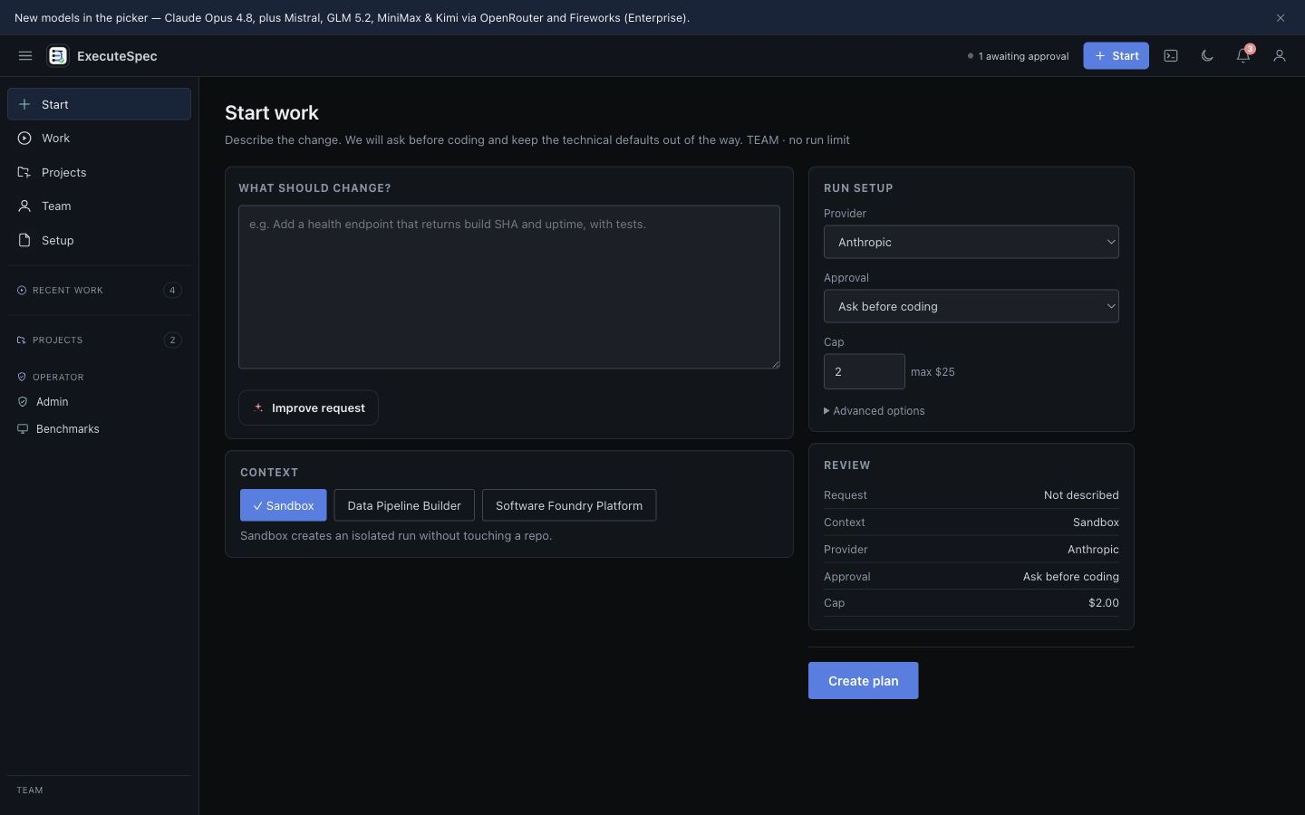
ExecuteSpec
Software foundry for AI-assisted software delivery
Spec-to-PR core today. Terminal CLI released. Roadmap expands into DevOps governance, Virtual SRE, and data pipeline workflows.
WORKING INVESTOR DECK
2026-06-19
Fresh Console captures from 2026-06-19
No deprecated product screenshots used.

Slide 2
ExecuteSpec
PROBLEM
AI coding has crossed the generation threshold. Team trust has not.
The buyer does not need another code suggestion surface. They need reviewable, cost-visible, governed output.
Merge readiness
Spend control
System context
Verification
Diffs still arrive without enough evidence to make reviewers confident.
Autonomy burns tokens before teams understand plan, scope, or cap.
Multi-repo work needs docs, memory, architecture, and policy in one loop.
A model's self-rating is not a team acceptance signal.
02 Current docs + website brand kit

Slide 3
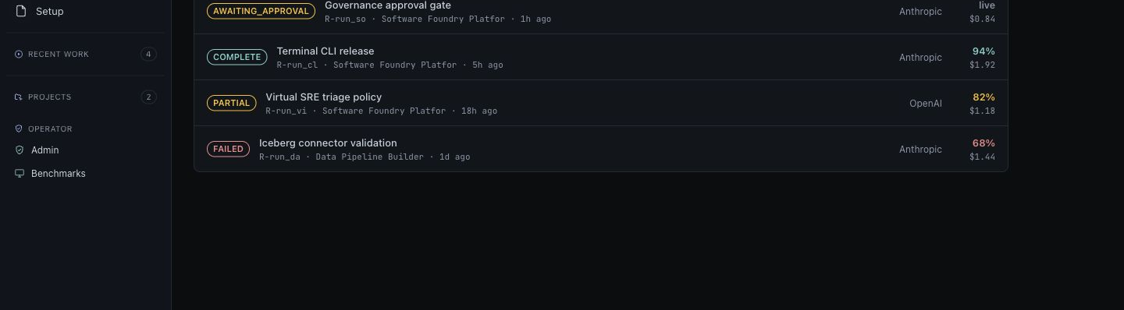
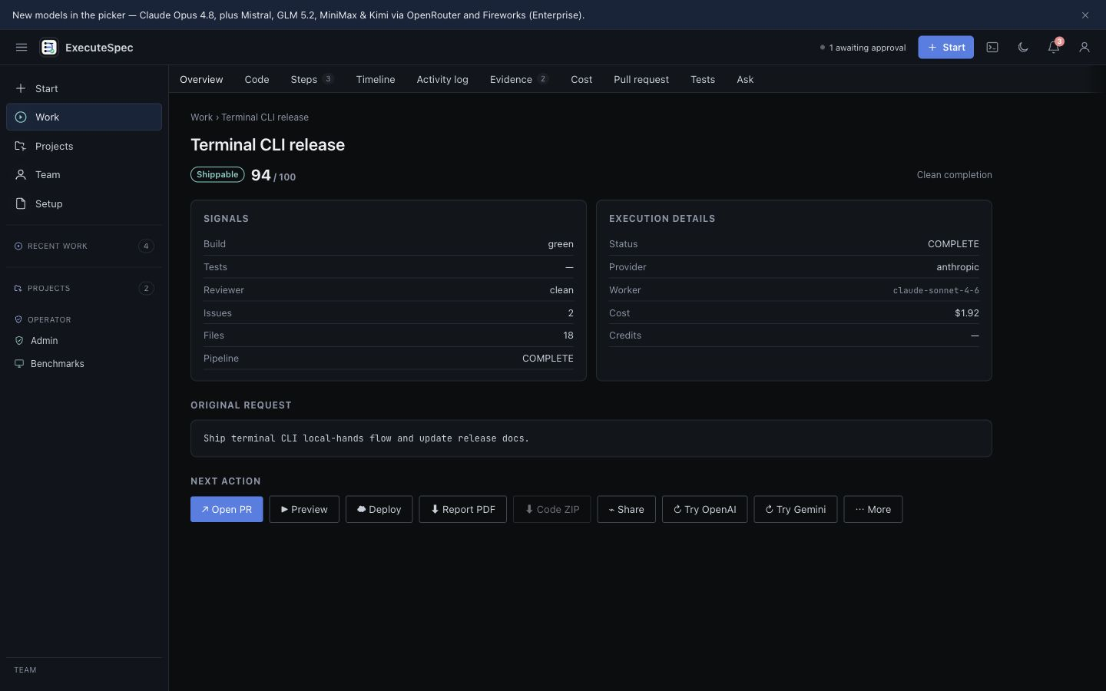
ExecuteSpec
PRODUCT TODAY
Current wedge: spec to verified pull request.
ExecuteSpec is an async control plane for bounded engineering work, not an IDE reskin.
Spec
Plan
Approve
Execute
Verify
PR
natural language
tasks + estimate
human gate
controlled tools
build/test/review
evidence attached
Core promise: bounded delegation with plan gate, cost visibility, run evidence, and reviewable output.
03 Current docs + website brand kit

Slide 4
ExecuteSpec
CURRENT PRODUCT SURFACE
Current surface map, without stale screenshots.
The protected app is the Console control plane; route-level surfaces own runs, projects, billing, org settings, and benchmarks. Terminal CLI is released.
Runs
Projects
compose, live, result
architecture, docs, memory
CLI
Billing / Org
released terminal workflow
plans, BYOK, model controls
QA rule for this deck: only current Console captures from website/press-kit/current are used.
04 Current docs + website brand kit

Slide 5
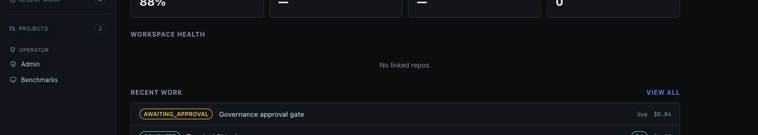
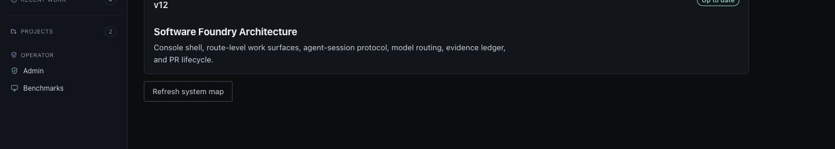
ExecuteSpec
SOFTWARE FOUNDRY THESIS
One agent platform across build, deploy, observe, and remediate.
The strategic advantage is shared context and governance, not four disconnected products.
Build
Deploy + Govern
Observe
Data Workflows
ExecuteSpec Core
DevOps agent
Virtual SRE
Pipeline builder
Shared primitives: org/RBAC/billing/BYOK, project graph, docs, memory, tool runtime, model routing, cost ledger, evidence ledger, PR and issue lifecycle.
05 Current docs + website brand kit

Slide 6
ExecuteSpec
EXPANSION ROADMAP
Expansion lines are roadmap, not shipped claims.
Sequence close adjacencies first; do not overpromise connector depth or auto-remediation.
NEXT
ROADMAP
ROADMAP
DevOps / Governance
Virtual SRE
Data Pipeline Builder
Terraform, Docker, deploy workflows, environment drift, policy checks, and guarded terminal/web operations.
Observe logs, metrics, traces, and alerts; raise evidence-backed issues; route fixes into reviewable PRs.
Pipelines across SQL, NoSQL, warehouses, lakehouses, HDFS, Iceberg, Databricks, Snowflake, and unstructured sources.
Data boundary: ExecuteSpec owns compute/orchestration. Customers own source and destination storage by default; managed destination is separately priced.
06 Current docs + website brand kit

Slide 7
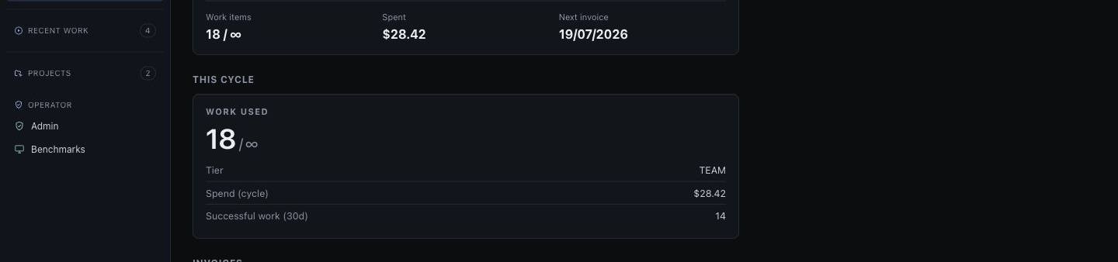
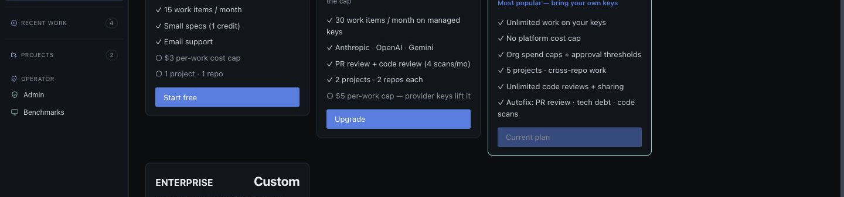
ExecuteSpec
BUSINESS MODEL
Managed entry, BYOK expansion.
Current pricing keeps evaluation simple while making Team and Enterprise the margin-safe path.
Tier
Price
Commercial role
Free
$0
15 runs/month; evaluation and activation
Pro
$29/mo or $289/yr
30 managed-key runs; solo conversion; cost cap protects margin
Team
$39/seat/mo
BYOK from one seat; primary self-serve revenue path
Enterprise
Custom
Contract, DPA/SLA path, org model controls, provider lanes
Pricing thesis: do not sell unlimited managed AI spend. Heavy usage should move toward BYOK or explicit usage pricing.
07 Current docs + website brand kit

Slide 8
ExecuteSpec
DIFFERENTIATION
Position around merge-ready work, not typing speed.
ExecuteSpec should be judged by reviewable output and trust evidence.
Pattern
Gap
ExecuteSpec response
IDE copilots
Engineer still drives every step
Async spec-to-PR workflow
Autonomous agents
Opaque plan and spend
Approval gate before execution cost
Chat over repo
Weak merge evidence
Verified score from build, tests, reviewer, criticals
Managed-only SaaS
Gross margin risk
BYOK Team/Enterprise with zero provider markup
08 Current docs + website brand kit

Slide 9
ExecuteSpec
PROOF DISCIPLINE
Make the trust story stronger by narrowing the claims.
Investor language should separate implemented product, roadmap, and proof gaps.
Safe
Qualify
Avoid
Spec-to-plan-to-PR core, terminal CLI released, billing ladder, BYOK, validation evidence.
Benchmark numbers, payment sandbox proof, enterprise compliance, tenant isolation.
SOC 2 certified, official leaderboard rank, unlimited managed runs, fully autonomous merge.
Operating principle: source-ground ambitious claims, and label roadmap separately from implemented product.
09 Current docs + website brand kit

Slide 10
ExecuteSpec
WEDGE
Land with verified PR throughput; expand into operations.
The first buyer does not need a universe. They need reliable, reviewable AI work in their existing repos.
1
Core + CLI
Initial wedge
released terminal workflow
Teams already using AI coding tools but still requiring human PR review.
Sell verified throughput and cost control, not engineer replacement.
2
DevOps/Governance
closest adjacency
3
Virtual SRE
incidents to PRs
4
Data Pipeline Builder
broadest connector scope
10 Current docs + website brand kit

Slide 11
ExecuteSpec
ASK
Decisions before final fundraising copy.
This deck is a working strategy artifact; the next pass should lock the round narrative and evidence level.
Round story
Pricing posture
Expansion anchor
Benchmark-led, enterprise-pilot-led, developer-launch-led, or software-foundry thesis?
Keep current ladder or move toward platform fee + customer provider spend?
Lead with DevOps/Governance, Virtual SRE, or Data Pipeline Builder after Core + CLI?
11 Current docs + website brand kit

Slide 12
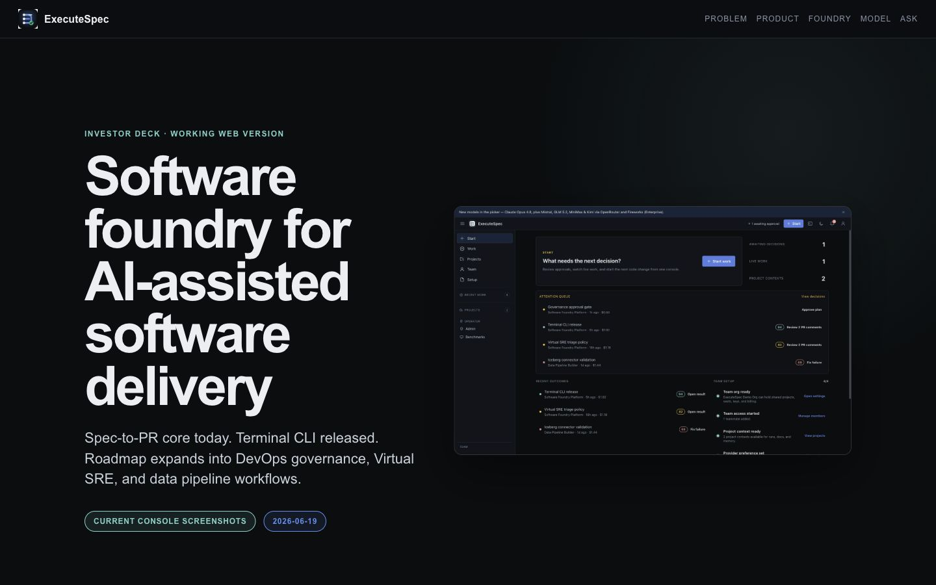
ExecuteSpec
NEXT
What the final investor deck still needs.
The working deck is now product-truth-safe. The fundraising deck still needs sharper evidence and narrative choices.
Evidence
Numbers
Payment sandbox proof and scorer-backed benchmark artifacts.
Run-cost economics, early funnel metrics, conversion assumptions, and funding ask.
No stale press-kit UI screenshots are included in this version.
12 Current docs + website brand kit

