Slide 1

Introduction to Communication toolbox in Simulink
2
+
2
+
By: Navneet Singh & Surani

Slide 2

Uniform Random Integer Generator
Catagory
Noise Generator
Description
The Uniform Random Integer Generator block generates uniformly distributed random integers in the range [0,M-1], where M is the multiple number defined in the dialog box.
Equivalent M-function
randint

Slide 3

Poisson Random Integer Generator
Catagory
Noise Generator
Description
The Poisson Random Integer Generator block generates random integers with a Poisson distribution.
When the input seed is a vector, the output of the block is a vector of equal length.
Equivalent M-function
Poissrnd in the Statistics Toolbox

Slide 4

Rayleigh Noise Generator
Catagory
Noise Generator
Description
The Rayleigh Noise Generator block generates Rayleigh distributed noise.
When the input seed is a vector, the output of the block is a vector of equal length. The Fading envelope can be either a scalar or a vector with its length equal to the length of the Seed. When the fading envelope is a scalar, every element of the output signal shares the same fading envelope.
Equivalent M-function
raylrnd in the Statistics Toolbox

Slide 5

Bernoulli Random Binary Noise Generator
Catagory
Noise Generator
Description
The Bernoulli Random Binary Noise Generator block generates Bernoulli random binary numbers. The output of this block are binary numbers.
Equivalent M-function
x = rand(n, m) > p;

Slide 6

Vector Pulse
Catagory
Pulse Signal Generator
Description
The Vector Pulse block generates a vector of pulse signals. The sample frequency of every element in the vector pulse signal is an integer multiplied by a common frequency F0. You can specify the offset for each pulse. The advantage of using the common frequency is that this block uses common frequency in the timing calculation, which eliminates any relative timing error between the elements outputted from the block. This makes the calculation more accurate.

Slide 7

Eye-Pattern & Scatter Plot
Catagory
Plotting
Description
The Eye-Pattern & Scatter Plot block plots eye-pattern plots, scatter plots or x-y plots depending on the parameter specification.
Eye-pattern plot : An eye-pattern plot is a simple and convenient tool to study the effects of inter-symbol interference and other channel impairments for digital transmission. The received signal is plotted against time, but when the x-axis
time limit is reached, the signal goes back to the beginning of the time point. This produces an overlaid set of plots. Typically, the time range is an integer multiple of the symbol interval.
Scatter plot : Scatter plots record the signal value at a given decision point. When the input signal is a two-dimensional vector, the scatter plot is a two-dimensional plot with the x-axis as the first input vector element and the y-axis as the second input vector element. The two-dimensional plot is widely used in the QAM application. In the case of an input vector that is not a length two vector, the plot is a one-dimensional plot.
x-y plot : x-y plot is valid only when the input message signal is a length two vector. The simulation will be terminated if the input signal has a dimension other than length two.

Slide 8
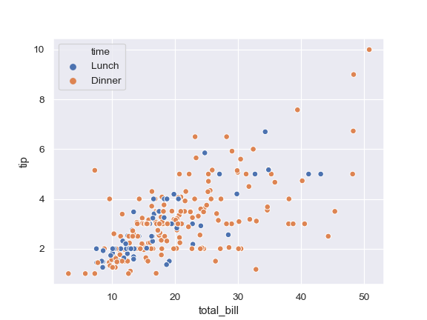
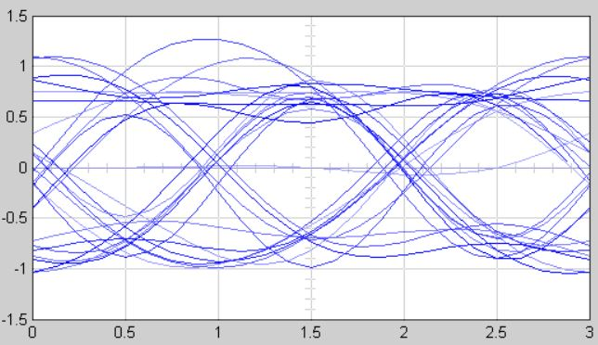
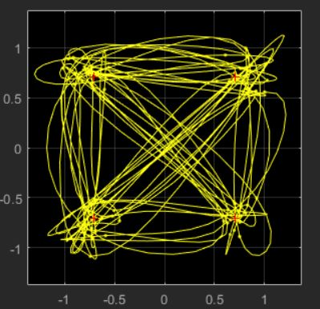
Eye-Pattern & Scatter Plot
Eye-pattern
x-y plots

Slide 9

Reed-Solomon encode Integer Vector In/Out
Catagory
Error-control encoder
Description
The Reed-Solomon Encode Integer Vector In/Out block encodes an integer vector message into a codeword vector using an integer vector in/out format.
Pair Block
Reed-Solomon Encode Integer Vector In/Out
Equivalent M-function
encode

Slide 10

Reed-Solomon Decode Integer Vector In/Out
Catagory
Error-control decoder
Description
The Reed-Solomon Decode Integer Vector In/Out block recovers a message vector from a codeword using an integer vector in/out format.
Pair Block
Reed-Solomon Encode Integer Vector In/Out
Equivalent M-function
decode

Slide 11

QAM
Catagory
Passband quadrature modulation
Description
The QAM (quadrature amplitude modulation) block combines two independent message signals into a single modulated signal. The two independent message signals are combined with two carrier frequencies that are 90° out of phase with each other. The resulting signal components are orthogonal, which simplifies message signal recovery on the receiving side.
Pair Block
QADM
Equivalent M-function
commod

Slide 12

QADM
Catagory
Passband quadrature demodulation
Description
The QMADM (quadrature amplitude demodulation) block recovers a message signal from a quadrature modulated carrier signal. This block recovers both the in-phase and quadrature message signals.
Pair Block
QAM
Equivalent M-function
comdemod

Slide 13

MASK Mod
Catagory
Passband Mapping/Modulation
Description
The MASK (multiple amplitude shift-keying) Mod block maps an input signal and then modulates the mapped signal. This block is a combination of the MASK Map and DSB-SC AM blocks.
MASK Mod is a passband simulation block. There are three timing variables in this block: duration of digit (Td), carrier frequency (fc), and sample time (Ts).
Pair Block
MASK Demod
Equivalent M-function
dmod

Slide 14

MASK Demod
Catagory
Passband Demodulation/Demapping
Description
The MASK Demod block recovers a message signal from a modulated and mapped input signal. This block is a combination of the Costas PLL DSB ADM and the MASK Demap blocks.
Pair Block
MASK Mod
Equivalent M-function
ddemod

Slide 15

MfSK Mod
Catagory
Passband Mapping/Modulation
Description
The MFSK (multiple frequency shift-keying) Mod block maps an input signal and then modulates the mapped signal. This block is a combination of the MFSK Map and FM blocks.
MFSK Mod is a passband simulation block. There are three timing variables in this block: duration of digit (Td), carrier frequency (fc), and sample time (Ts).
Pair Block
MFSK Demodulation
Equivalent M-function
dmod

Slide 16

Coherent MFSK Demod
Catagory
Passband Demodulation/Demapping
Description
The Coherent MFSK (multiple frequency shift-keying) Demod block demodulates an input signal and then demaps the demodulated signal. This block is a combination of the Coherent MFSK Corr Demap and Min/Max Demap blocks.
Pair Block
MFSK Mod
Equivalent M-function
demod

Slide 17

Noncoherent MFSK Demod
Catagory
Passband Demodulation/Demapping
Description
The Noncoherent MFSK (multiple frequency shift-keying) Demod block demodulates an input signal and then demaps the demodulated signal. This block is a combination of the Noncoherent MFSK Corr Demap and Min/Max Demap Arbitrary Constellation blocks.
Pair Block
MFSK Mod
Equivalent M-function
ddemod

Slide 18

AWGN Channel
Catagory
Passband Channel
Description
The AWGN (additive white Gaussian noise) Channel block adds white Gaussian noise to the signal transmitting through this channel. The AWGN channel model is commonly used in communications.

Slide 19
Any Questions?

