Slide 1

Advance Motion Detection System
Technotica 2014
By
Sake Nawab Arzoo
Krishanu Ghosh
Pritiwish Laha

Slide 2

INTRODUCTION
It’s a motion detection system refers to the capability of the surveillance system to detect motion and capture the events. Motion detection is usually a software - hardware based monitoring algorithm which, when it detects motions will signal the surveillance camera to begin capturing the event. Also called activity detection. An advanced motion detection surveillance system can also send the mail notification as well as video clip will be uploaded to internet.

Slide 3

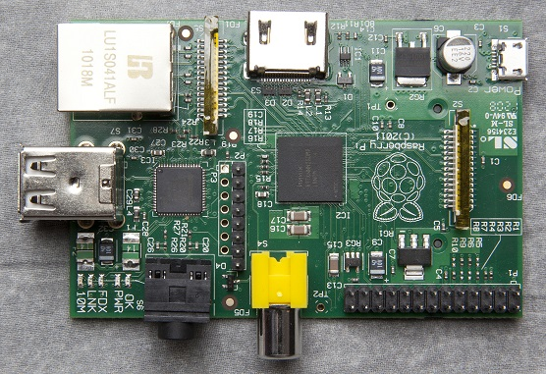

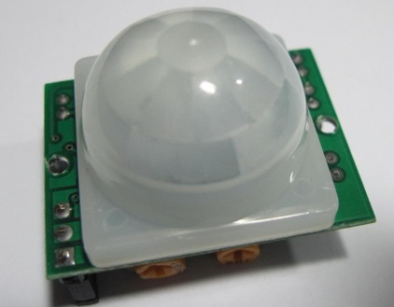
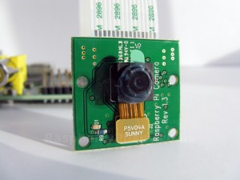
INTERNET
How Project works..
Mail Notification: MOTION HAS BEEN DETECTED

Slide 4
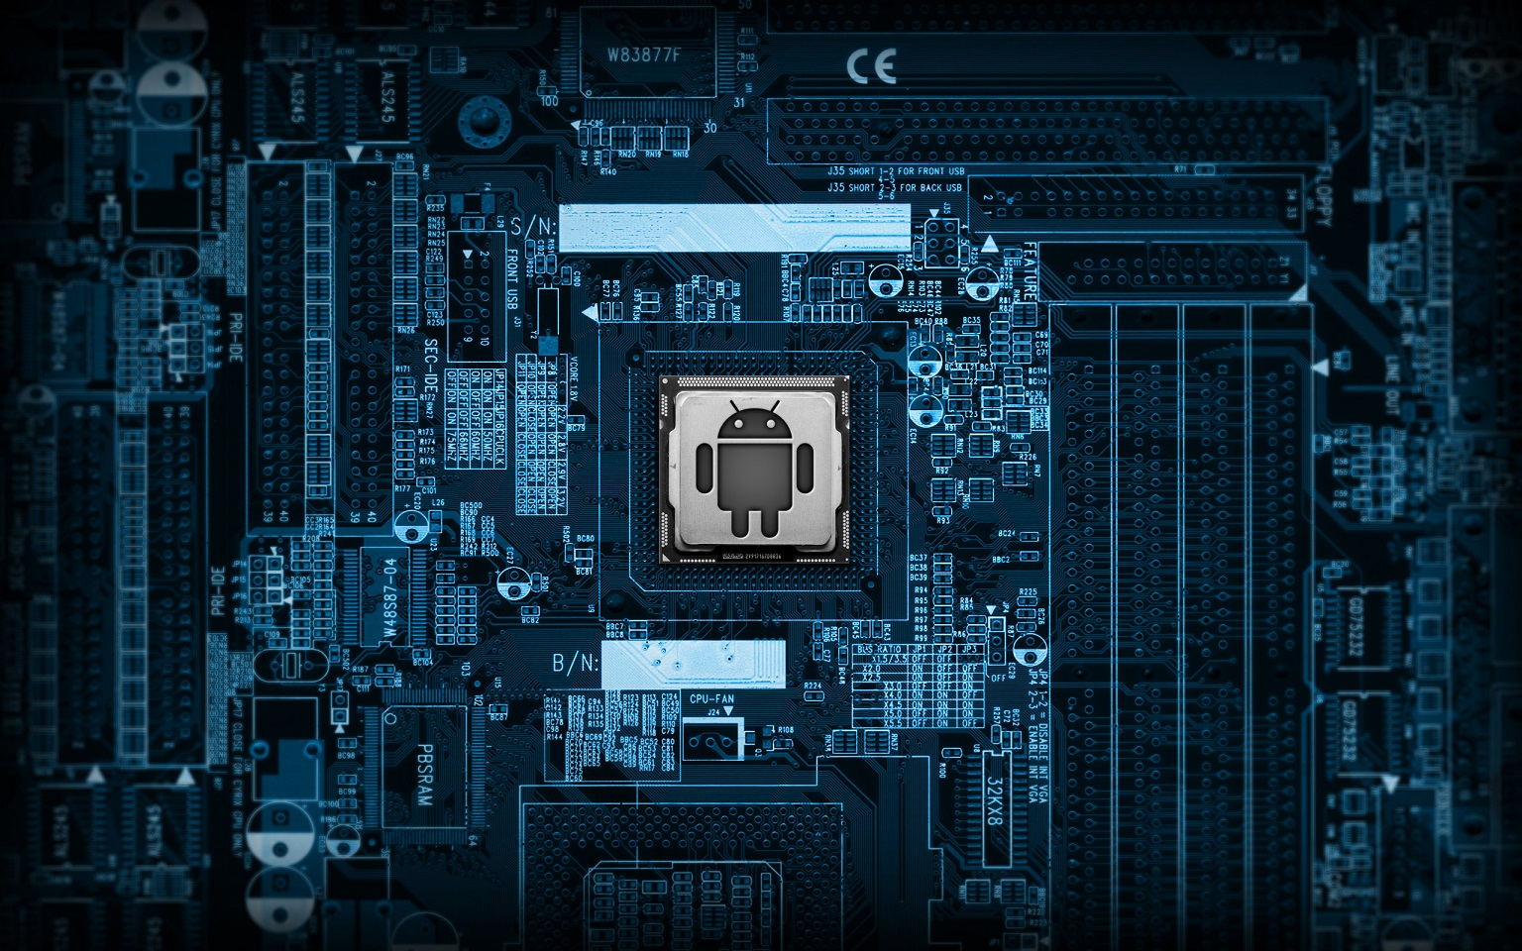
Quick Descriptions about the items :
The Raspberry Pi is a credit card-sized single-board computer developed in the UK by the Raspberry Pi Foundation with the intention of promoting the teaching of basic computer science in schools.
Passive Infrared Sensor (PIR sensor) allow you to sense motion, almost always used to detect whether a human has moved in or out of the sensors range. They are small, inexpensive, low-power, easy to use and don't wear out. For that reason they are commonly found in appliances and gadgets used in homes or businesses.
Dropbox is a home for all your photos, docs, videos, and files. Anything you add to Dropbox will automatically show up on all your computers, phones and even the Dropbox website - so you can access your stuff from anywhere.

Slide 5
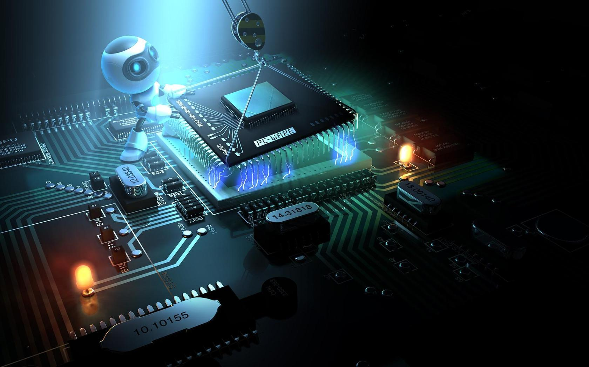
DESCRIPTION
Motion detection system is the first essential process in the extraction of information regarding moving objects and makes use of stabilization in functional areas, such as tracking, classification, recognition, and so on. In this project, we propose an idea and accurate approach to motion detection for the automatic video surveillance system. Our method achieves complete detection of moving objects by involving significant parts: motion detection by a sensitive PIR sensor, recording video footage by a camera module, all these are controlled by a raspberry pi. When a motion is detected by the PIR sensor then it sends a signal to the raspberry pi and then raspberry pi activates the camera and starts recording until the motion stopped. A mail notification is send to a given mail address and video footage is processed and then it will be uploaded to dropbox.

Slide 6
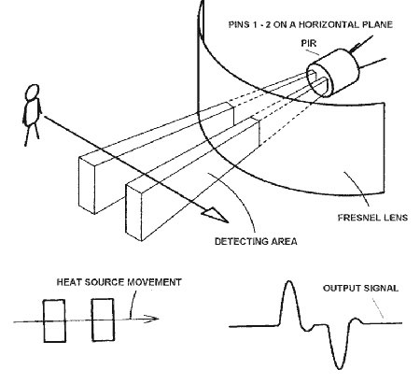
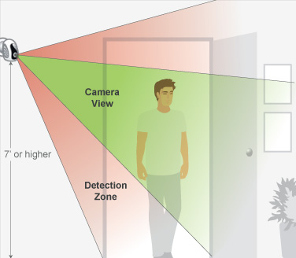
We will use Python programming language to write the codes in Raspberry Pi. Python is a widely-used high level programming language. Its elegant syntax allows you to clearly define application behavior using fewer lines of code than would be required in other languages like VB. It supports multiple programming paradigms including imperative, functional and object oriented styles, allowing a wide range of tasks to be performed.

Slide 7

USES OF THIS PROJECT
Could be used for monitoring your private items.
Could be used for home security.
Could be used for game gesture controller like playstations , xbox360 etc.
Could be used in parking areas for security purpose.
Could be used in banks for automatic locking .
and could be used for many other purposes..

Slide 8
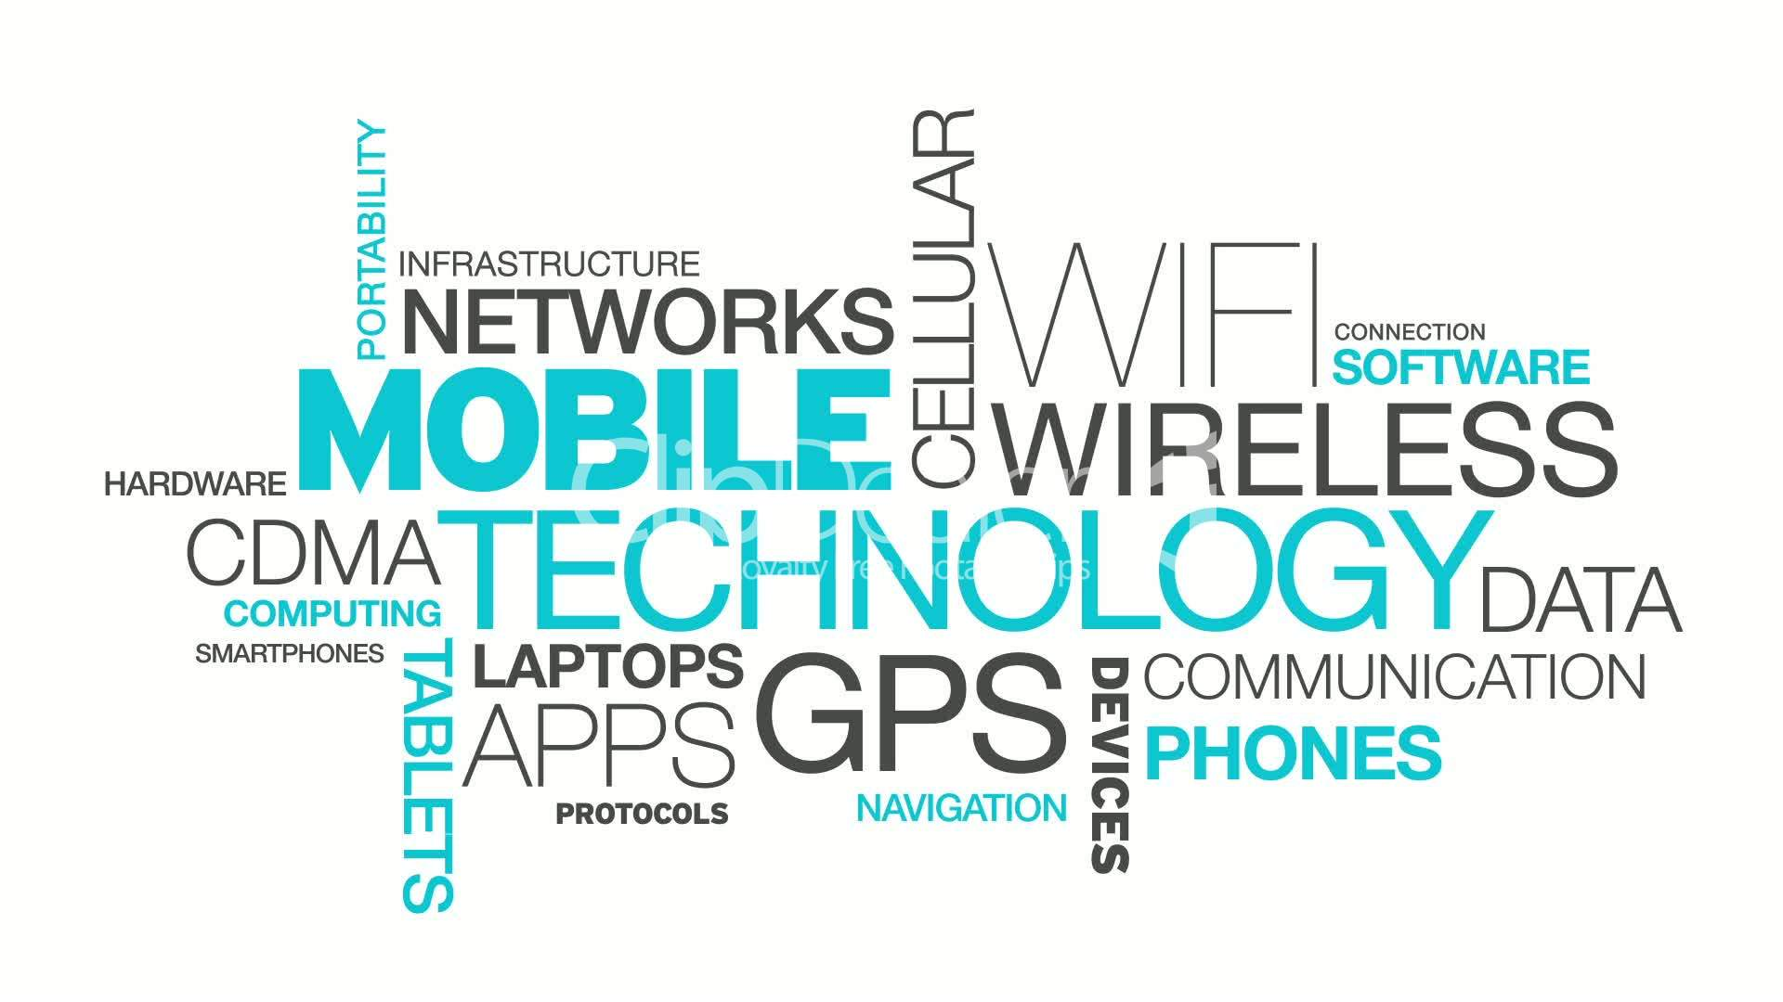
CONCLUSION
A Raspberry Pi can be used in different field and in different way for different works . It is just a single board computer which can perform almost like a computer .
In this project we have made a Advance Motion Detection System with the help of Raspberry Pi. The detection results produced by our proposed method were both qualitatively and quantitatively analyzed through visual inspection and for accuracy, along with comparisons to the results produced by other state-of-the-art methods. The analyses show that our method has a substantially higher degree of efficacy, outperforming other methods by an metric accuracy rate of up to 50 – 80 %.

Slide 9

Thank You….

