Slide 1
Registering in G5
Education Innovation and Research (EIR) Peer Reviewer Application
2017

Slide 2
3 Step Registration Process
Registering with G5
Activating Your Account
Selecting Reviewer Access

Slide 3
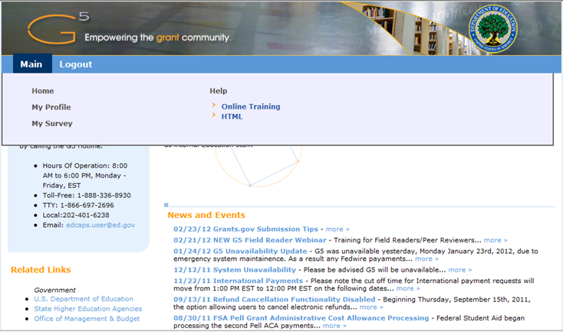
Already Registered?
For those who have previously served as an Education Department reviewer:
Log in to g5.gov
Go to My Profile and follow the instructions provided in Step 3. Selecting Reviewer Access

Slide 4
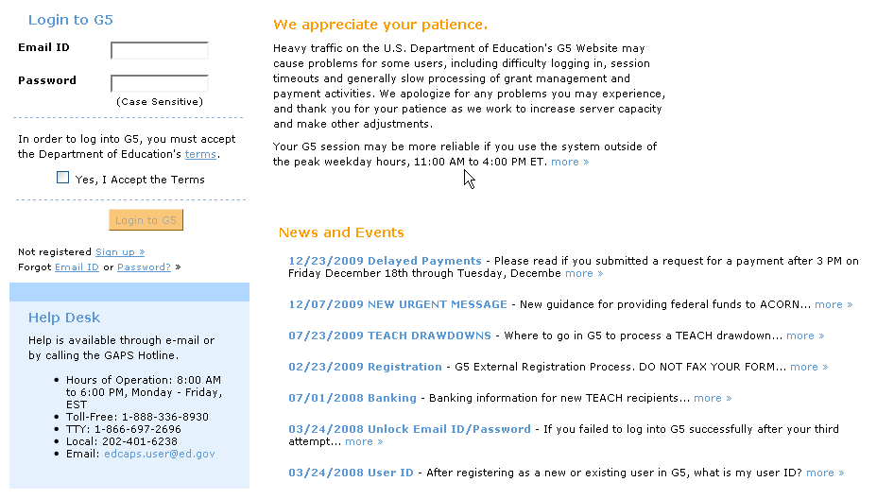
Step 1: Registering with G5
To register go to www.g5.gov and click the Sign up > link.
The image displays the G5 Welcome Page and has an arrow pointing at the Sign up > link, which moves the user to the next screen for registration.

Slide 5
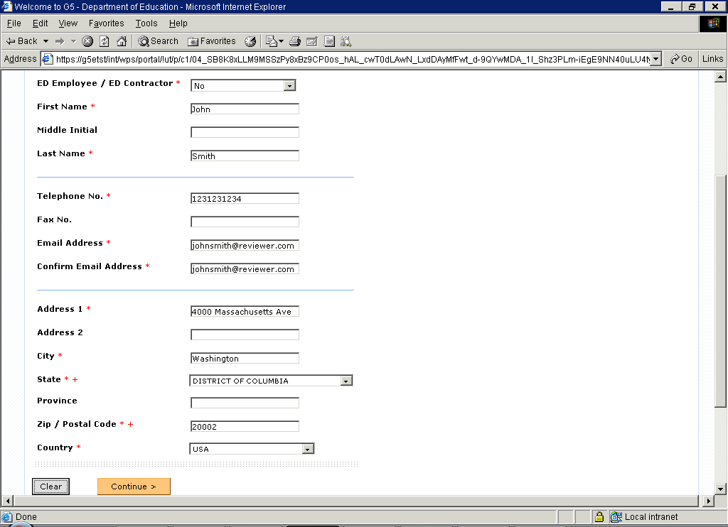
The Sign up > link brings you to the User Registration screen. This screen requires you to enter the fields marked by a red asterisk. The telephone and fax number must be ten numbers only. You must register with a valid email address in order to receive the activation link for your account. When you have finished completing the form click the Continue button.
Step 1: Registering with G5

Slide 6
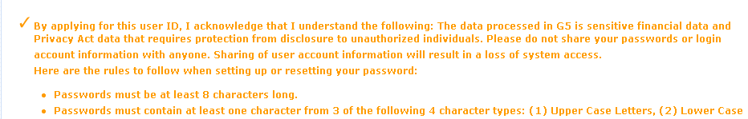
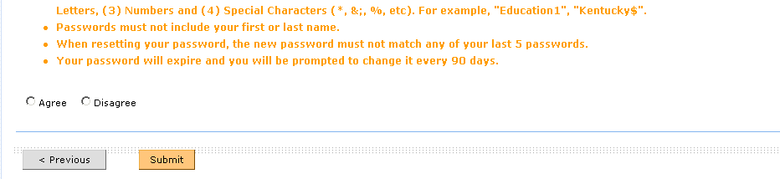
Step 1: Registering with G5
The Summary screen allows you to review and verify the information entered. If you agree to the terms listed in orange, select the Agree radio button and click the Submit button.

Slide 7
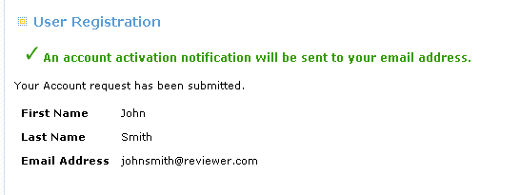
Step 1: Registering with G5
You will then see a Confirmation screen like the one above.
Please note that a link will be emailed to you at the email address you provided.

Slide 8
Step 2: Activating Your Account
Shortly after you register you will receive an email message similar to the one below. Click the link and it will take you to G5 to activate your account.
John,
Your Account Request has been received. Your user G5 user id is johnsmith@reviewer.com. Click on the link below to activate your account.
http://g5etst/ext/wps/portal/!ut/p/c0/dZBBb8IwDIX_0ZykKzS3ISEBZROaYNPaS2WKWwxNuqWhk_j1tEjcguyDn_y9J8uQw1AWe67Rc2uxgR_IJ8VnuvhezbQQm3QuhXqfJ5vF-isSQkAG-fT5fgq7MbGOi0tHzqDFmgxZX5BBbiA7tUfbGfbHN0c90z-5l7I1Ycso-QBZuv1Y7ZZCRiqWYbLBzls0BNl2zA5DFbsHlQ5XhCFHfxfqvOcRkypRMhavWkVJFOax9NzfX1e2h8ESV3upSaMehgp-z7i_0r1nN3GWEo4!/
Should you have any questions, please contact the Helpdesk at 1-888-336-8930 (TTY: 1-866-697-2696, local 202-401-8363) or email edcaps.user@ed.gov.
Hours of operation: 8am-6pm Washington DC time Monday-Friday.
Please note depending on your email provider, the link may be re-formatted. If clicking on the link directly does not work, you can try copying the entire link and pasting it into your browser.

Slide 9
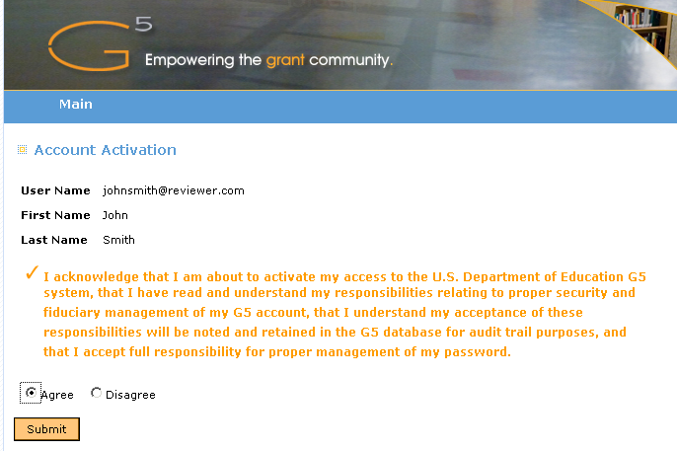
Step 2: Activating Your Account
The link in your email will bring you to the Account Activation screen. Please read the user agreement, click the Agree radio button to acknowledge your compliance, and click the Submit button.

Slide 10
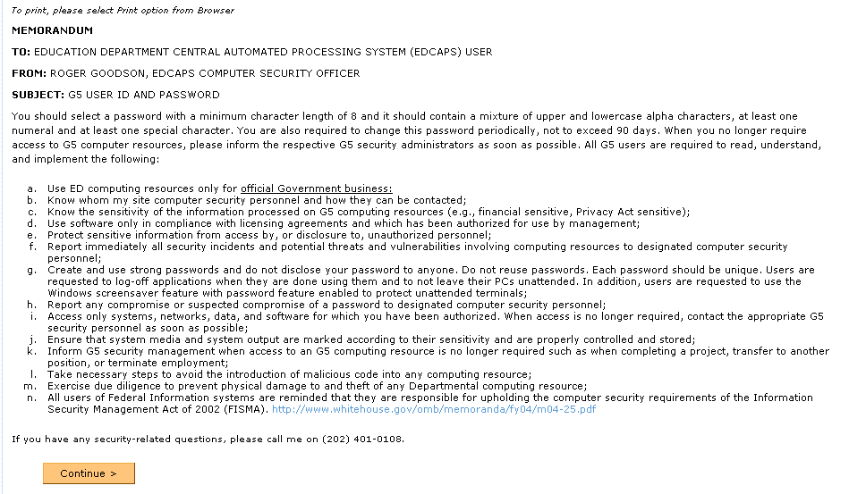
Step 2: Activating Your Account
Read the G5 User ID and Password Memorandum and click the Continue button.

Slide 11
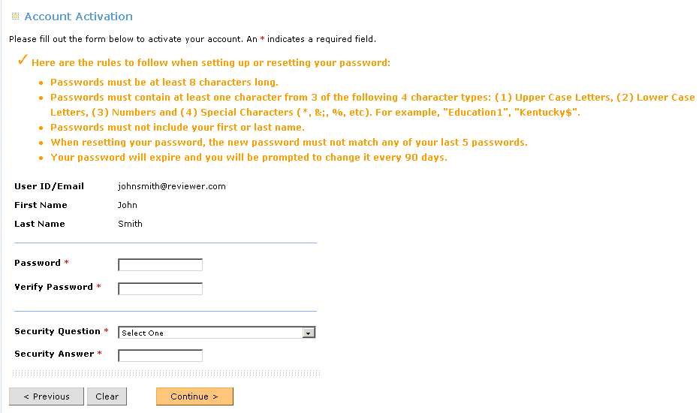
Next you will see the screen above. Enter the required fields and click the Continue button to finalize your activation.
Step 2: Activating Your Account

Slide 12
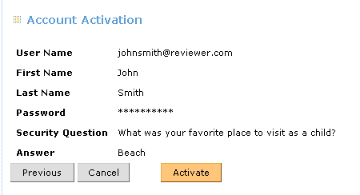
Click the Activate button to confirm the information you have entered and activate your account.
Step 2: Activating Your Account

Slide 13
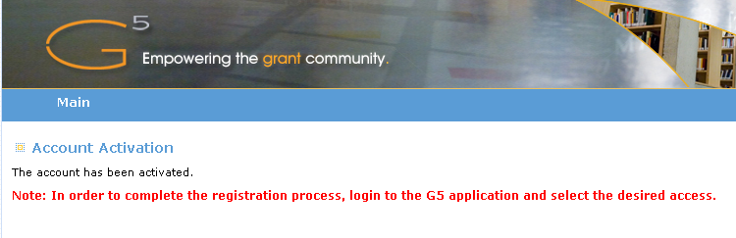
This screen tells you that your account is now activated. For the next step you will need to go to www.g5.gov and log in to select the reviewer access. The system will also send you an email confirming that your account has been activated. The email will include a link to the G5 web page where you can log in using the password you just created.
Step 2: Activating Your Account

Slide 14
Step 3: Selecting Reviewer Access
After entering your Email ID and Password, you must check the box indicating that you accept the Department of Education's terms for using the G5 site. Then click the Login to G5 button. Please note you will have to check the “Yes, I Accept the Terms” checkbox each time you log into G5.

Slide 15
Step 3: Selecting Reviewer Access
After you enter your Email ID and G5 password and click login you will be prompted with a new screen requesting that you verify existing phone numbers in G5, enter additional phone numbers (preferably one that is a mobile number), and answer two additional security questions.
You will then be directed to the Two Factor Authentication screen where you will have one of three ways to retrieve the unique code needed to complete the G5 log-in process. Use only one of the three options below to retrieve the unique code necessary to log into G5.
– App: Use an authenticator application on your smart device
– Voice: Receive Voice Call-Back
– Text: Receive SMS Text
More details on the two factor authentication process can be found in this step-by-step guide: https://www.g5.gov/ssoINT/HELP/G5_Two_Factor_Authentication_Guidance.pdf
Note that you will need to log in using the two factor authentication process each time you log into G5.

Slide 16
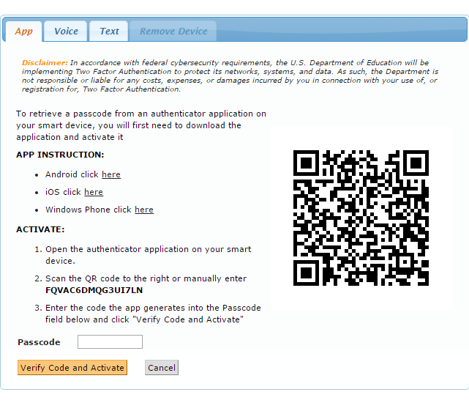
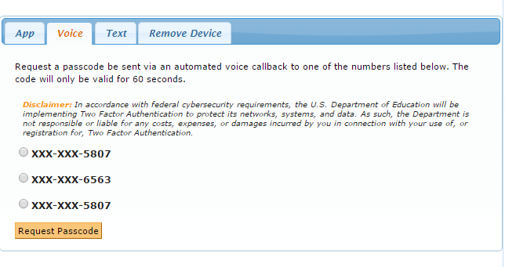
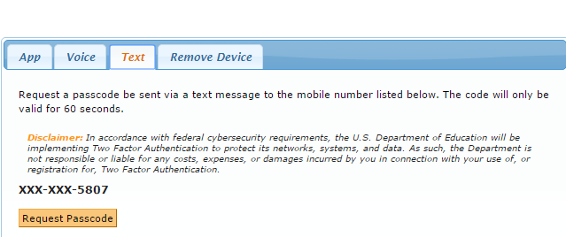
Step 3: Selecting Reviewer Access

Slide 17
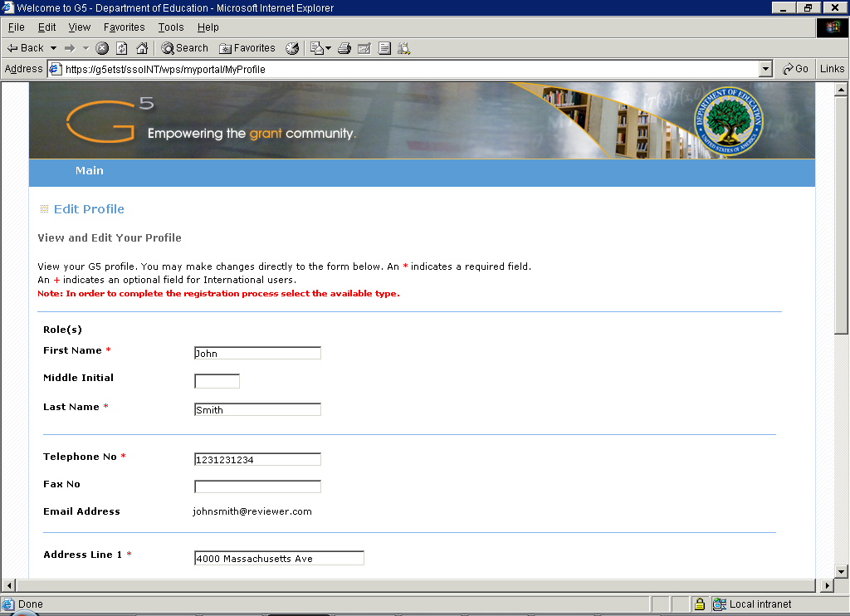
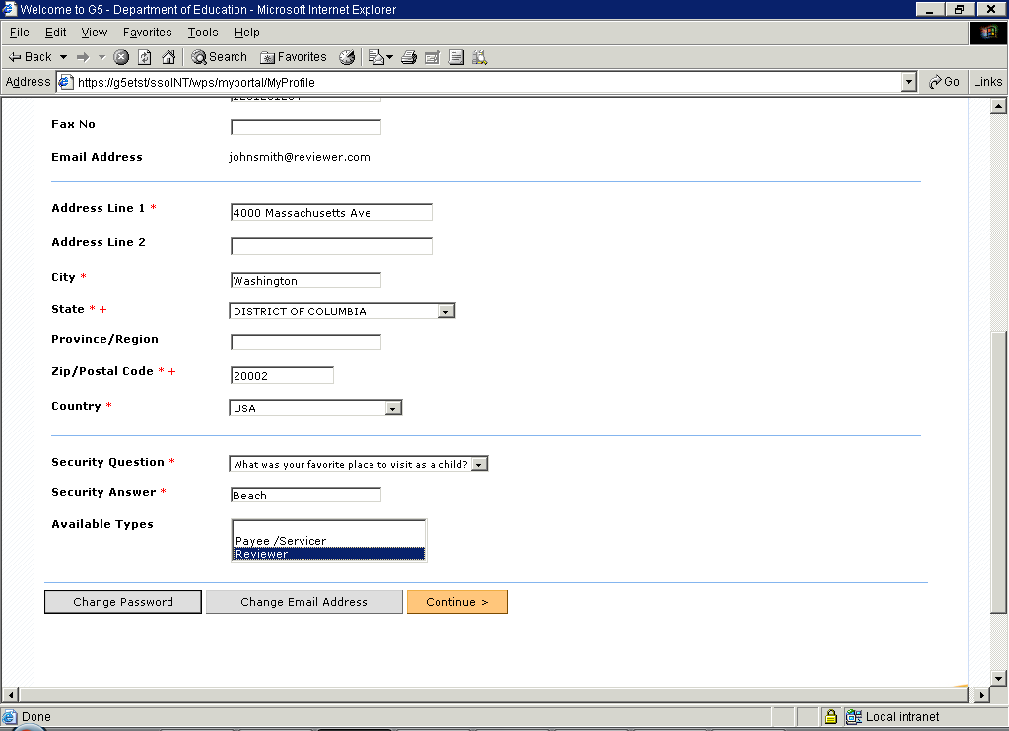
Once you log in you will be directed to My Profile, where you will need to select an available type of access. In this case you will select Reviewer and click the Continue button.
Step 3: Selecting Reviewer Access

Slide 18
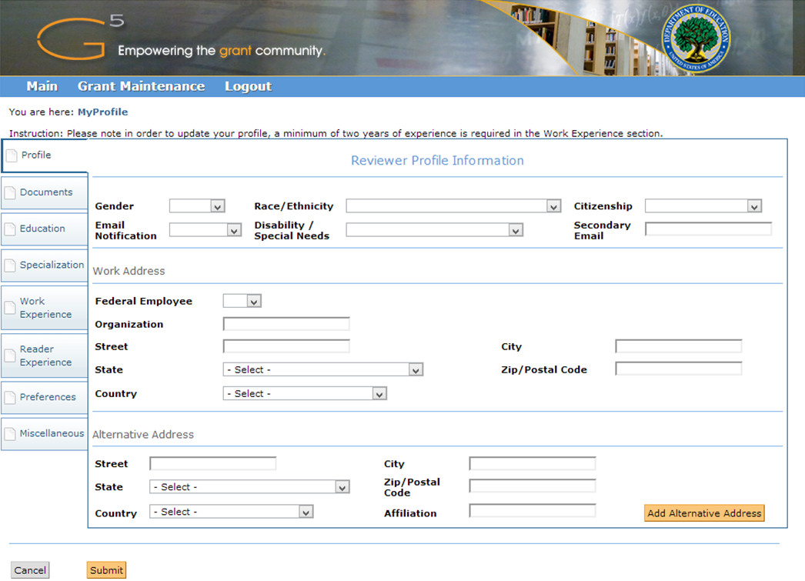
Step 3: Selecting Reviewer Access
The next screen will allow you to enter additional data including the ability to upload a current resume. The uploaded file must be in .PDF format only. Resume upload is required for all EIR reviewers. Please do not exceed the five-page limit for resumes.

Slide 19
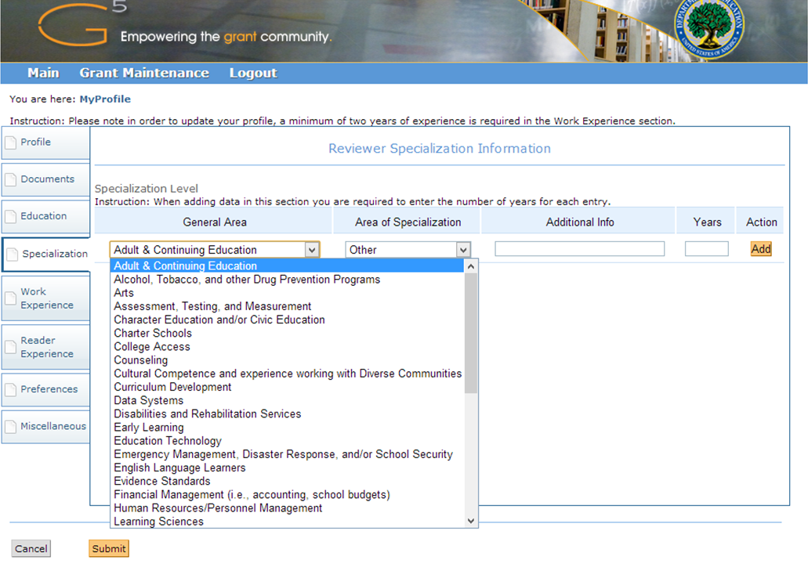
Step 3: Selecting Reviewer Access
Select your Areas of Specialization. Reviewer assignments will be made according to Absolute Priority. Be sure to select at least one Area of Specialization most closely aligned to your experience and the EIR Priority Areas.
Notes:
When the system prompts you for your areas of specialization, please ensure you select at least one of the i3 Absolute Priority areas: teacher/principal effectiveness (“teacher preparation” and/or “school leadership, and/or “strategy management”), low-performing schools (“school turnaround models”, and/or “student services”, and/or “professional development”) STEM education (“STEM”), students with disabilities (“disabilities and rehabilitation services” and/or “school-based mental health services”), English learners (“English language learners”), parent/family engagement (“parent and family engagement”), technology (“education technology”), rural achievement (“rural education”), and/or college-and career-ready standards (“standards” or “assessment, testing, and measurement”).
If you desire, you may indicate additional areas of expertise outside of the i3 Absolute Priorities (e.g., “charter schools” or “evidence standards”) to indicate complementary areas of expertise, but you are not required to do so.
For those interested in serving as an Evaluation reviewer be sure to select the “Program Evaluation” and/or “Research & Development” fields in addition to your other areas of expertise.

Slide 20
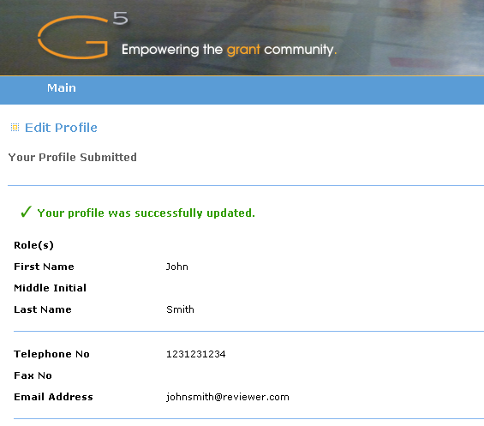
If you see a confirmation message like the one above, your request was successful. You will need to log out and allow some time for your request to be processed.
Step 3: Selecting Reviewer Access

Slide 21
Questions?
Please direct all questions to the EIR Peer Review Inbox at EIRpeerreview@ed.gov.
For information on the 2017 EIR Competition and to access the frequently asked questions, please visit the EIR website at: https://innovation.ed.gov/what-we-do/innovation/education-innovation-and-research-eir/.

