Slide 1
Academies for American History and Civics Grant Competition
Office of Innovation and Improvement
June 9, 2016
Note: These slides are intended as guidance only. Please
refer to the official documents published in the Federal Register.
Notes:
Welcome to the Academies for American History and Civics Application Overview Webinar. I am Christine Miller, Team Lead for the Academies program. On behalf of the US Department of Education, I would like to welcome you.
This is the first Academies competition in many years, and we are excited that Congress has restored funding for this program. The FY 16 Academies grant competition was announced on May 31. We are excited to make new awards that will continue to improve the quality of history and civics education across this great nation.
Many of you may be familiar with the requirements of the Academies program, but we wanted to go over the FY 16 Academies competition and give you an opportunity to ask us any questions you may have.

Slide 2
Note About These Slides
Note: These slides are intended as guidance only. Please
refer to the official documents published in the Federal Register.
The slides presented on this webinar will be available for download on the Resources page of the Academies website.
Additional guidance is provided in our application package on Grants.gov
Notes:
We are recording this Webinar and will make both the recording and these slides available to you on the Academies program website for your reference following today’s Webinar.
We also encourage applicants to download the FY 16 Academies Application Package from the Grants.gov website. We will discuss Grants.gov later in the webinar. The Academies Application Package serves as an additional set of instructions and guidance to potential applicants when applying for this grant. We will make references to the Academies Application Package several times during this webinar and again we encourage you to download it as soon as possible.
Finally, we want to stress that the information provided during this webinar is intended for guidance only. Applicants should refer to the official documents published in the Federal Register when applying for this Academies grant.

Slide 3
Notes on General Q&A
We cannot answer questions that are specific to your state or region.
We cannot answer questions that are applicant-specific.
  “Does this sound like a good idea?”
  “Does this idea address the absolute priority?”
We may not be able to answer all questions received during today’s webinar. If you have additional questions, please send them to the Academies inbox at: Academies@ed.gov
We will publish an Academies Frequently Asked Questions (FAQ) document at http://innovation.ed.gov/what-we-do/american-history-and-civics-academies/
Notes:
At various points during this webinar we will pause to answer questions. If you have questions on a particular section, please write those questions down and hold them until we ask for questions. When we ask for questions, please type your questions inside the
Q & A box to the right of your screen. We will attempt to answer as many as time allows. As you think about your questions, please consider that…
Read slide

Slide 4
Agenda for Today’s Webinar
I. Academies Program Purpose and Overview
II. Eligibility Requirements
III. FY 16 Competition Priorities
IV. Selection Criteria & Scoring
V. Submission Guidance
VI. Final Reminders
Notes:
Today’s webinar has been divided into several parts.
We will begin by taking you through an overview of the Academies program purpose and overview. Following that we will discuss the Eligibility requirements that must be met by all applicants. We will then take a closer look at the FY 16 program priorities, followed by the Selection Criteria. We will wrap up with the discussion with some additional Academies program requirements, submission guidance and a few final reminders.
At the end of each section, you will have the opportunity to ask questions. Again we ask you to use the Q&A function on the right side of the screen. We will answer as many questions as time permits.

Slide 5
Academies Program Purpose
Establish Presidential Academies for both veteran and new teachers of American history and civics to strengthen their knowledge and preparation for teaching American history and civics.
Establish Congressional Academies of American history and civics for high school students to develop a broader and deeper understanding of these subjects.
http://innovation.ed.gov/what-we-do/american-history-and-civics-academies//
Notes:
The Academies Grant Program supports two types of programs: First, it supports the establishment of Presidential Academies for both new and veteran teachers of American history and civics to strengthen their knowledge and preparation for teaching American history and civics. Second, the program supports the establishment of Congressional Academies of American history and civics for high school students to help them develop a broader and deeper understanding of these subjects.
At the bottom of the slide we have included the link to our program website. Please consult this website for competition information including a link to the Federal Register notice inviting applications.

Slide 6
Authorizing Legislation
The Academies for American History and Civics program statute is contained in the American History and Civics Education Act of 2004. You may view the full version of the law by clicking the link below:
https://www.gpo.gov/fdsys/pkg/PLAW-108publ474/html/PLAW-108publ474.htm
Notes:
The Academies program statute is contained in American History and Civics Education Act of 2004.
As a note of clarification, the new Every Student Succeeds Act also contains an authority for American History and Civics Academies. However, the Department will run this competition using the authority from the 2004 Act for the FY 16 competition. Any competitions conducted after FY 16 will be conducted under the new authority.

Slide 7
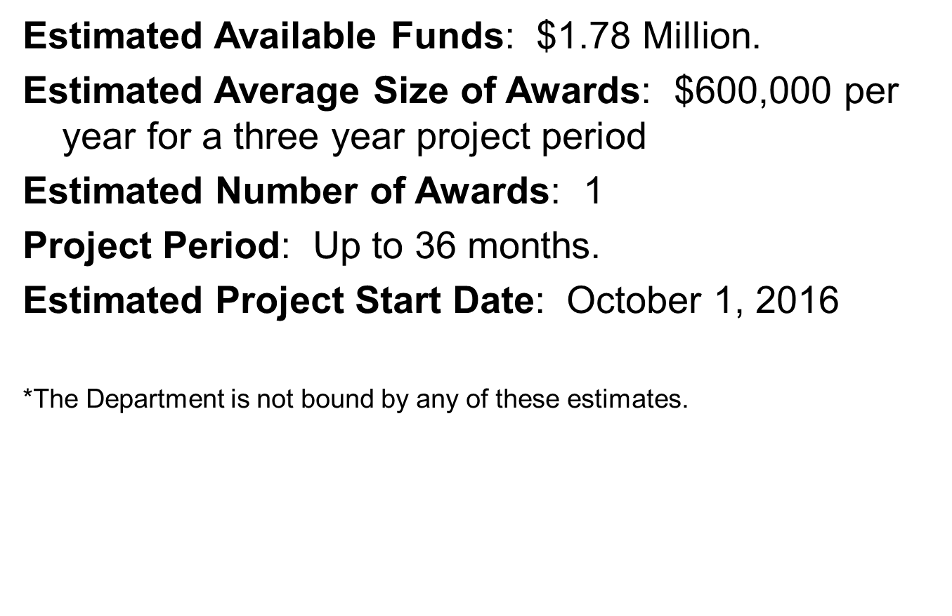
FY 16 Funding Estimates
Notes:
The estimated available funds for this competition are $1.78 Million. This is considered a small competition. We are estimating that the awards will be $600,000 per year per grantee. The grant period will be for 3 years. We expect to award funds for the entire project period from this appropriation. In other words, the grants will be fully frontloaded. We will not provide any additional funding from future appropriations to grants awarded under this competition. Thus, we expect that we will have only enough funds to award 1 grant. We encourage only serious applicants to apply for grants.
The numbers on this slide are just estimates and we are not bound to them. However we ask that you keep these numbers in mind as you plan activities and budget for your proposed project.

Slide 8
        Eligibility Requirements
Eligible Applicants may include:
  Local educational agencies;
  Institutions of higher education; or
  Other public and private agencies, organizations, and institutions.
  Note: Applicants must include in their applications evidence of their organization’s expertise in historical methodology or the teaching of history.
Notes:
Let’s move forward and discuss the Academies eligibility requirements. Applicants may include the entities described on this slide, and this list is also included in our Federal Register notice. An Applicant must include in its application evidence of its expertise in historical methodology or the teaching of history. Please make sure that your application provides appropriate evidence and documentation.
Read Slide.

Slide 9
        FY 16 Academies Priorities
Note: These slides are intended as guidance only. Please refer to the official Notices in the Federal Register.
Notes:
We will now discuss the three priorities for the FY 16 Academies competition. Again, please remember that these slides are intended as guidance only. Applicants should refer to the official notice in the Federal Register for information regarding these priorities

Slide 10
        Academies Priorities
Two Absolute Priorities—Applicants Must Address Both
Absolute Priority 1 -- Establishment of Presidential Academies for the Teaching of American History and Civics
Absolute Priority 2 -- Congressional Academies for Students of American History and Civics
Notes:
The FY 16 Academies competition includes two Absolute Priorities that every applicant must address in order to be considered for funding .
Read slide
Note that this is a different approach than the Department has used in previous Academies competitions. Previous Academies competitions focused on only one type of academy. However, we are utilizing this approach to provide both types of academies in an effort to create a more seamless model of service delivery that provides educational services to teachers AND students each year.

Slide 11
        Absolute Priorities
Applicants should read the Academies Notice Inviting Applications (NIA) for full Absolute Priority language.
Applicants must address BOTH Absolute Priorities in order to be considered for funding.
Applications that do not address both Absolute Priorities will not be reviewed.
Notes:
Lets being with the Absolute Priorities. Again, these priorities are required and you have to address both of them.
Here are some overarching things to consider when addressing the Absolute Priorities.
Read Slide…

Slide 12
Absolute Priority 1:
Presidential Academies
Absolute Priority 1--Presidential Academies for the Teaching of American History and Civics.
Under this priority, an applicant must propose to establish a Presidential Academy for Teaching of American History and Civics that may offer workshops for both veteran and new teachers of American history and civics.
(See NIA for full Absolute Priority 1 language)
Notes:
The next three slides provide highlights for each Absolute Priority. Applicants should read the full AP language found in the Academies NIA.
Read Slide

Slide 13
Absolute Priority 2:
Congressional Academies
Absolute Priority 2--Congressional Academies for Students of American History and Civics.
Under this priority, an applicant must propose to establish a Congressional Academy for Students of American History and Civics.
(See NIA for full Absolute Priority 2 language)
Notes:
This slide contains information about Absolute Priority 2, the Congressional Academies. Again should refer to the full AP language found in the Academies NIA.
We ask that applicants discuss in the program Abstract that they are addressing both Absolute Priorities and where this information may be found in the project narrative.
Read slide…

Slide 14
        Competitive Preference Priority (CPP)
Applicants should read the Academies Notice Inviting Applications (NIA) for full CPP language.
The CPP is optional; applicants may chose to address this priority.
Applicants should clearly identify in the Abstract if it has addressed this priority and where this response can be found.
Applicants may address the CPP in as a separate section of the application, or throughout the application.
The CPP is worth up to an additional 10 points.
CPP points will only be awarded to applicants that rate highly on the Selection Criteria.
Notes:
Now, lets discuss with the Competitive Preference Priority. This priority is optional and applicants are not required to address it. However if an applicant wishes to be considered for these competitive preference points, it must clearly identify in its abstract where in the project narrative section of its application it addresses this priority.
If you are thinking about addressing the CPP, here are some overarching things to consider when addressing the Competitive Preference Priority.
Read Slide…

Slide 15
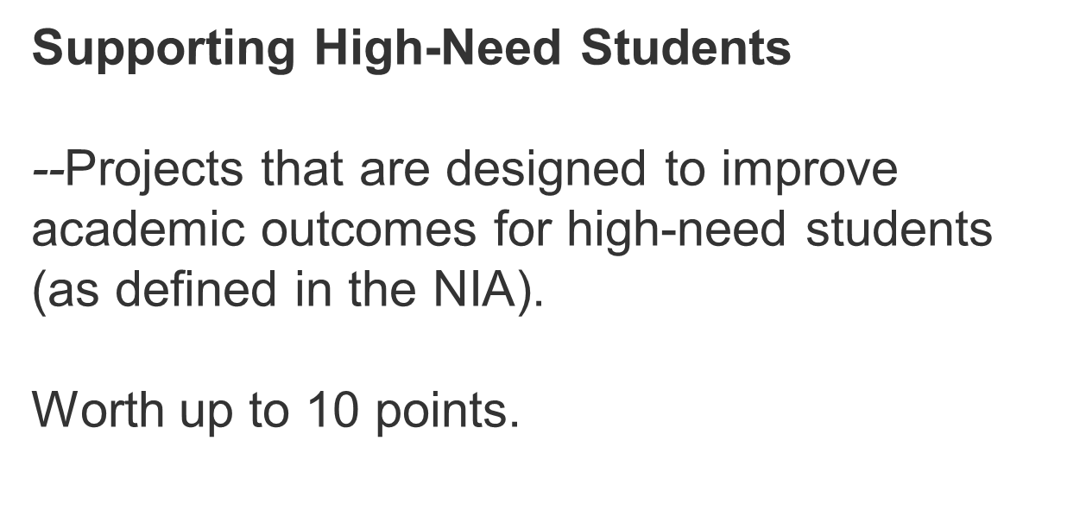
Competitive Preference Priority
Notes:
Read Slide…
Again, this priority is optional but it is worth up to 10 points.

Slide 16
High-Need Student Definition
High-need students means students who are at risk of educational failure or otherwise in need of special assistance and support, such as students who are living in poverty, who attend high-minority schools, who are far below grade level, who have left school before receiving a regular high school diploma, who are at risk of not graduating with a diploma on time, who are homeless, who are in foster care, who have been incarcerated, who have disabilities, or who are English learners.
Notes:
The Competitive Preference Priority refers to High-need students. For the purposes of the FY 16 Academies competition, High-need students means students who are at risk of educational failure or otherwise in need of special assistance and support, such as students who are living in poverty, who attend high-minority schools, who are far below grade level, who have left school before receiving a regular high school diploma, who are at risk of not graduating with a diploma on time, who are homeless, who are in foster care, who have been incarcerated, who have disabilities, or who are English learners.
Please refer to the Academies Notice Inviting Applications for this and other related definitions.

Slide 17
        Priority Questions
Please enter your questions in the chat box to the
right of your screen. We may not be able to answer all
questions at this time, but we will answer as many
questions as possible in the allotted Q&A time.

Slide 18
        Academies Selection Criteria & Scoring
Note: These slides are intended as guidance only. Please refer to the official Notices in the Federal Register.
Notes:
Next we will discuss the Selection Criteria for the FY 16 Academies competition. The selection criteria are the criteria by which all applications will be reviewed and scored.
We want to remind applicant that these slides are intended as guidance only. Please refer to the official Notice in the Federal Register.
Additionally, any verbal guidance provided during this discussion does not supersede the specific language of the selection criteria. It is merely intended to help clarify and contextualize the criteria for applicants.
.

Slide 19
        Academies Selection Criteria & Scoring
The Selection Criteria are the criteria against which the peer reviewers score each application
The Department selects grantees based on peer reviewer scores. It is critical to clearly address the Selection Criteria
Applicants should review the Academies NIA for full Academies Selection Criteria language.
Notes:
When addressing the Selection Criteria, we ask that you consider the following:
Read Slide
On the next few slides, we will review the key elements of the Academies selection criteria. Note that on the selection criteria slides, we may not include the full language of each criterion or factor, so again applicants should review the full language in the NIA.

Slide 20
Academies Selection Criteria Point Allocation
Selection Criteria | Max Points
Quality of the Project Design | 35
B. Significance | 20
Quality of the Management Plan | 30
Quality of the Project Evaluation | 15
Total Points | 100
Notes:
This chart displays the FY 16 Academies selection criteria and the points associated with each criterion. They are Quality of the Project Design, Signficance, Quality of the Management Plan, and Quality of the Project Evaluation. Applicants may receive additional points in response to the Competitive Preference Priority should you choose to address it. Peer reviewers will assign points based on how well they believe an application addresses the selection criteria and, if applicable, the competitive preference priority.
An application may receive up to 110 total points: up to 100 points for addressing the selection criteria, and up to 10 points for addressing the competitive preference priority. Only highly-rated applicants, will received the additional CPP points.
On the next few slides, we will review each criterion of the Academies selection criteria and provide some guidance on what may be addressed.

Slide 21
Selection Criterion:
Quality of the Project Design
The extent to which the proposed project represents an exceptional approach to the priority or priorities established for the competition.
The extent to which the services to be provided by the proposed project involve the collaboration of appropriate partners for maximizing the effectiveness of project services.
The extent to which the design of the proposed project reflects up-to-date knowledge from research and effective practice.
Is there a strong plan to implement proposed project?
Are project partners working together to ensure project is successful?
Is there evidence that the plan is research based?
Balance of Costs with Outcomes of Project
Notes:
The first criterion is Quality of the Project Design.
Project Design is the heart of the application and it establishes on the specific goals of the project and how those goals will be met. It also discusses the strategies used and necessary resources needed to implement a successful project.
The first sub factor deals with your plan of action. The applicant should ask, is the plan well explained, and does it clearly explain how the competition priorities are incorporated into the plan?
The second sub factor looks at the utilization of partnerships. The applicant should ask, are project partners clearly defined in the narrative, and does the plan clearly articulate how the partners will collaborate to ensure that the proposed project will be successful?
The third factor addresses research and effective practice. The applicant should ask, does the proposed project clearly reflect an examination of the research base? Does the plan demonstrate how effective practice will be incorporated into the academies activities?

Slide 22
Selection Criterion: Significance
How can your project improve teacher quality and student achievement?
The extent to which the proposed project is likely to build local capacity to provide, improve, or expand services that address the needs of the target population.
The importance or magnitude of the results or outcomes likely to be attained by the proposed project, especially improvements in teaching and student achievement.
How will your program outcomes improve teaching and learning in the field?
Notes:
The first criterion is Significance. The section is where an applicant should explain why their project is important and/or necessary to target population and and address why their project should be funded.
The first sub factor focuses on building capacity and addressing the needs of the target population. The applicant should ask, how does our proposed project improve teacher quality and student achievement in American History and Civics?
The second factor examines the results and potential outcomes of the proposed project. The applicant should ask, How will my project outcomes improve teaching and learning in the field? How can it drive the field?

Slide 23
Selection Criterion: Quality of the Management Plan
The adequacy of the management plan to achieve the objectives of the proposed project on time and within budget, including clearly defined responsibilities, timelines, and milestones for accomplishing the project tasks.
The adequacy of mechanisms for ensuring high-quality products and services from the proposed project. .
Is there a viable plan to carry out the proposed project?
Is there a step-by-step plan to continue to improve the proposed project?
Notes:
The third criterion is Quality of the Management Plan. This criterion is focused on whether an applicant has a specific plan for how to manage the project, and
The first sub factor looks at your plan implementation. What has to be done, when will it be done and who will do it? The applicant should ask, is there a viable plan to carry out the proposed project? Does the plan include milestones? Does the plan include timelines? Does the appendix include resumes for the key personnel?
The second sub factor looks at project feedback. How do you know if what you are doing is working or if something needs to change? The applicant should ask, is there a step-by-step plan to continue to improve the proposed project?

Slide 24
Selection Criterion:
Quality of Project Evaluation
The extent to which the methods of evaluation include the use of objective performance measures that are clearly related to the intended outcomes of the project and will produce quantitative and qualitative data to the extent possible.
The extent to which the methods of evaluation will provide performance feedback and permit periodic assessment of progress toward achieving intended outcomes.
What data will be generated to help determine if the project will meet its goals?
Is there a plan to provide intermediate feedback on successful outcomes?
Notes:
The fourth criterion is the Quality of Project Evaluation. This criterion explains how the project activities and outcomes will be evaluated and whether the evaluation will produce information of value to the field.
Project Evaluation is worth up to 15 points. While Project Design is the “heart” of the application, Evaluation lets us know if the project is making a difference.
We have established two subfactors for Quality of Project Evaluation. The first factor looks at evaluation methods and if they are clearly related to intended outcomes of the project. The applicant should ask, have I clearly laid out my project outcomes, and have I identified how I will measure these outcomes? Are the measures appropriate? Why? What data will be generated to help determine if the project will meet its goals?
The second factor looks at feedback and if the project is on track to meet its goals. The applicant should ask, is there a plan to provide intermediate feedback on successful outcomes? How often will this happen? What will we do with the information from the periodic assessments?

Slide 25
Additional Evaluation Plan Guidance
Evaluation plans should be clear and detailed.
Evaluation plans should include objectives that are S.M.A.R.T (Specific, Measureable, Attainable, Relevant, and Timely)
  Evaluation plans should include key questions and proposed methods for addressing them.
  Evaluation plans should include a summary of data to be collected and how it will be collected.
  Evaluation plans should include a justification for evaluation costs.
  Evaluation plans should include qualifications of proposed evaluation staff.
Notes:
As applicants craft their evaluation plans, we want to offer a bit more guidance. These are suggestions, not requirements, but we do want to encourage you to give careful thought to your evaluation plans.
Read slide…

Slide 26
        Selection Criteria Questions
Please enter your questions in the chat box to the
right of your screen. We may not be able to answer all
questions at this time, but we will answer as many
questions as possible in the allotted Q&A time.

Slide 27
        Application Submission Guidance
Note: These slides are intended as guidance only. Please refer to the official Notices in the Federal Register.
Notes:
We will now move to a discussion of the technical aspects of submitting an Academies application.

Slide 28
Registering for Grants.gov
Applications for grants under this competition MUST be submitted electronically using the Grants.gov site (www.Grants.gov).
Register with System Award Management (SAM). www.sam.gov
Register TODAY
Your ability to apply for an Academies grant, via Grants.gov, is contingent upon an active SAM registration.
Current registrants should confirm that your account is active.
Additional guidance and tips: http://www2.ed.gov/fund/grant/apply/sam-faqs.html
Notes:
The Academies application is entirely electronic. All applicants must use the Grants.gov website to submit applications. Applicants must be registered in order to submit an application in Grants.gov.
Your ability to apply for an Academies grant, via Grants.gov, is contingent upon an active System for Award Management (SAM) registration. Grants.gov registration involves many steps including registration on SAM (www.sam.gov) which may take approximately one week to complete, but could take upwards of several weeks to complete, depending upon the completeness and accuracy of the data entered into the SAM database by an applicant. You may begin working on your application while completing the registration process, but you cannot submit an application until all of the Registration steps are complete. Please note that once your SAM registration is active, it will take 24-48 hours for the information to be available in Grants.gov, and before you can submit an application through Grants.gov. For detailed information on the Registration Steps, please go to: http://www.grants.gov/web/grants/register.html [Note: Your organization will need to update its SAM registration annually (formerly Central Contractor Registry (CCR).]
Primary information about SAM is available at www.sam.gov. However, to further assist you with obtaining and registering your DUNS number and TIN in SAM or updating your existing SAM account the Department of Education has prepared a SAM.gov Tip Sheet which you can find at: http://www2.ed.gov/fund/grant/apply/sam-faqs.html.
All applicants are advised to confirm that they have an active record with SAM. If an applicant has an expired record, the applicant will need to activate its record in order to submit an application of the Academies competition.
If you are a current registrant, you do not need to do anything right away. However, all applicants are encouraged to check their status with SAM to make sure everything is up to date.

Slide 29
Applying Through Grants.gov
To apply for a Academies grant, go to the “Apply for Grants” link on the left hand side of the Grants.gov homepage.
Next, follow the step-by-step application instructions. The CFDA number you will enter for Step 1 is 84.422.
If you are experiencing problems submitting your application through Grants.gov, please contact the Grants.gov Support Desk, toll free, at 1-800-518-4726. You must obtain a Grants.gov Support Desk Case Number and keep a record of it. You can also contact them via email at support@grants.gov.
Further submission instructions are found in the FY 16 Academies notice in the Federal Register.
Notes:
Read Slide…

Slide 30
Grants.gov Tips
REGISTER EARLY – Do It TODAY!
  This process could take days to weeks to complete.
SUBMIT APPLICATION EARLY
  Depending on the size of the file, transmittal may take several minutes to hours.
  Applications time stamped after 4:30:00 Washington D.C. time on July 15, 2016 will be marked late and will not be read.
When in doubt, CALL THE GRANTS.GOV HELPDESK! (1-800-518-4726)
Notes:
Again, we want to emphasize that is very important to register early. The registration process is time consuming and you need to take care of this right away so that you are able to submit your application by July 15.
We also strongly recommend that you submit your application early to avoid any last minute technical difficulties. Late applications will not be accepted, so please submit early.
Our program office is here to help you with program-specific issues, but if you have technical issues that are specific to Grants.gov, please call the Grants.gov help desk.

Slide 31
        Application Submission Questions
Please enter your questions in the chat box to the
right of your screen. We may not be able to answer all
questions at this time, but we will answer as many
questions as possible in the allotted Q&A time.

Slide 32
        Final Reminders

Slide 33
Competition Resources
  FY 16 Academies Notice Inviting Applications (NIA)
  Academies Program Website http://innovation.ed.gov/what-we-do/american-history-and-civics-academies/
  FY 16 Academies Application Package
  FY 16 Academies Frequently Asked Questions (FAQ)
  All Academies questions may be sent to Academies@ed.gov
Notes:
This slide provides a short list of resources that you should keep in mind throughout the competition. As you will see on this slide, the Department provides multiple avenues for interested applicants to obtain information, ask questions and clarify their understanding of the Academies competition and process. The first resource listed here is the most important: the Notice Inviting Applications, or NIA. Always refer to the NIA first to make sure you have a clear understanding of the FY 16 Academies competition process and how to submit through Grants.gov.
The Department has published web page at the link on this slide and others throughout this presentation ( http://innovation.ed.gov/what-we-do/american-history-and-civics-academies/ ) Please consult this program web page for information about the Academies program as well as any competition updates. We will also publish a list of Frequently Asked Question on the web page in the near future. We will also link to an application package that is intended as guidance for you. This application package is available already in Grants.gov as a resource.
The Department has established a mailbox where interested applicants may send their questions. Please send your questions to Academies@ed.gov Please keep in mind that the Department cannot provide guidance on specific proposals.

Slide 34
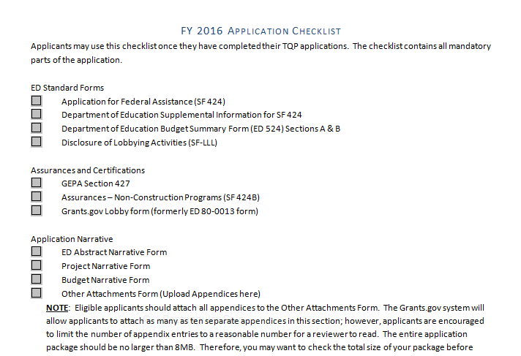
Application Checklist
Notes:
This slide displays a snap shot of the application checklist found in the Application Package. We encourage applicants to use this checklist to help ensure that all ED standard forms, assurances and certifications, all parts of the application narrative and all parts of the Appendices are uploaded and submitted.

Slide 35
  Closing Date:
  July 15, 2016
  4:30:00 PM Washington, D.C. Time
Note: These slides are intended as guidance only. Please refer to the official Notices in the Federal Register.
Notes:
As a final reminder the FY 16 Academies application is due in Grants.gov on July 15, 2016, at 4:30 pm, Washington, D.C. time. Applications will be time and date stamped by the Grants.gov system and any application that is received after 4:30:00 pm will be marked as late and will not be read. If an application is declared to be a duplicate, we will read the application with the last time and date stamp that is before 4:30:00 pm.

Slide 36
Intent to Apply
  Please email your Notice of Intent to Apply to Christine Miller at Academies@ed.gov by July 1.
  Please include name of your institution/organization. You may also list partnering institutions/organizations.
  Intent to Apply is an optional step but it will help us plan for a more efficient peer review. Thank you!
Notes:
Finally, in order to help us plan for a more efficient peer review of the Academies applications, we ask that you take a few moments to send us a notice of intent to apply. This is entirely optional, but it does help our office to plan for the peer review phase.
Please email me your intent to reply at Academies@ed.gov by July 1st. Please include name of your institution/organization. You may also list partnering institutions and organizations.

Slide 37
        Questions & Answers
Notes:
At this time, we take a final round of questions. Please enter your questions in the chat box to the
right of your screen. We may not be able to answer all questions at this time, but we will answer as many
questions as possible in the allotted Q&A time.

Slide 38
Call for Peer Reviewers!
  Peer Reviewers needed
  Must be available for panel calls August 1-17. (Exact dates will be announced later.)
  Must not have conflict of interest with submitted applications
  Send resume and brief cover letter to Christine Miller at Academies@ed.gov
Notes:
One last item before we close the webinar. We are currently issuing a call for peer reviewers for the Academies competition. If you are not writing an Academies application and do not have any significant conflicts of interest with any of the applications submitted, you may be eligible to serve as a reviewer.
The peer review will be virtual. We will mail applications to reviewers in late July. Reviewers will work from home and enter all scores and comments into an electronic database. Panels will meet via conference calls during the time period of August 1-17.
If you are interested in being considered as a peer reviewer, please email me your resume and a brief cover letter that outlines your experience in history and civics and any particular experience that you have that you believe is relevant to this competition. If you have read for ED previously, please list the programs for which you have read.
If you are selected as a peer reviewer we will contact you in late June or early July.

Slide 39
        Thank you for your interest in
        the Academies Grant Program.
Notes:
This concludes our Academies pre-application webinar. We thank you for your interest in this grant program and we wish you the best of luck with the competition. This webinar is being recorded and will be available on the Academies in the near future for your ongoing reference. Thank you and have a great day.

