Slide 1
INVESTING IN INNOVATION (i3)
SUMMARY OF 2016 i3
HIGHEST-RATED APPLICATIONS (HRAs)

Slide 2
“The evidence about what works will hopefully drive investment decisions in school districts every day... One of the stories we will have to tell is that there is still value in testing an innovation that didn't work... Part of this program isn't just about investing in success, it's about learning going forward.“
–John King, Secretary of Education

Slide 3
i3 IS THE DEPARTMENT’S LEADING PROGRAM FOCUSED ON INNOVATION AND EVIDENCE
i3 is a Department of Education signature grant program focused on seeding and scaling innovations in K–12 public education. i3 rewards applicants for the rigor of evidence that supports their application—the more rigorous the research, the larger the award; early-stage innovations do not require evidence of effectiveness and receive commensurately smaller grants.
Through six competitions from 2010 to 2015, i3 has awarded $1.3 billion in grants to 157 grantees out of 4,685 applications. These grantees have secured over $250 million in private sector matching funds. This year, the Department received more than 350 applications for the 2016 i3 competition.
The Department awards three types of grants, from greatest amount of funding available to least: “Scale-up grants,” “Validation grants,” and “Development grants.” This “tiered” structure enables i3 to support programs at various phases of growth—from early-stage efforts to organizations with a national reach.

Slide 4
THE 15 2016 i3 HRAs WILL SUPPORT STUDENTS ACROSS 24 STATES
Competition | Organization | Implementation Locations
Scale-up | National Writing Project | AL, CA, KY, MI, MO, MS, ND, NE, OH, OK, SC, TN, TX, VA, WI
Scale-up | Spurwink Services, Inc. | CA, TN, ME, MN, TX
Validation | Fresno County Office of Education | CA, WA
Validation | Texas A&M University | TX
Validation | Uncommon Schools, Inc. | NJ
Development | Arizona Board of Regents on behalf of Arizona State University | AZ
Development | Cabarrus County Schools | NC
Development | Florida State University | FL
Development | HighScope Educational Research Foundation | MI
Development | Leading Educators, Inc. | IL
Development | Morningside Center for Teaching Social Responsibility, Inc. | NY
Development | Region One Education Service Center | TX
Development | Riverside County Office of Education | CA
Development | Santa Ana Unified School District | CA
Development | Virginia Advanced Study Strategies, Inc. | VA

Slide 5
THE 15 2016 i3 HRAs WILL SERVE APPROXIMATELY 373,634 STUDENTS WITH OVER $102M IN FEDERAL FUNDING
There are 15 HRAs for the 2016 competition. These 15 organizations were selected from over 350 applications and, assuming they meet their required private-sector match, will receive a total investment of over $102 million in federal funds.
Approximately 373,634 students will be served by these 15 projects.
One of the Scale-up grants will fund the expansion of an intervention that built evidence on its effectiveness with an i3 Development AND i3 Validation grant—a first in i3’s history.
  Spurwink: The Building Assets Reducing Risks (BARR) model, developed by an educator, targets the critical time of 9th grade, and also impacts the entire school through training, coaching, and materials for the entire staff. BARR has produced significant improvements in course credits earned and standardized test scores. The grant will enable scaling to an additional 50 schools, impacting an estimated 146,250 students and 11,600 teachers.
One of the Validation grantees is an LEA that used evidence generated through an i3 Development grant to qualify for the next tier.
  Fresno County Office of Education: The grant will fund the expansion of the evidence-based Expository Reading and Writing Course to grades 11 and 12 and to California and Washington. The project will serve 9,600 students and an additional 50,000 students will benefit from an improved curriculum and teacher professional learning.

Slide 6
THE 15 2016 i3 HRAs ADDRESS A RANGE OF STUDENT NEEDS, INCLUDING ENHANCING STUDENTS’ NON-COGNITIVE SKILLS AND IMPROVING LOW-PERFORMING SCHOOLS
Absolute Priority | # of Development HRAs | # of Validation HRAs | # of Scale-up HRAs
Low-Performing Schools | N/A | 1 | 1
Non-Cognitive Factors | 2 | N/A | N/A
Promoting Diversity | 2 | N/A | N/A
Rural: Non-Cognitive Factors | 2 | N/A | N/A
Rural: Standards & Assessments | N/A | – | 1
Rural: STEM | N/A | 1 | –
School Climate | 2 | N/A | N/A
Standards & Assessments | 2 | 1 | –
Total | 10 | 3 | 2
Key: N/A = Priority not available in grant category; “–” = HRA not included in that priority

Slide 7
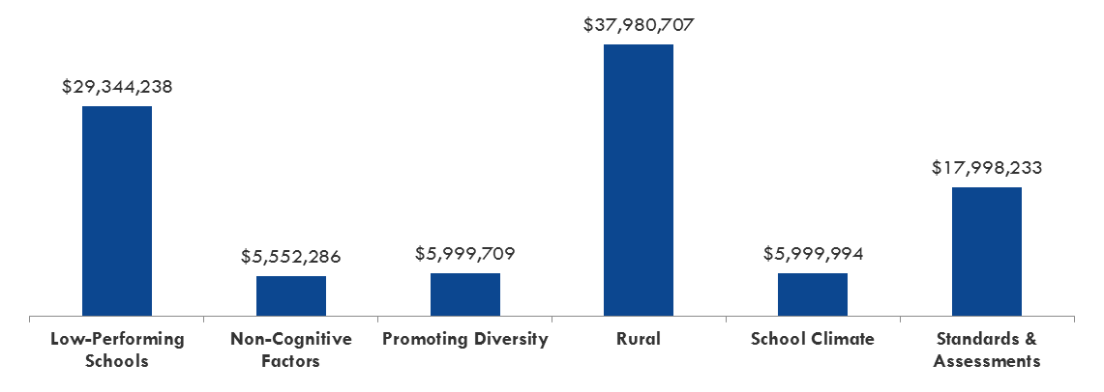
APPENDIX A:
HRAs BY COMPETITION AND APPLICANT TYPE
 | Development | Validation | Scale-up | Total
Local Educational Agency | 4 | 1 | 0 | 5
Nonprofit with Consortium of Schools | 1 | 0 | 1 | 2
Nonprofit with Local Educational Agency | 5 | 2 | 1 | 8
Total | 10 | 3 | 2 | 15
HRAs BY ABSOLUTE PRIORITY AND FUNDING

Slide 8
APPENDIX B:
TOTAL NUMBER OF STUDENTS SERVED BY COMPETITION AND ABSOLUTE PRIORITY
Priority | Development | Validation | Scale-up | Total
Low-Performing Schools | N/A | 23,000 | 146,250 | 169,250
Non-Cognitive Factors | 47,024 | N/A | N/A | 47,024
Promoting Diversity | 10,308 | N/A | N/A | 10,308
Rural: Non-Cognitive Factors | 5,340 | N/A | N/A | 5,340
Rural: Standards & Assessments | N/A | – | 40,000 | 40,000
Rural: STEM | N/A | 6,240 | – | 6,240
School Climate | 59,472 | N/A | N/A | 59,472
Standards & Assessments | 26,400 | 9,600 | – | 36,000
Total | 148,544 | 38,840 | 186,250 | 373,634
TOTAL NUMBER OF STUDENTS SERVED BY COMPETITION AND APPLICANT TYPE
Organization Type | Development | Validation | Scale-Up | Total
Local Educational Agency | 69,108 | 9,600 | – | 78,708
Nonprofit with Consortium of Schools | 21,600 | – | 146,250 | 167,850
Nonprofit with LEA | 57,836 | 29,240 | 40,000 | 127,076
Total | 148,544 | 38,840 | 186,250 | 373,634
Key: N/A = Priority not available in grant category; “–” = HRA not included in that priority

