Slide 1
Education Innovation and Research (EIR) Expansion priorities
February 2019
Notes:
We’re going to introduce you the EIR Expansion competition priorities, which includes strong evidence, in these informational slides. There are separate informational slides for Early-phase and Mid-phase.
If you are planning to apply to EIR, you should read carefully the specific notice inviting applications (NIA) and the specific application package for the competition to which you are applying. These slides are for information purposes only, and applicants should rely upon the NIA for the official competition requirements.

Slide 2
Expansion PRIORITIES
REQUIRED: Everybody Must Address Absolute Priority 1 | REQUIRED: Applicants Must Select Either Absolute Priority 2 or Absolute Priority 3
Absolute Priority 1: Strong Evidence | Absolute Priority 2: Field-Initiated Innovations – General
 | Absolute Priority 3 Field-Initiated Innovations – Promoting STEM Education, With a Particular Focus on Computer Science
Note: This priority establishes an evidence requirement. | Note: Must clearly indicate in the abstract and project narrative which option has been selected.
Notes:
Under 34 CFR 34.105(c)(3), we consider only applications that meet Absolute Priority 1, Strong Evidence, and one additional absolute priority.

Slide 3
ABSOLUTE PRIORITY 1:
Absolute Priority 1– Strong Evidence.
Under this priority, we provide funding to projects supported by strong evidence.
Notes:
Read slide

Slide 4
What is strong Evidence? (1 of 2)
Strong evidence means that there is evidence of the effectiveness of a key project component in improving a relevant outcome for a sample that overlaps with the populations and settings proposed to receive that component, based on a relevant finding from one of the following:
(i) A practice guide prepared by the WWC using version 2.1 or 3.0 of the WWC Handbook reporting a “strong evidence base” for the corresponding practice guide recommendation;
(ii) An intervention report prepared by the WWC using version 2.1 or 3.0 of the WWC Handbook reporting a “positive effect” on a relevant outcome based on a “medium to large” extent of evidence, with no reporting of a “negative effect” or “potentially negative effect” on a relevant outcome; or
(iii) A single experimental study (as defined in this notice) reviewed and reported by the WWC using version 2.1 or 3.0 of the WWC Handbook, or otherwise assessed by the Department using version 3.0 of the WWC Handbook, as appropriate,
and
(continued)
Notes:
Read slide

Slide 5
What is strong Evidence? (2 of 2)
…and that—
(A) Meets WWC standards without reservations;
(B) Includes at least one statistically significant and positive (i.e., favorable) effect on a relevant outcome;
(C) Includes no overriding statistically significant and negative effects on relevant outcomes reported in the study or in a corresponding WWC intervention report prepared under version 2.1 or 3.0 of the WWC Handbook; and
(D) Is based on a sample from more than one site (e.g., States, counties, cities, school districts, or postsecondary campuses) and includes at least 350 students or other individuals across sites. Multiple studies of the same project component that each meet requirements in paragraphs (iii)(A), (B), and (C) of this definition may together satisfy this requirement.
Notes:
Read side

Slide 6
How DO YOU DEMONSTRATE THAT YOU MEET STRONG EVIDENCE?
Use the evidence form that is included in the application package
Identify up to 4 study citations to be reviewed against the WWC handbook, and for each include a description of:
The positive student outcomes to be replicated, and a description of how the characteristics of the students in the study correspond to those high needs students proposed in the application
how the proposed practices correspond between the study and the proposed application
the intended student outcomes that the proposed practice(s) attempts to impact
Citations must refer to publicly available sources (provide links or other guidance)
Applicants will not get an opportunity to provide additional information; however, study authors may be asked by the WWC to respond to queries on key aspects of the study design.
Notes:
You must cite either a specific recommendation from a What Works Clearinghouse Practice Guide, a What Works Clearinghouse Intervention Report, or a publicly available, original study of the effectiveness of a component of your proposed project on a student outcome or other relevant outcome.
If citing individual studies, an applicant must identify up to four study citations to be reviewed against What Works Clearinghouse Handbook for the purposes of meeting strong evidence (as defined in the notice). The studies may have been conducted by the applicant or by a third party. An applicant should clearly identify these citations in the Evidence form that is included in the EIR Expansion application package.
In addition to including up to four study citations, applicants should describe in the form information such as the following: (1) the positive student outcomes they intend to replicate under their Expansion grant and how the characteristics of students and the positive student outcomes in the study citations correspond with the characteristics of the high-need students to be served under the Expansion grant; (2) the correspondence of practice(s) the applicant plans to implement with the practice(s) cited in the studies; and (3) the intended student outcomes that the proposed practice(s) attempts to impact.
An applicant must ensure that all evidence is available to the Department from publicly available sources and provide links or other guidance indicating where it is available. If the Department determines that an applicant has provided insufficient information, the applicant will not have an opportunity to provide additional information at a later time. However, if the What Works Clearinghouse determines that a study does not provide enough information on key aspects of the study design, such as sample attrition or equivalence of intervention and comparison groups, the What Works Clearinghouse may submit a query to the study author(s) to gather information for use in determining a study rating. Authors would be asked to respond to queries within 10 business days. Should the author query remain incomplete within 14 days of the initial contact to the study author(s), the study may be deemed ineligible under the grant competition. After the grant competition closes, the What Works Clearinghouse will continue to include responses to author queries and will make updates to study reviews as necessary. However, no additional information will be taken into account after the competition closes and the initial timeline established for response to an author query passes.

Slide 7
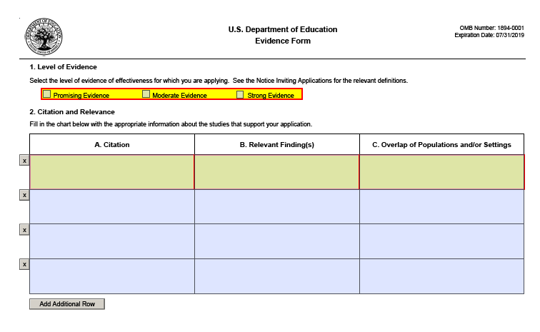
Expansion evidence Form instructions
Notes:
Here is a screen shot of the Evidence form that an Expansion applicant is required to complete and submit with its application.
When completing the form, don’t forget to check “strong evidence.”
Also, please remember that you must identify a specific recommendation from a What Works Clearinghouse Practice Guide, a What Works Clearinghouse Intervention Report, or up to four publicly available study citations. For each, you need to identify the relevant findings and demonstrate that they overlap with the populations and settings proposed in your application.
The overlap of populations and settings requires at least “partial” overlap, but not “complete” overlap. Overlap also needs to be of “similar” populations and settings, not “identical” ones in every respect. Thus a study conducted in one state can overlap with the target population and target settings in another state and provide strong evidence, as long as the respective populations and settings are reasonably similar.

Slide 8
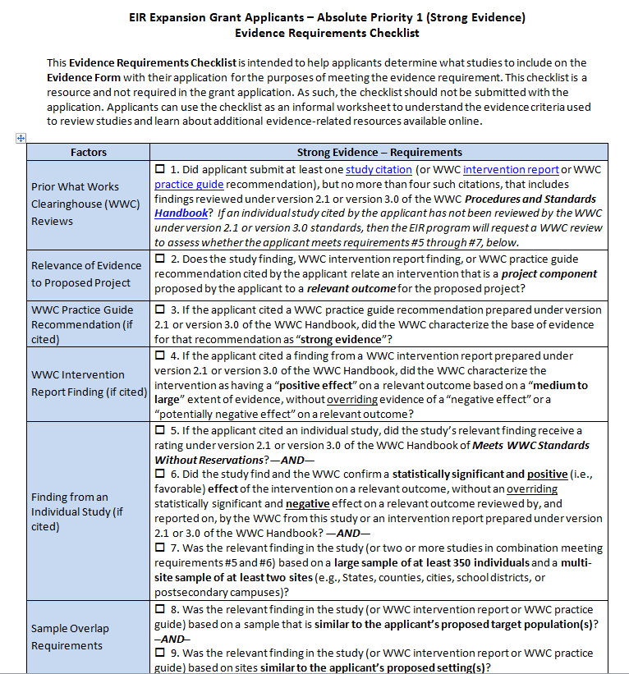
Expansion Evidence Standards Checklist
Notes:
The EIR program website includes an evidence checklist as an available resource to Expansion applicants.
This Evidence Requirements Checklist is intended to help applicants determine what studies to include on the Evidence Form with their application for the purposes of meeting the evidence requirement. Applicants can use the checklist as an informal worksheet to understand the evidence criteria used to review studies and learn about additional evidence-related resources available online.

Slide 9
Don’t forget to Examine your evidence
In reviewing potential studies for the strong evidence requirement, you should first review the What Works Clearinghouse (http://ies.ed.gov/ncee/Wwc/) to determine if the study in question has ever been reviewed. You should also ask yourself the following questions:
Is it an experimental study?
Is there a finding that is relevant to a proposed practice of your project?
Does the cited finding examine the relationship between a practice and a student outcome or other relevant outcome.
Is the cited finding based on a large sample?
Is the cited finding based on a multi-site sample?
Does the sample for the cited finding overlap with a population and setting for your proposed project?
Is the cited finding a statistically significant and positive effect?
Notes:
We offer this slide as a caution and a reminder. It would be a shame to go through all the work of preparing an application if you are not sure whether your study citations actually meet the strong evidence requirement.
Consequently, we recommend that you check again now to make sure they do or have the potential to do so, and to seek the advice of an expert evaluator to help you if you don’t have this expertise yourself.
(Read slide)
In addition, the Institute of Education Sciences has put together more detailed informational slides on strong evidence that we have posted as a resource on the EIR program website.

Slide 10
Expansion PRIORITIES
REQUIRED: Everybody Must Address Absolute Priority 1 | REQUIRED: Applicants Must Select Either Absolute Priority 2 or Absolute Priority 3
Absolute Priority 1: Strong Evidence | Absolute Priority 2: Field-Initiated Innovations – General
 | Absolute Priority 3 Field-Initiated Innovations – Promoting STEM Education, With a Particular Focus on Computer Science
Note: This priority establishes an evidence requirement. | Note: Must clearly indicate in the abstract and project narrative which option has been selected.
Notes:
Now let’s return to the chart with which we started. In addition to addressing the first absolute priority, Strong Evidence, you must select either Absolute Priority 2 or Absolute Priority 3 and clearly identify in the project narrative which of the two options you have selected. As we continue the informational slides, we’ll tell you more about each of these priorities.

Slide 11
Expansion ABSOLUTE Priority 2: Field-initiated innovations – General
Under the priority, we provide funding to projects that are designed to create, develop, implement, replicate, or take to scale entrepreneurial, evidence-based, field-initiated innovations to improve student achievement and attainment for high-need students.
Notes:
If you select Absolute Priority 2: Field-Initiated Innovations-General, you will have the option to propose your own project idea, as long as it targets K-12 students, is consistent with the purposes of the EIR program, complies with all the program requirements, and aims to improve student achievement and attainment for high-need students.
This “field-initiated” option provides an opportunity for applicants to make a case for the national significance of an education practices, and for their potential to widely influence future research and practice. The field-initiated option is not intended to provide operational funding for those programs that are up and running and simply need an infusion of funds to keep going.

Slide 12
Expansion Absolute Priority 3: Field-initiated innovations -- Promoting STEM education, with a particular focus on computer Science
Under the priority, we provide funding to projects that are designed to:
Create, develop, implement, replicate, or take to scale entrepreneurial, evidence-based, field-initiated innovations to improve student achievement and attainment for high-need students, and;
Improve student achievement or other educational outcomes in one or more of the following areas: science, technology, engineering, math, or computer science (as defined in this notice).
Notes:
If you don’t choose to propose something under field-initiated innovations-General, then your other option is to address Absolute Priority 3, Field-Initiated Innovations--Promoting Science, Technology, Engineering, or Math education, with a particular focus on computer science. If you choose to address this priority, please note that you must identify and implement instructional strategies in STEM fields, including computer science, that are supported by strong evidence.
In Absolute Priority 3, the Department recognizes the importance of funding Pre-Kindergarten through grade 12 STEM education that addresses the enrollment and achievement gap for underrepresented students, in a manner consistent with nondiscrimination requirements contained in the U.S. Constitution and federal civil rights laws. The Department also includes funding to expand access to STEM education in rural areas, especially through partnerships with rural school districts to utilize virtual and remote access to makerspace technologies, such as 3-D printers, to expand opportunities for students in rural areas where such tools are often cost prohibitive.
Please note also that there is a definition of computer science provided in the notice inviting applications. You’ll want to look carefully at the precise language of this definition. Computer science refers to the use of computer programming or coding as a tool to create software, and it may refer to the use of computational thinking and interdisciplinary problem solving skills necessary to use computation in our digital world.
This definition does not include using the computer for everyday activities such as browsing the internet, or using common software programs like word processing or spreadsheets.
In addition, for FY 2019 the EIR program intends to award at least $60 million in funds for STEM education projects, contingent on receipt of a sufficient number of applications of sufficient quality.

Slide 13
REMINDER: All applicants must target High-Need Students
All applicants must target high-need students.
Applicants may select one or more particular groups of high-need students to focus on in their projects.
Not all students served in a project must be high need; but it must be a primary focus.
Notes:
Finally, we’ll end with a couple of reminders. First, regardless of the priorities you address, you must target high-need students. Typically, these are students who are in some way at risk of educational failure or in some need of special assistance or support. But you may provide your own working definition of what high-need means within the context of your application.
Not all students served must be high-need, but this must be a primary focus of your application.

Slide 14
Reminder: Expansion Grantees are Encouraged to Scale to a national level
National level describes the level of scope or effectiveness of a process, product, strategy, or practice that is able to be effective…
..in a wide variety of communities, including rural and urban areas,
…as well as with different groups (e.g., economically disadvantaged, racial and ethnic groups, migrant populations, individuals with disabilities, English learners, and individuals of each gender).
Notes:
In addition, Expansion grants are encouraged to support scaling of projects to the national level (as defined in the notice).
At the national level, grants should serve a wide variety of communities, including rural and urban areas.
They should also serve a variety of groups, including, for example, economically disadvantaged students, racial and ethnic groups, migrant groups, individuals with disabilities, English learners, and individuals of each gender.

Slide 15
Education Innovation and Research (EIR) expansion priorities
February 2019
Notes:
That concludes our informational slides on the Expansion priorities. If you have additional questions, please consult the notice inviting applications for the competition.
We hope this information has been helpful to you.

