Slide 1
Education Innovation and Research (EIR) Mid-phase priorities and Evidence Requirement
February 2019
Notes:
We’re going to introduce you the EIR Mid-phase competition priorities, which includes moderate evidence, in these informational slides. There are separate informational slides for Early-phase and Expansion.
If you are planning to apply to EIR, you should read carefully the specific notice inviting applications (NIA) and the specific application package for the competition to which you are applying. These slides are for information purposes only, and applicants should rely upon the NIA for the official competition requirements.

Slide 2
MID-PHASE PRIORITIES
REQUIRED: Everybody Must Address Absolute Priority 1 | REQUIRED: Applicants Must Select Either Absolute Priority 2 or Absolute Priority 3
Absolute Priority 1: Moderate Evidence | Absolute Priority 2: Field-Initiated Innovations – General
 | Absolute Priority 3 Field-Initiated Innovations – Promoting STEM Education, with a Particular Focus on Computer Science
Note: This priority establishes an evidence requirement. | Note: Must clearly indicate in the abstract and project narrative which option has been selected.
Notes:
Under 34 CFR 34.105(c)(3), we consider only applications that meet Absolute Priority 1, Moderate Evidence, and one additional absolute priority.

Slide 3
ABSOLUTE PRIORITY 1:
Absolute Priority 1--Moderate Evidence.
Under this priority, we provide funding to projects supported by moderate evidence.
Notes:
Read slide.

Slide 4
What is MODERATE Evidence? (1 of 2)
Moderate evidence means that there is evidence of effectiveness of a key project component in improving a relevant outcome (as defined in this notice) for a sample that overlaps with the populations or settings proposed to receive that component, based on a relevant finding from one of the following:
(i) A practice guide prepared by the WWC using version 2.1 or 3.0 of the WWC Handbook reporting a “strong evidence base” or “moderate evidence base” for the corresponding practice guide recommendation;
(ii) An intervention report prepared by the WWC using version 2.1 or 3.0 of the WWC Handbook reporting a “positive effect” or “potentially positive effect” on a relevant outcome based on a “medium to large” extent of evidence, with no reporting of a “negative effect” or “potentially negative effect” on a relevant outcome; or
(iii) A single experimental study (as defined in this notice) or quasi-experimental design study (as defined in this notice) reviewed and reported by the WWC using version 2.1 or 3.0 of the WWC Handbook, or otherwise assessed by the Department using version 3.0 of the WWC Handbook, as appropriate
and….
(continued)
Notes:
Read slide.

Slide 5
What is MODERATE Evidence? (2 of 2)
and that—
(A) Meets WWC standards with or without reservations;
(B) Includes at least one statistically significant and positive (i.e., favorable) effect on a relevant outcome;
(C) Includes no overriding statistically significant and negative effects on relevant outcomes reported in the study or in a corresponding WWC intervention report prepared under version 2.1 or 3.0 of the WWC Handbook; and
(D) Is based on a sample from more than one site (e.g., States, counties, cities, school districts, or postsecondary campuses) and includes at least 350 students or other individuals across sites. Multiple studies of the same project component that each meet requirements in paragraphs (iii)(A), (B), and (C) of this definition may together satisfy this requirement.
Notes:
Read slide.

Slide 6
HOW DO you demonstrate that you meet moderate evidence?
Use the Evidence form that is included in the application package
Identify up to 2 study citations to be reviewed against the WWC handbook, and for each include a description of:
The positive student outcomes to be replicated, and a description of how the characteristics of the students in the study correspond to those high needs students proposed in the application
how the proposed practices correspond between the study and the proposed application
the intended student outcomes that the proposed practice(s) attempts to impact
Citations must refer to publicly available sources (provide links or other guidance)
Applicants will not get an opportunity to provide additional information; however, study authors may be asked by the WWC to respond to queries on key aspects of the study design.
Notes:
You must cite either a specific recommendation from a What Works Clearinghouse Practice Guide, a What Works Clearinghouse Intervention Report, or a publicly available, original study of the effectiveness of a component of your proposed project on a student outcome or other relevant outcome.
If citing individual studies, an applicant must identify up to two study citations to be reviewed against the What Works Clearinghouse Handbook for the purposes of meeting moderate evidence (as defined in the notice). The studies may have been conducted by the applicant or by a third party.
An applicant should clearly identify these citations in the Evidence form.
The Department may not review a study citation that an applicant fails to clearly identify for review. In addition to including up to two study citations, applicants should describe in the form information such as the following: (1) the positive student outcomes they intend to replicate under their Mid-phase grant and how the characteristics of students and the positive student outcomes in the study citations correspond with the characteristics of the high-need students to be served under the Mid-phase grant; (2) the correspondence of practice(s) the applicant plans to implement with the practice(s) cited in the studies; and (3) the intended student outcomes that the proposed practice(s) attempts to impact.
An applicant must ensure that all evidence is available to the Department from publicly available sources and provide links or other guidance indicating where it is available. If the Department determines that an applicant has provided insufficient information, the applicant will not have an opportunity to provide additional information at a later time. However, if the WWC determines that a study does not provide enough information on key aspects of the study design, such as sample attrition or equivalence of intervention and comparison groups, the WWC may submit a query to the study author(s) to gather information for use in determining a study rating. Authors would be asked to respond to queries within 10 business days. Should the author query remain incomplete within 14 days of the initial contact to the study author(s), the study may be deemed ineligible under the grant competition. After the grant competition closes, the WWC will continue to include responses to author queries and will make updates to study reviews as necessary. However, no additional information will be taken into account after the competition closes and the initial timeline established for response to an author query passes.

Slide 7
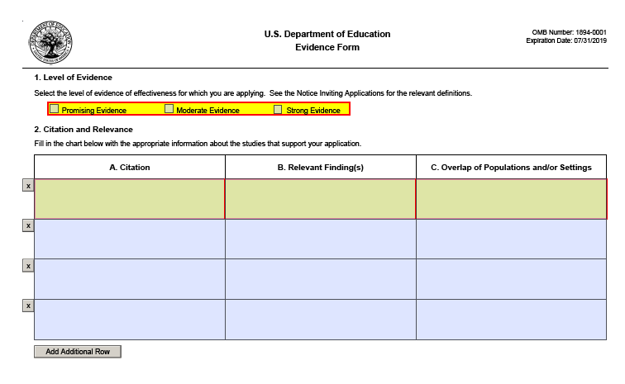
Mid-phase evidence Form instructions
Notes:
Here is a screen shot of the Evidence form that a Mid-phase applicant is required to complete and submit with its application.
When completing the form, don’t forget to check “moderate evidence.”
Also, please remember that you must identify a specific recommendation from a What Works Clearinghouse Practice Guide, a What Works Clearinghouse Intervention Report, or up to two publicly available study citations. For each, you need to identify the relevant findings and demonstrate that they overlap with the populations or settings proposed in your application.
The overlap of populations and/or settings requires at least “partial” overlap, but not “complete” overlap. Overlap also needs to be of “similar” populations and/or settings, not “identical” ones in every respect. Thus a study conducted in one state can overlap with the target population and target settings in another state and provide moderate evidence, as long as the respective populations and/or settings are reasonably similar.

Slide 8
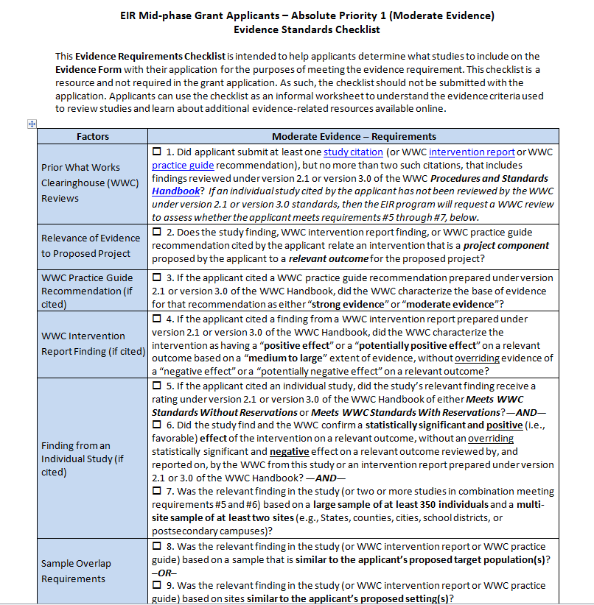
Mid-Phase Evidence Standards Checklist
Notes:
The EIR program website includes an evidence checklist as an available resource to Mid-phase applicants.
This Evidence Requirements Checklist is intended to help applicants determine what studies to include on the Evidence Form with their application for the purposes of meeting the evidence requirement. Applicants can use the checklist as an informal worksheet to understand the evidence criteria used to review studies and learn about additional evidence-related resources available online.

Slide 9
Don’t forget to Examine your evidence
In reviewing potential studies for the moderate evidence requirement, you should first review the What Works Clearinghouse (http://ies.ed.gov/ncee/Wwc/) to determine if the study in question has ever been reviewed. You should also ask yourself the following questions:
Is it a quasi-experimental or experimental study?
Is there a finding that is relevant to a proposed practice of your project?
Does the cited finding examine the relationship between a practice and a student outcome or other relevant outcome?
Is the cited finding based on a large sample?
Is the cited finding based on a multi-site sample?
Does the sample for the cited finding overlap with a population or setting for your proposed project?
Is the cited finding a statistically significant and positive effect?
Notes:
We offer this slide as a caution and a reminder. It would be a shame to go through all the work of preparing an application if you are not sure whether your study citations actually meet the moderate evidence requirement.
Consequently, we recommend that you check again now to make sure they do or have the potential to do so, and to seek the advice of an expert evaluator to help you if you don’t have this expertise yourself.
(Read slide)
In addition, the Institute of Education Sciences has put together more detailed informational slides on moderate evidence that we have posted as a resource on the EIR program website.

Slide 10
MID-PHASE PRIORITIES
REQUIRED: Everybody Must Address Absolute Priority 1 | REQUIRED: Applicants Must Select Either Absolute Priority 2 or Absolute Priority 3
Absolute Priority 1: Moderate Evidence | Absolute Priority 2: Field-Initiated Innovations – General
 | Absolute Priority 3 Field-Initiated Innovations – Promoting STEM Education, with a Particular Focus on Computer Science
Note: This priority establishes an evidence requirement. | Note: Must clearly indicate in the abstract and project narrative which option has been selected.
Notes:
Under 34 CFR 34.105(c)(3), we consider only applications that meet Absolute Priority 1, Moderate Evidence, and one additional absolute priority.

Slide 11
Mid-Phase ABSOLUTE Priority 2: Field-initiated innovations -- General
Under the priority, we provide funding to projects that are designed to create, develop, implement, replicate, or take to scale entrepreneurial, evidence-based, field-initiated innovations to improve student achievement and attainment for high-need students.
Notes:
If you select Absolute Priority 2: Field-Initiated Innovations-General, you will have the option to propose your own project idea, as long as it targets K-12 students, is consistent with the purposes of the EIR program, complies with all the program requirements, and aims to improve student achievement and attainment for high-need students.
This “field-initiated” option provides an opportunity for applicants to make a case for the national significance of an education practices, and for their potential to widely influence future research and practice. The field-initiated option is not intended to support tried and true practices that are already common, nor is it meant to provide operational funding for those programs that are up and running and simply need an infusion of funds to keep going.

Slide 12
Mid-PHASE Absolute Priority 3: field-initiated innovations -- Promoting STEM education, with particular focus on computer Science
Under the priority, we provide funding to projects that are designed to:
Create, develop, implement, replicate, or take to scale entrepreneurial, evidence-based, field-initiated innovations to improve student achievement and attainment for high-need students, and;
Improve student achievement or other educational outcomes in one or more of the following areas: science, technology, engineering, math, or computer science (as defined in the notice).
Notes:
If you don’t choose to propose something under Field-Initiated Innovations-General, then your other option is to address Absolute Priority 3, Field-Initiated Innovations -- Promoting Science, Technology, Engineering, or Math education, with a particular focus on computer science.
In Absolute Priority 3, the Department recognizes the importance of funding Pre-Kindergarten through grade 12 STEM education that addresses the enrollment and achievement gap for underrepresented students such as minorities, in a manner consistent with nondiscrimination requirements contained in the U.S. Constitution and federal civil rights laws. The Department also includes funding to expand access to STEM education in rural areas, especially through partnerships with rural school districts to utilize virtual and remote access to makerspace technologies, such as 3-D printers, to expand opportunities for students in rural areas where such tools are often cost prohibitive.
Please note also that there is a definition of computer science provided in the notice inviting applications. You’ll want to look carefully at the precise language of this definition. Computer science refers to the use of computer programming or coding as a tool to create software, and it may refer to the use of computational thinking and interdisciplinary problem solving skills necessary to use computation in our digital world.
This definition does not include using the computer for everyday activities such as browsing the internet, or using common software programs like word processing or spreadsheets.
In addition, for FY 2019 the EIR program intends to award at least $60 million in funds for STEM education projects, contingent on receipt of a sufficient number of applications of sufficient quality.

Slide 13
REMINDER: All applicants must target High-Need Students
All applicants must target high-need students.
Applicants may select one or more particular groups of high-need students to focus on in their projects.
Not all students served in a project must be high need; but it must be a primary focus.
Notes:
Finally, we’ll end with some reminders. Regardless of the priorities you address, you must target high-need students, which we discuss further in the matching and other requirements informational slides. Typically, these are students who are in some way at risk of educational failure or in some need of special assistance or support. But you may provide your own working definition of what high-need means within the context of your application.
Not all students served must be high-need, but this must be a primary focus of your application.

Slide 14
Reminder: mid-phase Grantees are Encouraged to Scale to a regional or national level
Regional (see definition in the notice inviting applications):
Serve a variety of communities in a state or multiple states
Serve different student groups
If an LEA-based project, must serve students in more than one LEA
National (see definition in the notice inviting applications):
Serve a wide variety of communities
Serve different student groups
Notes:
In addition, Mid-phase grants are encouraged to support scaling of projects to the regional level or to the national level (as defined in the notice).
At the regional level, grants should serve a variety of communities in a state or multiple states, serve different student groups, and if it is an LEA-based project, must serve students in more than one LEA.
At the national level, grants should serve a wide variety of communities and serve different student groups.

Slide 15
Education Innovation and Research (EIR) mid-phase priorities and evidence requirement
February 2019
Notes:
That concludes our informational slides on the Mid-phase priorities. If you have additional questions, please consult the notice inviting applications for the competition.
We hope this information has been helpful to you.

