Slide 1


Slide 2


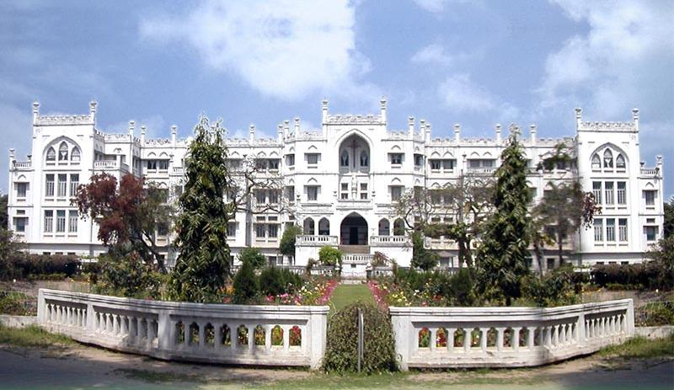
PATNA WOMEN’S COLLEGE
AUTONOUMOUS
PATNA UNIVERSITY
3rd Cycle NAAC Accredited at ‘A’ Grade with CGPA 3.58/4
SEESSION: 2016-19
ON THE JOB TRAINING PROJECT
DEPARTMENT OF COMPUTER SCIENCE

Slide 3


PROJECT ON
“SCHOOL MANAGEMENT SYSTEM”
FOR
KUSUM KIDS
AT
AZTECH
Technology & Engineer’s Pvt. Ltd.
DEVELOPED BY:
NAVODITA PRIYADARSHINI(26)
SHIKHA PRIYANKA (75)
NIKITA KUMARI(76)
(B.A/B.Sc COMPUTER APPLICATIONS-|||)

Slide 4
ACKNOWLEDGEMENT
We want to express our sincere thanks to KUSUM KIDS (Aztech Technology), Patna for giving us an opportunity for the SOFTWARE DEVELOPEMENT. With the coalesce of God’s grace and great teamwork we were able to satisfactorily complete the project.
We would like to thank MR. AZAD DEEPAK, project lead at KUSUM KIDS Patna for accommodating in his team and posing the confident in us and assigning us to work on this development project. We are also grateful to MRS. MANISHA PRASHAD coordinator BCA department and other faculty members for their consistent guidance and support throughout the project tenure.
We would also extend our thanks to the “MRS. SONAM SANDILAYA, of KUSUM KIDS (Aztech Technology), Patna for giving us the opportunity to work on this project and providing a healthy work environment.

Slide 5

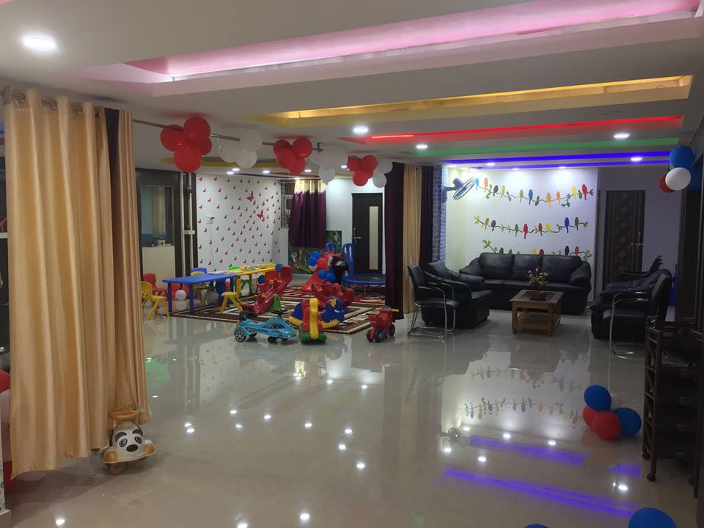
“OUR PASSION , THEIR FUTURE”

Slide 6

ABOUT SCHOOL
Kusum kids is the interactive, safe and activity oriented learning centre and best play school in Patna. The room is beautifully decorated with large cut out of animals birds, flowers and cartoon characters. So, that new entrants enjoy and gets attracted towards their first school. It supplies the students kit (bags, books, uniforms, diary, id cards). It also provides the facility of doctor, who is available throughout the school time in order to provide medical care and support to the students when necessary. It has a well-equipped range of facilities and resources for all students from kindergarten to grade 5 which will help them to achieve a well rounded education in a child friendly education. The activity rooms are designed to make learning more fun and exciting. The concept of the activity room is about learning through play in a totally different environment. One more safety measure taken for your kids is trustworthy transport facility. The most important facility is DAY CARE. Working parents can easily avail this opportunity of sending their kids to this school . Future of the kids is secure and bright. Hence, it satisfies its TAGLINE-“OUR PASSION THEIR FUTURE.”

Slide 7
SCHOOL MANAGEMENT SYSTEM
School management is an important part of any educational system.
To better perform the function of school management and assure parents of their child’s safety and progress ,we made our software.
It provides all the features to improve the overall administration of schools.
It provides great relief to teachers by providing all records related with student as well as employee.
It also helps parents to actively participate in their children’s educational activities.

Slide 8



TOOLS AND ENVIRONMENT USED
tools
Backend : MYSQL
Frontend : JAVA
Driver : JDBC
software environment
Operating System : Windows 8.1
RDBMS : MYSQL
Software language : JAVA ( jdk1.8 )
Platform : Netbeans ( 8.1 version )

Slide 9
FEASIBILITY STUDY
Introduction
The Feasibility Study determines whether a certain plan of action is feasible – that is, Whether or not it will work, and Whether or not it is worth Doing Economically. It evaluates the best System to Choose in terms of Economic, Technical and Operational Constraints.
Technical Feasibility
After Doing the Technical Feasibility analysis we came to a conclusion that the company has the capability, in terms of Software, Hardware, Personnel and Expertise, to handle the Completion of the project.
Economic Feasibility
Economic Feasibility depends upon development cost, Operating Cost, Hardware Cost. To us, the cost incurred on the development of the System was tolerable. The Proposed System was accepted as Economically Feasible.
Operational Feasibility
In this Analysis we studied about our System’s technical Performance and acceptance of the Software by the users as well as the ones who are going to implement it. We came to a conclusion that our System is Operationally Feasible.

Slide 10
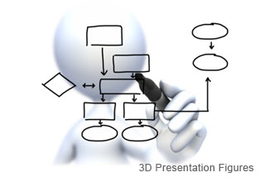

ENTITY
RELATIONSHIP
DIAGRAM

Slide 11
STEPS OF ERD
USER LOGIN TO APPLICATION
ADMIN VERIFY USER
USER MANAGE STUDENTs RECORD
USER MANAGE EMPLOYEEs RECORD
USER MANAGE EVENTS RECORD
USER GENERATE RECORDs
ADMIN GENERATE ALL RECORDs

Slide 12
VERIFY
USER_ID
LOGIN TO APPLICATION
USER_PASSWORD
USER
ADMIN
AADHAR
ENQUIRY FORM
STUDENT
REPORT
ADMISSION FORM
MANAGES
GENERATES
EMP_REPORT
STUDENT
REPORT
MEDICAL FORM
BIRTHDAY
REPORT
ATTENDANCE
FEE STATUS
EMPLOYEE
EVENTS
FEE RECEIPT
CALENDAR
APPLICATION
LEAVE APPLICATION
EMP_ ATTENDANCE
EMP_
APPLICATION

Slide 13

DATA FLOW DIAGRAM

Slide 14
0 LEVEL DFD
0 LEVEL DFD
SCHOOL MANAGEMENT SYSTEM
STUDENT
DETAILS
GIVES
DEGREE
EMPLOYEE
MAINTAINS
GIVES
SALARY
DATABASE

Slide 15
1 LEVEL DFD
1 LEVEL DFD
1.0
ADMIN
VERIFY
LOGIN PROCESS
LOGIN
USER
VERIFY
ENQUIRY FORM
DETAILS
GENERATES
STUDENT
ENQUIRY
2.0
ADM. FORM
DETAILS
GENERATES
ADMISSION
FEE RECEIPT
PAYMENT
GENERATES
FEE
A

Slide 16
CONTINUE…
CONTINUE…
A
APPLICATION FORM
DETAILS
3.0
GENERATES
APPLICATION
EMPLOYEE
ATTENDENCE FORM
DETAILS
GENERATES
ATTENDENCE
DETAILS
REPORT
STUDENT
4.0
GENERATES
STUDENT REPORT
EMPLOYEE
DETAILS
GENERATES
EMPLOYEE REPORT

Slide 17
1 LEVEL DFD
2 LEVEL DFD
2ND LEVEL FOR 1.0 (LOGIN PROCESS)
1.1
GENERATES
USER
DETAILS
LOGIN
CREATE ID
1.2
RESET
PASSWORD
GENERATE
NEW PASSWORD
AADHAR NO.
GIVES
LOGIN
1.3
DELETE ID
AADHAR NO.
GIVES
REMOVES
USER ID

Slide 18
1 LEVEL DFD
CONTINUE…
2ND LEVEL FOR 2.0 (OF STUDENT)
2.1
STORE DATA
STUDENT
ENQUIRY
ENQUIRY
ENQUIRY FORM
2.2
ADMISSION FORM
STUDENT
DETAILS
STORE DATA
ADMISSION
2.3
STUDENT
PAY
STORE DATA
FEE RECEIPT
FEE RECEIPT

Slide 19
1 LEVEL DFD
CONTINUE…
2ND LEVEL FOR 3.0 (OF EMPLOYEE)
3.1
EMPLOYEE
DETAILS
STORE DATA
EMPLOYEE
EMPLOYEE APPLICATION
EMPLOYEE
ATTENDANCE
3.2
EMPLOYEE
ATTENDENCE
STORE DATA
ATTENDANCE
DETAILS

Slide 20
1 LEVEL DFD
CONTINUE…
2ND LEVEL FOR 4.0 (OF REPORT)
4.1
GENERATES
REPORT
CLASS WISE
DETAILS
STUDENT REPORT
ADMISSION
EMPLOYEE
REPORT
4.2
MOBILE
DETAILS
GENERATES
REPORT
EMPLOYEE

Slide 21

LIMITATIONS
There is always a necessity for improvements and modifications in a project. This project also have some limitations and problems. These problems are listed below:-
The computer in which the package is installed must have JAVA and MYSQL installed in them.
The hardware components like processor, RAM, Hard disk etc. must be compatible with the package requirements.
This software is helpful in keeping each and every records however there is no facility of keeping records of the solutions given to the customers and pending complains.
It will not work on web.
Multi users can’t work on this software as it is admin based system.

Slide 22
FUTURE SCOPE
From the project point of view ,it has several future scopes. After the system is found to be working successfully as per the requirement further enhancement could be made in one of the following direction.
System is very flexible for further modifications.
With very little modification , it can be deployed for use in other similar system.
Many changes can be made to make system updated.

Slide 23
CONCLUSION
Working on this project “SCHOOL MANAGEMENT SYSTEM” was a great learning experience.
The system is developed Fully newly created and provide update information about administration of kusum kids.
The main benefits of the system can be enlisted as:-
The system is working fine when tested and most probably will be implemented.
It helped us gain technical as well as interpersonal skill .
It also provided us some understanding about the work culture of the co-operate world.
we are sure this period will always remain a stepping stone in our career as software professional.

Slide 24
BIBLIOGRAPHY
BOOK REFERRED
Core JAVA complete reference by C . Horstmann & Herbert Schieldt
Head First Java by Kathy Sierra & Bert Bates
System Analysis and Design by Elias Awad
Relational Database Management System by B . S . Desai
WEBSITES VISITED
javatpoint
tutorials point
Wikipedia
YouTube
Google

Slide 25


Slide 26




