Slide 1

G2M Insight for Cab Investment Firm
Navodith Shankar
02/21/2023

Slide 2

Agenda
Executive Summary
Problem Statement
Approach
EDA
EDA Summary
Recommendations

Slide 3
Problem Statement
XYZ is a private firm in US. Due to remarkable growth in the Cab Industry in last few years and multiple key players in the market, it is planning for an investment in Cab industry and as per their Go-to-Market(G2M) strategy they want to understand the market before taking final decision.
XYZ is interested in using your actionable insights to help them identify the right company to make their investment.
Analysis:
Find the most popular cab company
Find the best cab company
Find the best company for XYZ to invest in
Test multiple hypothesis statements

Slide 4
Data Sets
Cab_Data – This Data Set includes data about Pink and Yellow Cabs
City – This data set includes data about different US cities and users of each cab in each city
Customer_ID – This data set includes data about the users of the cabs like their income and gender
Transaction_ID – This data set includes data about the details of transactions made by users of the cabs

Slide 5
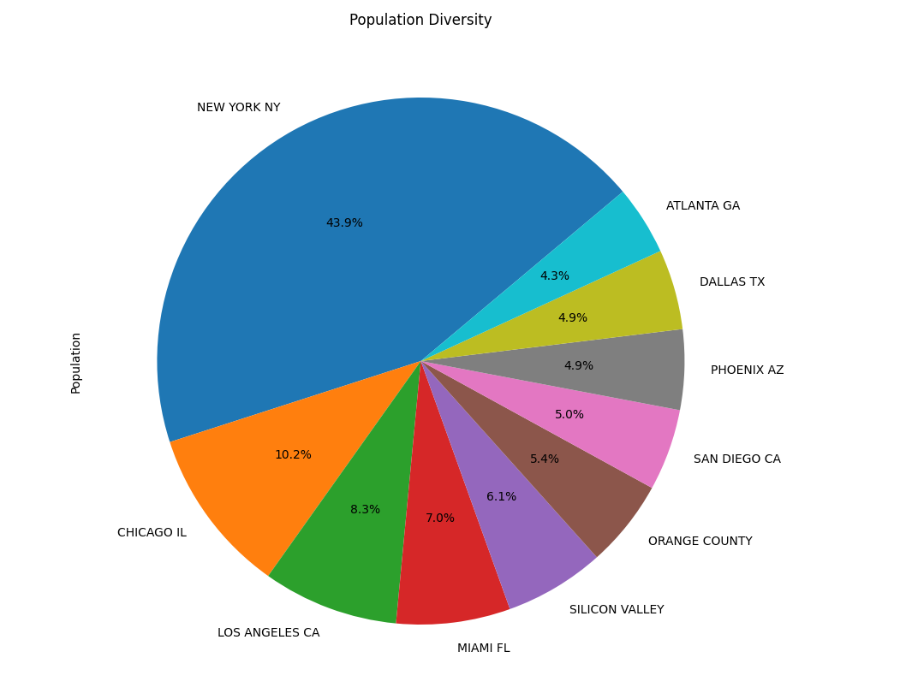
City Population
As we can see, New York has the largest population percentage of 43.9%. We can presume that most users come from New York as it has the highest population. We can also presume that population of a city plays a major role in the number of users.

Slide 6
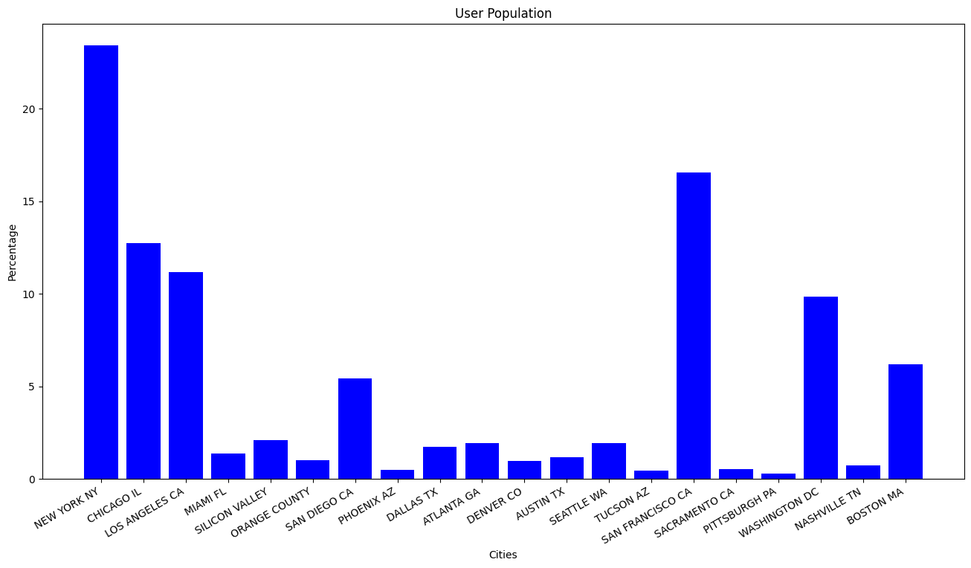
User Population
As we can see, from what we presumed before, majority of users reside in New York with San Francisco being the second highest in user population. From this we can conclude that city population heavily affects user population in each city.

Slide 7
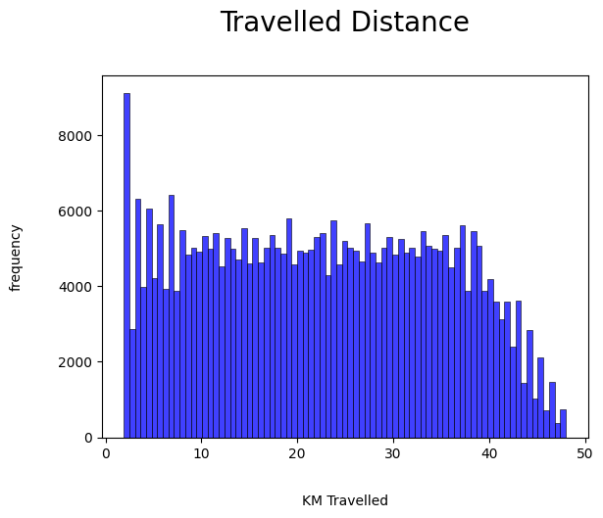
Common Trip Distance
As we can see, between both cab companies the most travelled distance is 2km. This makes sense as most people in cities travel short distances.

Slide 8
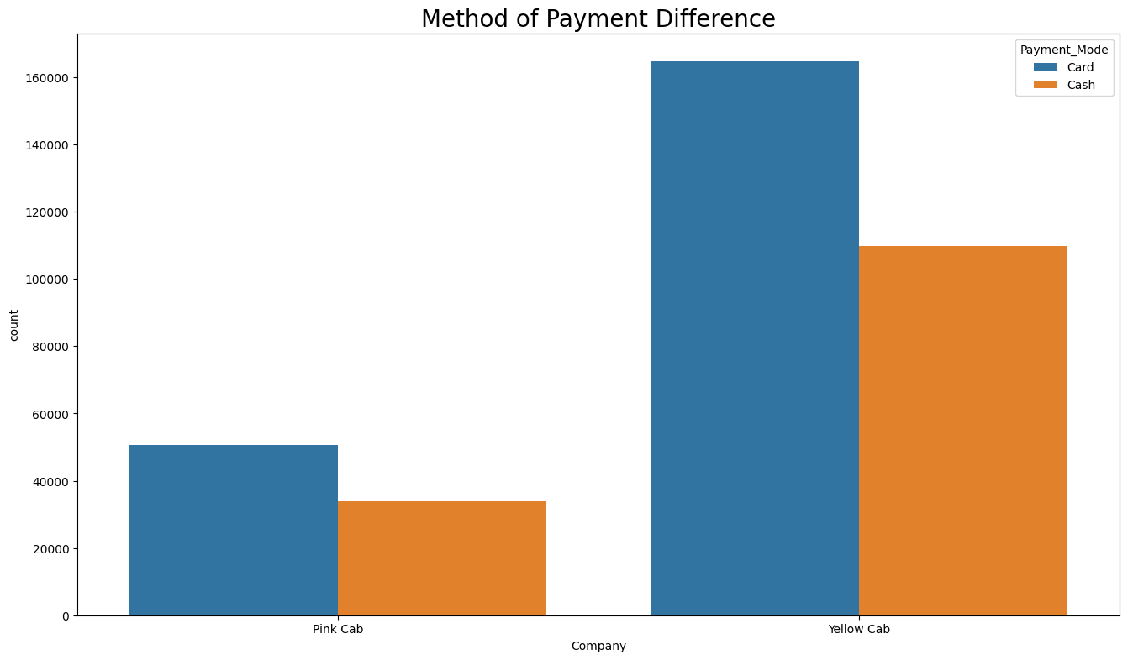
Method of Payment
As we can see, between both cab companies most users pay via card, but we can also see a huge difference in the number of payments made between both cabs. Yellow cab has a larger number of payments, this yields that more users use yellow cab instead of pink cab.

Slide 9
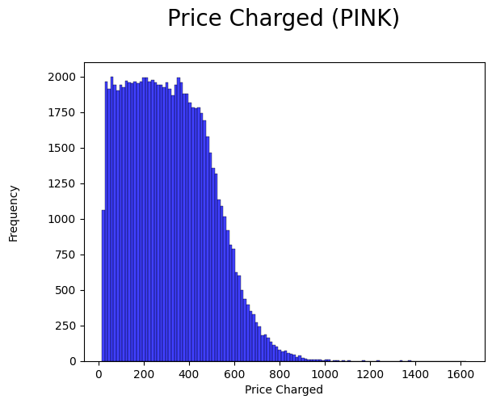
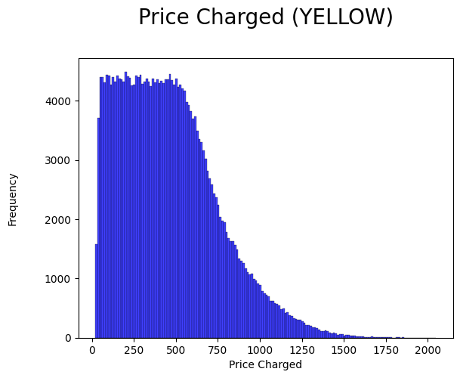
Price Charged
As we can see, between both cab companies pink cab charges users less compared to yellow cab. Yellow cab has charged close to $2000 whereas pink cab has never charged more than $1400.

Slide 10
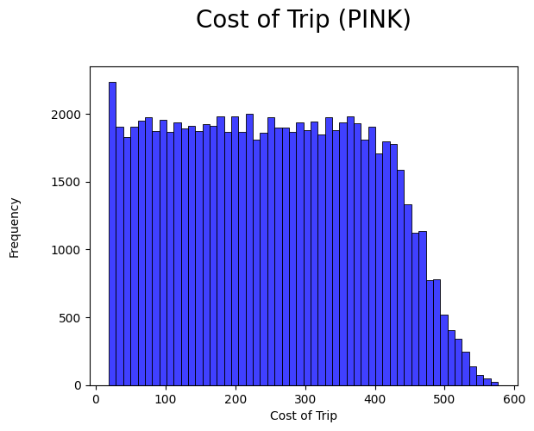
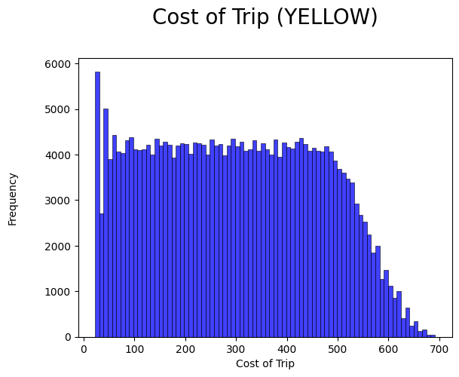
Cost of Trip
As mentioned before, yellow cab is more expensive. By looking at the cost of trip we can surely say that yellow cab is expensive. The cause of this could also be because more users use yellow cab which results in different type of users needing to travel different distances.

Slide 11
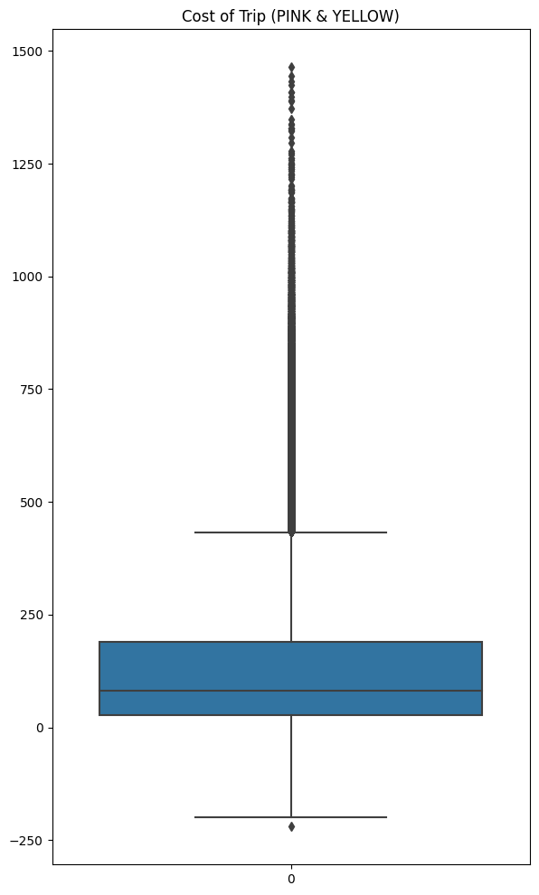
Cost of Trip
Here we can see the cost of trip with both companies combined. We can see that most trips do not exceed the cost of $1200.

Slide 12
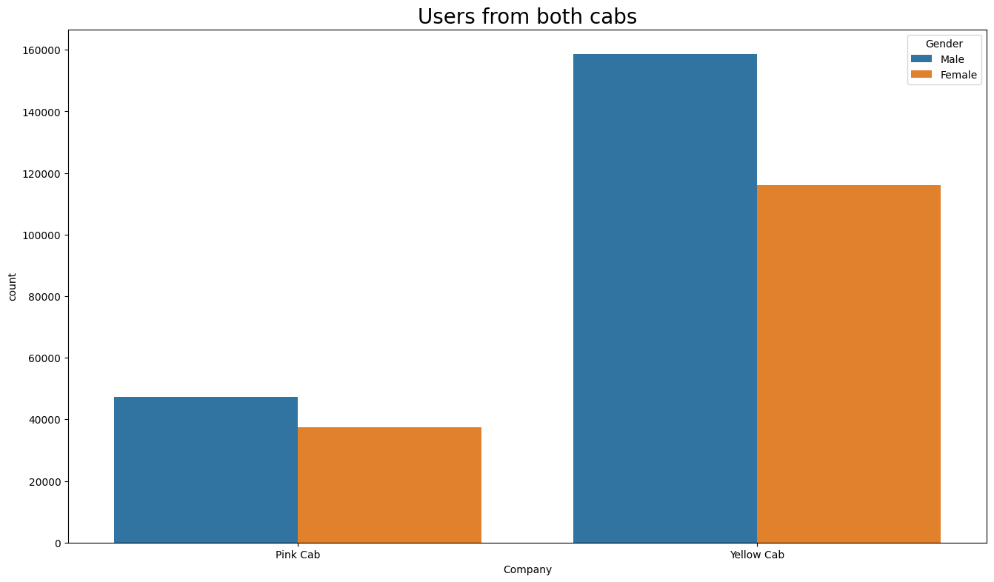
Gender
As we can see, between both cab companies mostly males use pink and yellow cab. Even though mostly males use pink cab, the difference between male and female is minimal where the difference in yellow cab is greater.

Slide 13
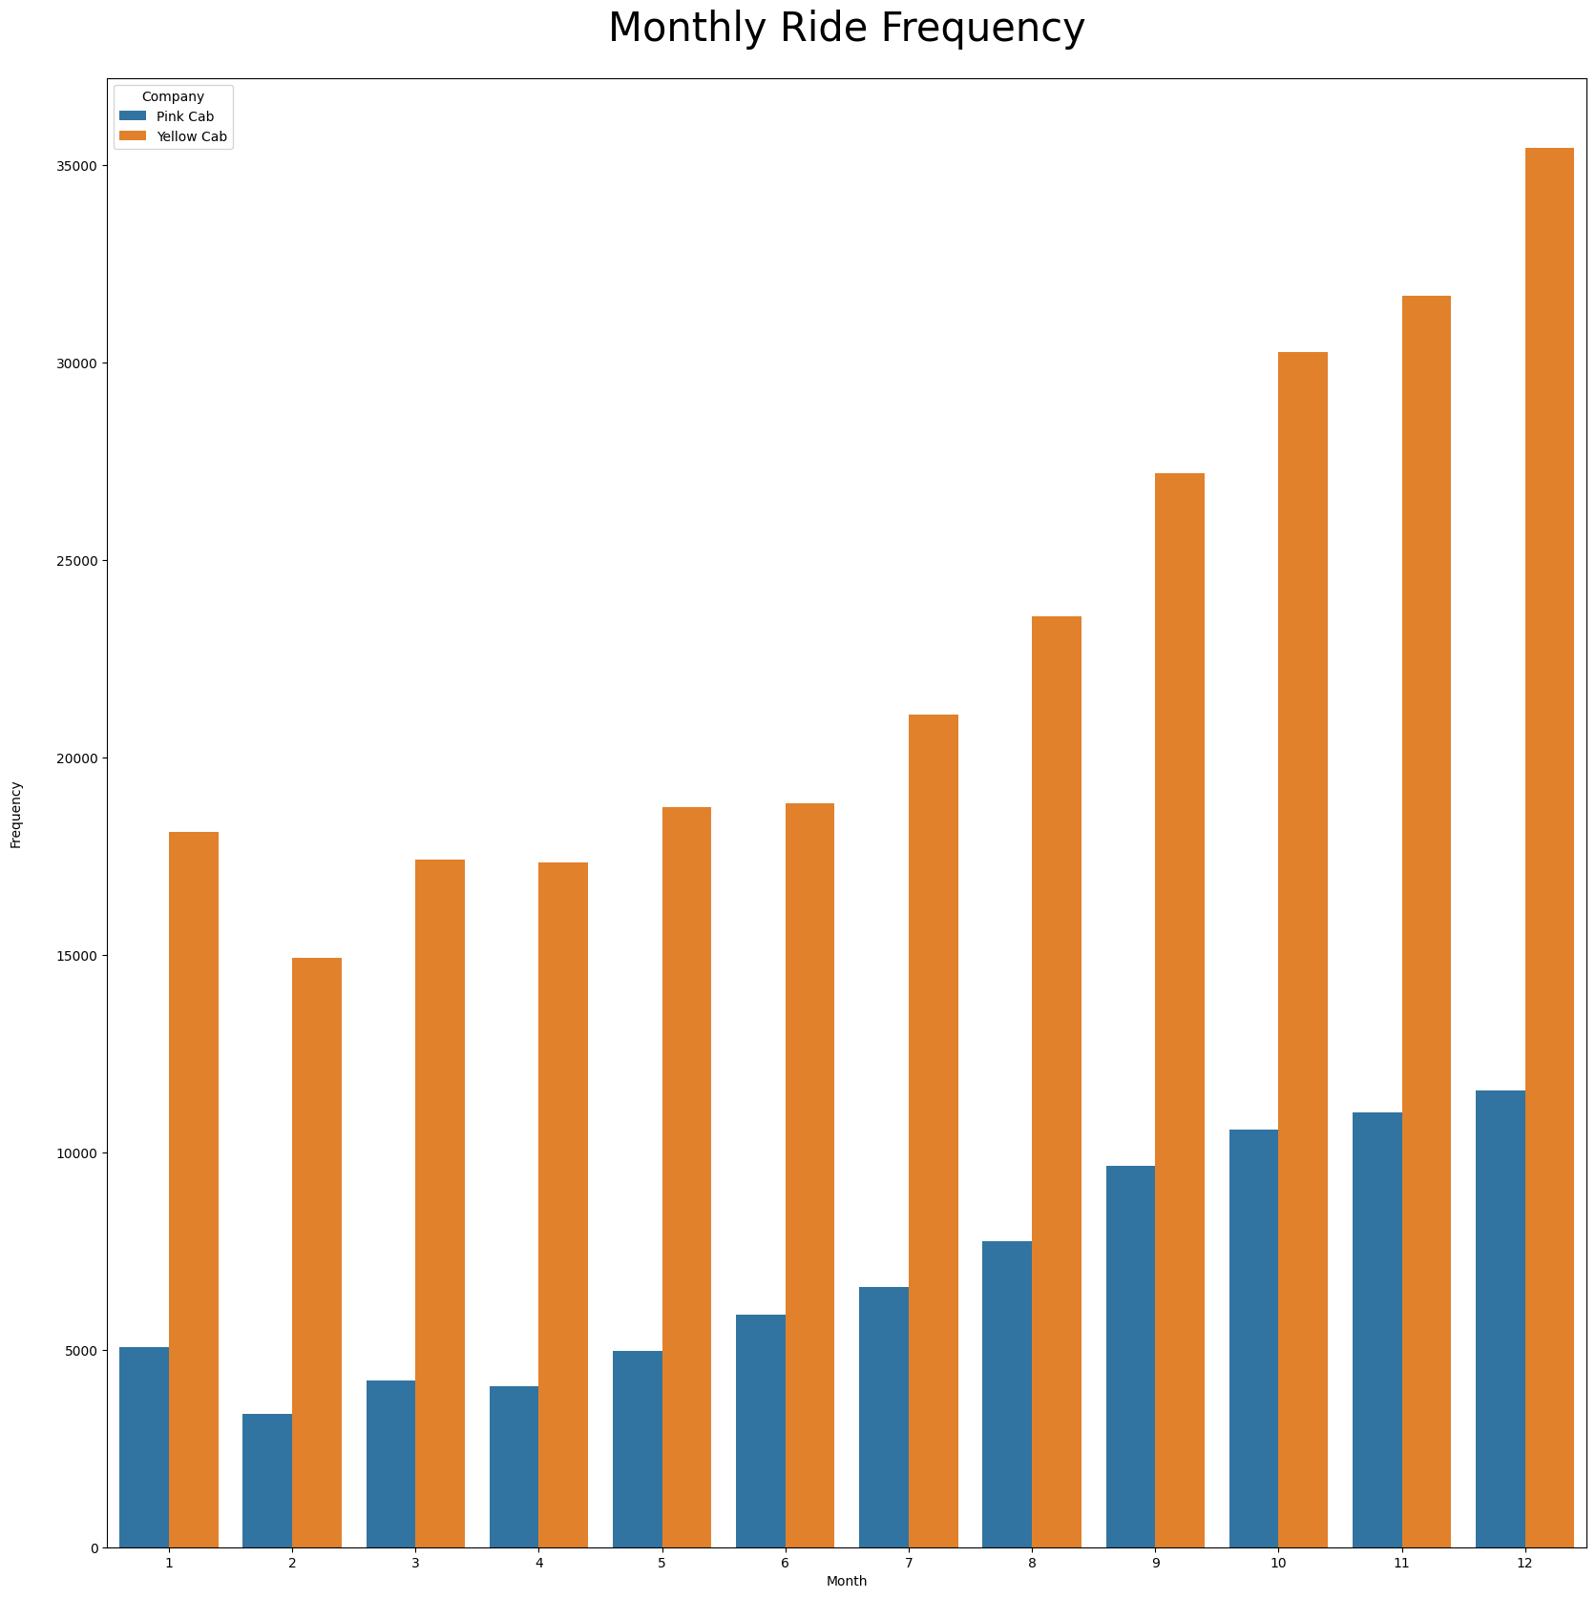
Ride Preference
As we can see, between both cab companies most users tend to travel in yellow cab which ultimately means that yellow cab is the most popular cab company. In both cabs, december is the most popular month but yellow cab has more than double the rides.

Slide 14
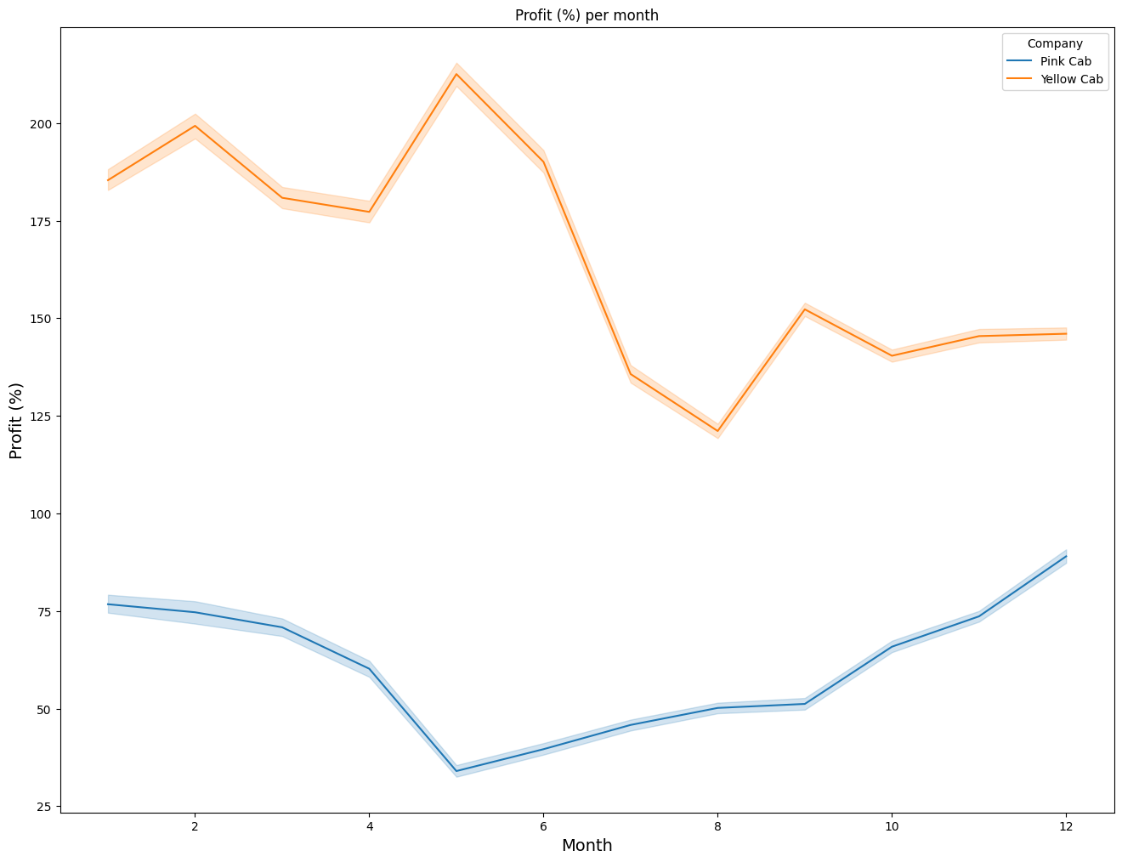
Profit
Previously, it was found that yellow cab was the most popular cab. By looking at the profits between both cabs we can see that the result of more popularity is more profit generated. Yellow cab generates more profit than pink cab.

Slide 15
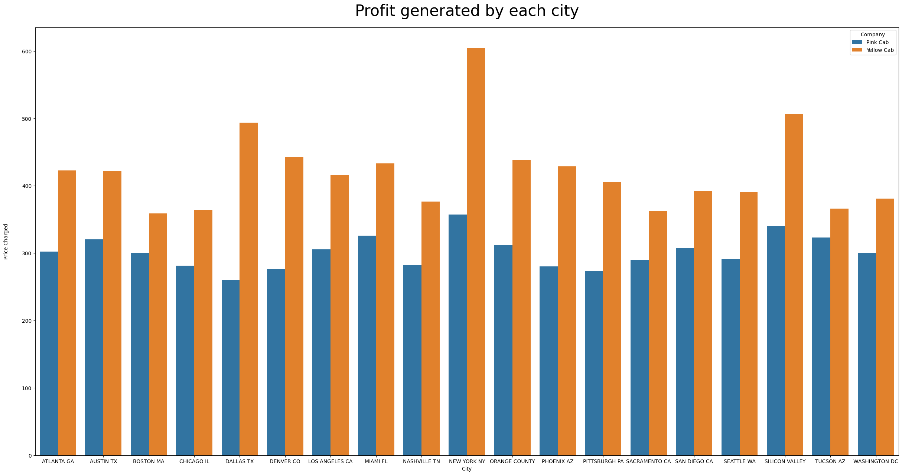
Profit per city
By looking at this bar plot, we can see that New York generates the most profit for both cab companies with yellow cab generating the most profit.

Slide 16
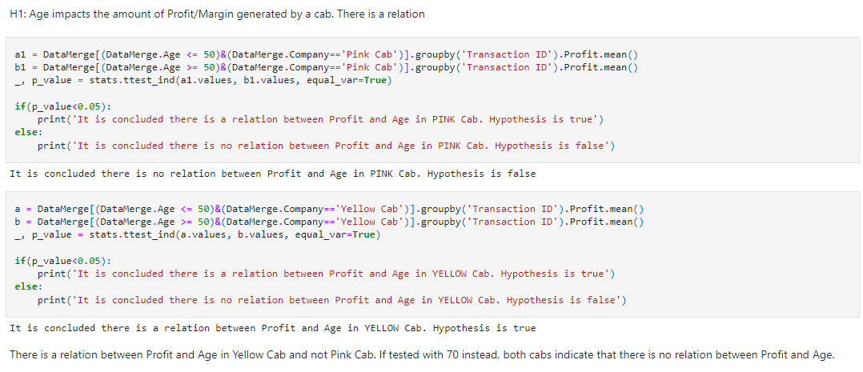
Hypothesis #1

Slide 17
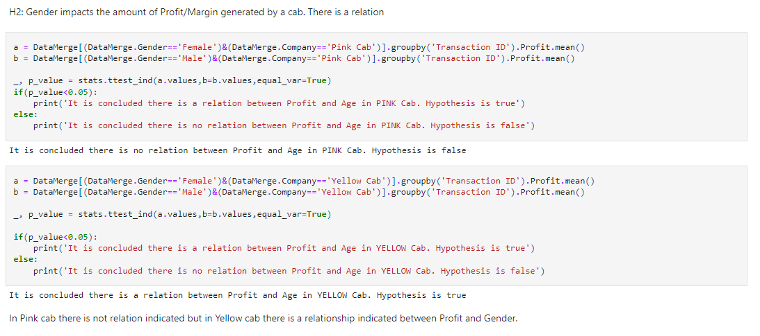
Hypothesis #2

Slide 18
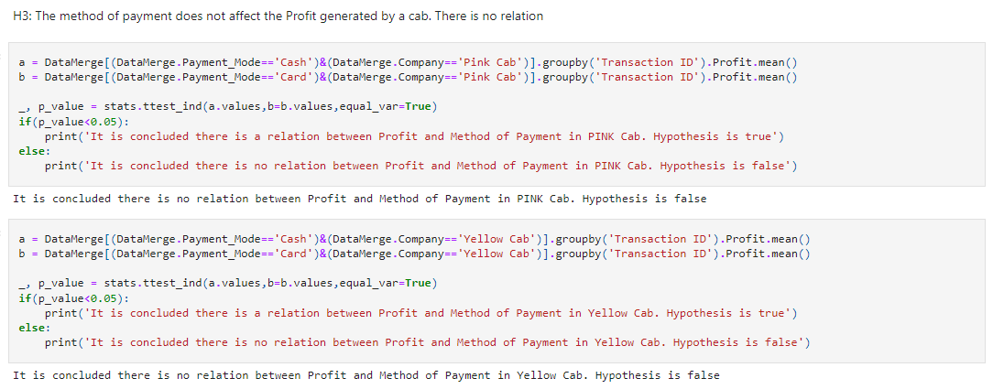
Hypothesis #3

Slide 19
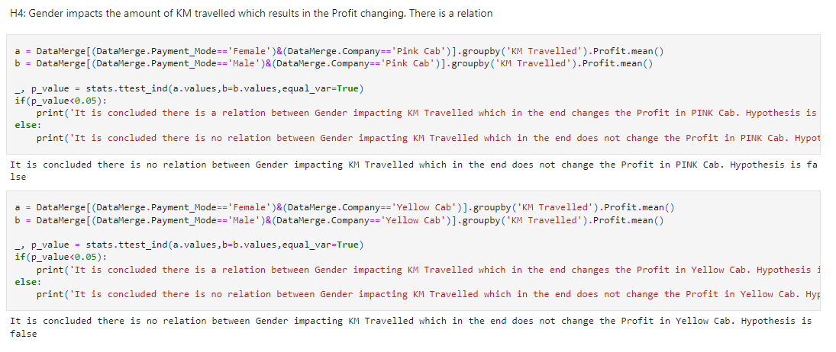
Hypothesis #4

Slide 20
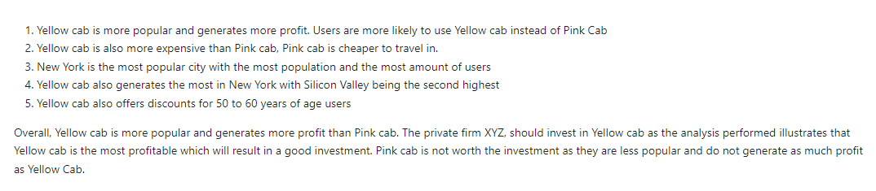
Conclusion

Slide 21
G2M Insight for Cab Investment Firm Navodith Shankar 02/21/2023
Thank You

