Slide 1

Cross Selling EDA
Navodith Shankar
ns229@njit.edu
United States
NJIT
Data Analyst
04/16/2023

Slide 2

Agenda
Problem Statement
Datasets
EDA
Recommendations

Slide 3
Problem Statement

Slide 4
Problem Statement
XYZ credit union in Latin America is performing very well in selling the Banking products (eg: Credit card, deposit account, retirement account, safe deposit box etc) but their existing customer is not not buying more than 1 product which means bank is not performing good in cross selling (Bank is not able to sell their other offerings to existing customer). XYZ Credit Union decided to approach ABC analytics to solve their problem.
Solve the problem, the credit union is looking to leverage data and analytics to develop a better understanding of their customers and improve their cross-selling efforts

Slide 5
Data Sets

Slide 6
Data Sets
Test.csv
Train.csv

Slide 7
EDA & Imputation

Slide 8
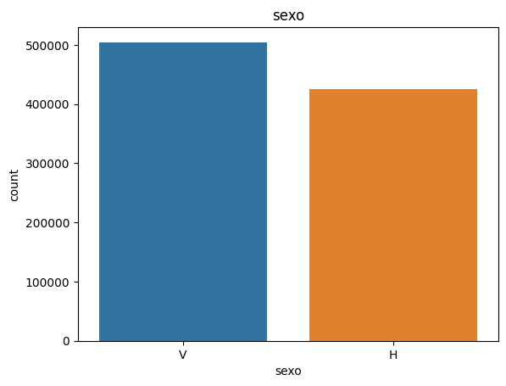
Gender Distribution
As we can see, V is the most popular with the count being 500,000 and H having a count of over 400,000

Slide 9
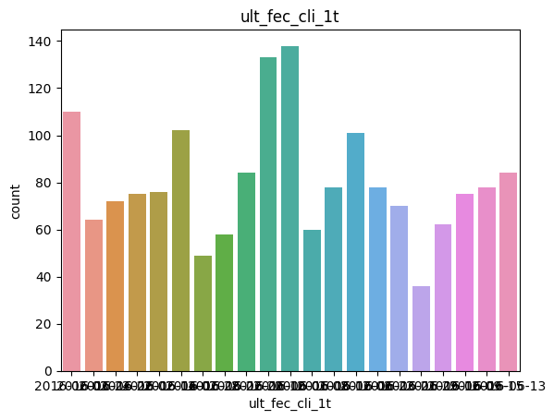
Primary User Analysis
This is a very big dataset, displaying all the dates clearly is tough but by going through the datasets, most customers stop being a primary customer during the middle of the year.

Slide 10
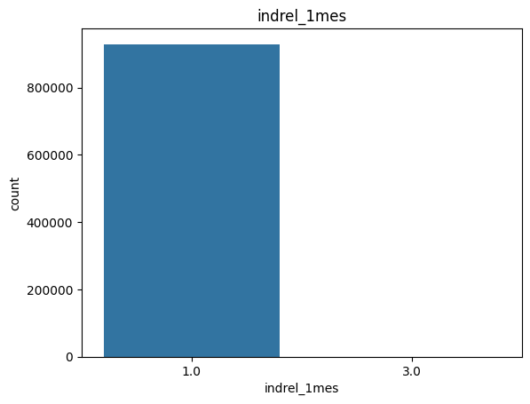
Customer Type
As we can see, the only customer types are 1 and 3 which is First/Primary and Former Primary with a lot of customers being primary customers with count of over 800,000. In the dataset, there is a very small amount of Former Primary customers but it is so small it cannot be illustrated.

Slide 11
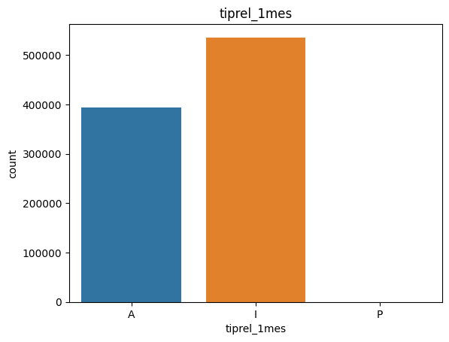
Customer Relation
As we can see, there are only three types customer relations, Active, Inactive and Former customer. We can see that there is a high amount of Inactive users compared to Active users and almost no former customers. The exact number of Former customers can be seen in the dataset description. The numbers are so small it cannot be illustrated.

Slide 12
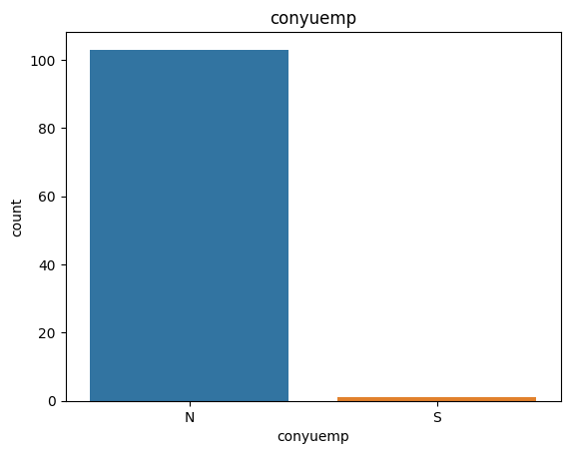
Customer-Spouse Relation
As we can see, most customers are the spouse of an employee (N) whereas some customers are not the spouse of an employee (S)

Slide 13
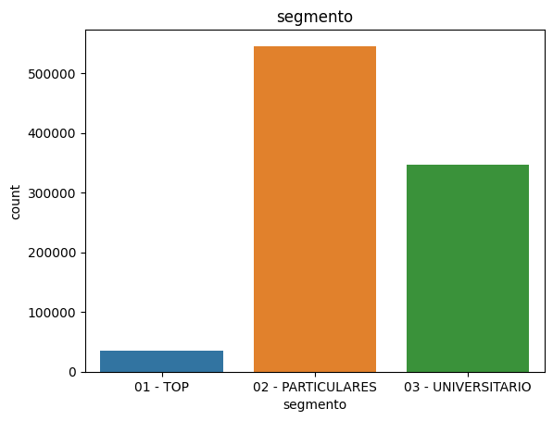
Segmentation Analysis
As we can see, most customers are Individuals (02) with a count of over 500,000 and some customers are college graduates (03) and a small amount of customers are VIPS (01)

Slide 14
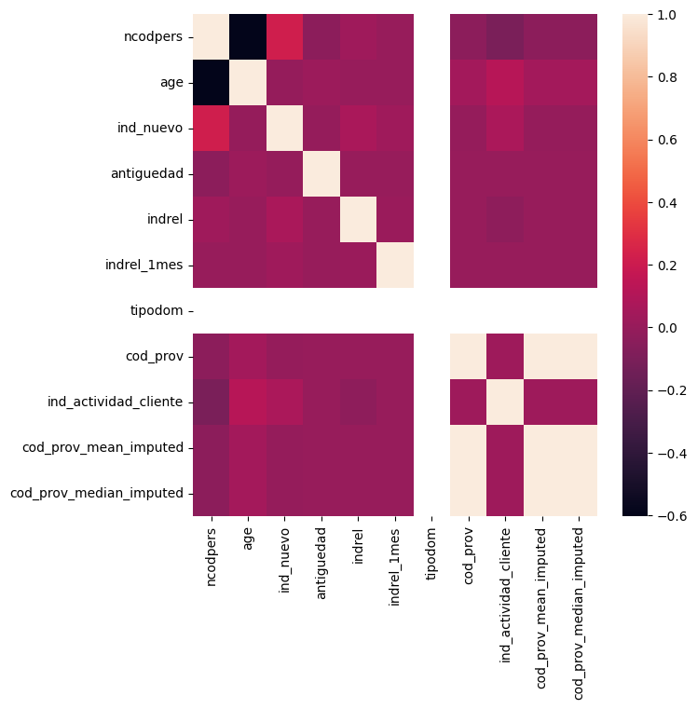
Correlation Heat Map

Slide 15
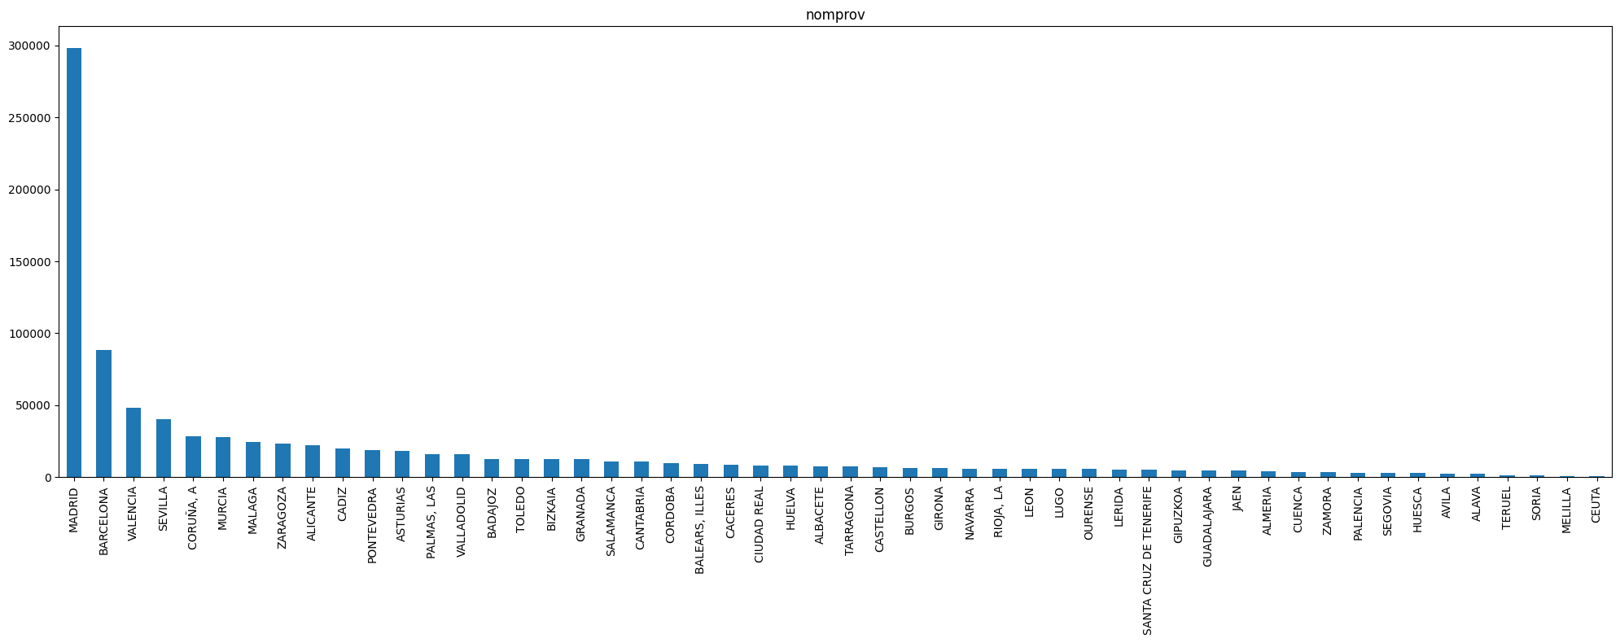
Province Names
As we can see, the most popular province is Madrid with a count of almost 300,000 which the credit union can take advantage of. Most of the other provinces are not as popular as Madrid

Slide 16
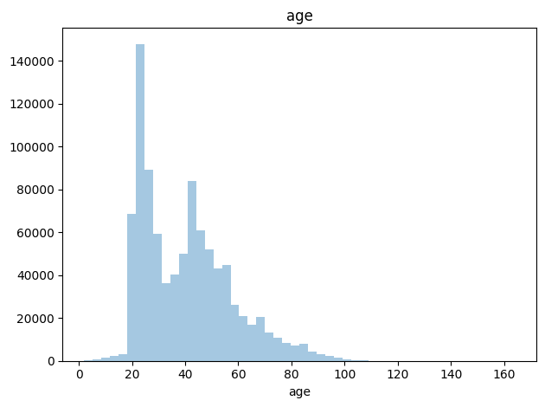
Age
As we can see, the age of most customers lie in between 20-60 with the most popular range being from 18 – 30.

Slide 17
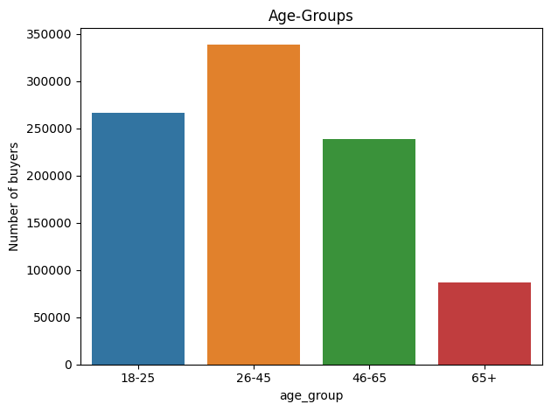

Age (cont.)
As we can see more clearly now, the most popular age group is 26-45 with a count of almost 350,000

Slide 18
Recommendation
Based on the exploratory data analysis, it is recommended that XYZ credit union focuses on improving their customer retention strategies and offering personalized and targeted promotions to their customers to increase cross-selling opportunities. Additionally, the bank should consider providing better customer service and investing in digital channels to enhance the overall customer experience. Finally, the bank should closely monitor customer behavior and use data-driven insights to continuously optimize their cross-selling efforts.

Slide 19
Recommendation for models
Logistic Regression
Decision Tree
Random Forest
Ada Boost

Slide 20
Cross Selling EDA Navodith Shankar 04/17/2023
Thank You

