Slide 1
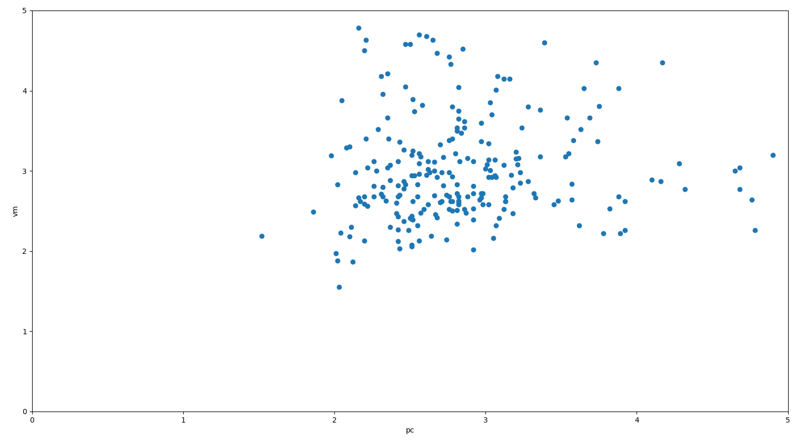
Time(seconds) pc 2
Time(seconds) pc 1

