Slide 1
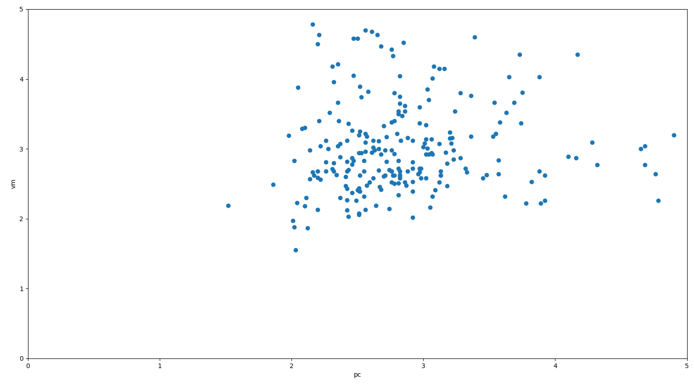
Time(seconds) PC 2
Time(seconds) PC 1

Slide 2
Optimization
*Manipulator variables:
Joints Types, DOF, Length of Links, Joint Axis
* Manipulability Index
* Mid Proximity Joint Index
* DOF
Interface
Configuration Builder
Indices Calculator
* Success
* Current Position
* Jacobian
* Create URDF
Simulator

Slide 3
Parent
Parent1
Parent2
1
2
3
4
1
2
3
4
5
6
7
8
Mutation
Crossover
i=2
4
1
2
3
Offspring
1
2
7
8
Offspring

Slide 4
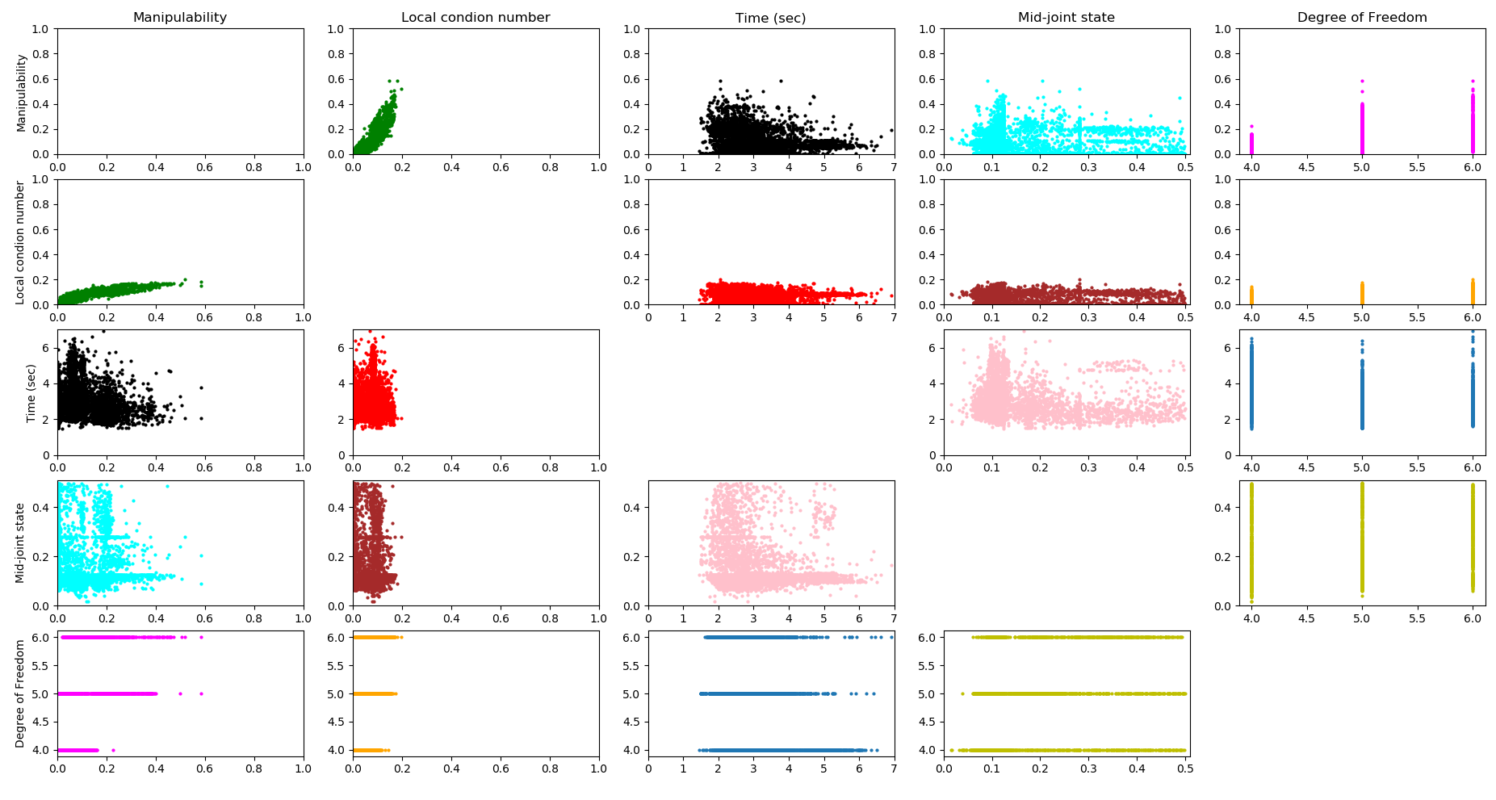

Slide 5
Manipulability Index
Mid-Proximity Joint Index
Local Condition Number
Manipulability Index
Manipulability Index
Degrees of freedom

Slide 6
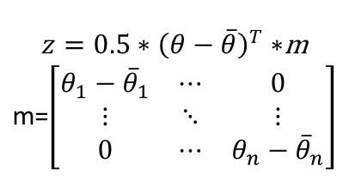

Slide 7
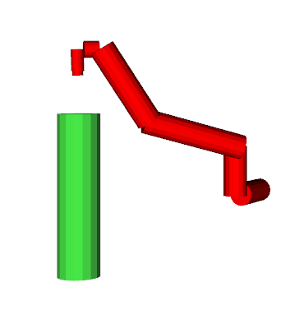
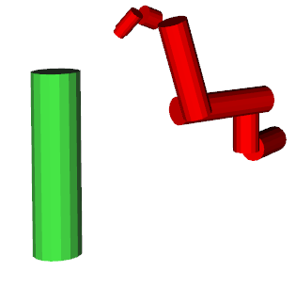
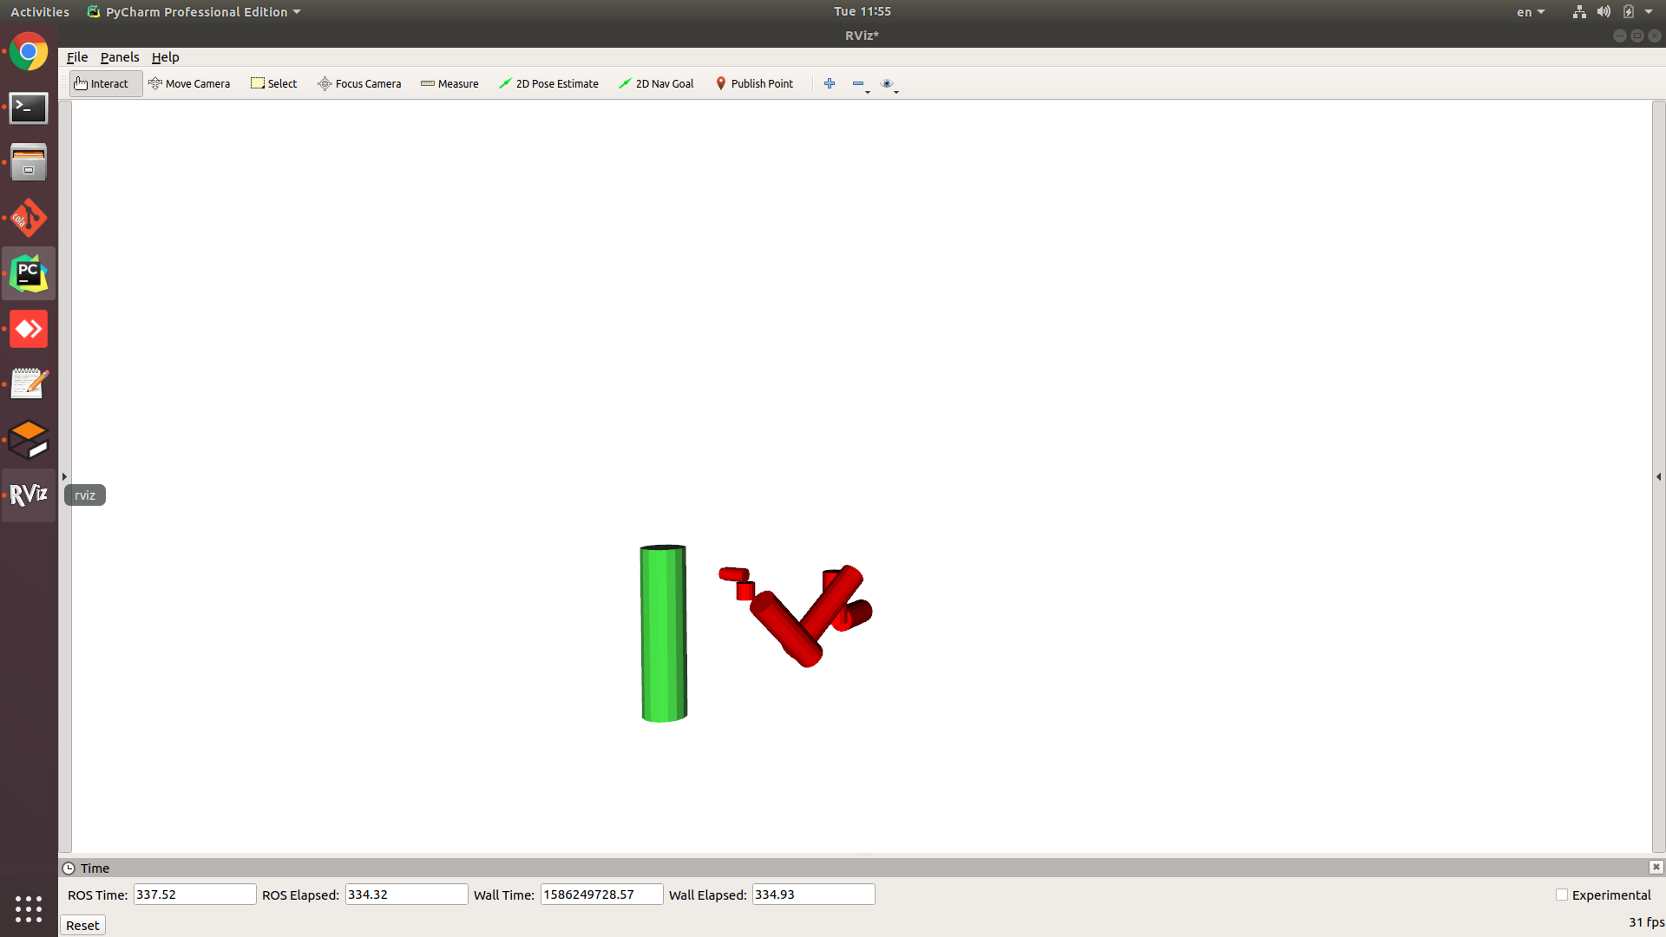
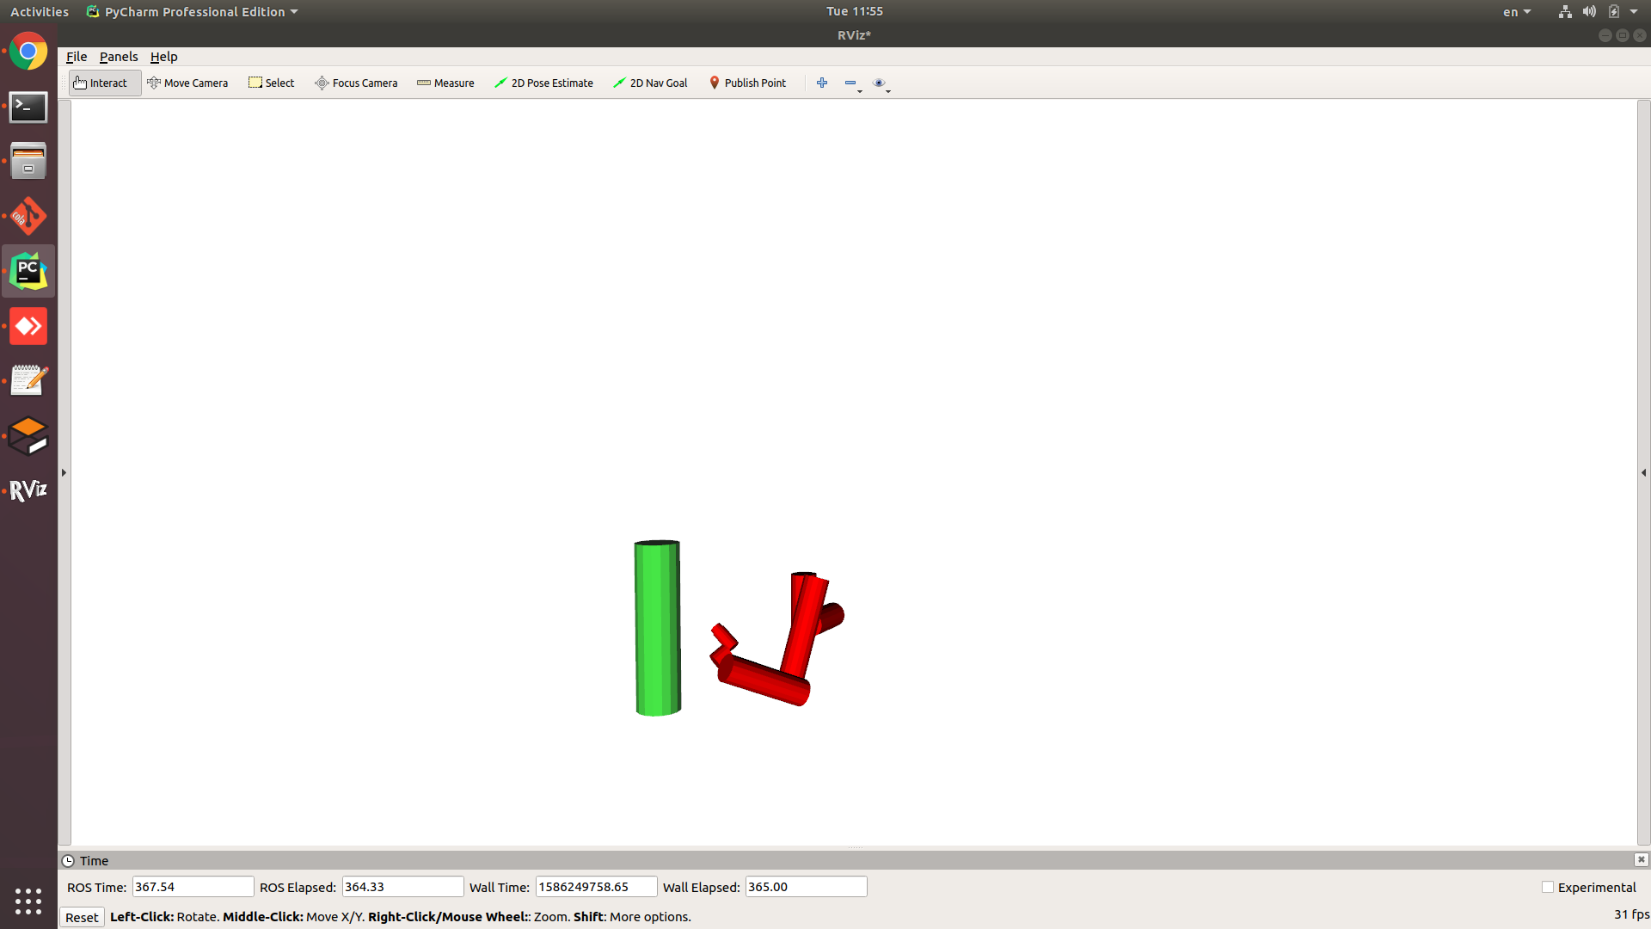

Slide 8
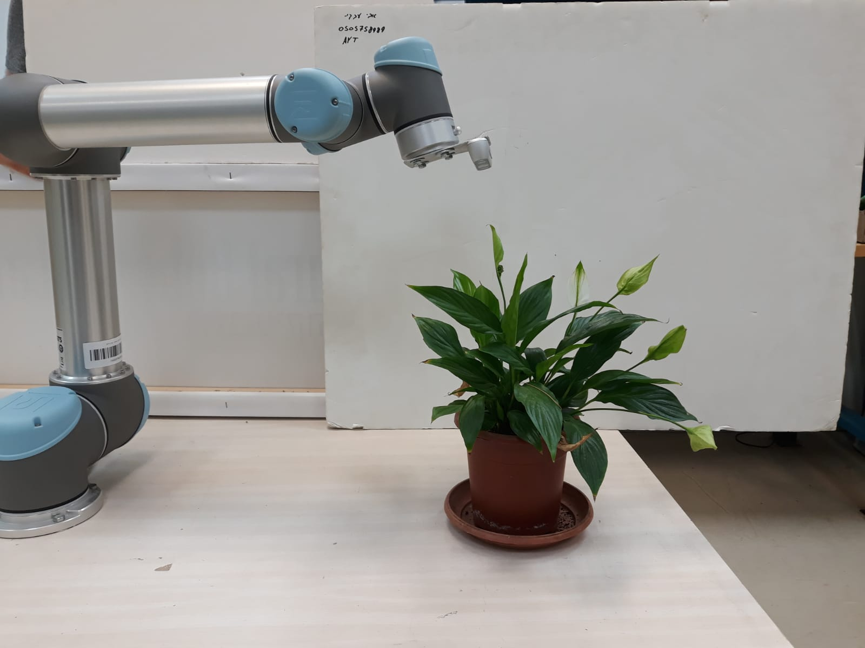

Slide 9
# of long link | Long link | DOF | Par Axes Y | Pitch joints | p/r ratio | Acc length
2 | 0.7 | 6 | 0 | 2 | 0 | 2.6
2 | 0.7 | 6 | 0 | 4 | 0 | 2.6
2 | 0.7 | 6 | 2 | 4 | 0 | 2.6
3 | 0.7 | 6 | 0 | 4 | 0 | 3.1
3 | 0.7 | 6 | 0 | 3 | 0 | 3.1
2 | 0.7 | 6 | 0 | 3 | 0 | 2.6

Slide 10
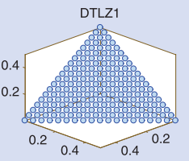
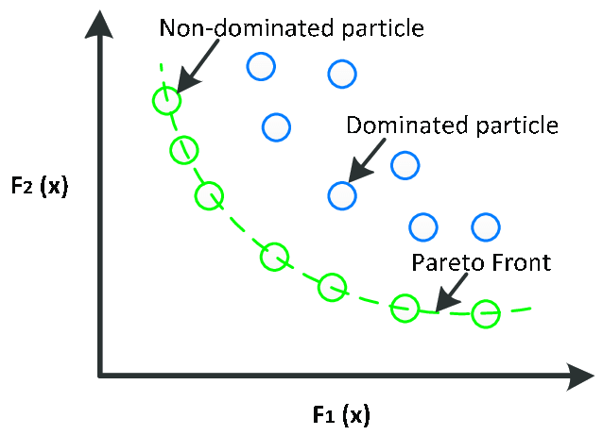

Slide 11
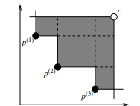

Slide 12
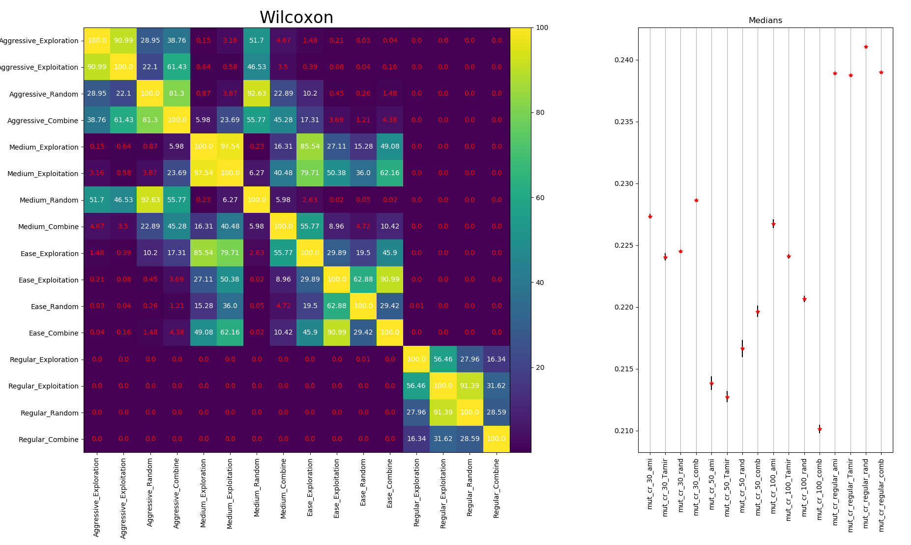

Slide 13


