Slide 1
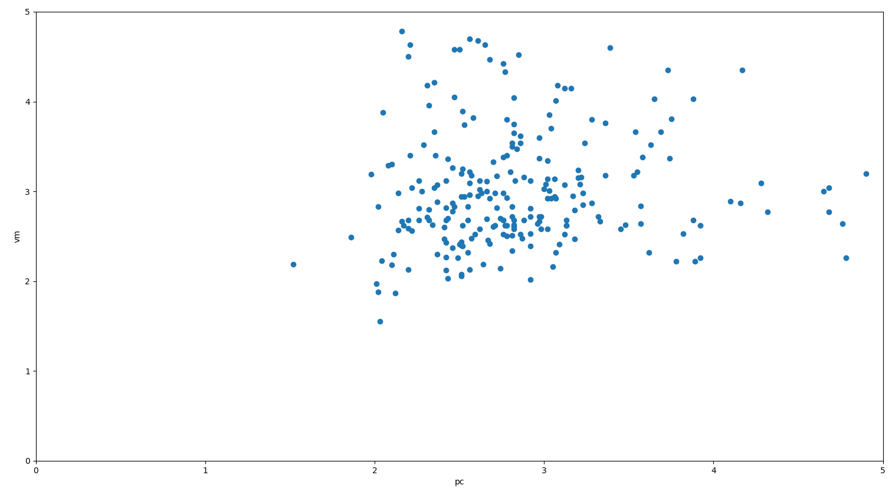
Time(seconds) pc 2
Time(seconds) pc 1

Slide 2
Optimization
*Manipulator variables:
Joints Types, DOF, Length of Links, Joint Axis
* Manipulability Index
* Mid Proximity Joint Index
* DOF
Interface
Configuration Builder
Indices Calculator
* Success
* Current Position
* Jacobian
* Create URDF
Simulator

