Slide 1
React
v 01. nma 11-12/2018 - v.02 4/2020

Slide 2
Introduction

Slide 3
React
React (also known as React.js) is a JavaScript library for building user interfaces. It is maintained by Facebook and a community of individual developers and companies. First released in 2011 (Jordan Walke)
React can be used as a base in the development of single-page or mobile applications.
React is only concerned with rendering data to the DOM, and so creating React applications usually requires the use of additional libraries for state management (Redux) and routing (React Router).
React Native, which enables native Android, iOS, and UWP(windows) development with React, was announced in 2015.
React is currently the most popular front-end JS framework.
https://www.youtube.com/watch?v=5fG_lyNuEAw (Jordan Walke, talk on the future of React, 10/2019)

Slide 4
what is React
The purpose of React is to show content (HTML) to the user and handle user interaction
React code is made of entities called components. We pass values to components, called props.
We can declare components through functions or classes.
const Greeting = (props) => <div>Hello, {props.name}!</div>;
class definition
class ParentComponent extends React.Component {
state = { color: 'green' };
render() {
return (
<ChildComponent color={this.state.color} /> ); } }
React uses JSX (JavaScript XML) to render components (syntax similar to HTML)
React defines event handlers
We use React and ReactDOM (to show components in DOM) libraries

Slide 5
install React
Node JS
create-react-app
npm install –g create-react-app
npx create-react-app myapp
to unistatll …
npm unistall –g create-react-app
rm –rf /usr/local/bin/create-react-app
-g : globally
installing create-react-app
running create-react-app to create myapp

Slide 6
installing and creating an app
npx --ignore-existing create-react-app myapp
………
Installing packages. This might take a couple of minutes.
Installing react, react-dom, and react-scripts...
added 1810 packages from 770 contributors and audited 931495 packages in 165.644s
found 0 vulnerabilities

Slide 7
eventually… to start the application
cd myapp
npm start
Compiled successfully!
You can now view myapp in the browser.
Local: http://localhost:3000/
On Your Network: http://192.168.1.4:3000/
Note that the development build is not optimized.
To create a production build, use npm run build.

Slide 8
why so many dependencies? libraries like Babel, Webpack, Dev Server are also included
about Babel
ES5 is the mostly supported version of JavaScript
ES2015 and later are not fully supported by users' browsers
Babel produces an ES5 version of our code
Babel is included in a new React project

Slide 9
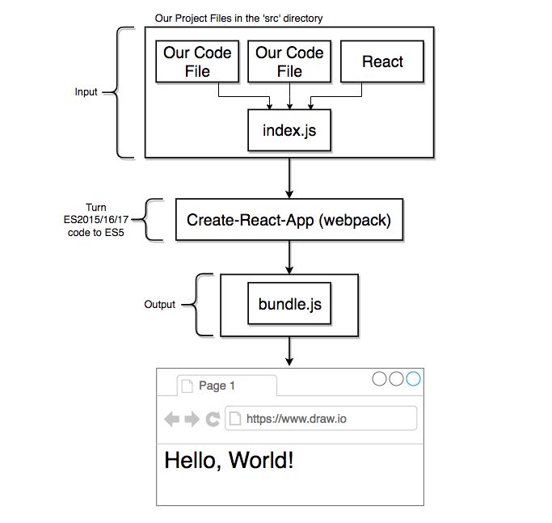
babel + webpack+ dev server ➔ transpiling to ES5
source: Boduch, 2017

Slide 10
/src directory:
my-code1.js
my-code2.js
…
index.js
React
turn ES2015+ javascript to ES5 (babel)
create-react-app (webpack)
bundle.js
hello world!

Slide 11
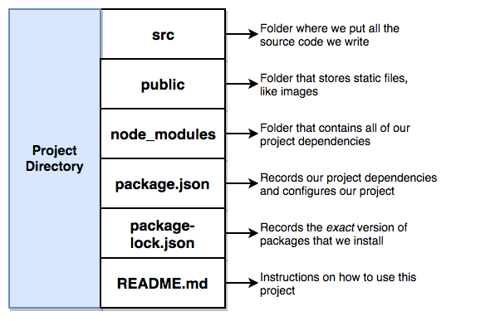
directory structure

Slide 12
Our first React application

Slide 13
our first application
in the src directory we get rid of existing files and create our own index.js
// import the React and ReactDOM libraries // (import for ES2015 Modules, "require" for CommonJS Modules)
// in node.js const React = require('react') import React from 'react';
import ReactDOM from 'react-dom'
// Create a React component // Take the React component and show it on the screen
1
2
3

Slide 14
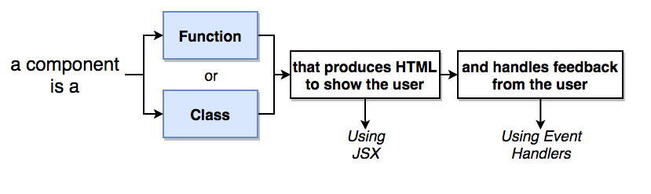
react component

Slide 15
Components - functions
// Create a React component const App = function() { return <div> Καλή σας μέρα! </div>; }; // Take the React component and show it on the screen ReactDOM.render( <App />, document.querySelector("#root") );
show component App to the DOM element with id= 'root' (in public/index.html )

Slide 16
JSX

Slide 17
JSX
Go to https://babeljs.io -> try it out in order to see how compile JSX to javascript
JavaScript dialect that allows use of HTML–like code to build UI through react components
const App = function() { return <div> Καλή σας μέρα! </div>; };
JSX
"use strict";
var App = function App() { return React.createElement( "div", null, " \u039A\u03B1\u03BB\u03AE \u03C3\u03B1\u03C2 \u03BC\u03AD\u03C1\u03B1! " );};
JS5

Slide 18
let us investigate differences between JSX and HTML
Consider the following code (in codepen.io)
<div style="font-family: sans-serif;">
<label class='label' for 'name'>Το όνομά σας: </label>
<input id='name' type='text'>
<button style='background-color: blue; color: white'> Υποβολή
</button>
</div>
If we include this code in a react component return ( … ), we get an error.
Error: The `style` prop expects a mapping from style properties to values, not a string. For example, style={{marginRight: spacing + 'em'}} when using JSX. in button (at src/index.js:14) in div (at src/index.js:11) in App (at src/index.js:23)

Slide 19

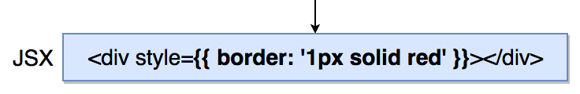
differences JSX to HTML : (a) { jsVariable }
we can include javascript variables in HTML within { }
<button> submit </button>
<button> { buttonText } </button>
a JS object cannot be used as text
const buttonText='submit';
const buttonText=['sub','mit'];
const buttonText={a:'sub', b:'mit};

Slide 20
differences JSX to HTML : (b) element styling
JavaScript Object

Slide 21
differences JSX to HTML : (c) element class
<label class="label" for="name">
<label className="label" for="name">
'class' is a reserved word in JavaScript

Slide 22
differences JSX to HTML : (d) warnings: e.g. for
HTML
JSX
<label className="label" for="name">
<label className="label" htmlFor="name">
index.js:1452 Warning: Invalid DOM property `for`. Did you mean `htmlFor`? in label (at src/index.js:12) in div (at src/index.js:11) in App (at src/index.js:22) function.console.(anonymous function) @ index.js:1452
for is reserved word in JS

Slide 23
test: transform the following html to JSX
// Create a React component const App = function() {
return ( <div style="font-family: sans-serif;">
<label class='label' for 'name'>Το όνομά σας: </label>
<input id='name' type='text'>
<button style='background-color: blue; color: white'> Υποβολή </button>
</div>
) };
Notes:
const App = function() { return ( <div> <label for="name">Enter name:</label> <input id="name" type='text' /> <button style={{backgroundColor: "blue", color:"white"}}>Submit</button></div>);};

Slide 24
how to change this code in order to show the current time?
// create another React component
function getTime() {
return (new Date()).toLocaleTimeString()
}
// Creates a functional component
const Timer = () => {
return (
<div>
<h3>Current Time: { getTime() }</h3>
</div>
);
}
// Take the React component and show it on the screen
ReactDOM.render(
<Timer />,
document.querySelector("#root")
);

Slide 25
Component nesting, reusability and configuration

Slide 26




project : build a list of contacts' comments
using Semantic UI
<link rel="stylesheet" href="https://cdnjs.cloudflare.com/ajax/libs/semantic-ui/2.4.1/semantic.min.css">
Kostas
Σήμερα στις 5:00
Πολύ ωραία, τα λέμε αργότερα
Maria
Σήμερα στις 12:00
Ευχαριστώ, περιμένω νέα σου.

Slide 27
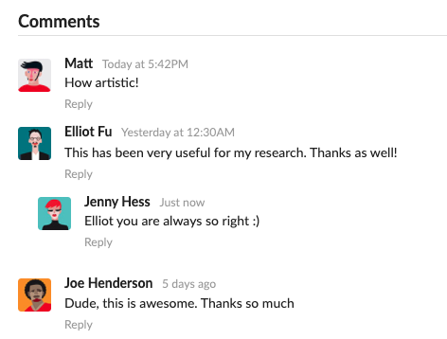
project : build a list of contacts' comments
using Semantic UI
<link rel="stylesheet" href="https://cdnjs.cloudflare.com/ajax/libs/semantic-ui/2.4.1/semantic.min.css">
semantic ui cdn
https://cdnjs.com/libraries/semantic-ui
search for semantic.min.css
<link rel="stylesheet" href = "https://cdnjs.cloudflare.com/ajax/libs/semantic-ui/2.4.1/semantic.min.css" />

Slide 28

project : build a list of contacts' comments
<div className="ui container comments">
<div className="comment">
<a href="/" className="avatar">
<img alt="avatar"></img>
</a>
<div className="content">
<a href="/" className="author">Kostas
</a>
<div className="metadata">
<span className="date">
Σήμερα στις 5:00
</span>
</div>
<div className="text">Πολύ ωραία, τα
λέμε αργότερα</div>
</div>
</div>
</div>
Kostas
Σήμερα στις 5:00
Πολύ ωραία, τα λέμε αργότερα
Maria
Σήμερα στις 12:00
Eυχαριστώ, περιμένω νέα σου.

Slide 29

faker.js used to fake avatar images
fake data to use during development
npm install --save faker
import faker from 'faker';
src = { faker.image.avatar() }

Slide 30
We need to create a reusable configurable component
We should build a file to the re-usable component with the component name CommentDetail.js
Make this component re-usable by using the React's 'props' system

Slide 31
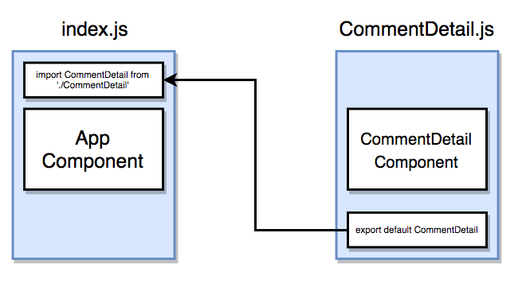
new component
We create a component CommentDetail found in file CommentDetail.js in src folder
declare export in
component file
and import in index.js
parent
component
child component
<CommentDetail />

Slide 32
new components
We create components B,C found in files B.jsx, C.jsx in src folder
C.jsx
index.js
B.jsx
import B from "./B.jsx"
import C from "./C.jsx"
B component
B component
we declare export in
component files
and import in index.js
parent
component
<App > component
<B />
<C />
child component
export default C
export default B

Slide 33
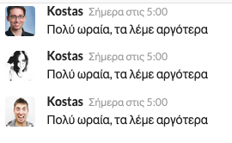
creation of new component
We create a component CommentDetail found in file CommentDetail.js in src folder
const CommentDetail = () => {
}
export default CommentDetail;
import CommentDetail from './CommentDetail.js'
const App = () => {
return (
<div className="ui container comments">
<CommentDetail />
<CommentDetail />
<CommentDetail />
</div>
)
}

Slide 34
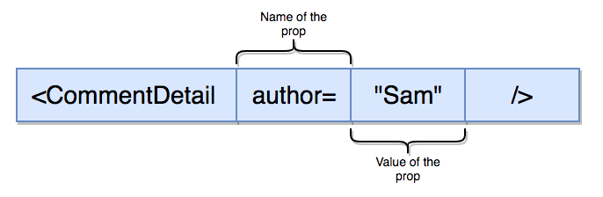
the props (properties) system
props (properties) used to pass values to a child component, e.g. to pass a value for author
through the props.property in the component definition
const CommentDetail = (props) => {
return (<div> { props.author }</div>);
};
then the values are passed as attributes of the component in the JSX code

Slide 35
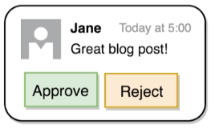
Embedding component in components
ApprovalCard
CommentDetail
Let us suppose that we would like to embed CommentDetail in another component that contains two buttons (Approve, Reject).
<ApprovalCard>
<CommentDetail … />
</ApprovalCard>
const ApprovalCard = (props) => {
return (
…
< > { props.children } </ >
)
}

Slide 36
embedding components
props (properties) are used to contain a child component in its parent
<Parent>
<Child />
</Parent>
const Parent = (props) => {
return (
<div> { props.children } </div>
);
};
Parent
here we wrap any child element, like the Child component
Child

Slide 37
example
modify components App and Message, make Message more generic
<script type="text/babel" data-presets="env,react">
const App = () => {
return (
<div>
<Message header=" Changes in Service " text="We just updated our privacy policy" >
</div> ); }
const Message = (props) => {
return (
<div className="ui message">
<div className="header"> {props.header} </div>
<p> { props.text } </p>
</div> ); }
// Renders the App component into a div with id 'root'
ReactDOM.render(<App />, document.querySelector('#root'));
</script>
<!--The App component above will be rendered into this-->
<div id="root"></div>

Slide 38
Class components

Slide 39
Class-based components
if a component contains complex logic, needs to respond to user input, we may use a class component instead of a functional component

Slide 40
example
Let us build a component that knows the location of the user and the time of the year to decide if it is cold (winter) or hot (summer)
for this we are going to use the html5 geolocation API and the Date().getMonth() function that returns the month as an integer
navigator.geolocation.getCurrentPosition(
position => console.log(position), #callback if ok
err => console.log(err) ); #callback if error

Slide 41
a class component
import React from 'react'; import ReactDOM from 'react-dom'; class App extends React.component { render() { navigator.geolocation.getCurrentPosition( (position)=>console.log(position), (err)=>console.log(err) ); return ( <div> Latitude: </div> ); } }
the problem here is that the geolocation API returns data after the component has been rendered.
So we need state in order to synchronize the rendered component and data in the class

Slide 42
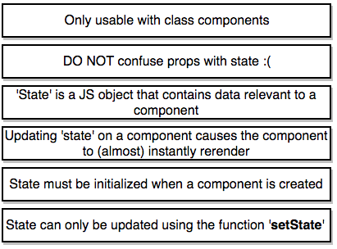
state system
state is a component object that holds information that is expected to change, the state changes through use of setState(state-object), as a result the component re-renders itself.
DO NOT
this.state = { x:0};
this.setState({x: 100});

Slide 43
example
this runs asynchronously and in case of successful execution returns a callback that sets the value of state
class App extends React.Component {
constructor(props) {
super(props);
this.state = {lat: null, long: null};
window.navigator.geolocation.getCurrentPosition( (position)=>this.setState({lat:position.coords.latitude}), (err)=>console.log(err) );
render() {
return(
<div> Latitude: {this.state.lat}</div>
);
}
};
render function is called again and again and displays the result of setState( )

Slide 44
example conditional rendering
render() {
if (this.state.lat && !this.state.errorMessage){ return <div>Latitude: {this.state.lat} </div>;}
if (!this.state.lat && this.state.errorMessage){
return <div>Error: {this.state.errorMessage} </div>;} return (
<div> Loading ... </div> );
}

Slide 45
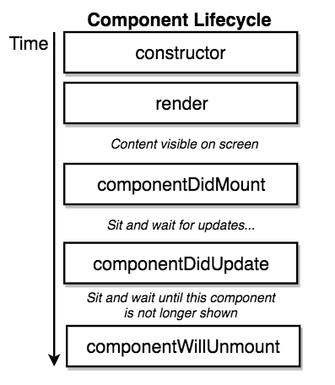
Component lifecycle methods
one-time setup
compulsory method: it returns JSX that renders the component
this is called after the component is rendered
this is called after the component is re-rendered

Slide 46
two alternative ways to define state
(a)
class App extends React.Component {
constructor(props) {
super(props);
this.state = {lat: null, long: null};
}
render(){
}
}
(b)
Babel during transplining generates the constructor method of (a)
class App extends React.Component {
state = {lat: null, long: null};
render(){
}
}

Slide 47
state can be passed on to children-components through props
import SeasonDisplay from './SeasonDisplay'
…
// define App component
render() {
if (this.state.lat && !this.state.errorMessage){ return <SeasonDisplay lat = {this.state.lat} />
}
file index.js
import React from 'react';
const SeasonDisplay = (props) => {
return (
<div> The latitude is ... {props.lat} </div> );
}
export default SeasonDisplay;
file SeasonDisplay.js

Slide 48
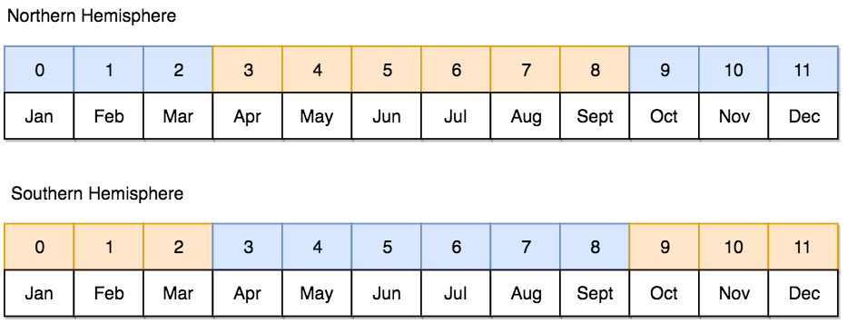
example
In order to determine if it is cold (winter) or warm (summer), we need the month of the year and the latitude to decide if we are in the southern or northern hemisphere
Date().getMonth() returns the current month (zero indexed)
window.navigator.geolocation.getCurrentPosition(callback) returns a position object with latitude as one of its attributes

Slide 49
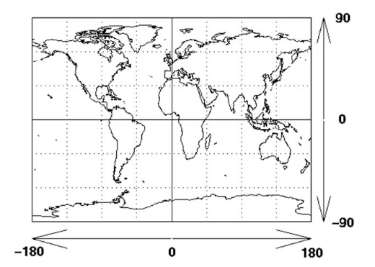
Geographical Coordinates : latitude, longitude in decimal degrees: ddec to DMS (degrees, minutes, seconds)
Latitude: +/-90 : positive values North hemisphere, negative values: South hemisphere
Longtitude: +/-180 : positive values are east of Prime Meridian, negative values are west of prime Meridian
ww.fcc.gov/media/radio/dms-decimal
https://en.wikipedia.org/wiki/Decimal_degrees

Slide 50
convert from DD to DMS and from DMS to DD
(a) Decimal degrees (DD) to Degrees, minutes, seconds (DMS)
One degree (°) is equal to 60 minutes (') and equal to 3600 seconds ("): 1° = 60' = 3600"
The integer degrees (d) are equal to the integer part of the decimal degrees (dd): d = integer(dd)
The minutes (m) are equal to the integer part of the decimal degrees (dd) minus integer degrees (d) times 60: m = integer((dd - d) × 60)
The seconds (s) are equal to the decimal degrees (dd) minus integer degrees (d) minus minutes (m) divided by 60 times 3600: s = (dd - d - m/60) × 3600
Degrees, minutes, seconds (DMS) to Decimal degrees (DD)
dd = d + m/60 + s/3600
example: DMS = 38°17'10.2"N 21°47'13.0"E → DD = 38.286159, 21.786945

Slide 51
example
application logic in a function (e.g. getSeason)
configuration object. (e.g. seasonConfig)
// configuration object
const seasonConfig = {
summer: {
text: "it is summer, it is warm",
iconName: 'sun' },
winter: {
text: "is is winter, it is cold",
iconName: 'snowflake' }};
function getSeason (lat, month) {
// determine the season from month {0-11} and lat {-90, +90}
if ((lat > 0 && (month > 2 && month < 9)) || //northern hemisphere summer
(lat <= 0 && (month >= 9 || month < 3))) { // southern hemisphere summer return "summer"; }
else { return "winter"; } }

Slide 52


adding a .css file to a component
SeasonDisplay.css
.icon-left {
position: absolute;
top: 20px;
left: 20px;}
.icon-right {
position: absolute;
bottom: 20px;
right: 20px;}
.season-display {
display: flex;
justify-content: center;
align-items: center;
height: 100vh;}
.winter {
background-color: blue;}
.summer {
background-color: orange;}
SeasonDisplay.js
import './SeasonDisplay.css'
const SeasonDisplay = (props) => {
const month = new Date().getMonth();
const season = getSeason(props.lat, month);
const {text, iconName} = seasonConfig[season];
return (
<div className = {`season-display ${season}` } >
<i className = {`icon-left icon huge ${iconName}`} />
<div>{text} </div>
<i className = {`icon-right icon huge ${iconName}`} />
</div> ); }

Slide 53
exercise
Make all necessary changes so that the timer works ok
class Clock extends React.Component {
componentDidMount() {
setInterval(() => {
this.time = new Date().toLocaleTimeString()
}, 1000)
}
render() {
return (
<div className="time">
The time is: {this.time}
</div> );
}
}

Slide 54
a digital clock in JavaScript
<!DOCTYPE html> <html> <head> <style> p { font-family: Arial; font-size: 40px;} </style> </head> <body> <p id="demo"></p> <script> setInterval(myTimer, 1000); function myTimer() { const d = new Date(); document.getElementById("demo").innerHTML = d.toLocaleTimeString(); } </script> </body> </html>
23:49:36
setInterval(func, t); repeats the func every
t msec

Slide 55
exercise solution
Make all necessary changes so that the timer works ok
import React from 'react';
import './Clock.css'
class Clock extends React.Component {
constructor(props){
super(props);
this.state = {time:null}; }
componentDidMount() {
setInterval(() => {
this.setState( {time: new Date().toLocaleTimeString()})}, 1000);
};
render() {
return (
<div className="time"> The time is: {this.state.time}</div> );
}
}
export default Clock;
The main change is that we need to introduce state. We then include as callback in the setInterval function the setState call that updates the state, then we pass the this.state value to the JSX

Slide 56
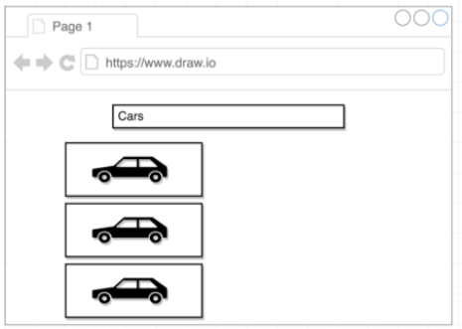
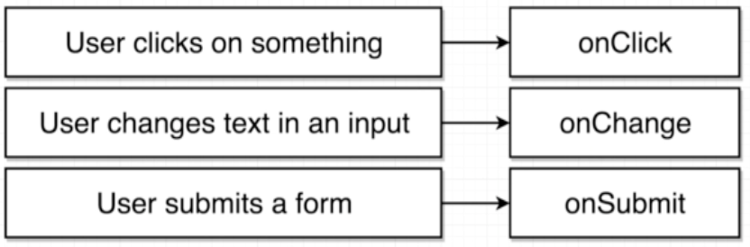
user events
project pictures
App
component
let us build a searchBar component
SearchBar component
ImageList component
onInputChange(event) { console.log(event.target.value); }
<input type="text" onChange= {this.onInputChange}/>

Slide 57
invoking a callback in a child
App
SearchBar
App
onSearchSubmit(term){
console.log("app", term); }
<SearchBar onSearchSubmit= {this.onSearchSubmit}/>
pass a callback as prop to the child
SearchBar
onFormSubmit(event) {
event.preventDefault(); // not to refresh on submit this.props.onSearchSubmit(this.state.term); }
<form onSubmit={(e) => {this.onFormSubmit(e)}}> // arrow function for callbacks to address the this problem

Slide 58
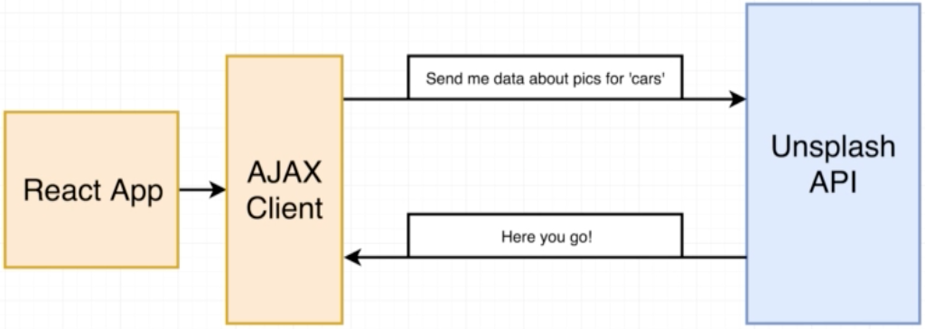
running an ajax request to an API (api.unsplash.com)
two different approaches:
axios package npm installl –save axios
fetch (function built into modern browsers)

Slide 59
axios GET request
class App extends React.Component {
onSearchSubmit(term){ axios.get('https://api.unsplash.com/search/photos', { params: { query: term },
headers: {
Authorization: 'Client-ID b9d6bb97fecc94c4…'
}
}).then( (response) => { // promise based syntax
console.log(response.data.results);
}
alternatively async syntax …
async onSearchSubmit(term) {
const response = await axios.get( …)

Slide 60
array.map(function)
how to extract images from the API call results
const images = this.props.images.map((i) => {
return <img key={i.id} alt={i.description} src={i.urls.small} /> });
index.js:1452 Warning: Each child in an array or iterator should have a unique "key" prop.Check the render method of `Images`. See https://fb.me/react-warning-keys for more information. in img (at Images.js:8) in Images (at App.js:30) in div (at App.js:28) in App (at src/index.js:6)

Slide 61
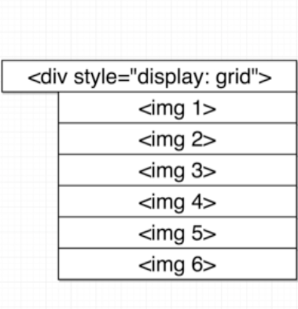
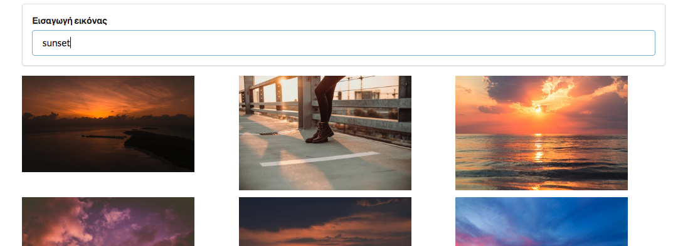
display:grid
.image-list {
display: grid;
grid-row-gap: 10px;
grid-column-gap: 10px;
grid-template-columns: repeat(auto-fill, minmax(250px, 1fr));}
.image-list img {
width: 250px;}
import './Images.css'
…
return (<div className="image-list" > {images} </div>);

Slide 62
access the DOM with refs
refs give access to single DOM element
we create refs in the constructor, assign them to instance variables, and pass to a particular JSX element as props
class MyComponent extends React.Component {
constructor(props) {
super(props);
this.myRef = React.createRef(); }
render() {
return <div ref={this.myRef} />; } }

Slide 63
each individual image as a component ImageCard
we need to know the height of the individual image from the DOM (the loaded image object)
class ImageCard extends React.Component {
constructor(props){
super(props)
this.imageRef = React.createRef(); };
componentDidMount() {. // after mounting the component
console.log(this.imageRef);
this.imageRef.current.addEventListener( //after loading the image
'load', () => {console.log(this.imageRef.current.clientHeight);}); };
render (){
return (
<img ref={this.imageRef} src={this.props.src} alt={this.props.alt} />);
}
}
export default ImageCard;

Slide 64
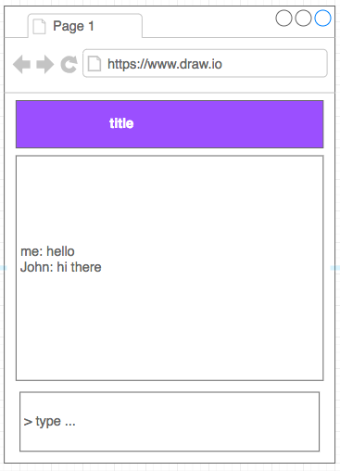
a mini project
App
Using the chatkit api to build a chat app
TitleBox
DialogueBox
SendMessageForm

Slide 65
Components
App
TitleBox
App
TitleBox
DialogueBox
DialogueBox
SendMessageForm
SendMessageForm

Slide 66
class App extends React.Component { render() { return ( <div className="app"> <TitleBox /> <MessageBox /> <SendMessageForm /> </div> ) } }

Slide 67
additional frameworks used
semantic ui (css framework)
User Interface is the language of the web
search for content delivery network url for semantic.min.css
in the public/ index.html we insert …
<link rel="stylesheet", href="https://cdnjs.cloudflare.com/ajax/libs/semantic-ui/2.4.1/semantic.min.css" />

Slide 68
additional service used
unsplash.com
a free searchable images database

Slide 69
resources
Boduch A. (2017) React and React Native, Packt
udemy course by S. Grider ($)

