Slide 1
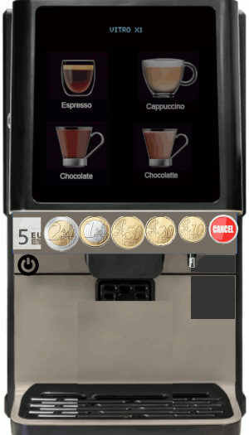

panel
1
2
3
4
rest
cup

