Slide 1
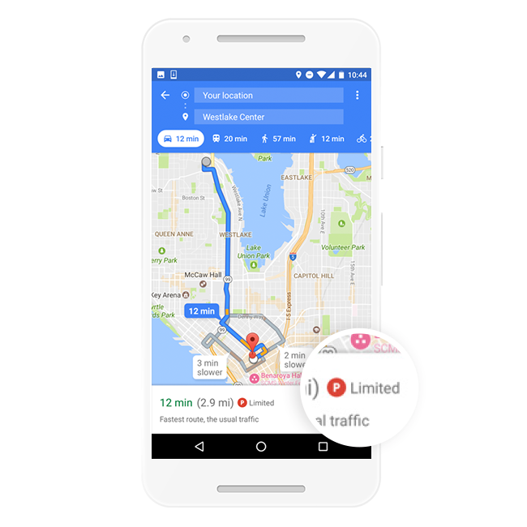
Machine Learning for Parking Difficulty

Slide 2
Building this feature is hard...
Parking is very variable
Can’t account for illegal parking, park with a permit, or depart early from still-paid meters
Parking structures are more complex
Supply and demand for parking is in constant flux

Slide 3
Ground Truth Data
Gathering high-quality ground truth data is often a key challenge in building any ML solution. We began by asking individuals at a diverse set of locations and times if they found the parking difficult. But we learned that answers to subjective questions like this produces inconsistent results - for a given location and time, one person may answer that it was “easy” to find parking while another found it “difficult.” Switching to objective questions like “How long did it it take to find parking?” led to an increase in answer confidence, enabling us to crowdsource a high-quality set of ground truth data with over 100K responses.

Slide 4
Model Features
Utilize anonymous aggregated information from users who opt to share their location data, which already is a vital source of information for estimates of live traffic or popular times and visit durations.
Need more robust aggregate features
Dispersion of parking locations, time-of-day and date dependence of parking (e.g. what if users park close to a destination in the early morning, but further away at busier hours?), historical parking data and more. In the end, we decided on roughly twenty different features along these lines for our model. Then it was time to tune the model performance.
Fingerprinting

Slide 5
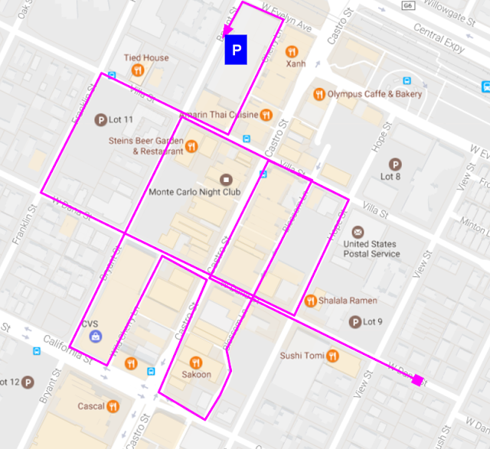

Slide 6
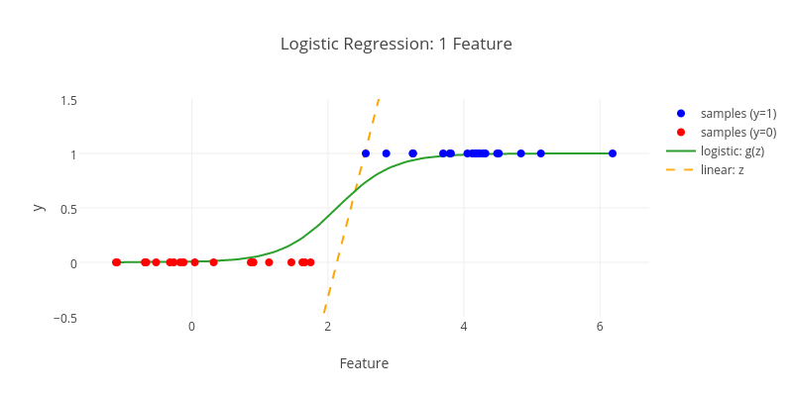
Model
Logistic Regression

Slide 7
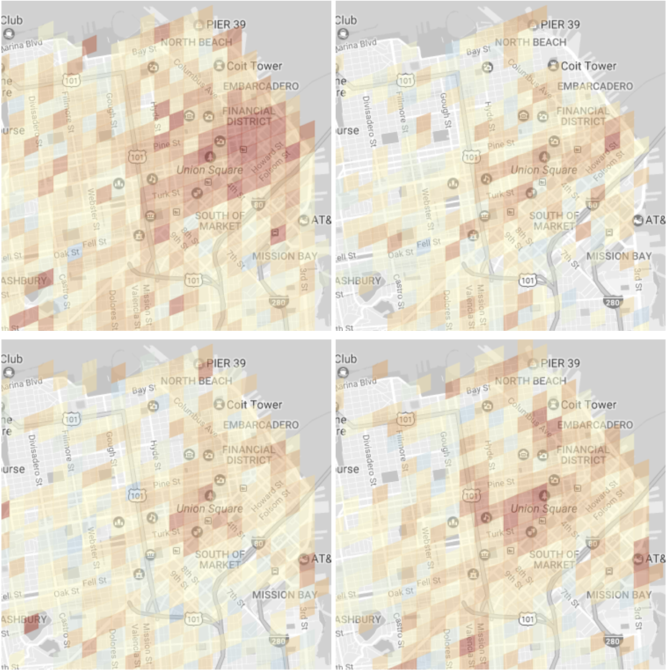
Results

