Slide 1
Linear Algebra for ML

Slide 2
Lesson Objectives
Describe how different data modalities would be represented using matrices
Apply Matrix and Vector Operations
Gain intuition for what is linear independence, span, basis vectors, orthogonality
Describe inner products, norms, matrix inverses, and eigenvalues
Understand SVD

Slide 3

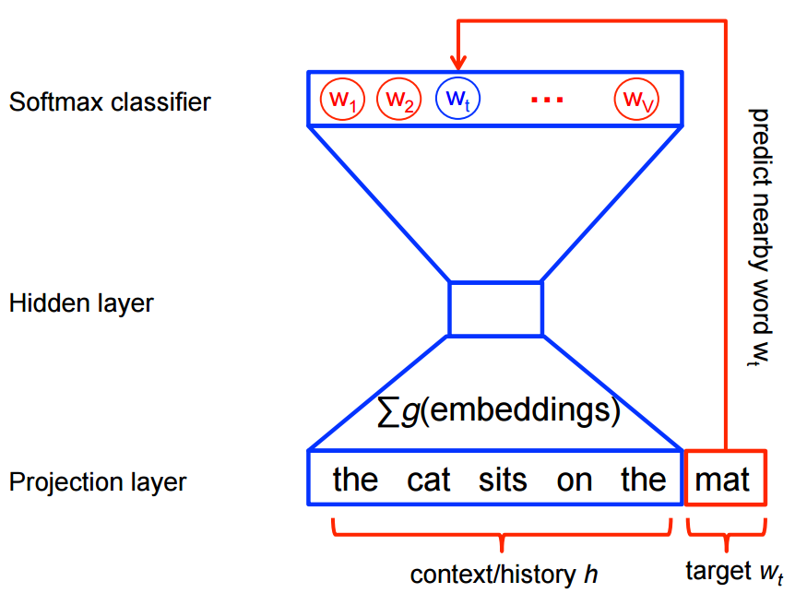
Why is LA important?
Notes:
-- Add demos where you read in images and see what they look like

Slide 4
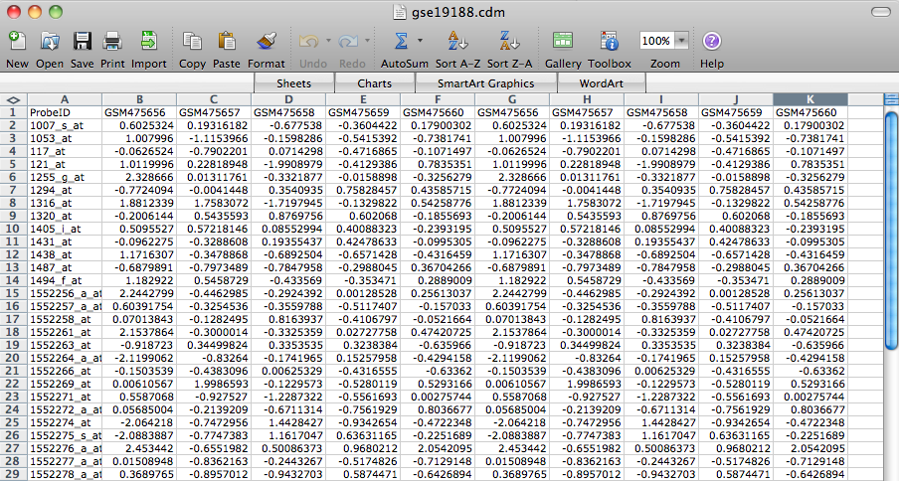
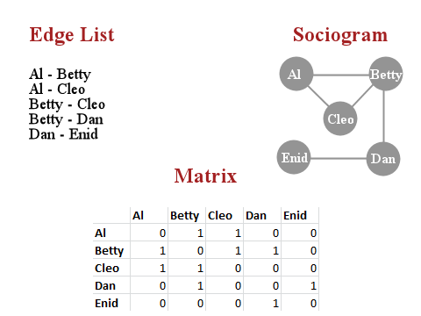
Why is LA important?

Slide 5
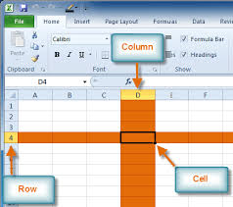
Spreadsheets are matrices!

Slide 6
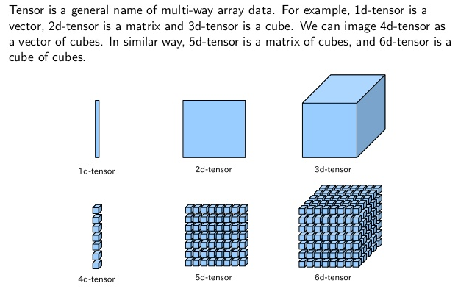
Scalars, Vectors, Matrices, and Tensors

Slide 7
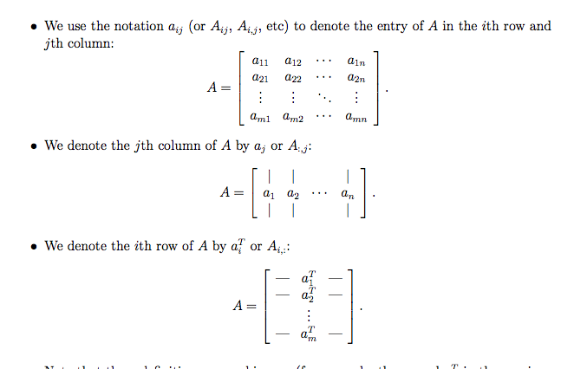
Matrix Operations: Notation

Slide 8
Exercise: How would you represent the following data?
Score on a test
Scores of an entire class on a test
Scores of an entire class on test with the amount of time they spent on the test and their prior background
Color Images of 100 faces vs. Grayscale Images of 100 Faces
Login Activity for one user by the hour for one day on Linkedin
Login Activity of 100K users by the hour for one day on Linkedin
Login Activity of 100K users for one day with colored images of their faces at each hour when they logged in

Slide 9
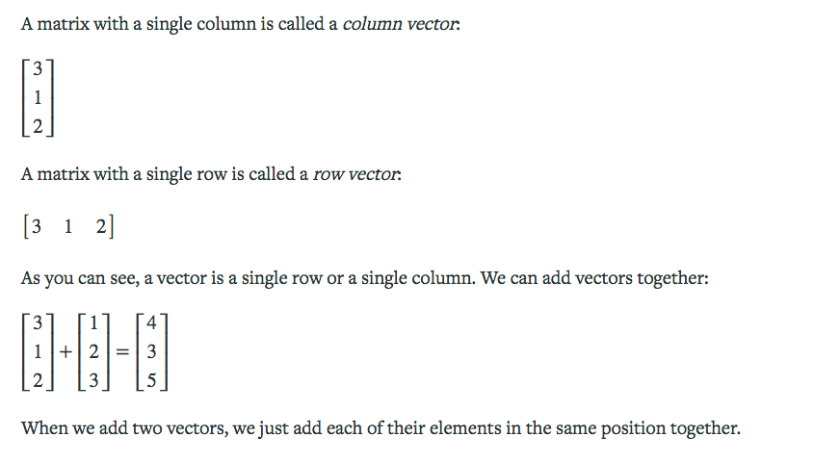
Matrix Operations

Slide 10
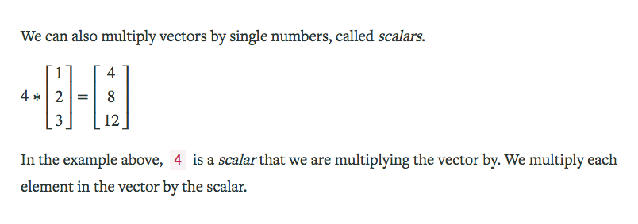
Matrix Operations

Slide 11
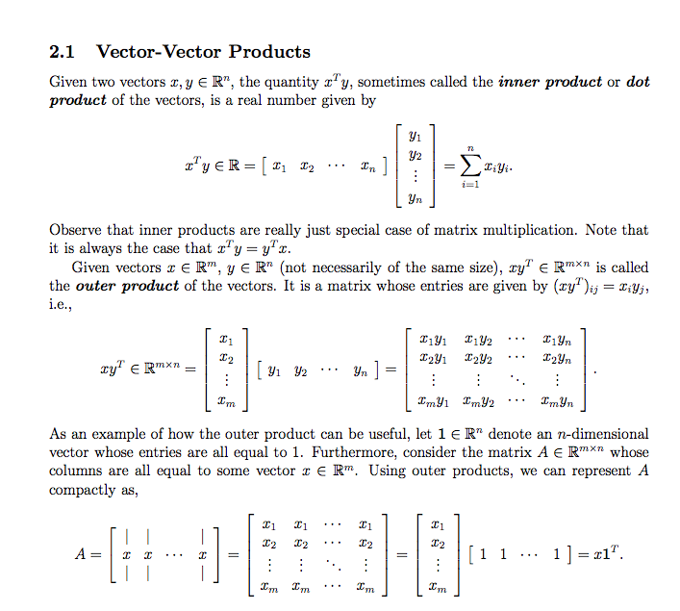

Slide 12
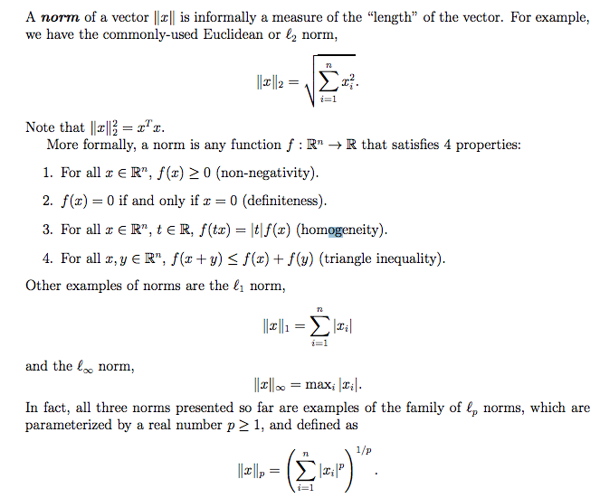
Norms

Slide 13

Inner Products
Inner Products between measure the alignment between two vectors
Notes:
http://www.falstad.com/dotproduct/

Slide 14


Matrix Operations: Vector and Matrix Multiplication

Slide 15
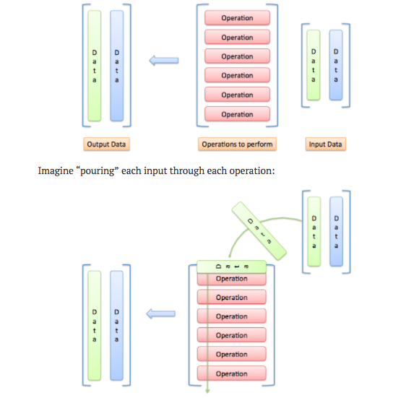
Matrix Operations: Matrix Multiplication

Slide 16
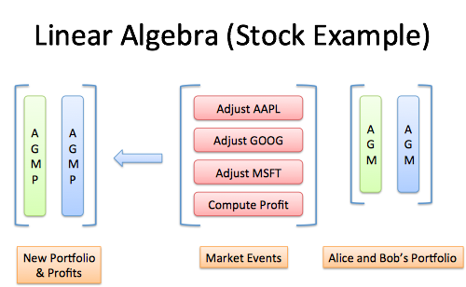
Matrix Operations: Matrix Multiplication

Slide 17
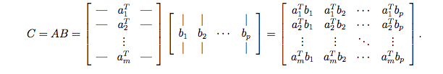


Matrix Operations: Notation

Slide 18
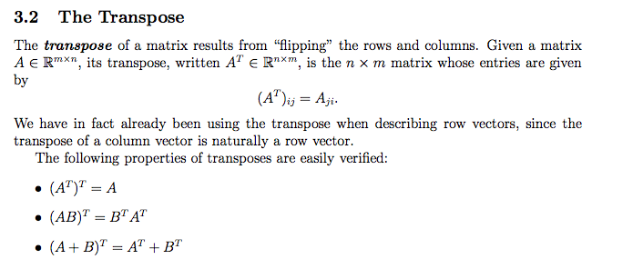
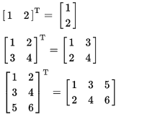
Matrix Types: Transpose

Slide 19
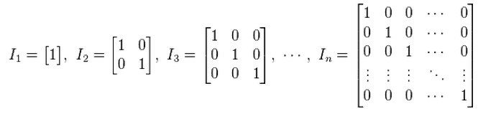
Matrix Types: Identity Matrix

Slide 20
Matrix Exercise
How would you compute the average and sum of a list of numbers using matrix/vector operations?
Identity matrices are n x n matrices that return the input vector and matrix. Using this information, how would you:
Scale: make all inputs bigger/smaller
Flip: make inputs negative
Challenge: Rotate: make new coordinates based on old ones (East becomes North, North becomes West, etc.)

Slide 21
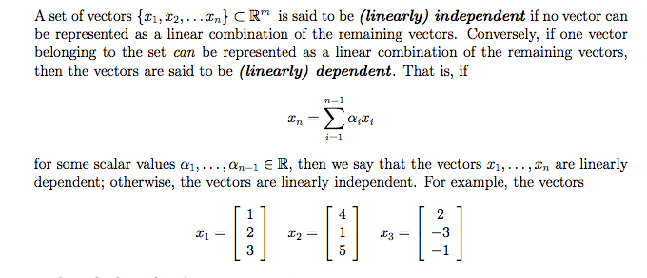
Quantifying Information: Linear Independence, Span, Basis
Notes:
Do 2d, 3d in class, play around with wolfram alpha on your own

Slide 22

Quantifying Information: Linear Independence, Span, Basis, Orthogonality
Basis vectors must be spanning and linear independent
Orthogonal vectors are where each combination of dot product is 0.
Notes:
Do 2d, 3d in class, play around with wolfram alpha on your own

Slide 23
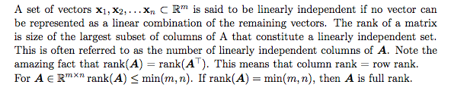
Rank of Matrix

Slide 24
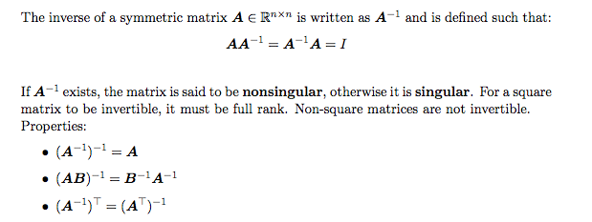
Matrix Types: Inverse

Slide 25
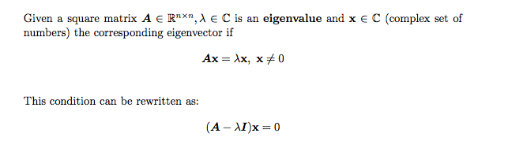
Eigenvalues and Eigenvectors
Notes:
http://setosa.io/ev/eigenvectors-and-eigenvalues/

Slide 26
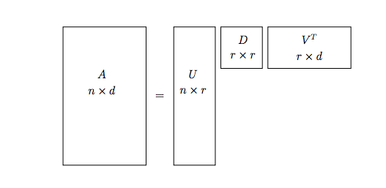
Singular Value Decomposition

Slide 27
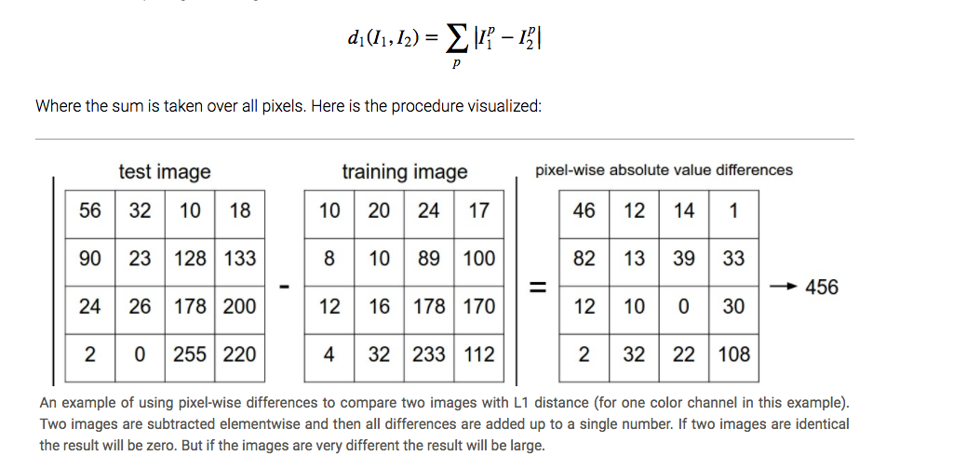
Aside: KNN

