Slide 1
Mapping “The Hunger Games”
Using location quotients to find the Districts of Panem
Original Article: BLS Hunger Games

Slide 2
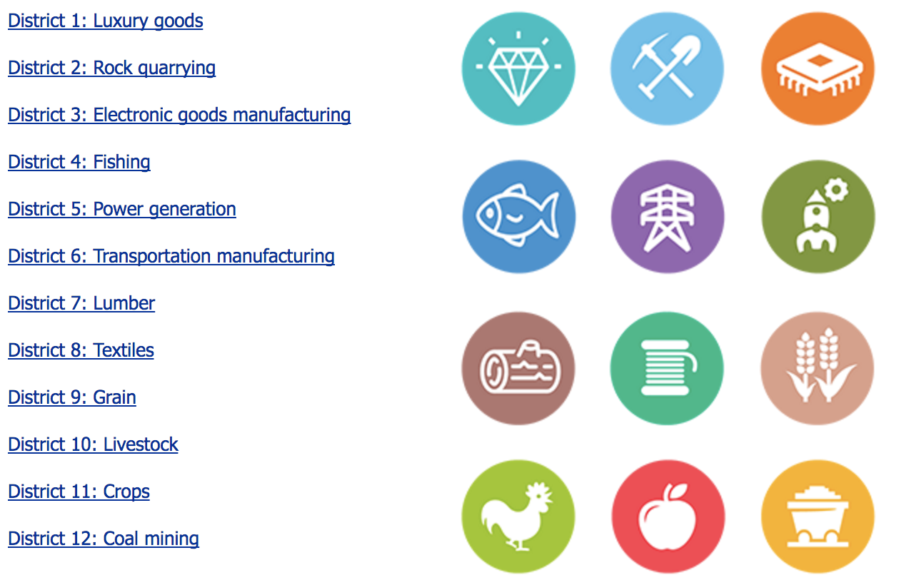

Slide 3
Data Sources
Quarterly Census of Employment and Wages (QCEW)
QCEW data show industry employment at the county level.
Occupational Employment Statistics (OES)
OES data for occupation employment for metropolitan and nonmetropolitan statistical areas.
Both are provided by the Bureau of Labor Statistics of the U.S. Department of Labor
Total employment - Total employment can show you where lots of workers are in an industry or occupation.
Location quotient - The location quotient is a ratio of the percentage of workers in an industry or occupation in a certain area to the percentage of workers in that industry or occupation nationally. A location quotient greater than 1.0 indicates a higher-than-average concentration for an industry or occupation.

Slide 4
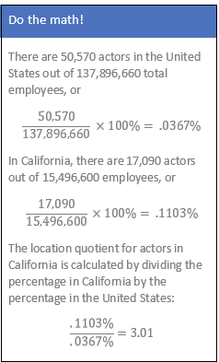
Finding data
Total employment and location quotients

Slide 5
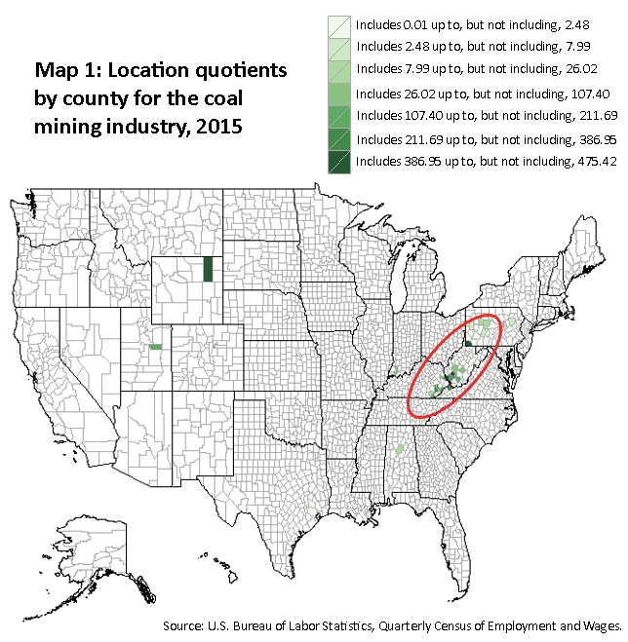
Finding District 12: Coal mining

